Slide 1
Level 6/7 HANDSPRING vault by Nawgj
Education committee August 2018
Films provided by nawgj library
6/7 Handspring Parameters
•45 degree or less arrival angle
•Tight body in pre flight**
•On Table tight body**
**BP should not exhibit an excessive arch – degree of arch yet to be defined and slides identifying an arch “may” be redefined at a later time. For now and for the purpose of this project, deductions have been very slight for the mid body arch. The arch of the body that produces an undesired shoulder angle will create a cause and effect that will be deducted.
•Off table at vertical
•Minimal time in support
•Maximum Height
•Hollow BP in post flight
•Good distance with good posture upon contact with mat.
Notes:
It has been the opinion of some professionals that a mid body and/or thoracic arch is acceptable and indeed a technique for the front handspring front vaults, for which this is a “drill” preparatory vault. The degree of this body shape needs further clarification, at which time this project will be modified to be kept current with any changes.

Slide 2
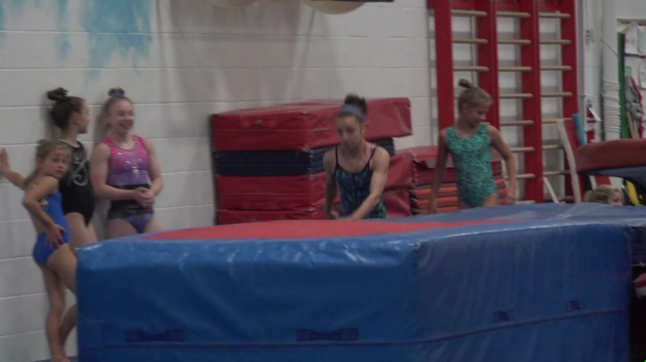
Current MODEL (NOT a 10.0!) Use slider to watch in slow motion if desired)

Slide 3
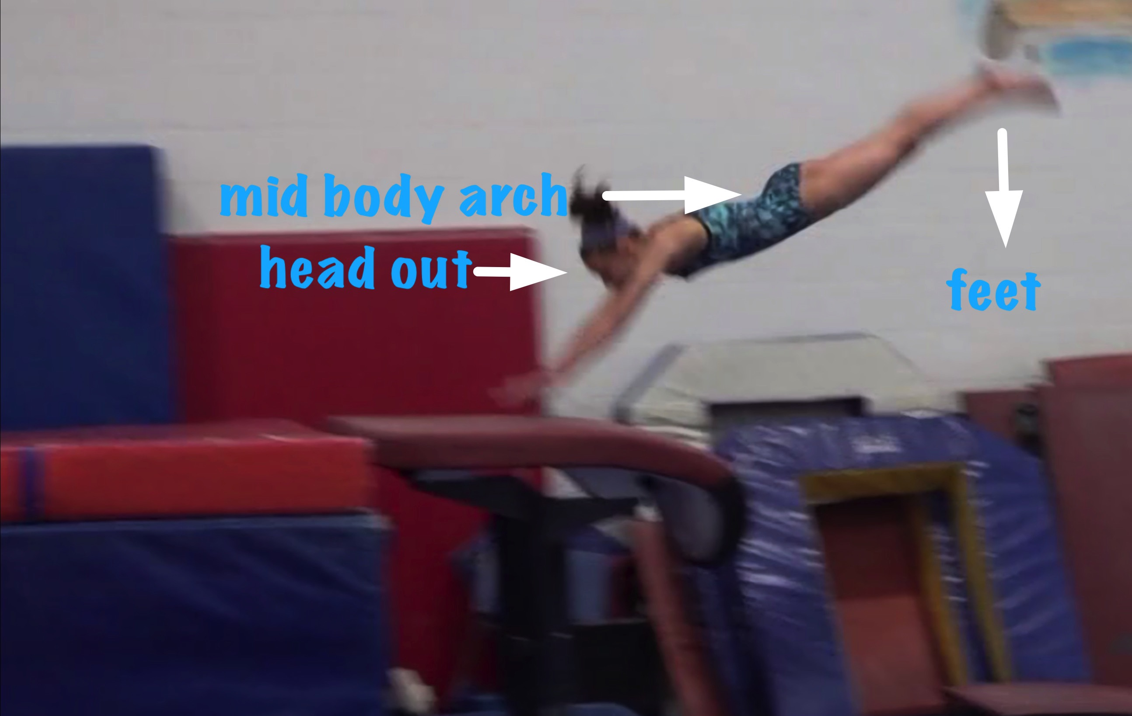
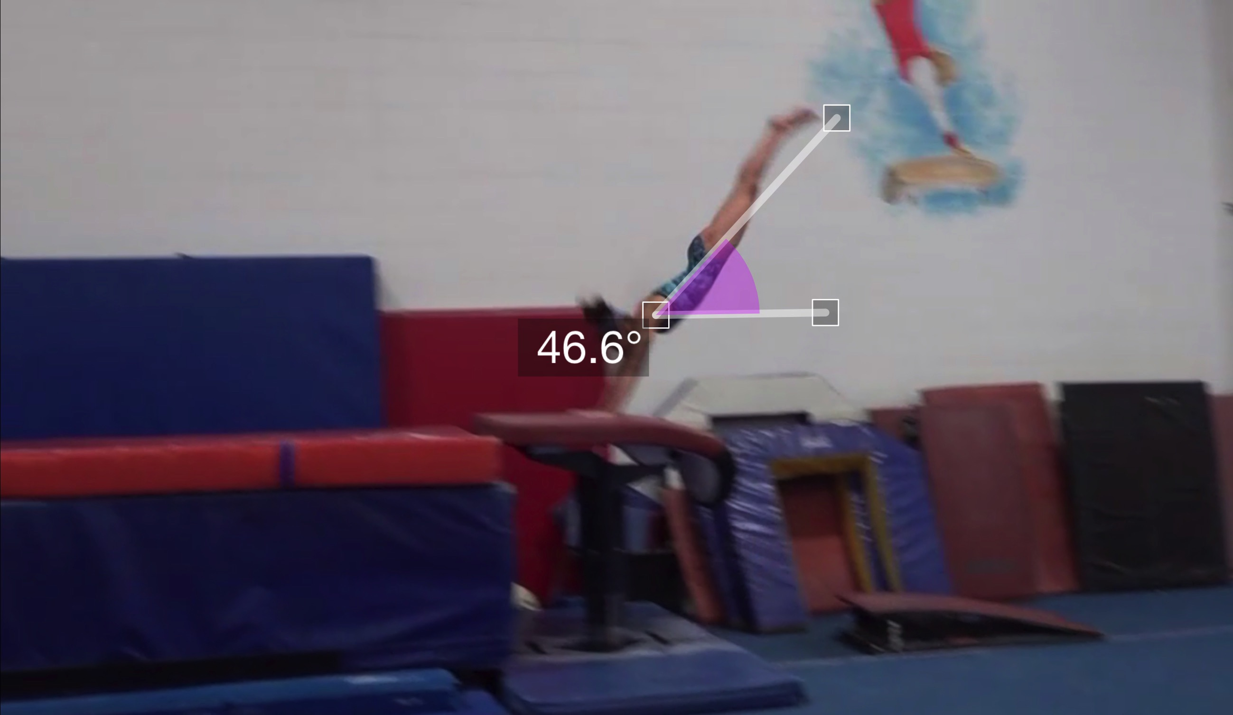
Handspring #10 model
(as is numbered on library dvd to correspond)
Pre Flight Body Position
Angle of Arrival

Slide 4
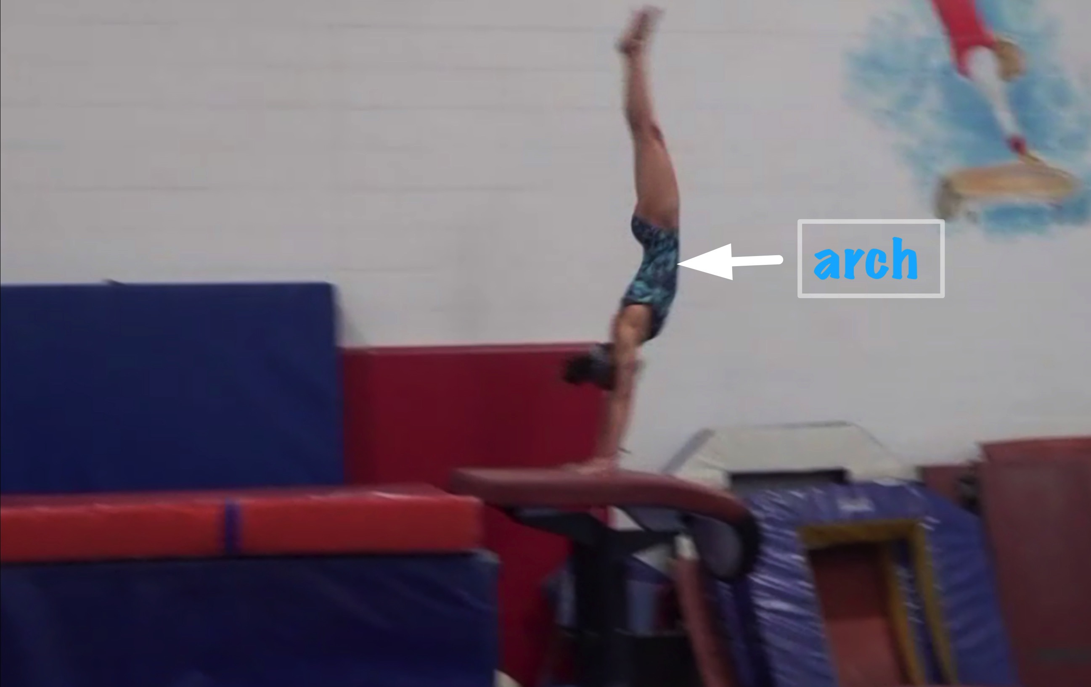
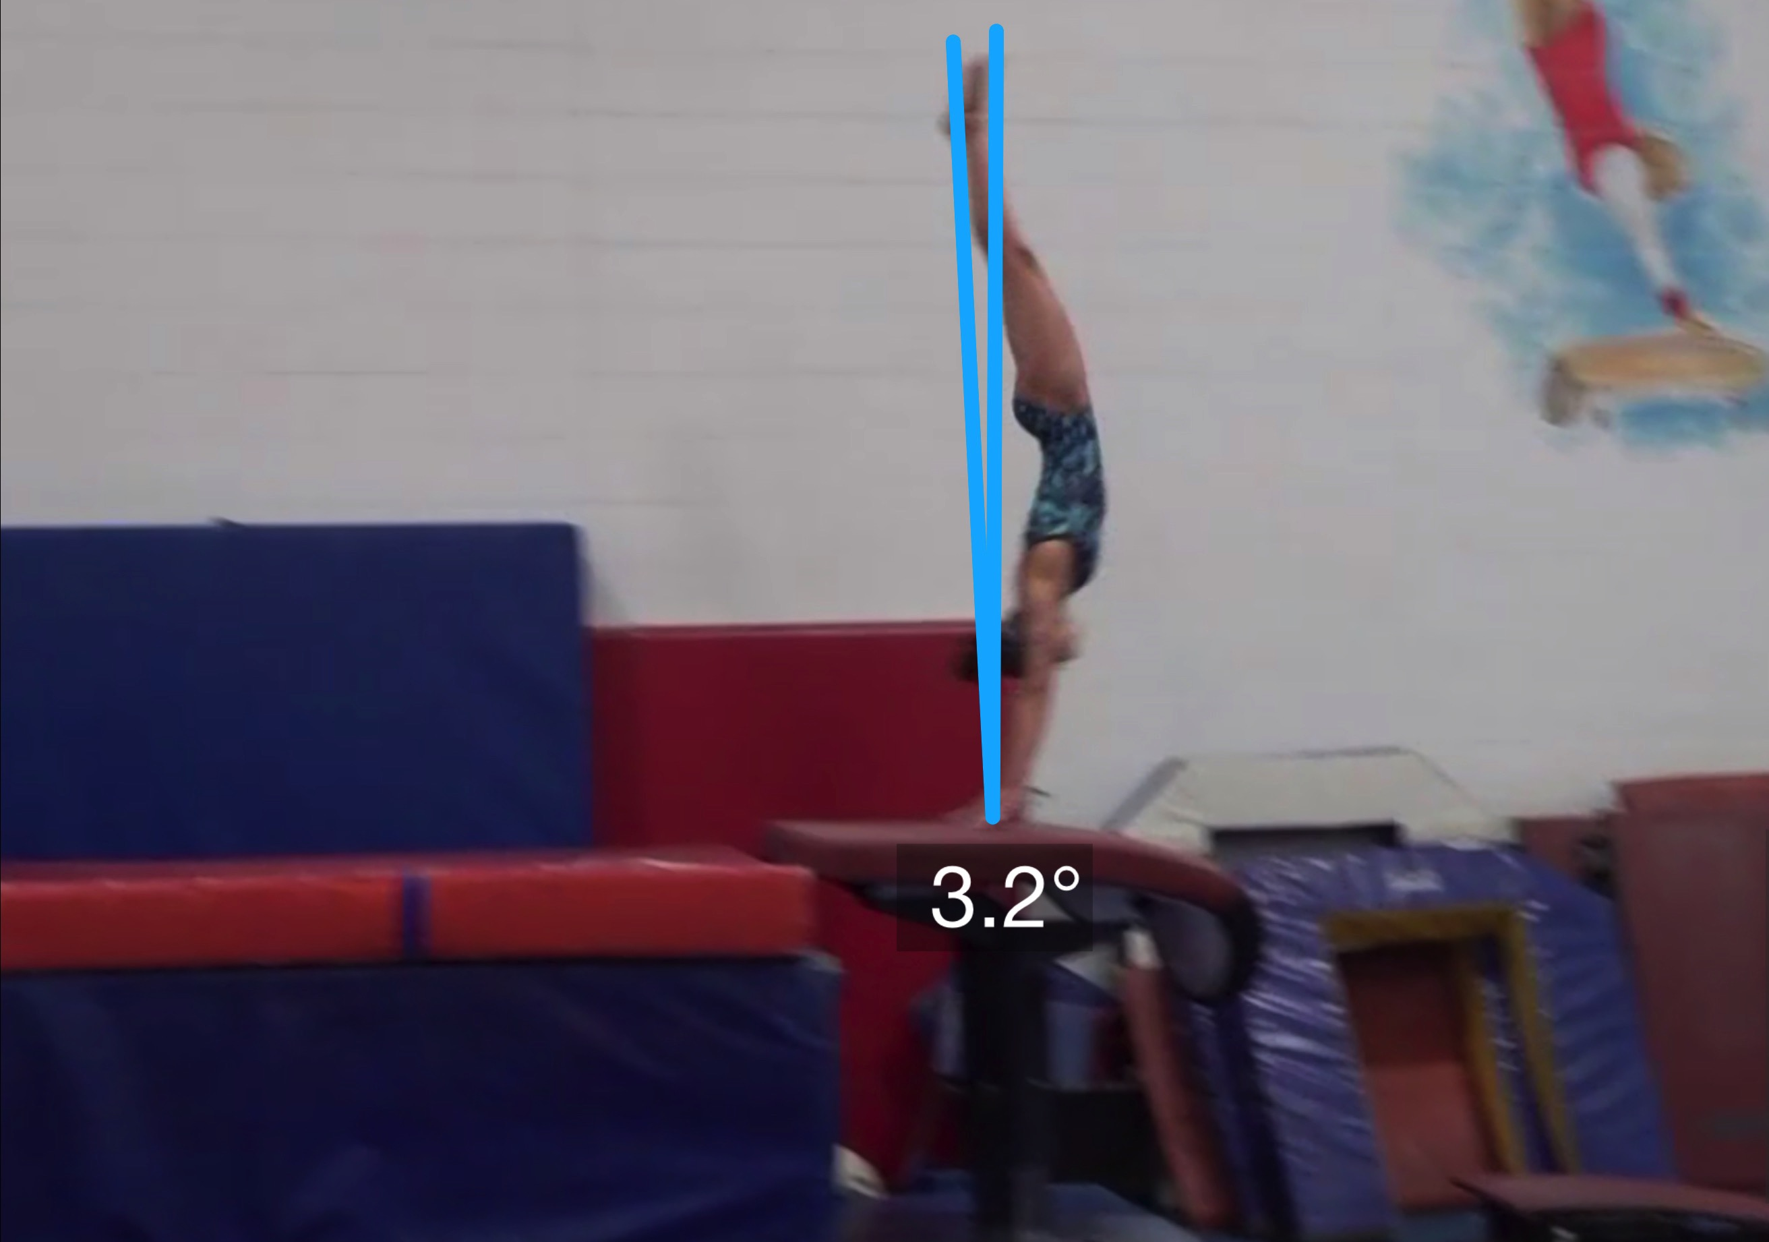
Handspring #10 Model
Angle off the Table and corresponding Time in Support
Body Position in Support

Slide 5
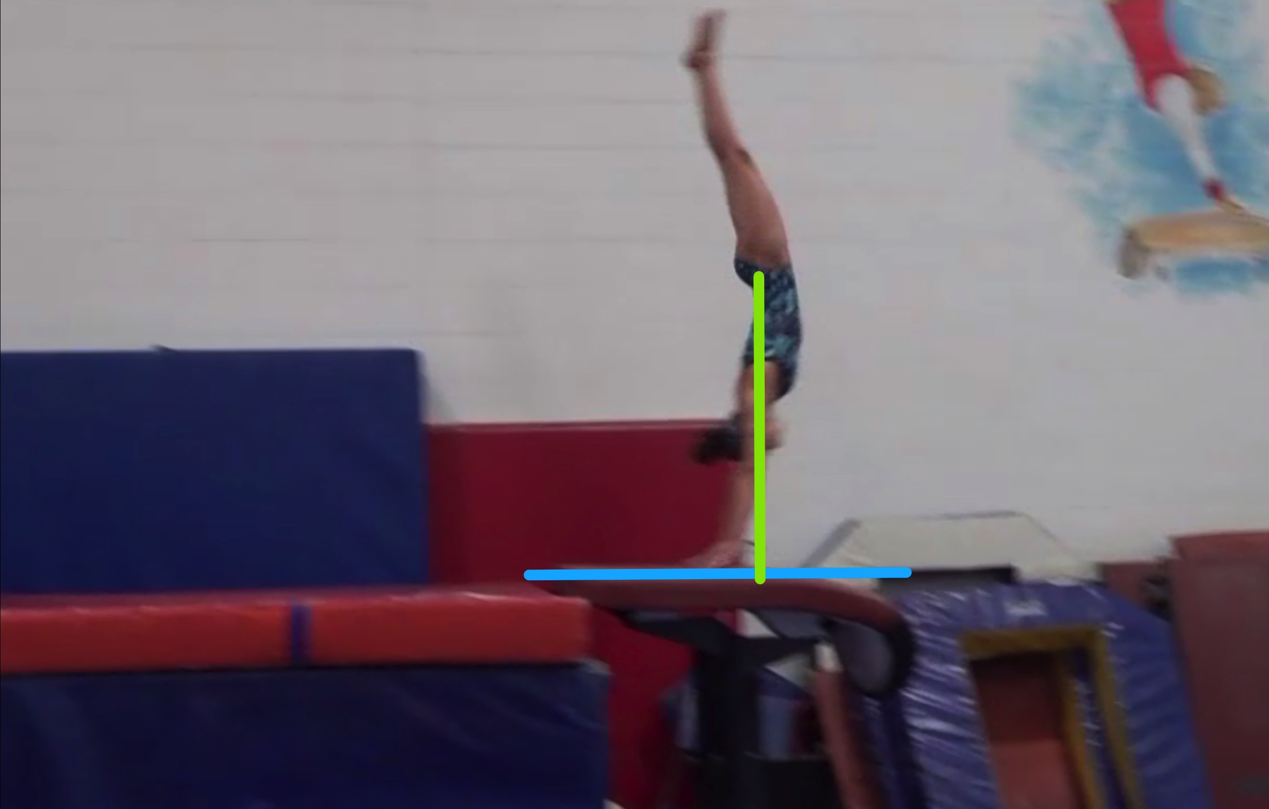
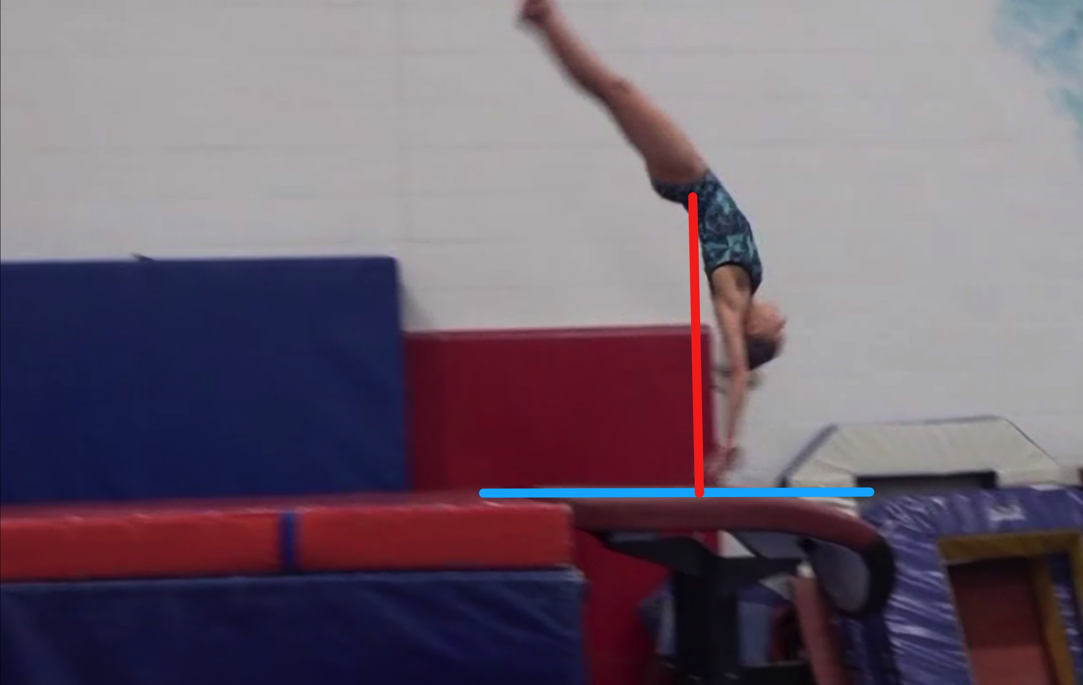
Handspring #10 model
Height Baseline (measured from table to center of gravity when inverted before repulsion)
Height Achieved (compare red line to green line after lining up blue table height line for accurate comparison.

Slide 6
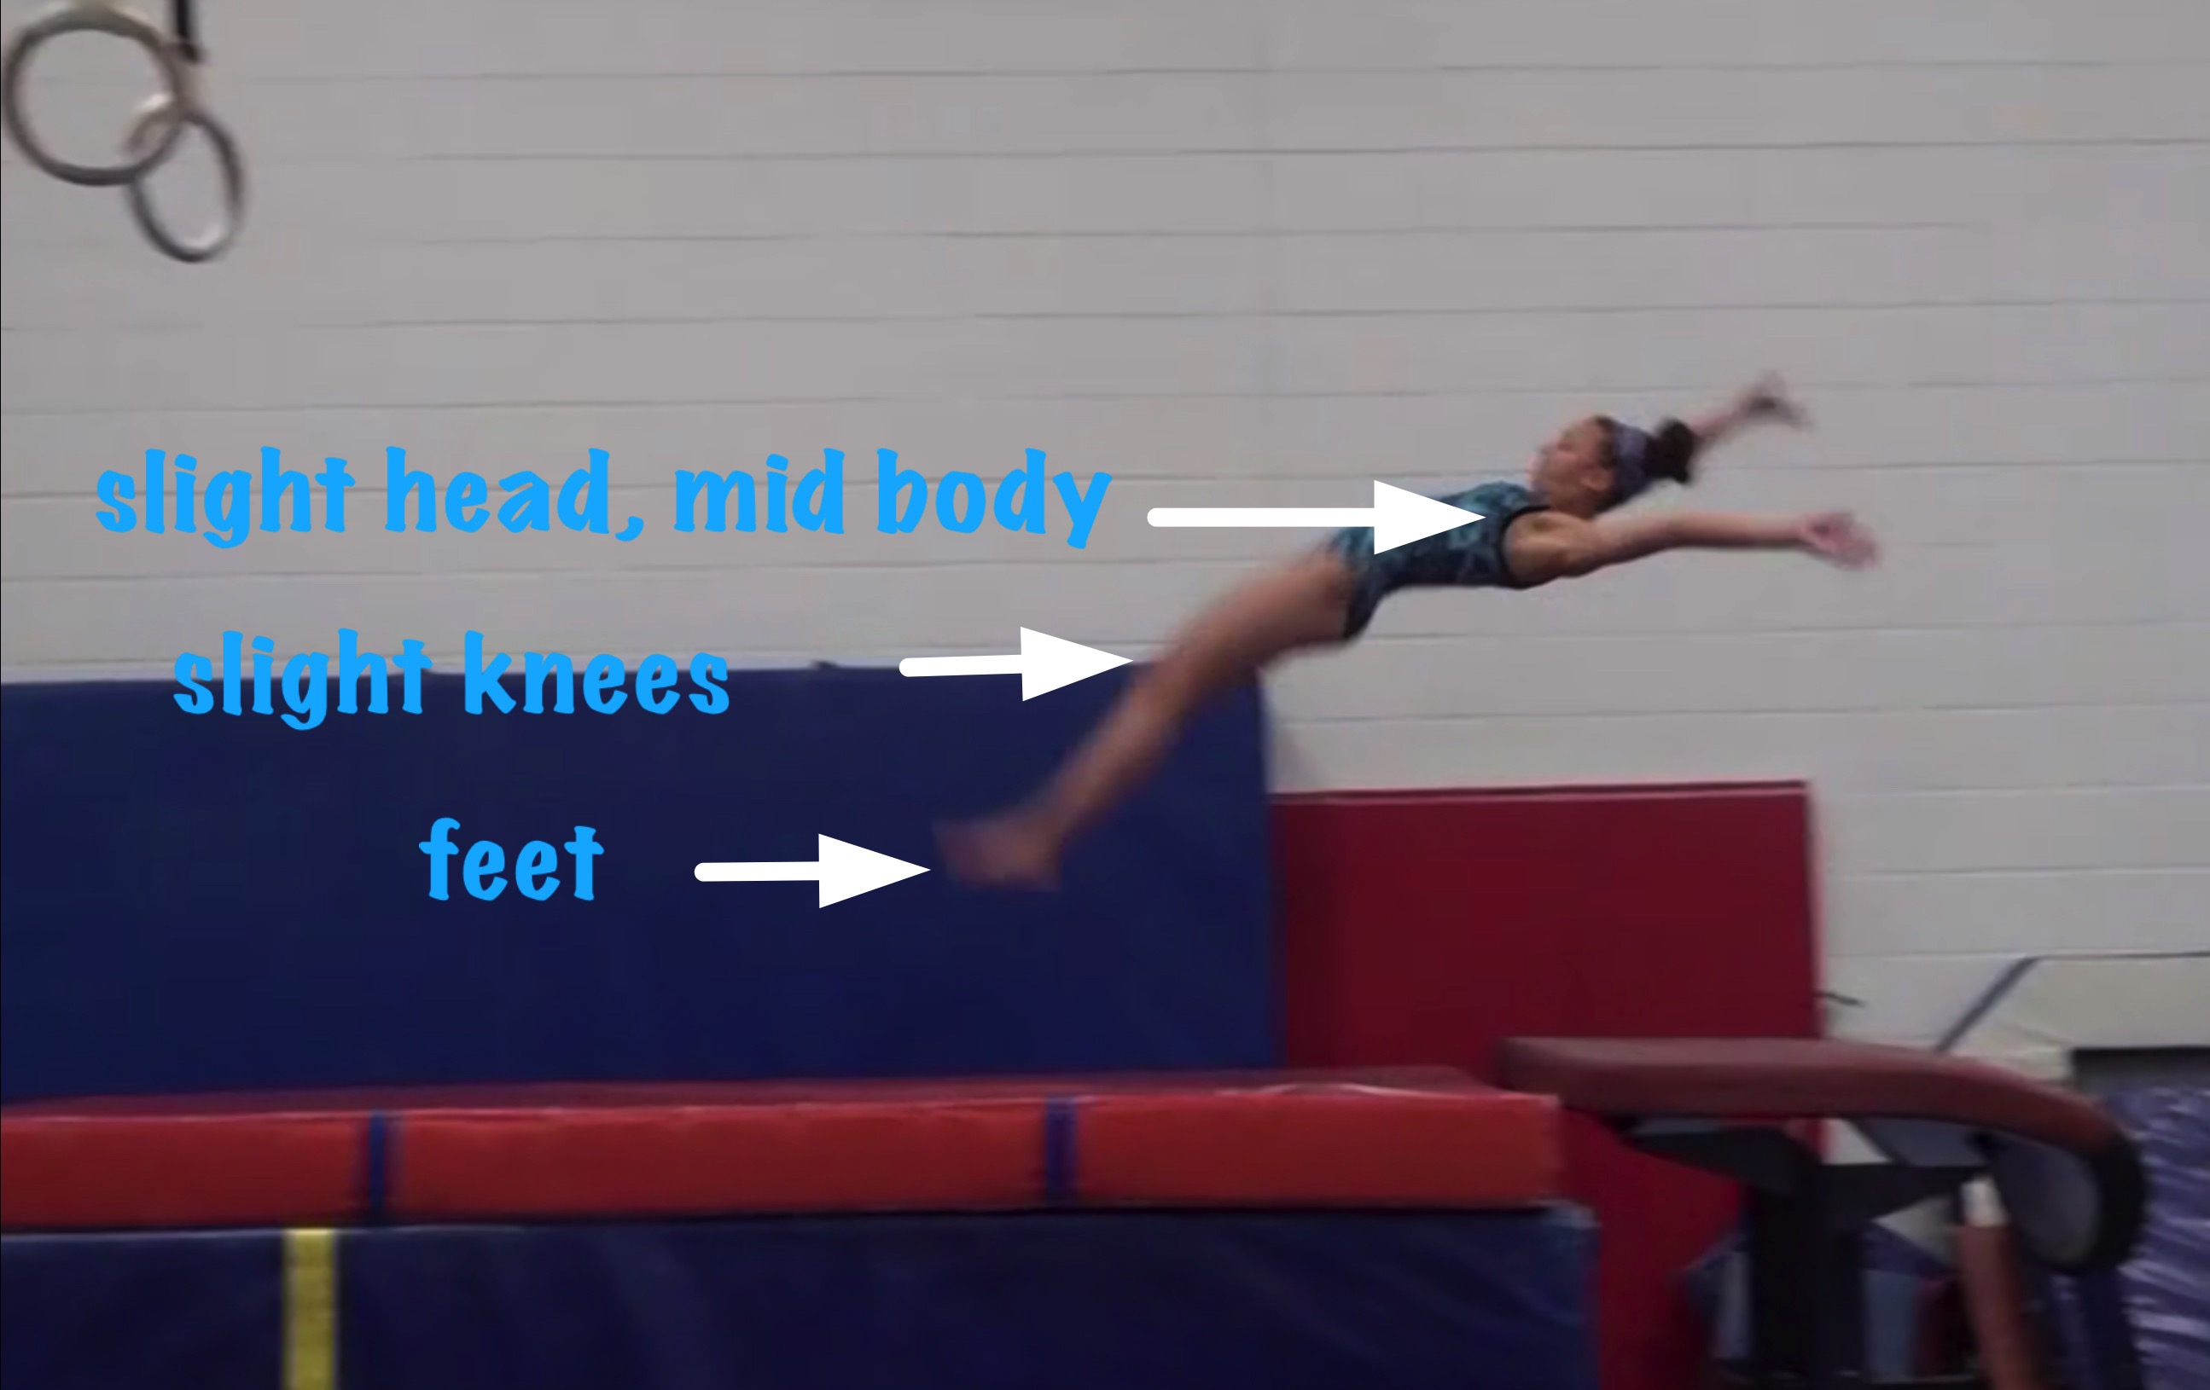
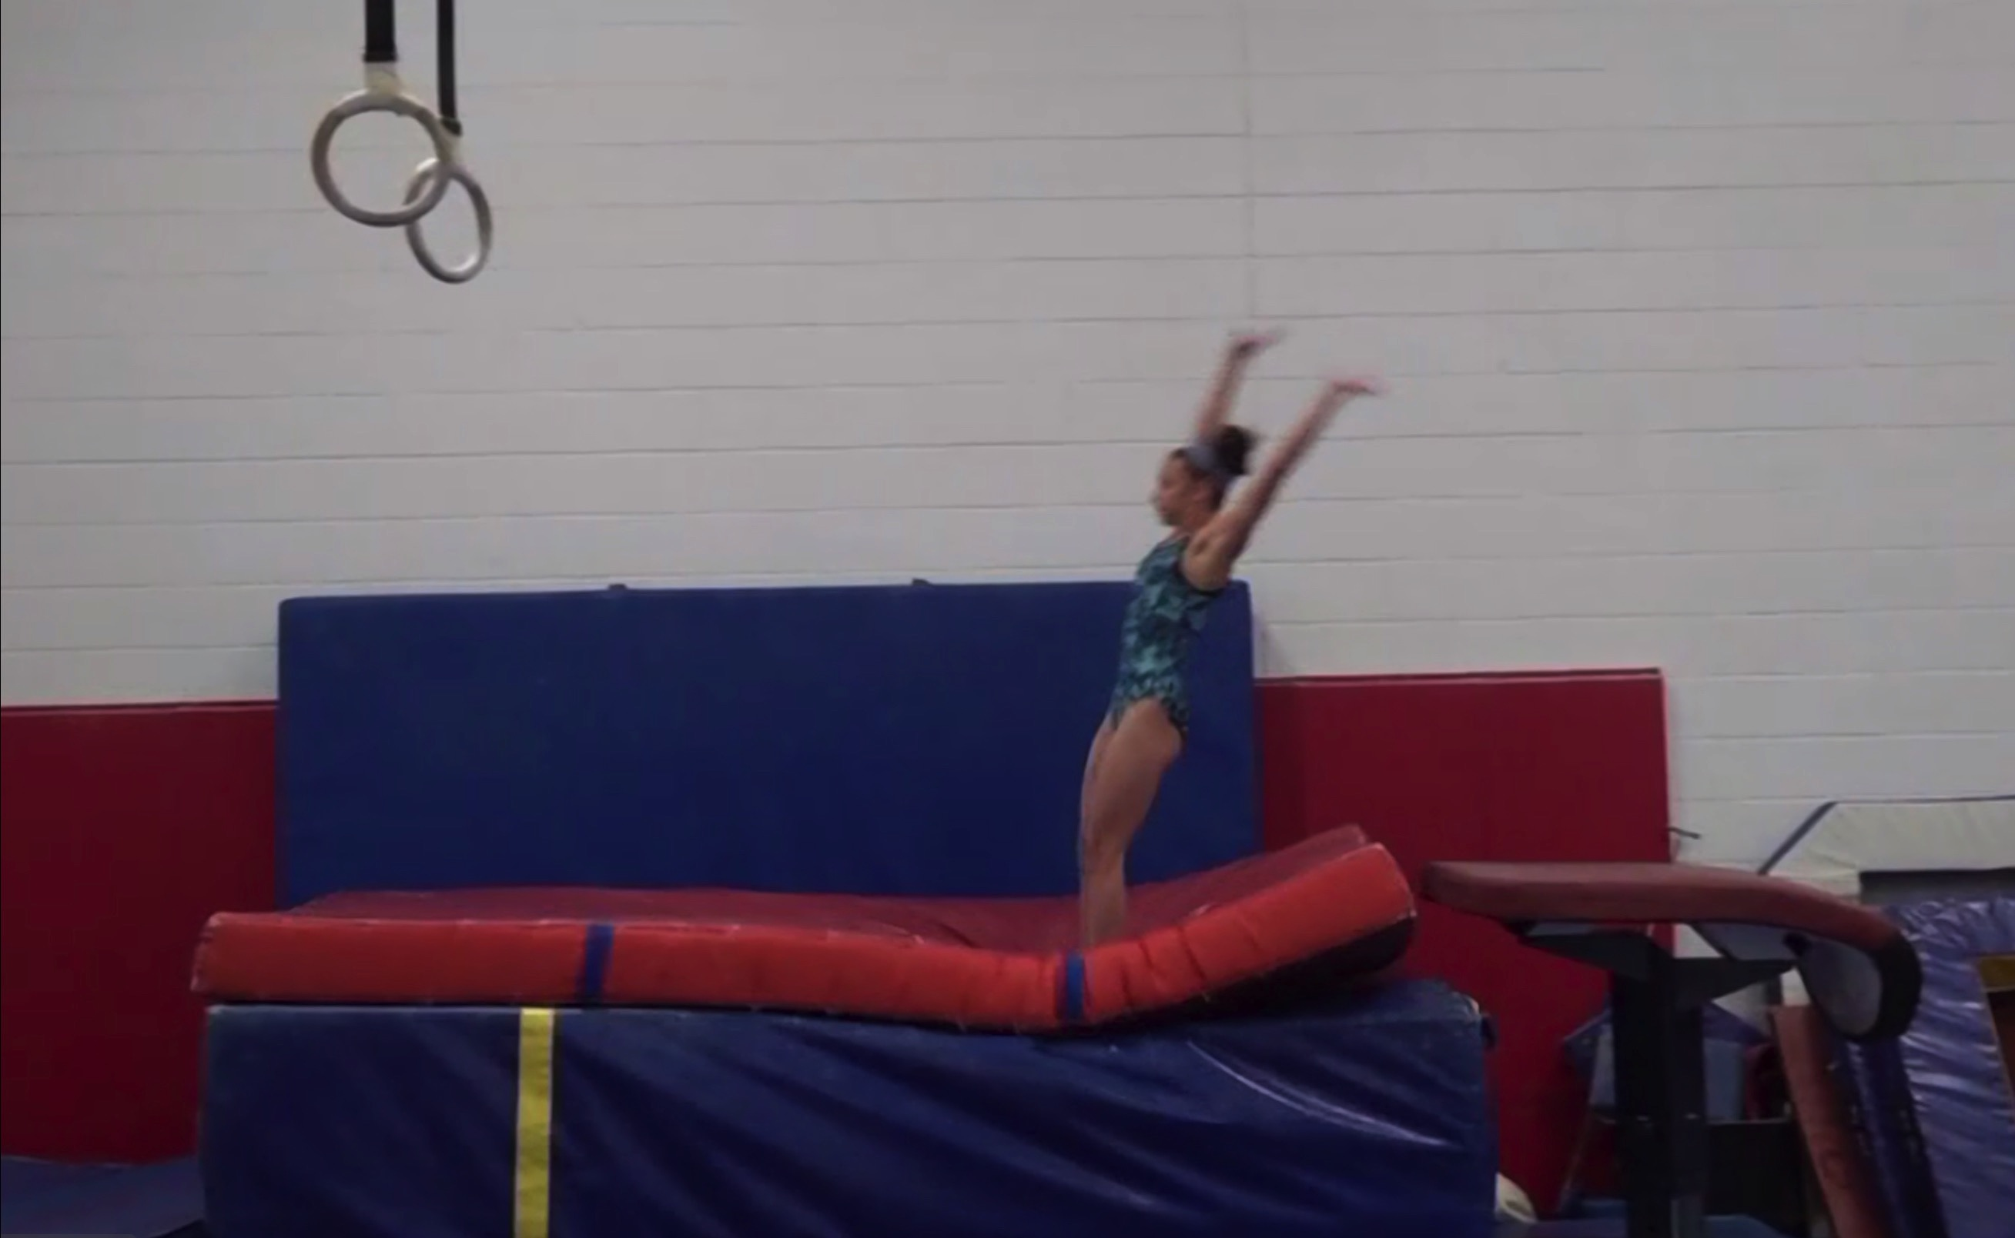
Handspring #10 MODEL
Body Position in post flight
Posture on Contact & Distance

Slide 7
“Model” UNOFFICIAL but Vetted Deductions Breakdown
Pre Flight Body Position .2
Angle on 0
In Support Body Position .15
Angle off .05
Time in Support .1
Height .1
Off Flight Body Position .1
Posture on Landing 0
Landing 0
Distance .1
Dynamics .1
Score: 9.1
Look at the vault again and use the slider to view it in slow motion and study the corresponding deductions for each phase of the vault.

Slide 8
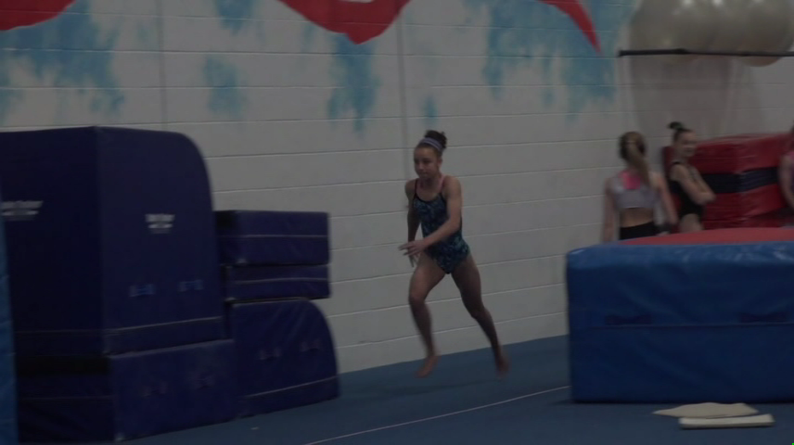
Handspring #2
Handspring #2 is performed by the same athlete as in MODEL but with a different result. Compare #2 on the left to the MODEL on the right by selecting the slide and then pressing the PLAY arrow. Play it again in slow motion by using the slider bar for a detailed comparison.
MODEL

Slide 9
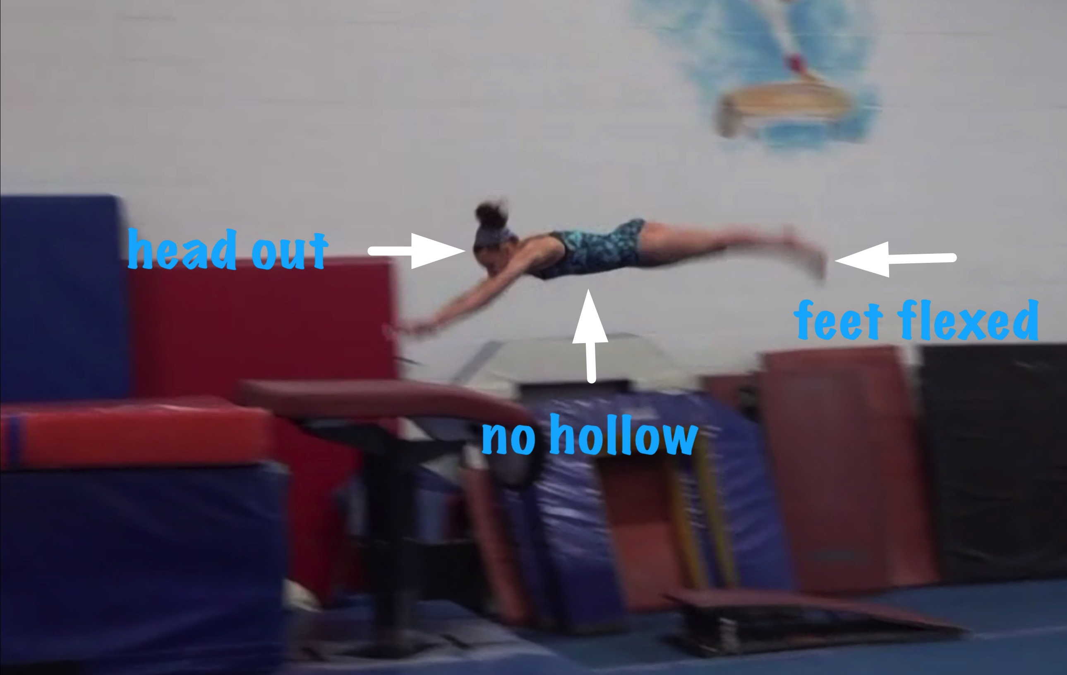
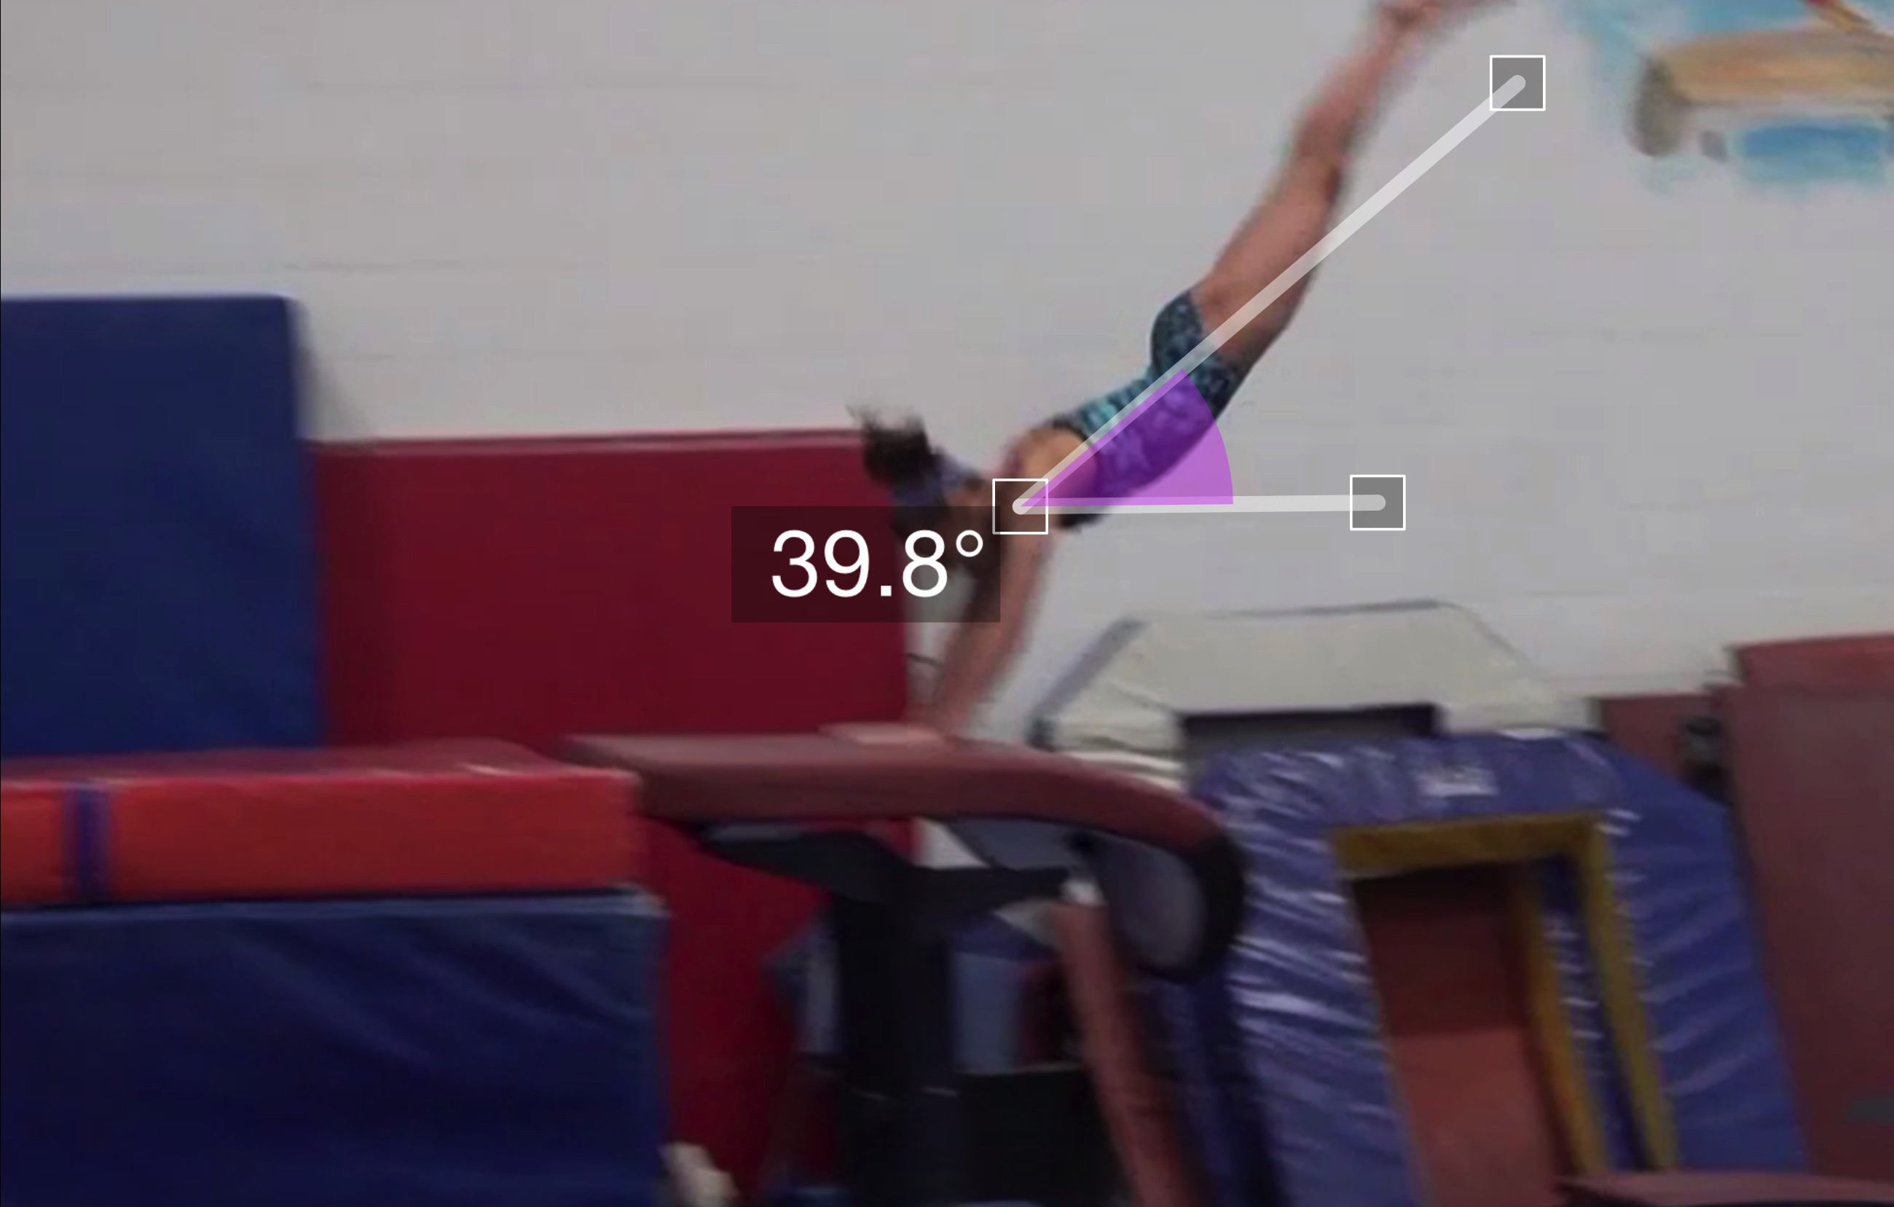
Handspring #2
Pre Flight Body Position
Angle of Arrival

Slide 10
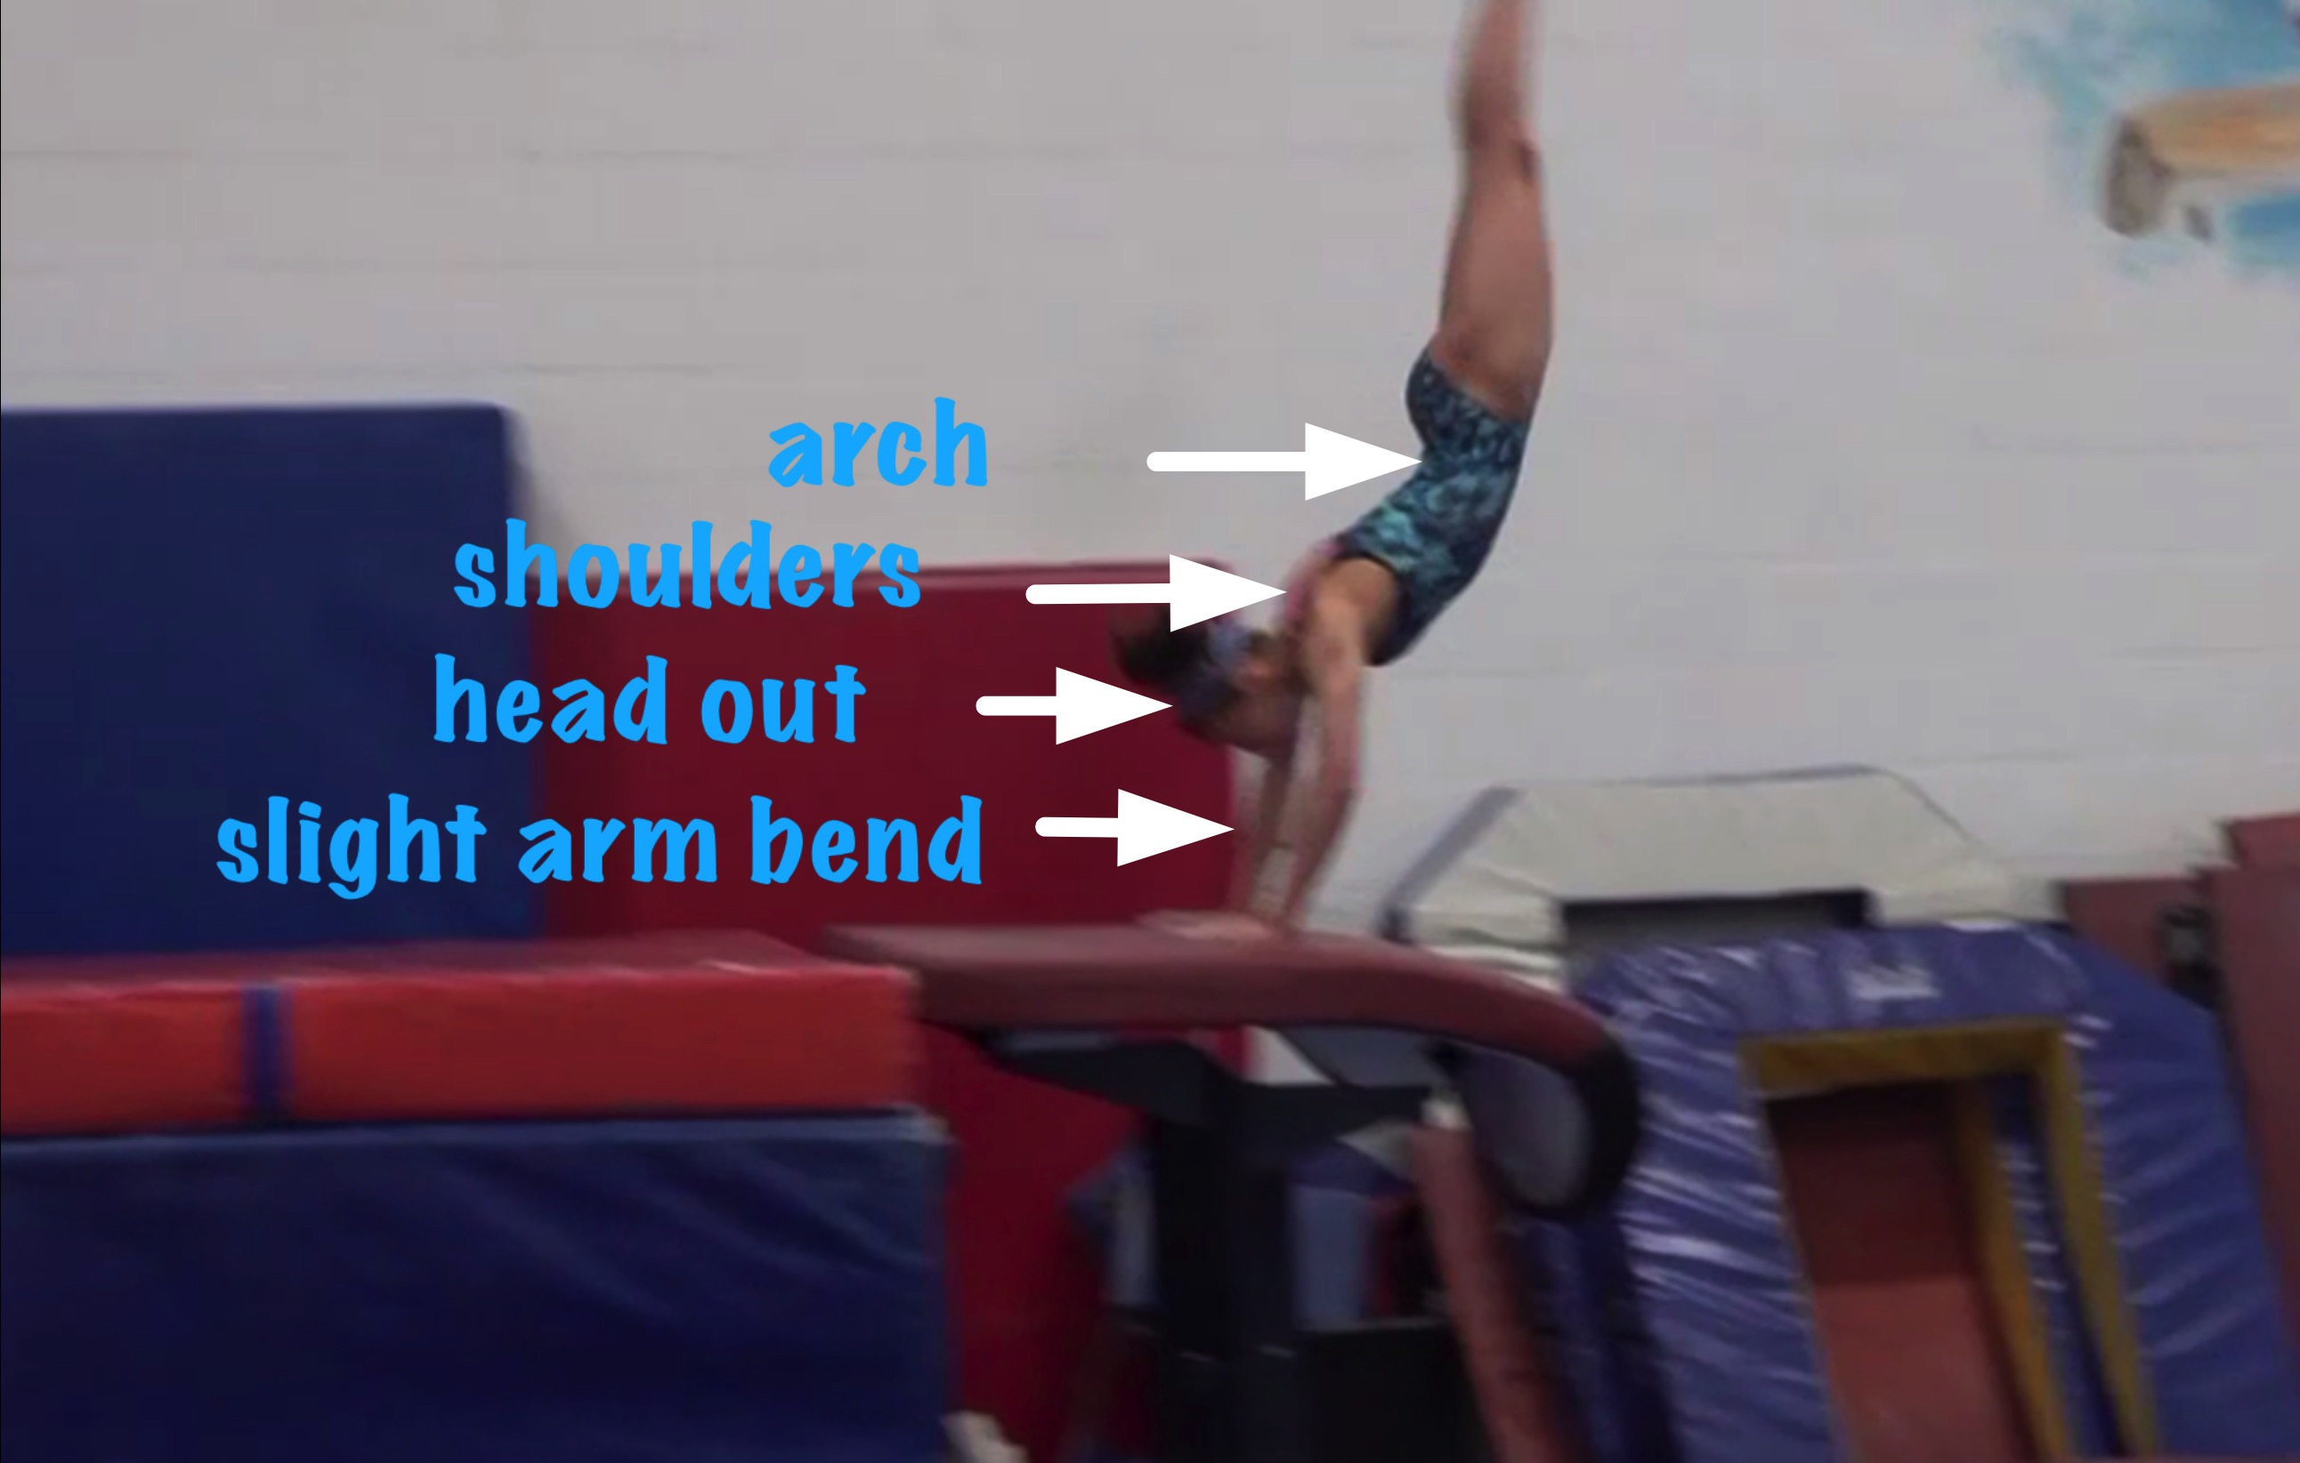
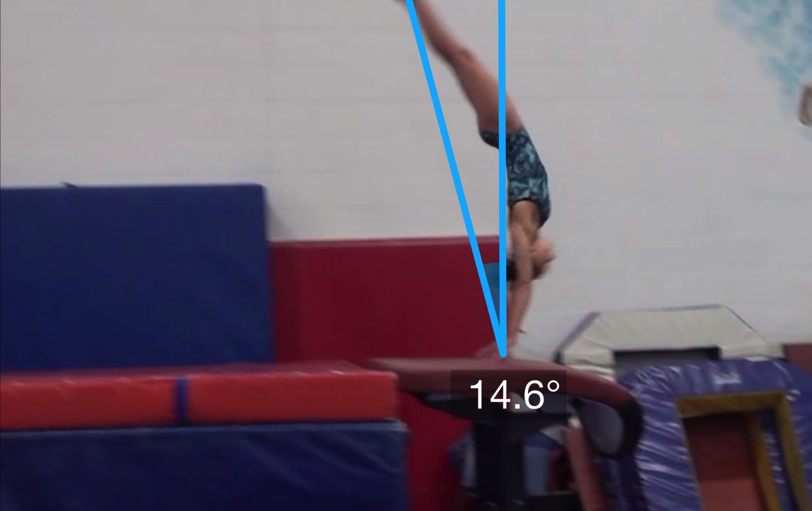
Handspring #2
Body Position in Support
Angle off the Table and corresponding Time in S

Slide 11
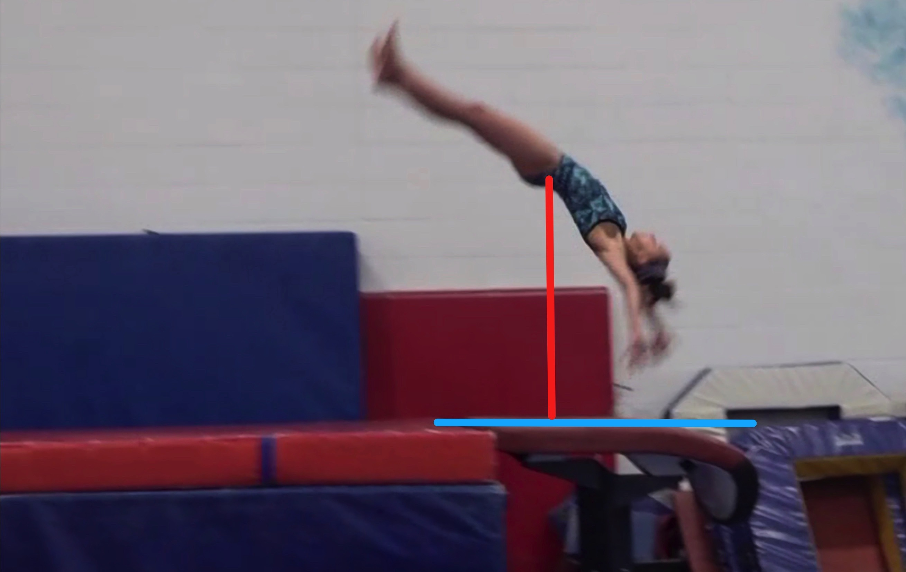
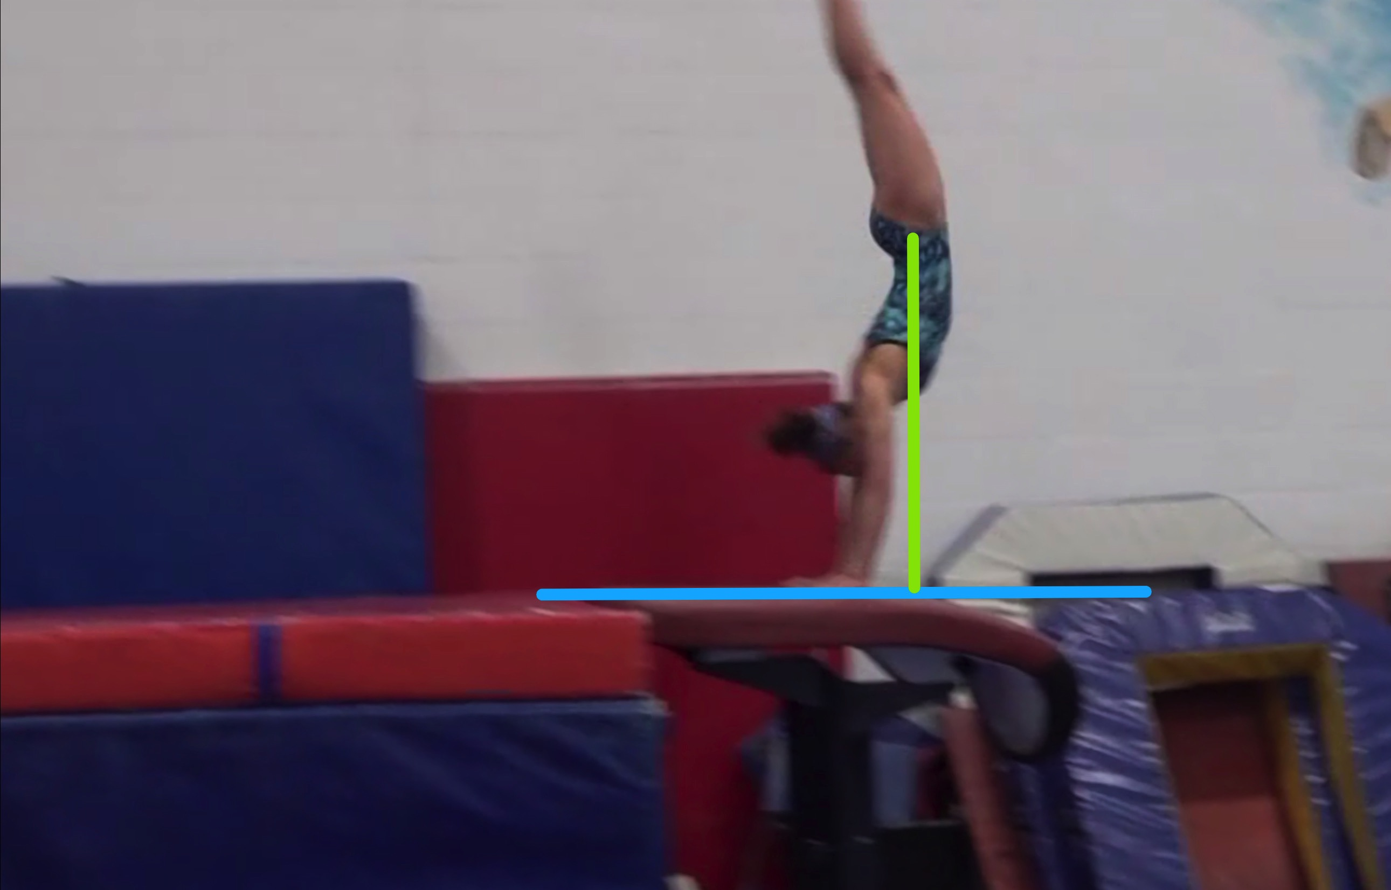
Handspring #2
Height Baseline (measured from table to center of gravity when inverted before repulsion)
Height Achieved (compare red line to green line after lining up blue table height line for accurate comparison.

Slide 12
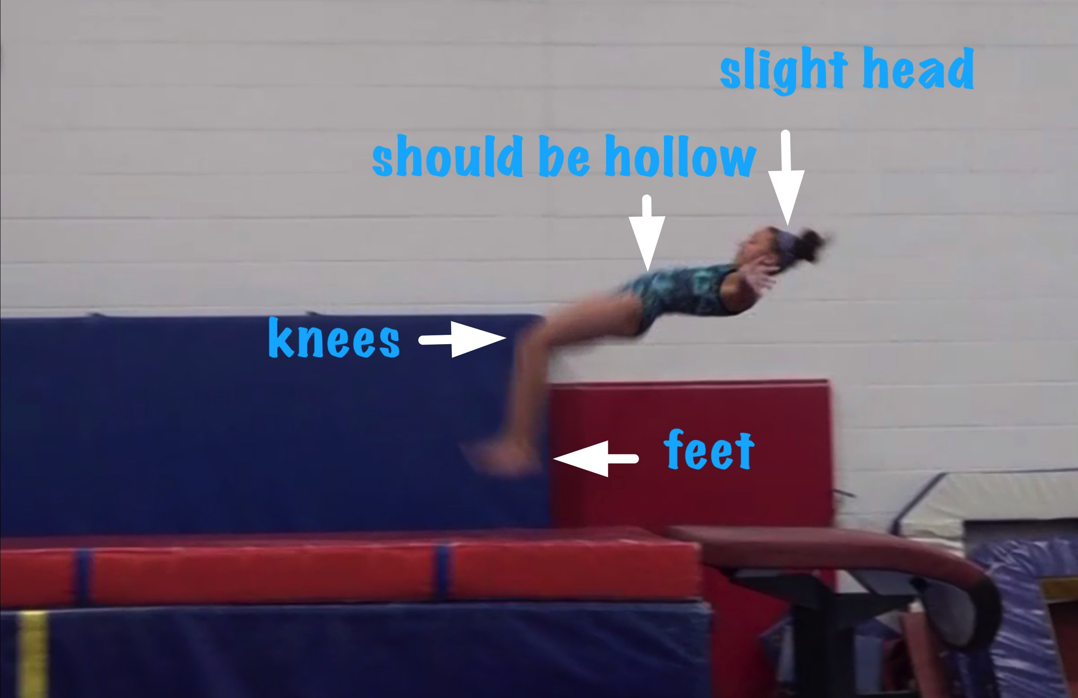
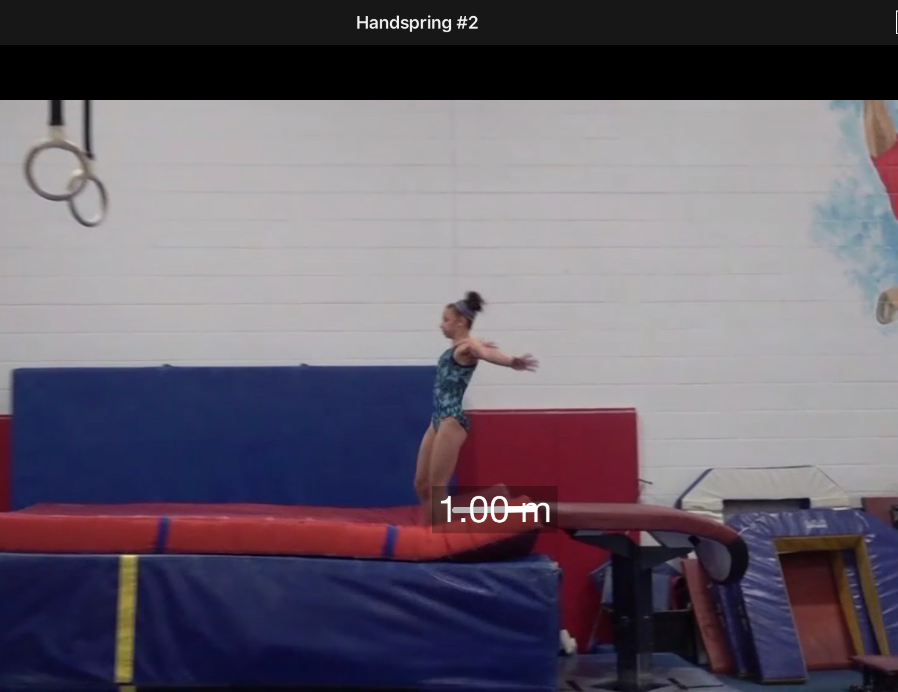
Handspring #2
Body Position in post flight
Posture on Contact & Distance

Slide 13
Handspring #2 UNOFFICIAL but Vetted Deductions Breakdown
Pre Flight Body Position - .15
Angle on - .1
In Support Body Position - .45
Angle off - .2
Time in Support - .2
Height - .3
Off Flight Body Position - .3
Posture on Landing - .2
Landing - 0
Distance - .2
Dynamics - .15
Score: 7.75
Look at the vault again and use the slider to view it in slow motion and study the corresponding deductions for each phase of the vault.

Slide 14
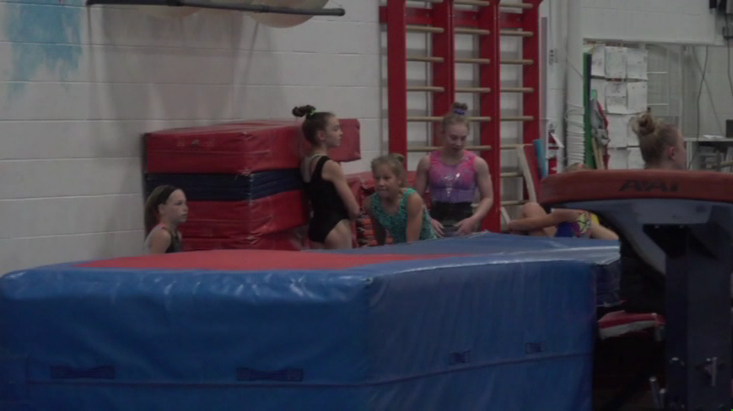
Handspring #4
Compare #4 on the left to the MODEL on the right.

Slide 15
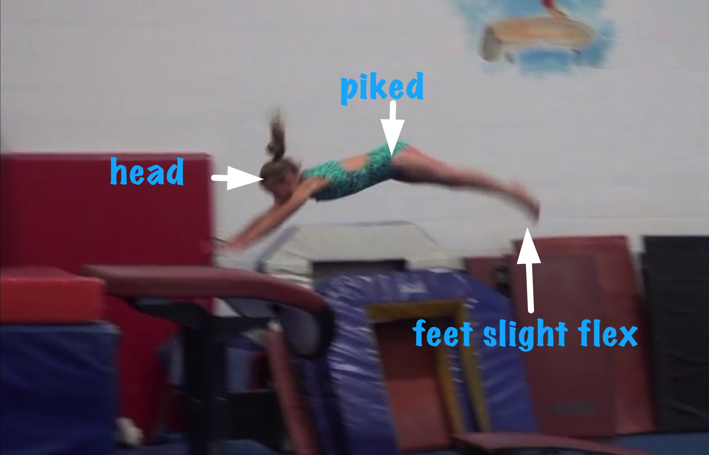
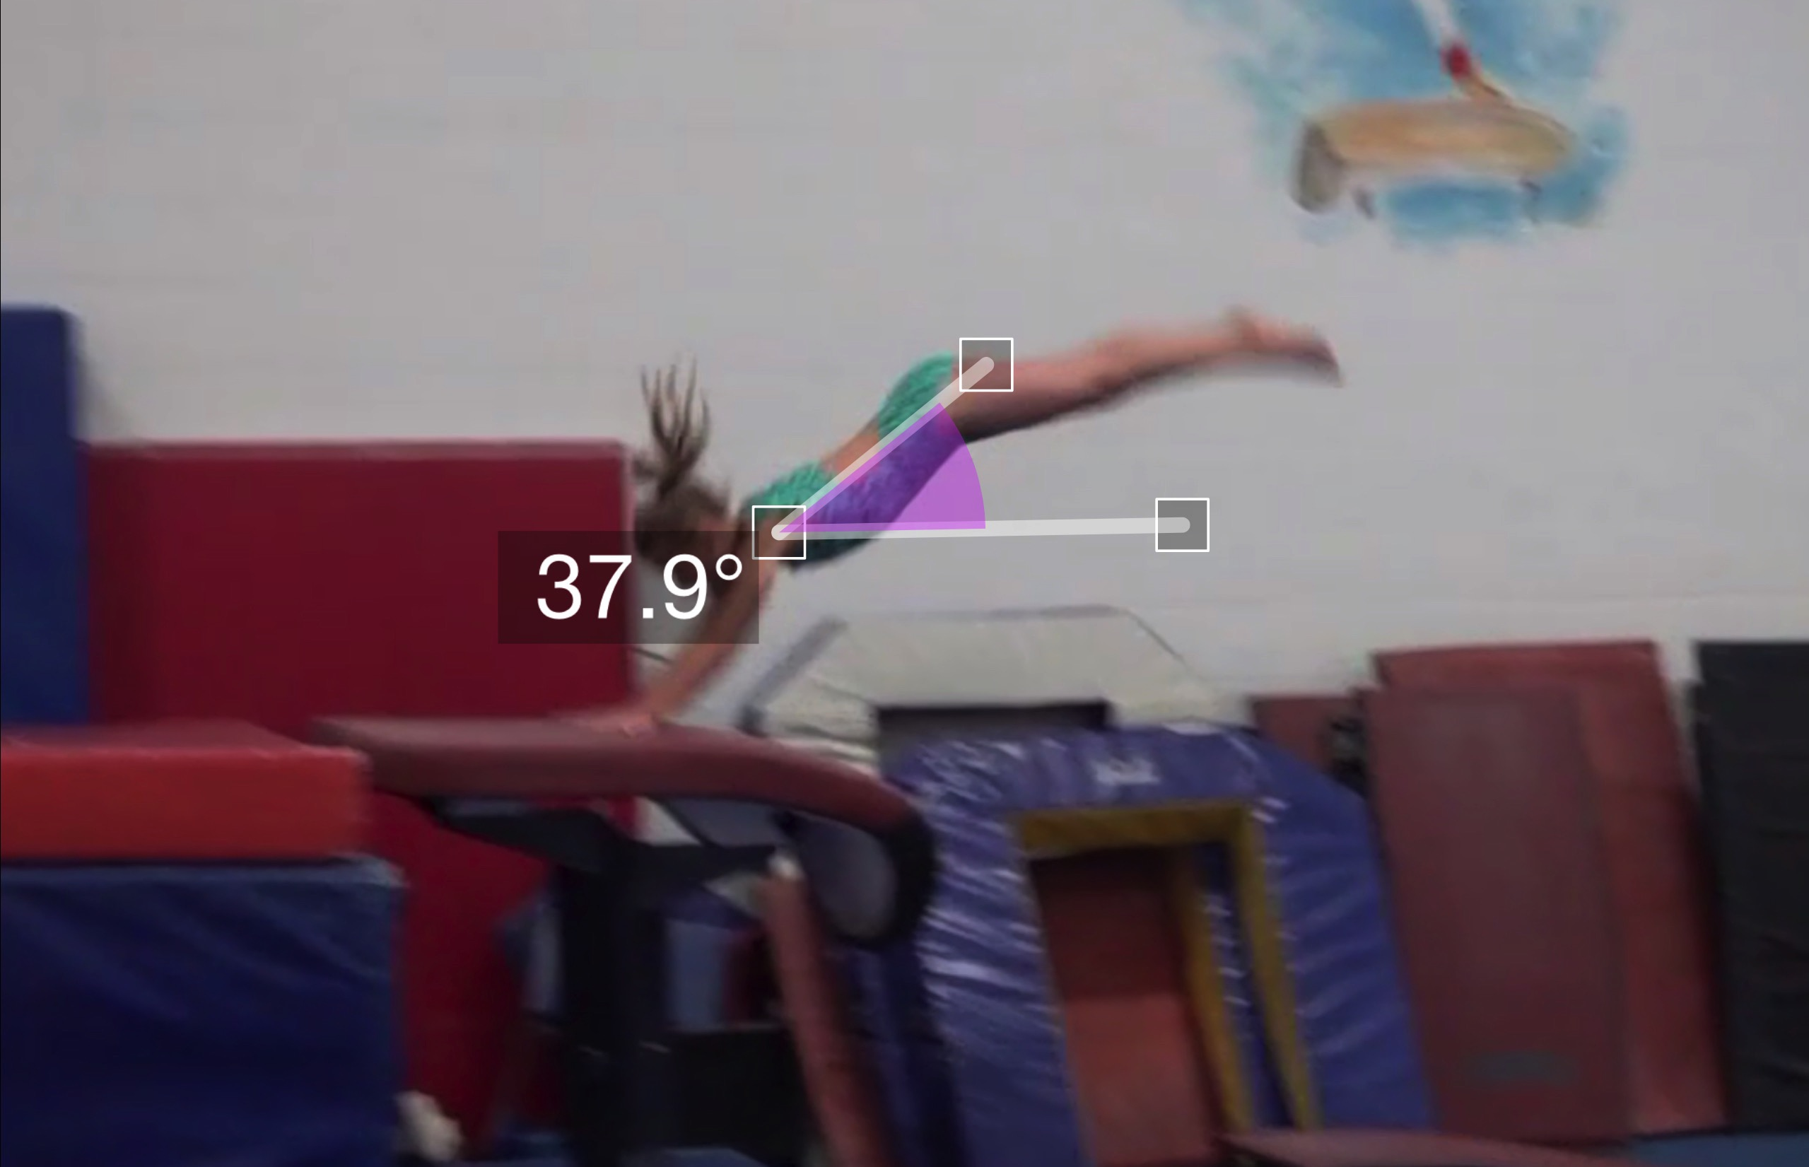
Handspring #4
Pre Flight Body Position
Angle of Arrival

Slide 16
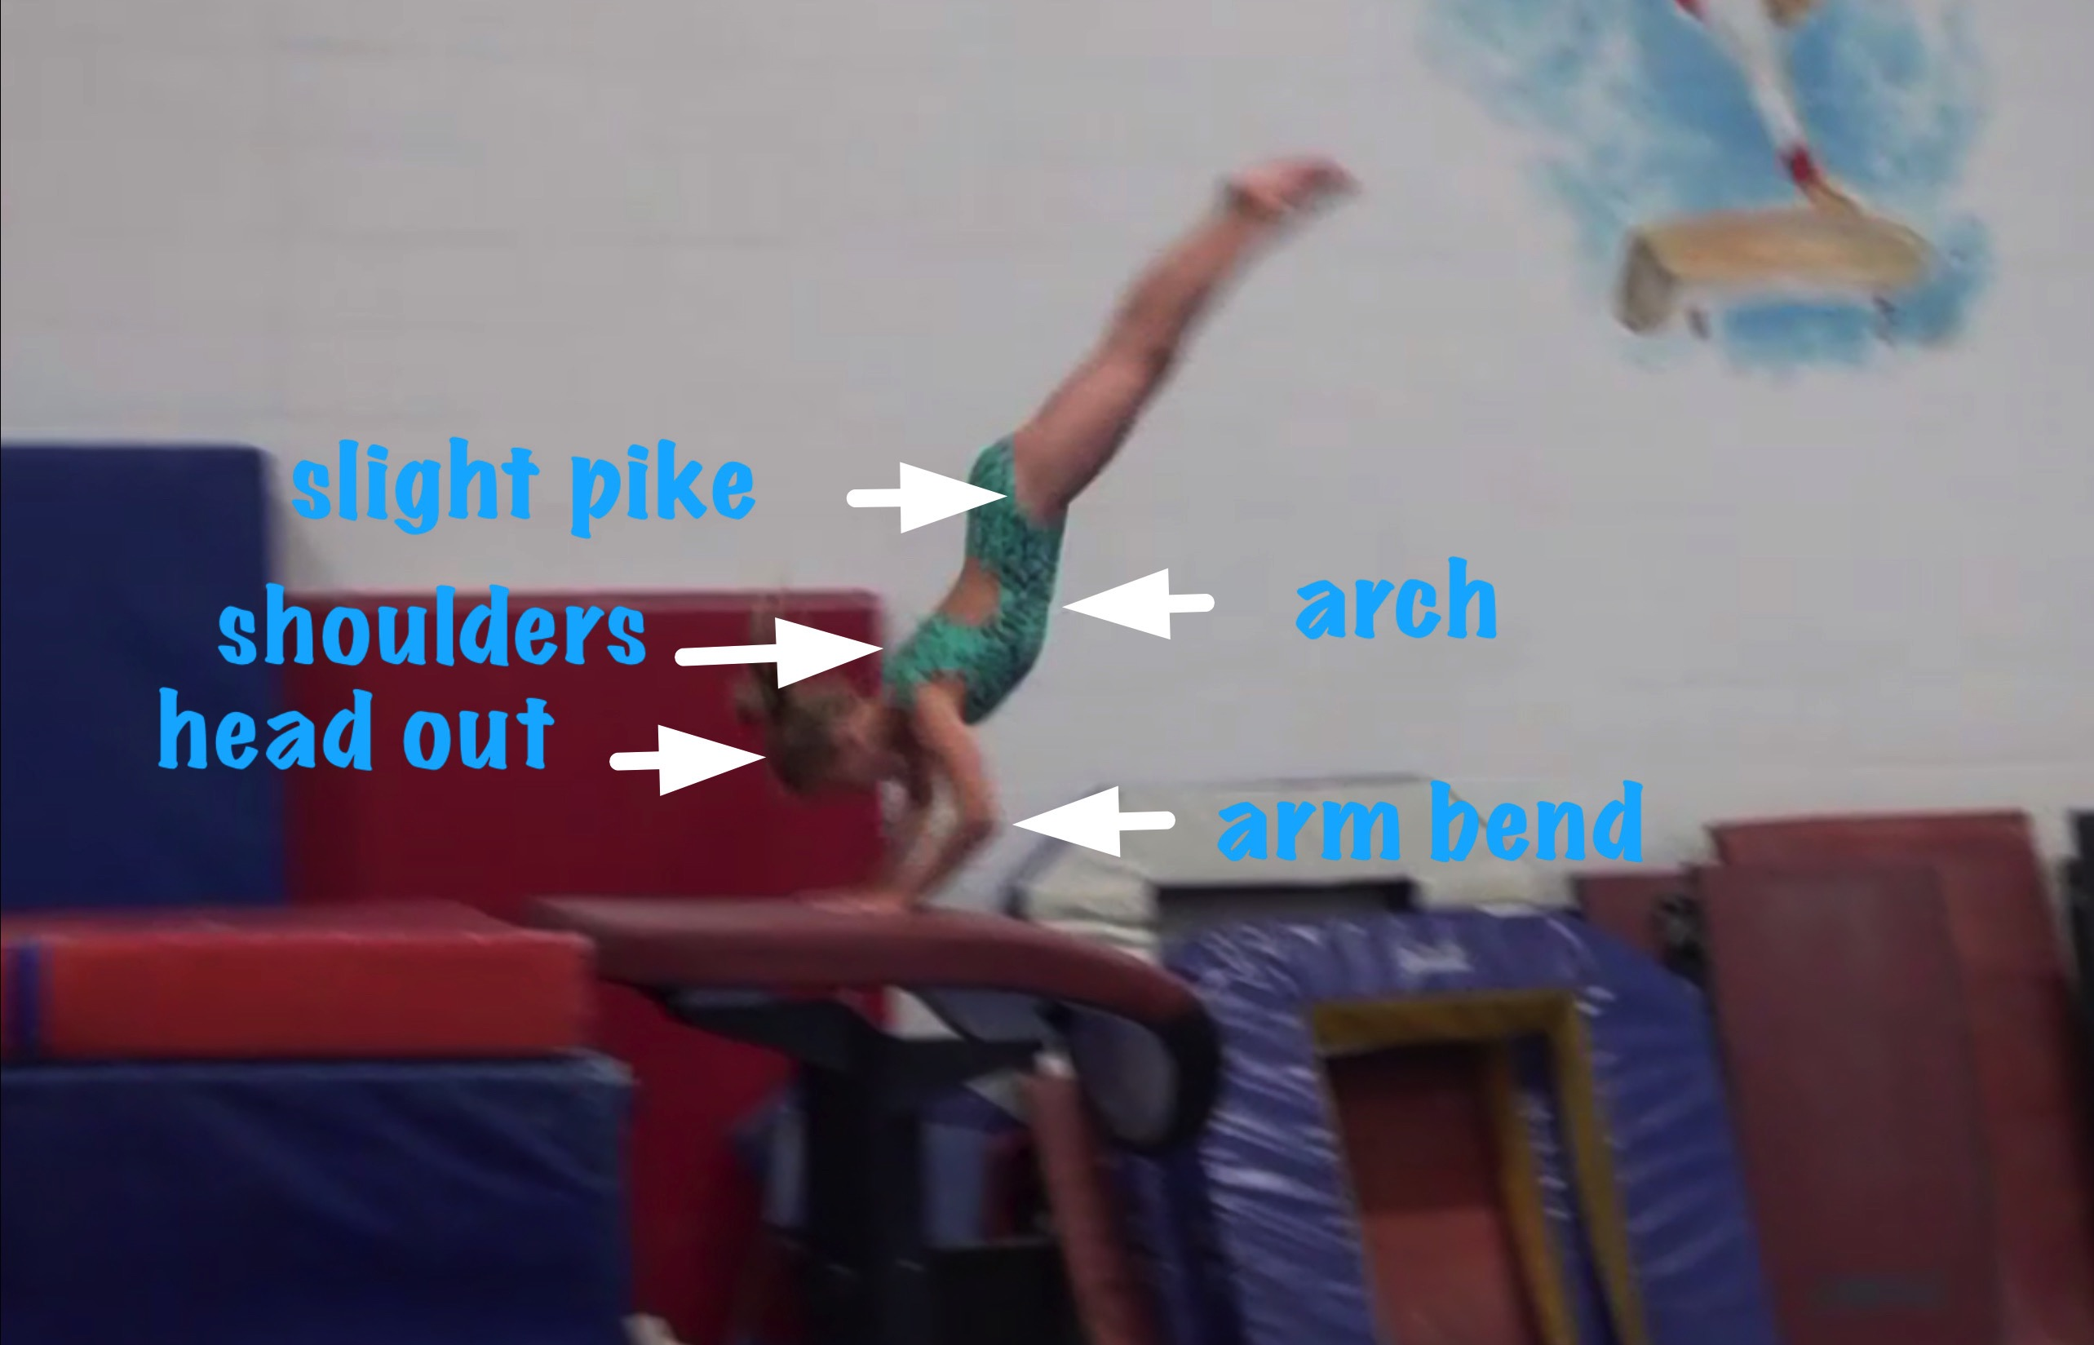
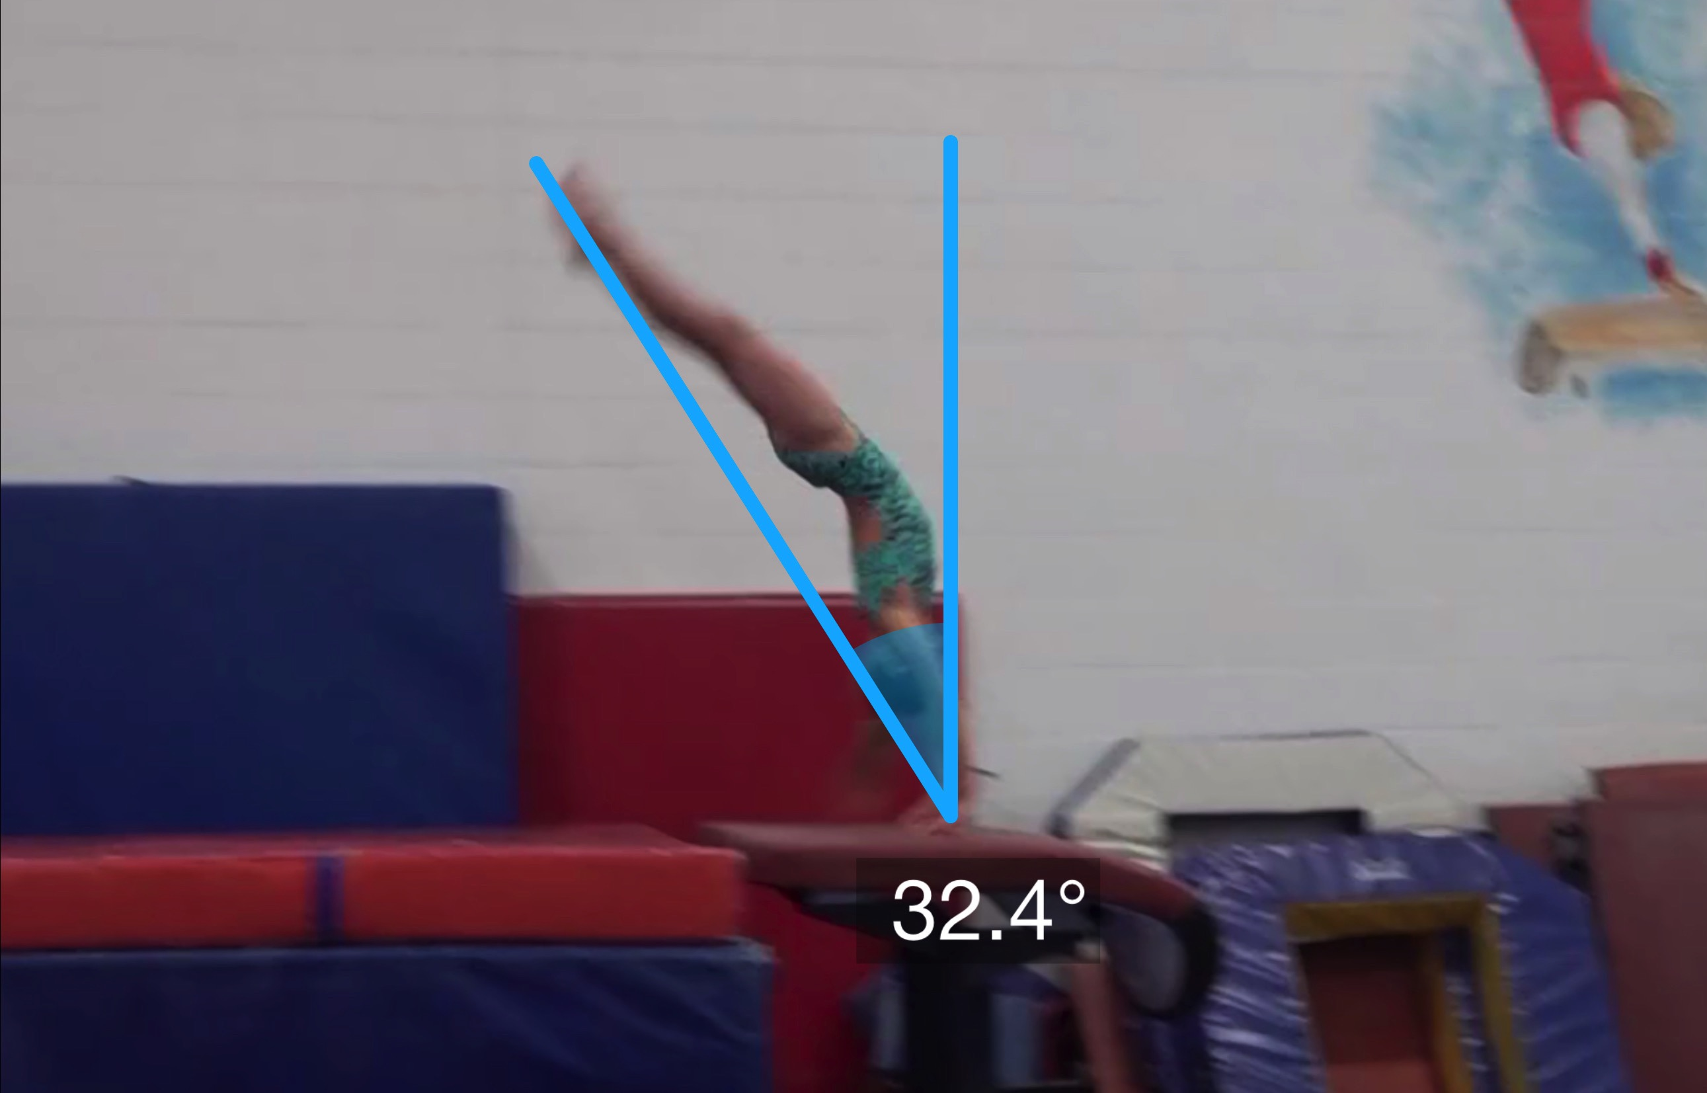
Handspring #4
Body Position in Support
Angle off the Table and corresponding Time in Support

Slide 17
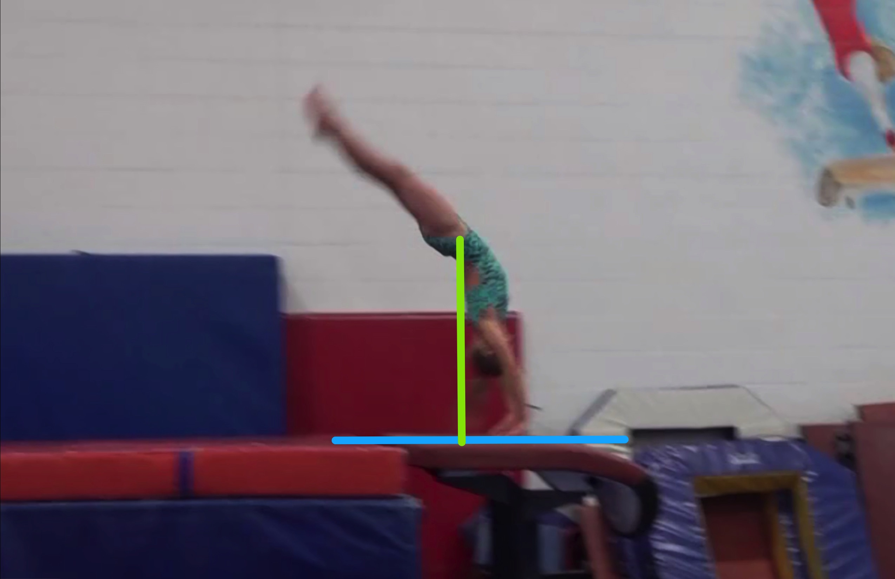
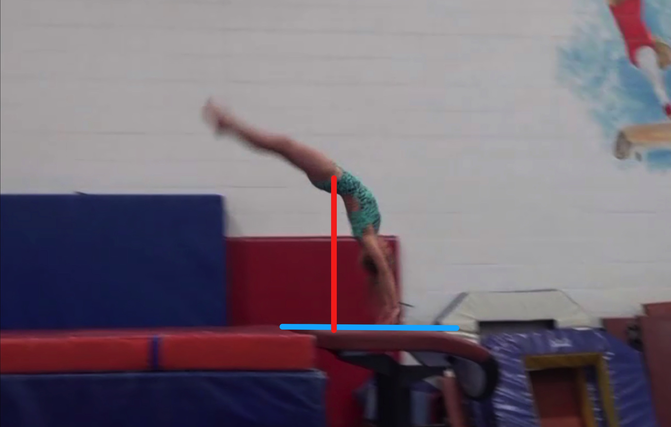
Handspring #4
Height Baseline (measured from table to center of gravity when inverted before repulsion)
Height Achieved (compare red line to green line after lining up blue table height line for accurate comparison.

Slide 18
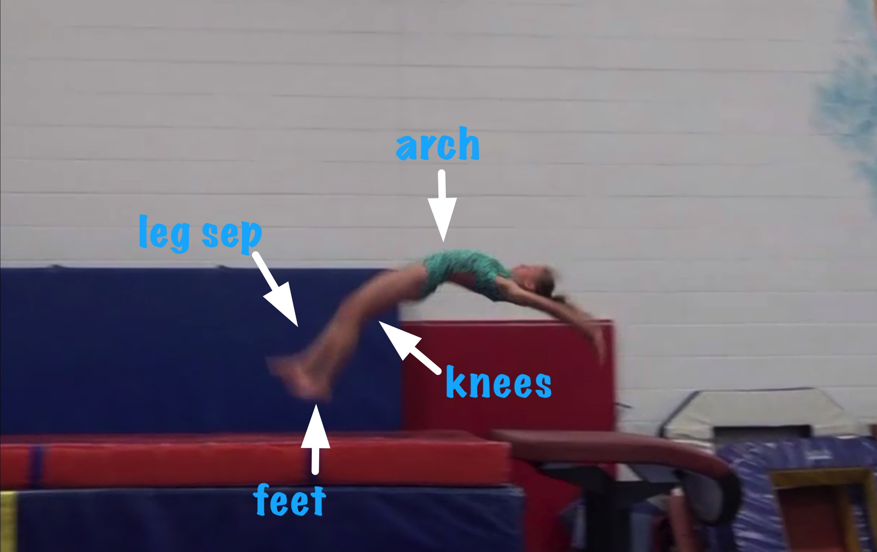
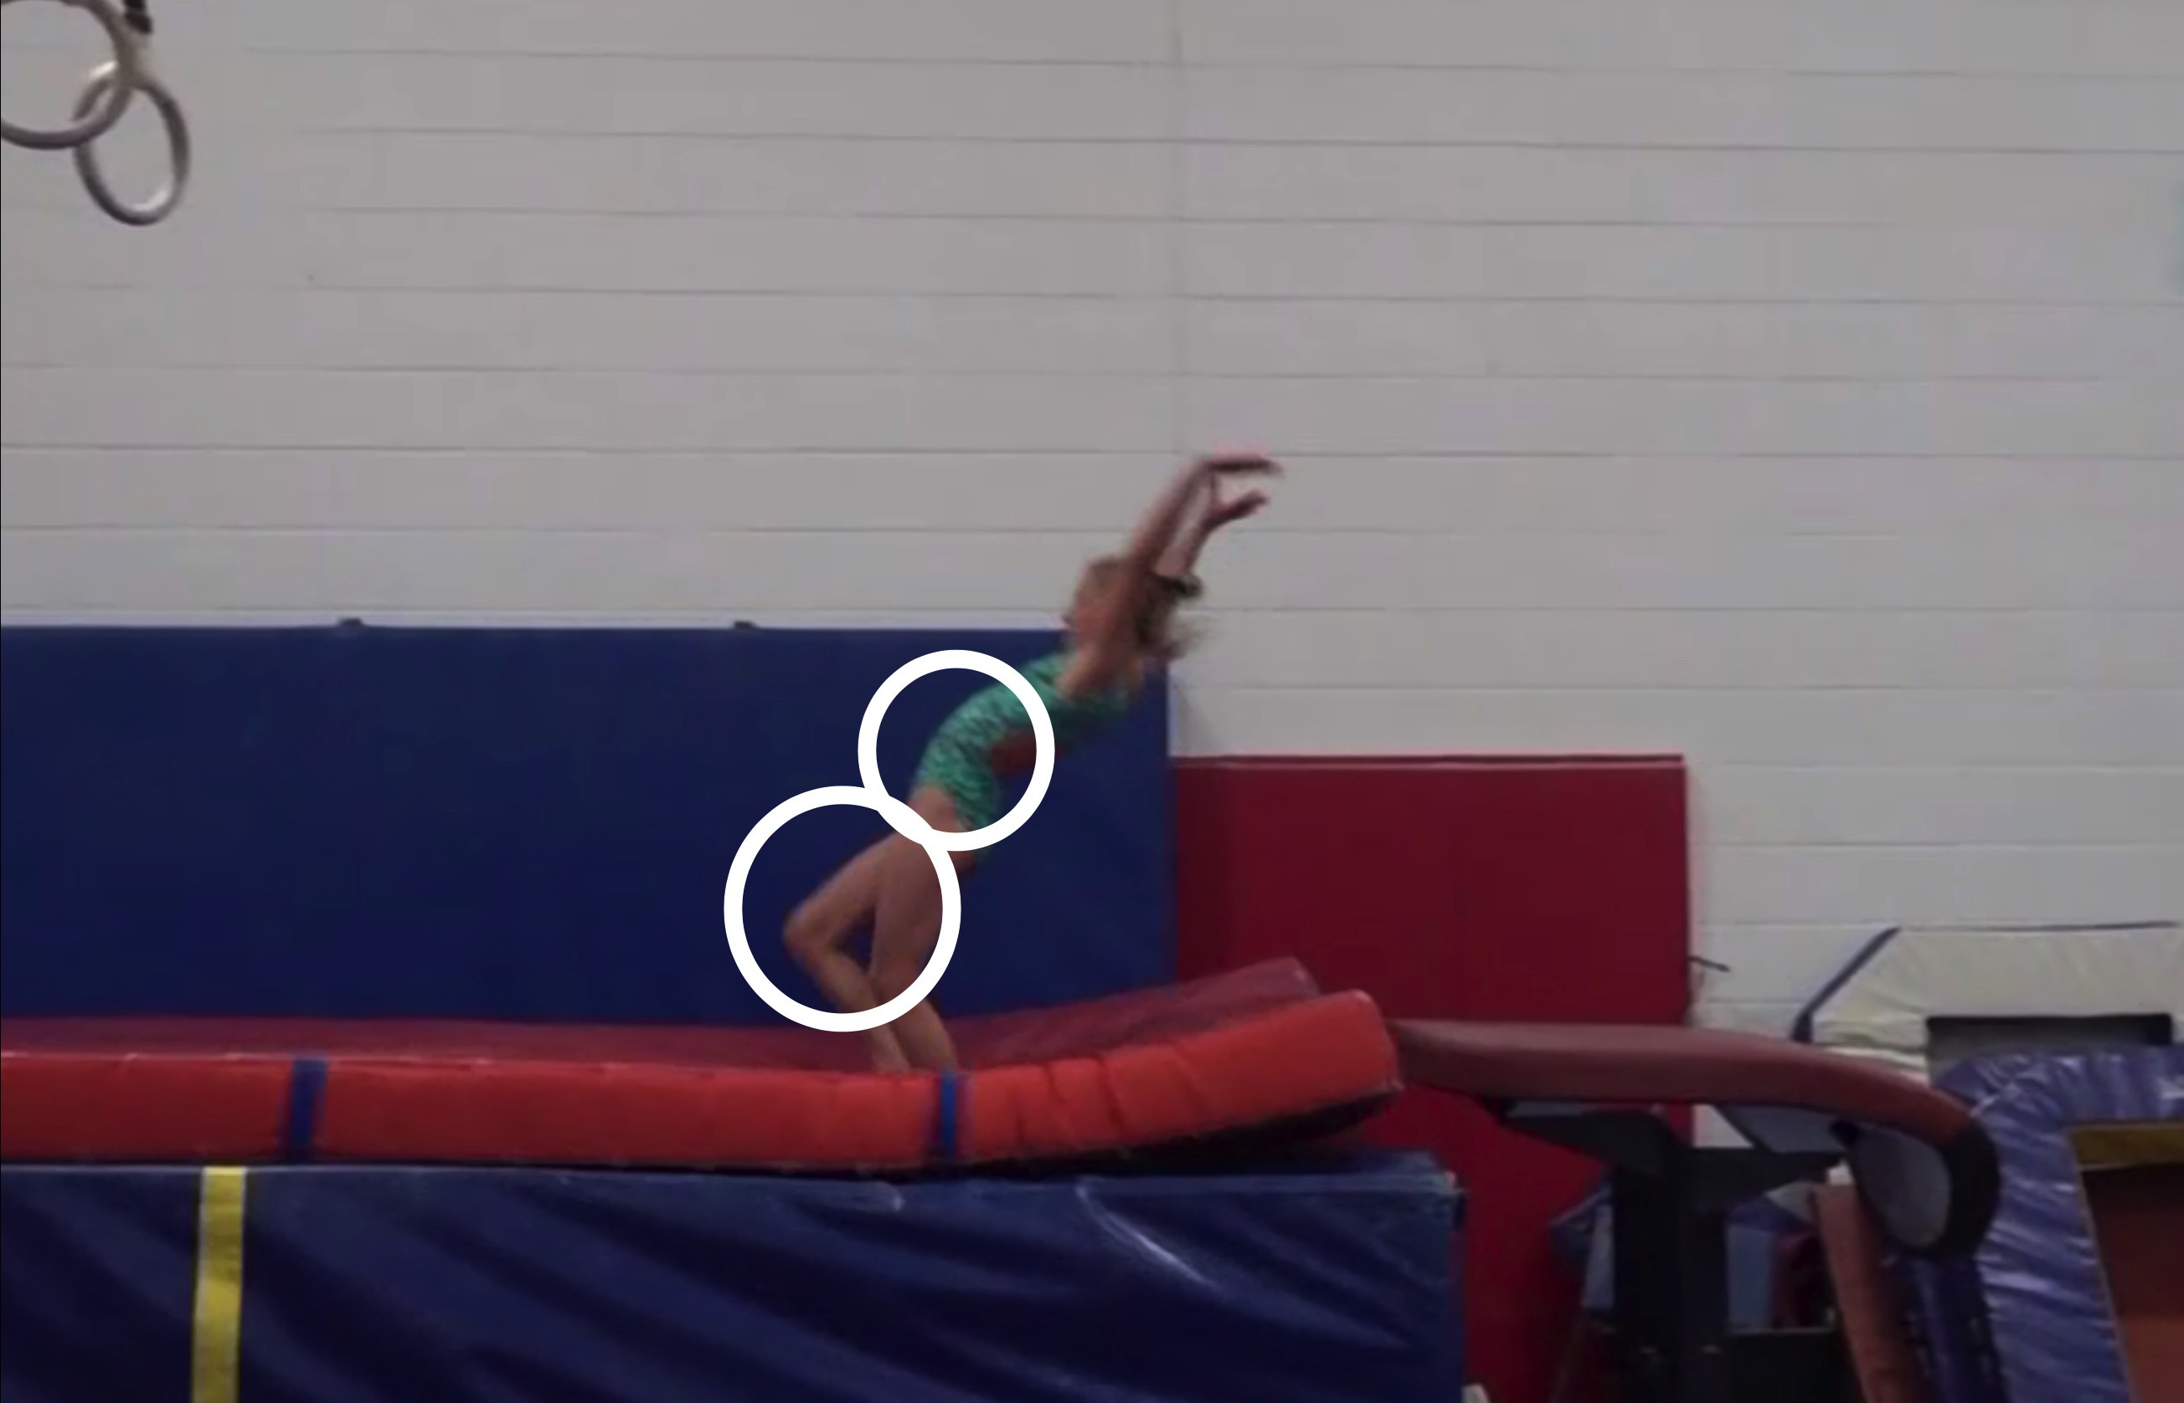
Handspring #4
Body Position in post flight
Posture on Contact & Distance

Slide 19
Handspring #4 UNOFFICIAL but Vetted Deductions Breakdown
Pre Flight Body Position: .3
Angle on: 0
In Support Body Position: .5
Angle off: .6
Time in Support: .35
Height: .45
Off Flight Body Position: .1
Posture on Landing: .2
Landing: 0
Distance: .2
Dynamics: .2
Score: 7.1
Look at the vault again and use the slider to view it in slow motion and study the corresponding deductions for each phase of the vault.

Slide 20
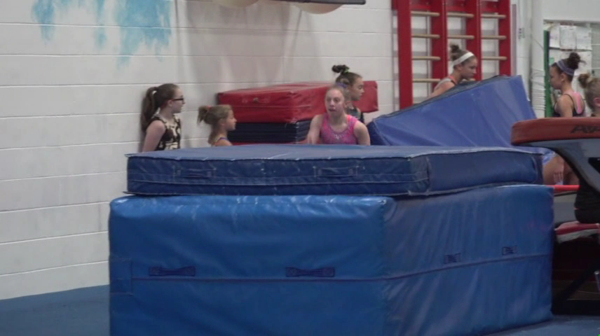
Handspring #11
Compare #11 on the left to the MODEL on the right.

Slide 21
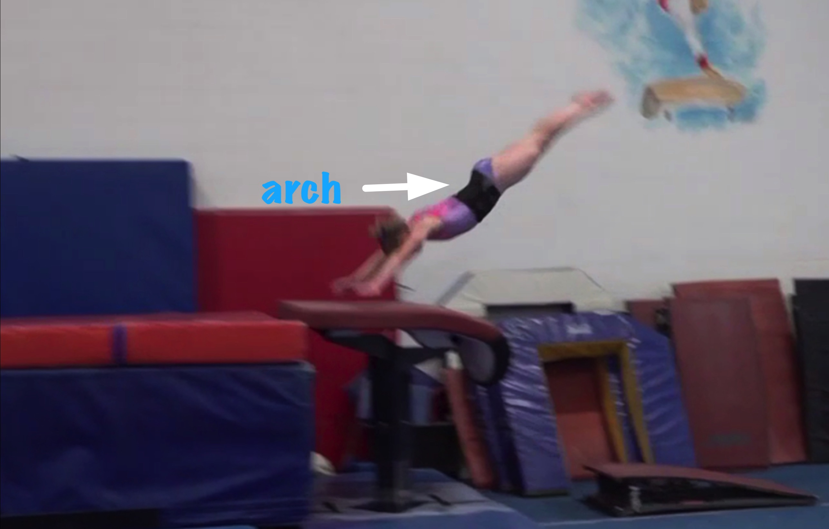
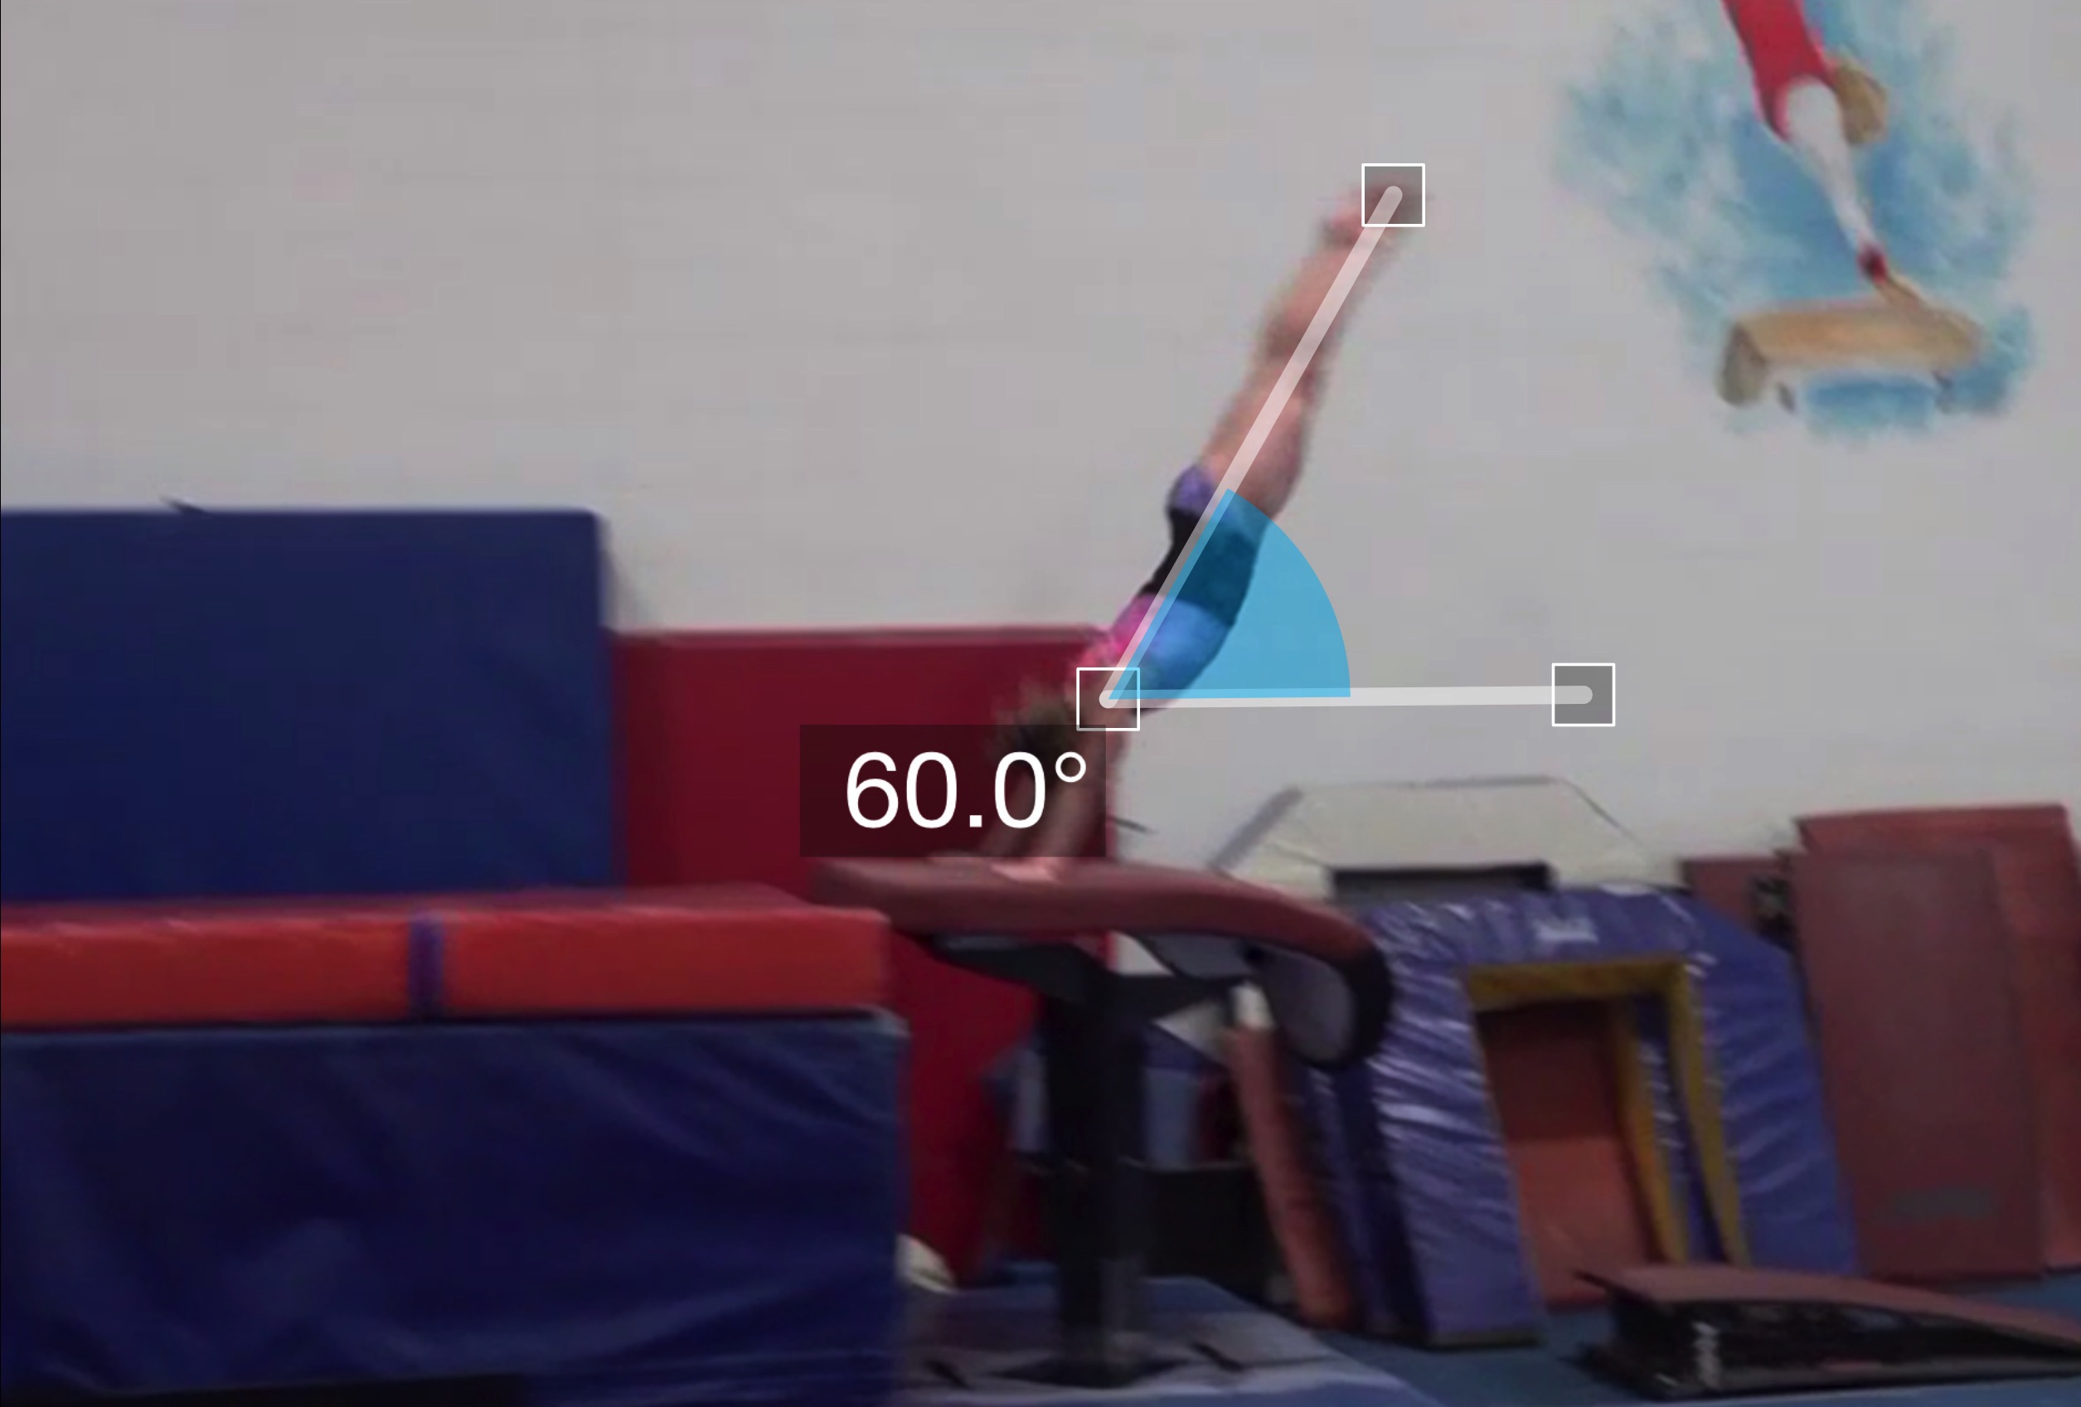
Handspring #11
Pre Flight Body Position
Angle of Arrival

Slide 22
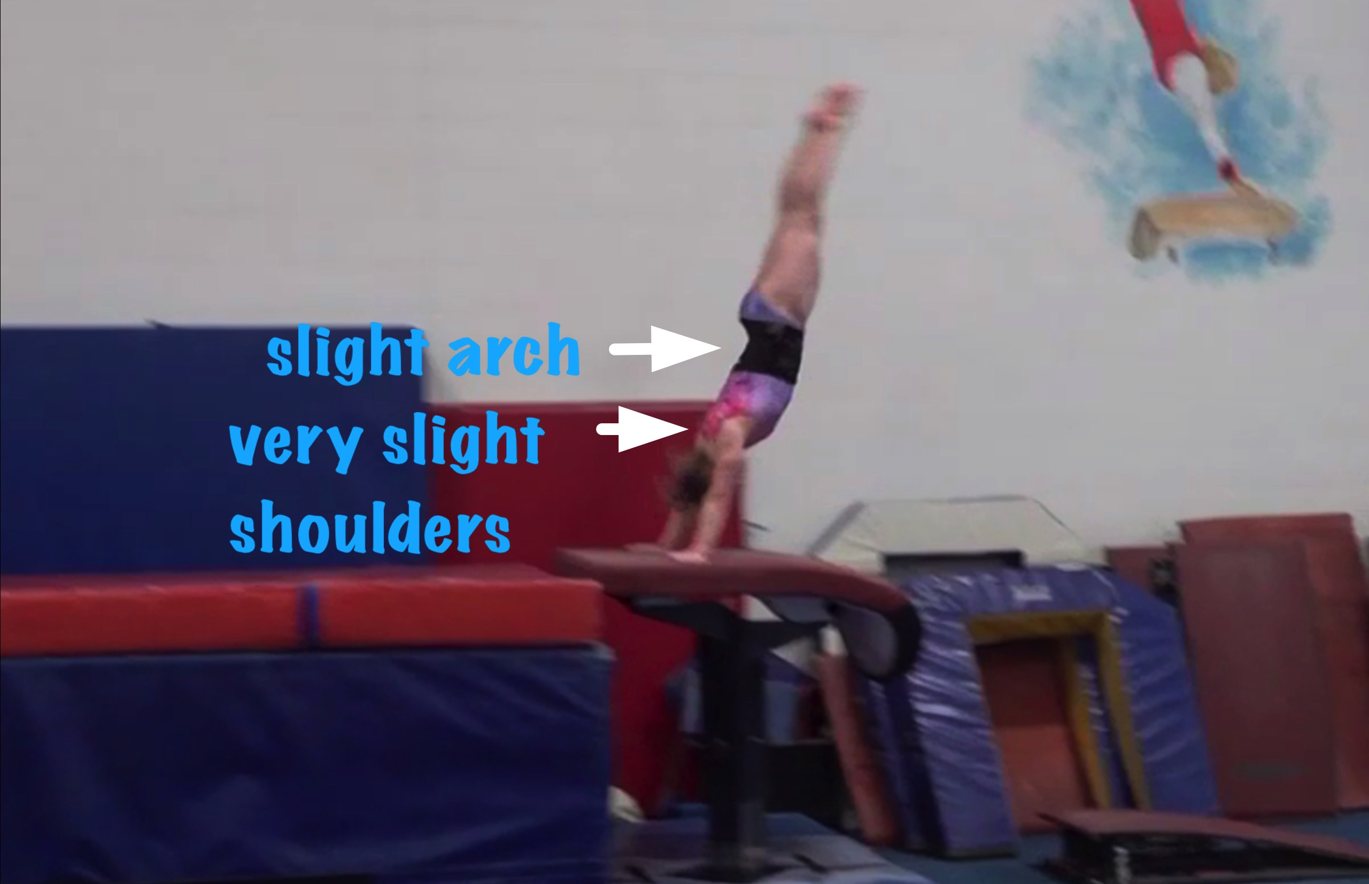
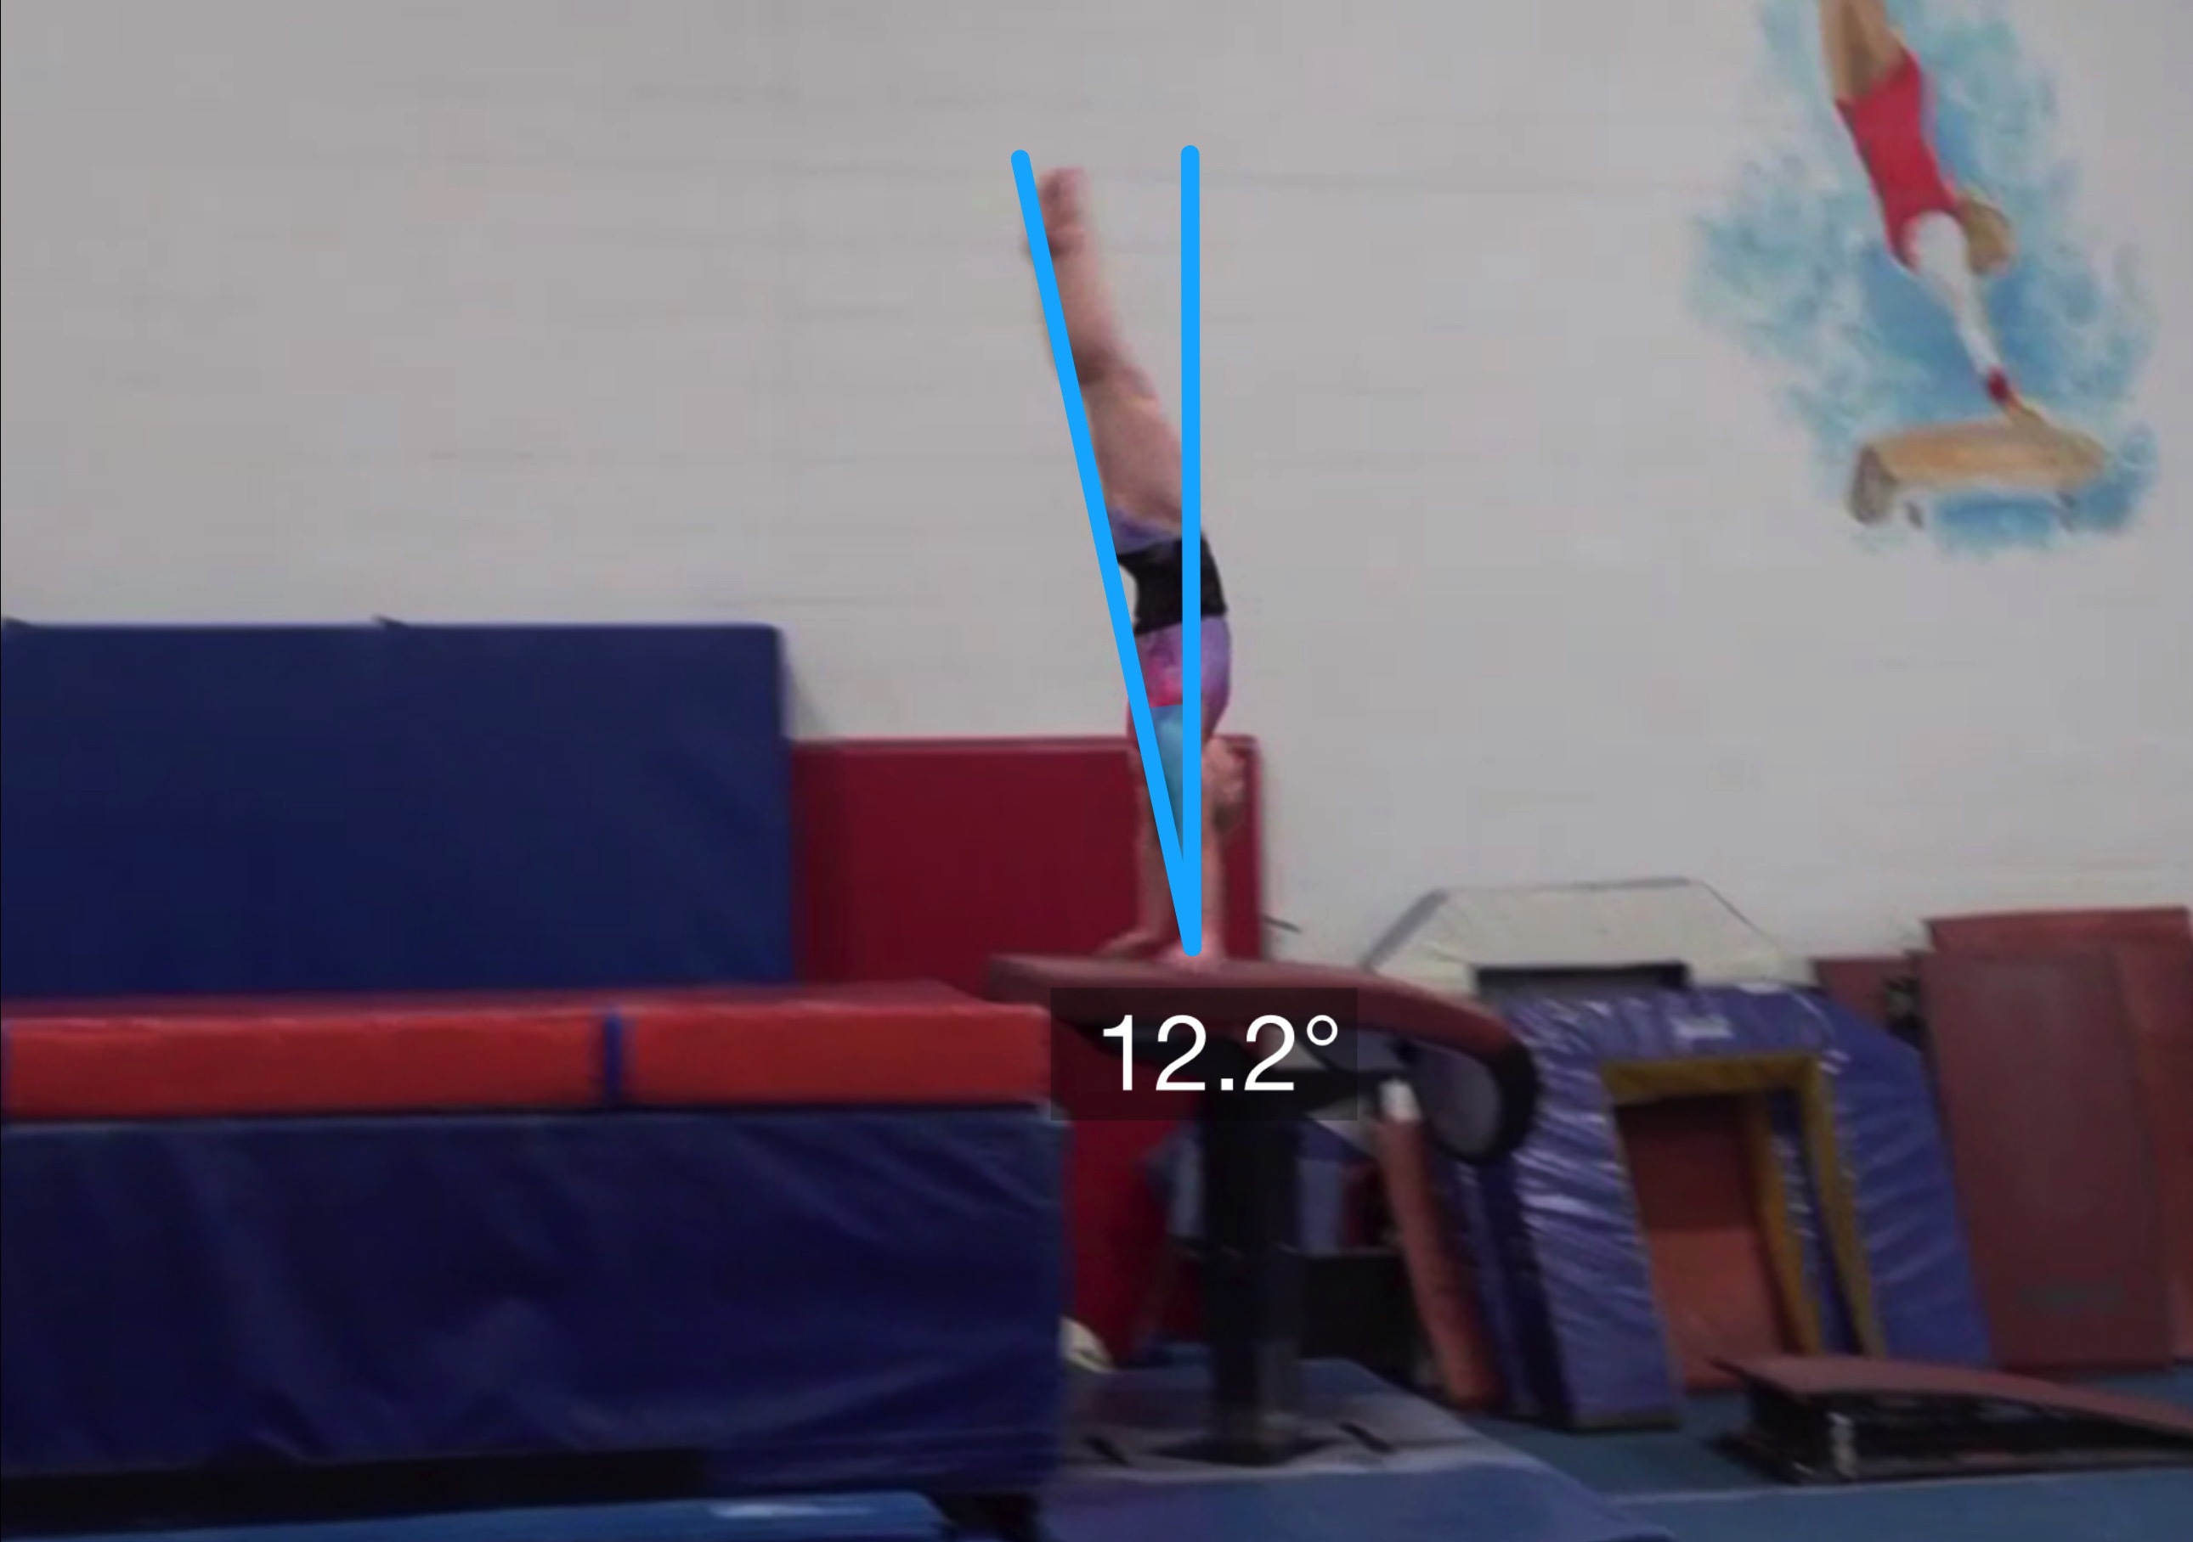
Handspring #11
Body Position in Support
Angle off the Table and corresponding Time in Support

Slide 23
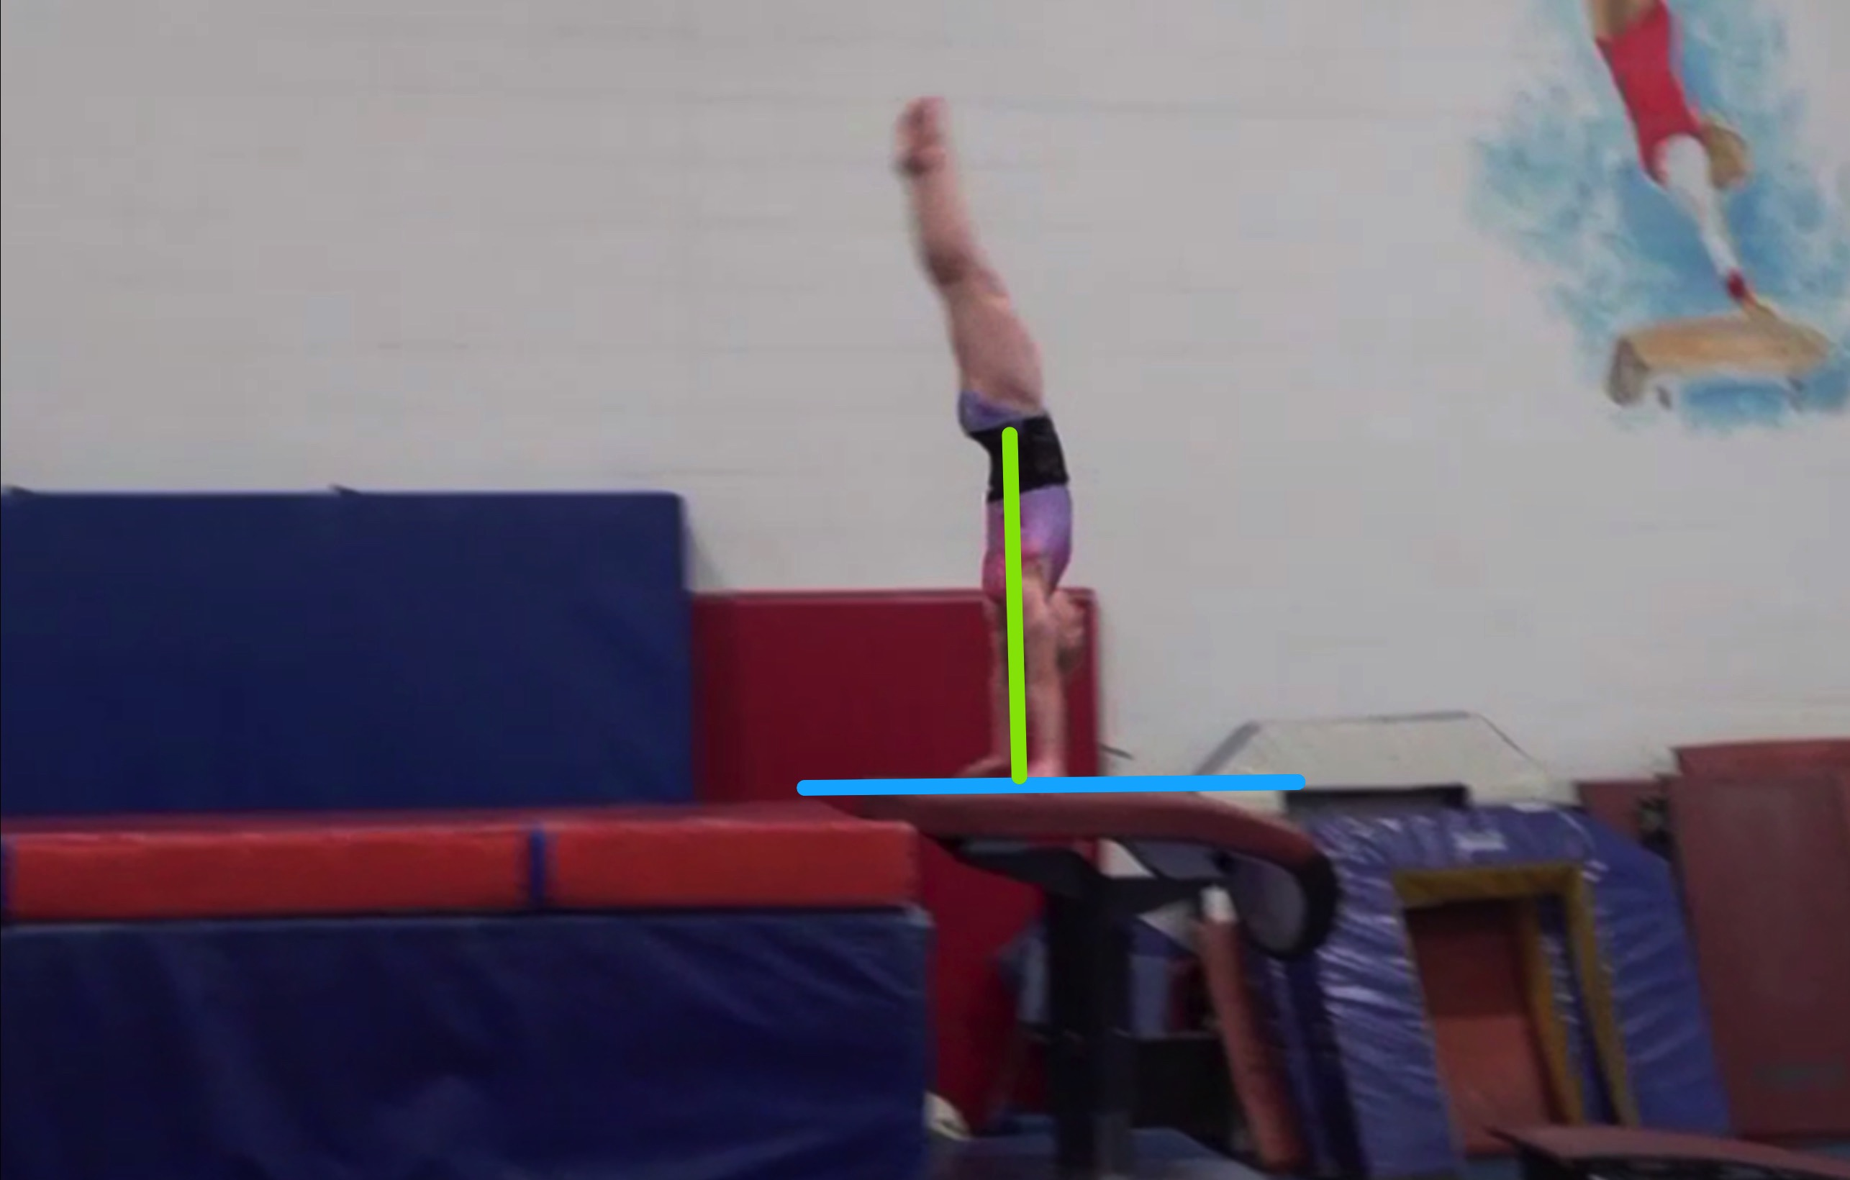
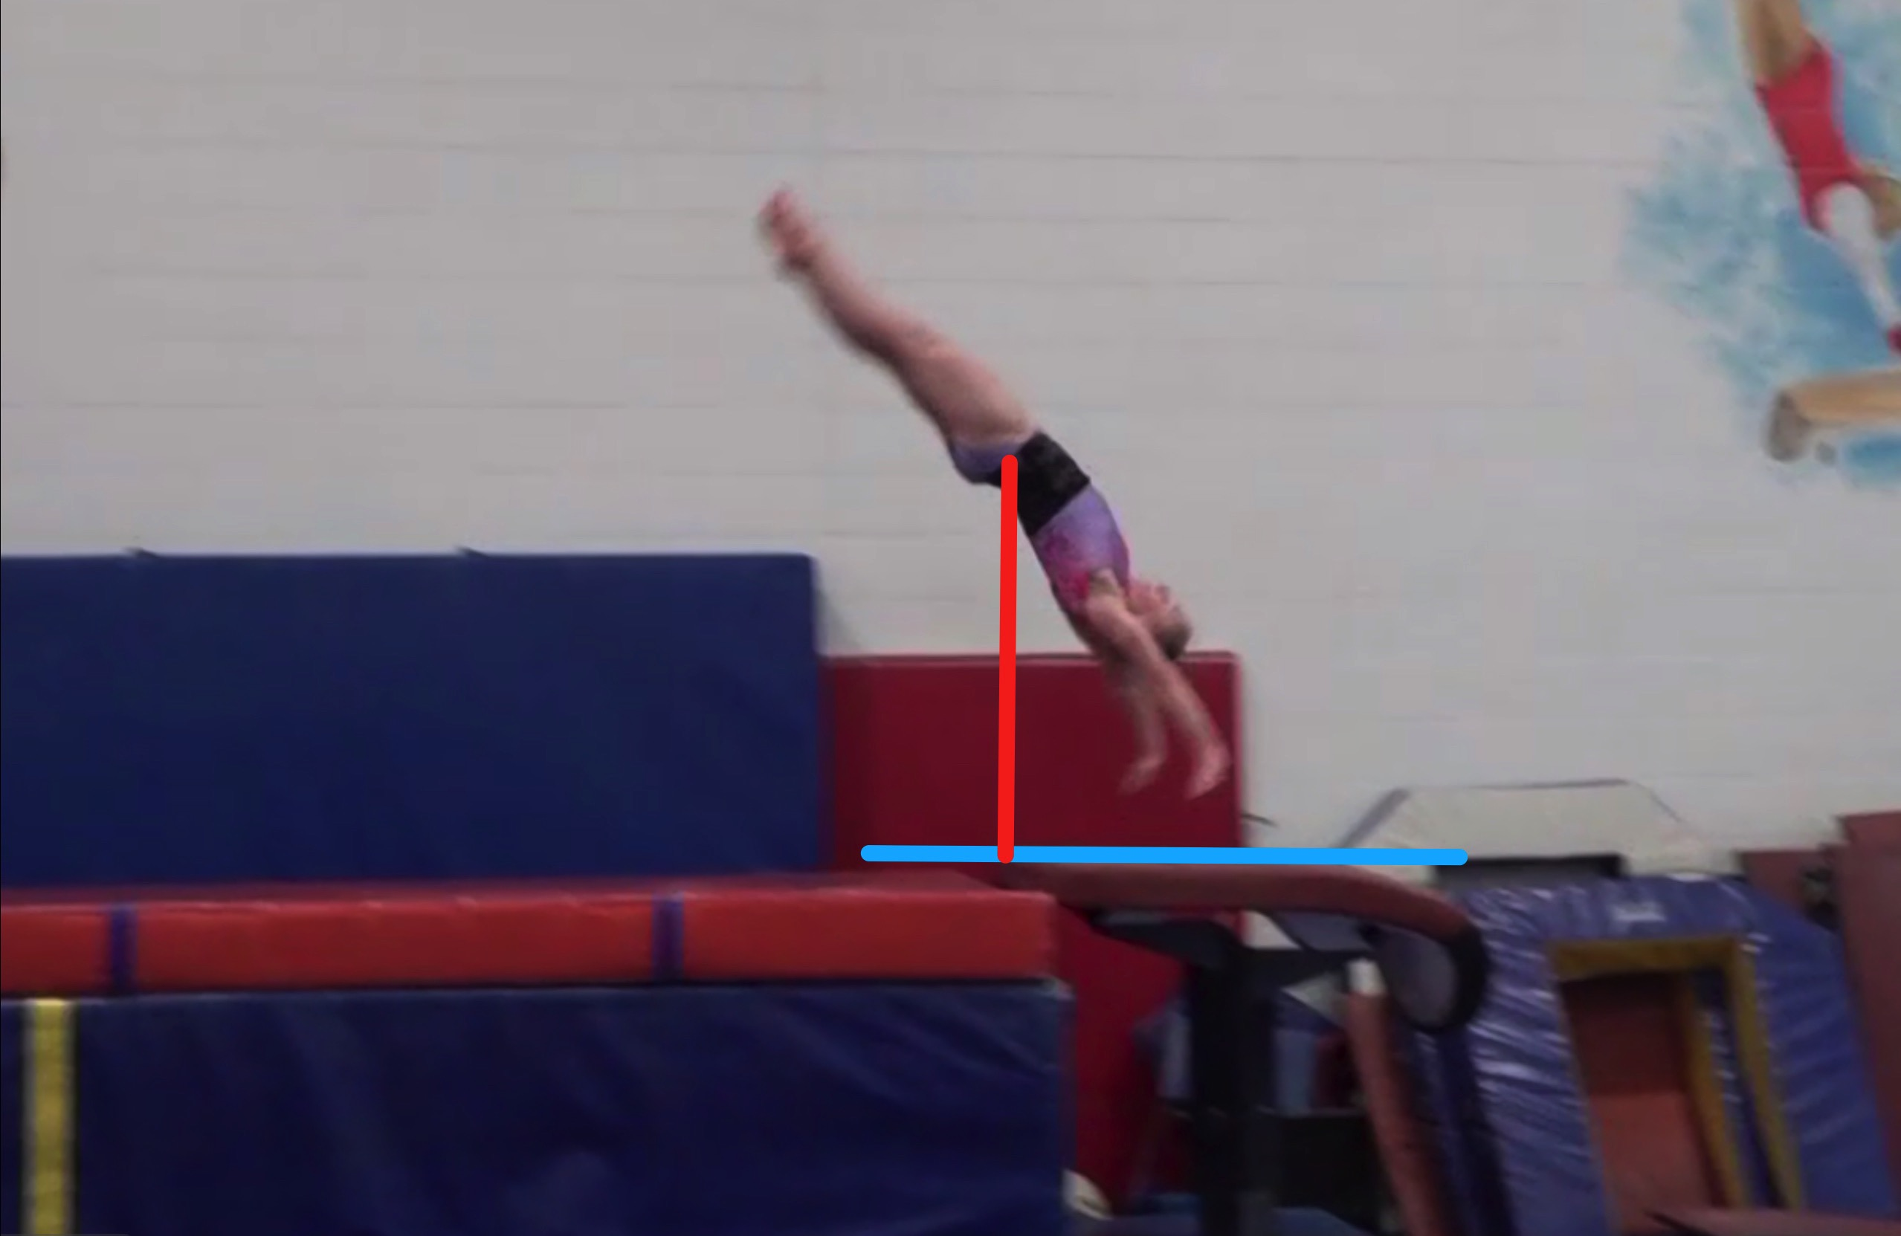
Handspring #11
Height Baseline (measured from table to center of gravity when inverted before repulsion)
Height Achieved (compare red line to green line after lining up blue table height line for accurate comparison.

Slide 24
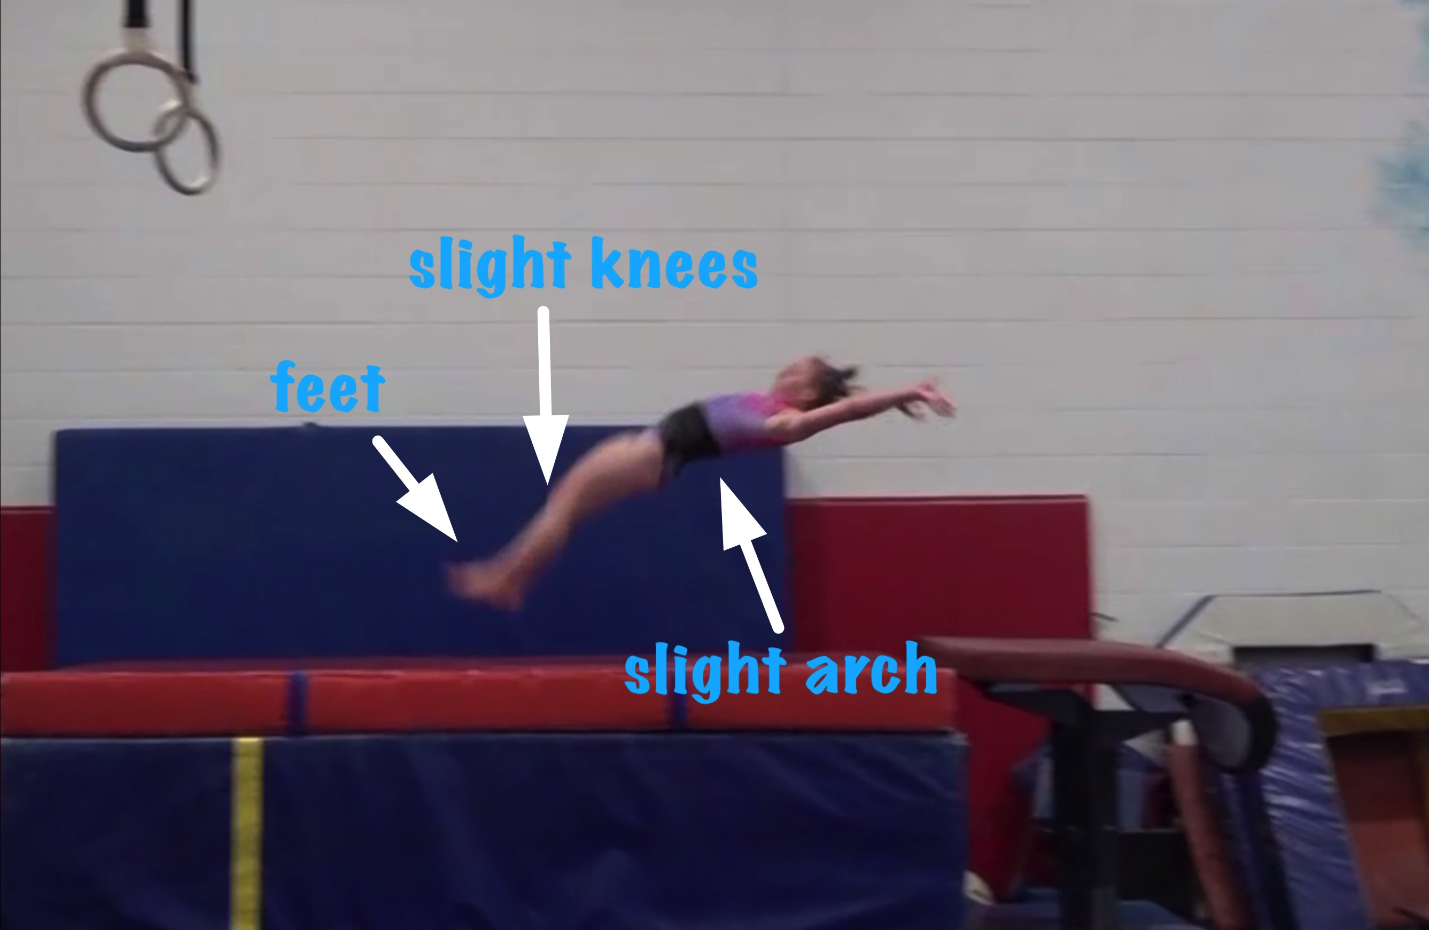
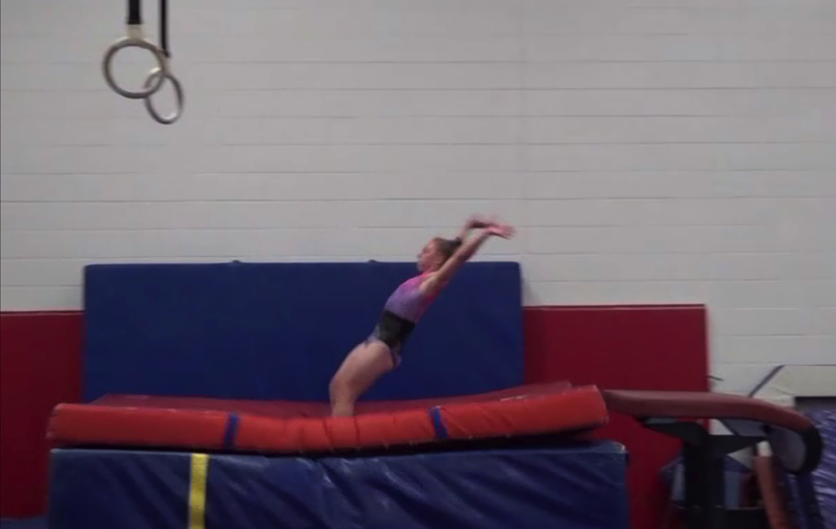
Handspring #11
Body Position in post flight
Posture on Contact & Distance

Slide 25
Handspring #11 UNOFFICIAL but Vetted Deductions Breakdown
Pre Flight Body Position: .05
Angle on: .2
In Support Body Position: 0
Angle off: .1
Time in Support: .15
Height: .4
Off Flight Body Position: .1
Posture on Landing: .1
Landing: 0
Distance: 0
Dynamics: .15
Score: 8.75
Look at the vault again and use the slider to view it in slow motion and study the corresponding deductions for each phase of the vault.

Slide 26
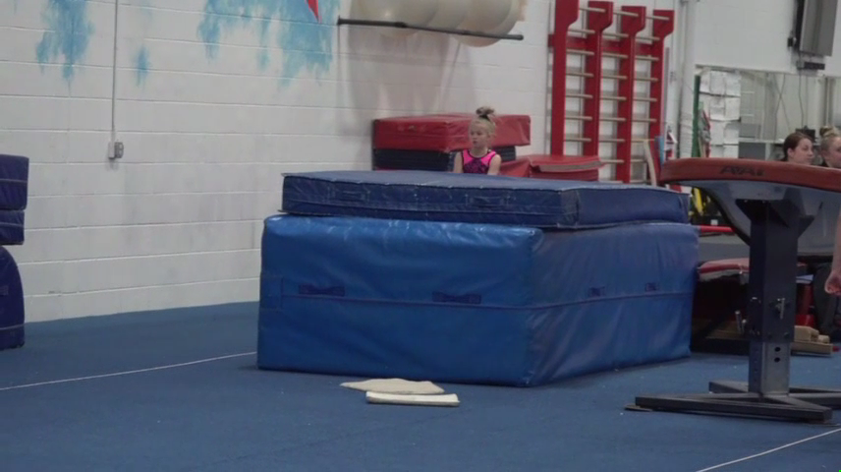
Handspring #12
Compare #12 on the left to the MODEL on the right.

Slide 27
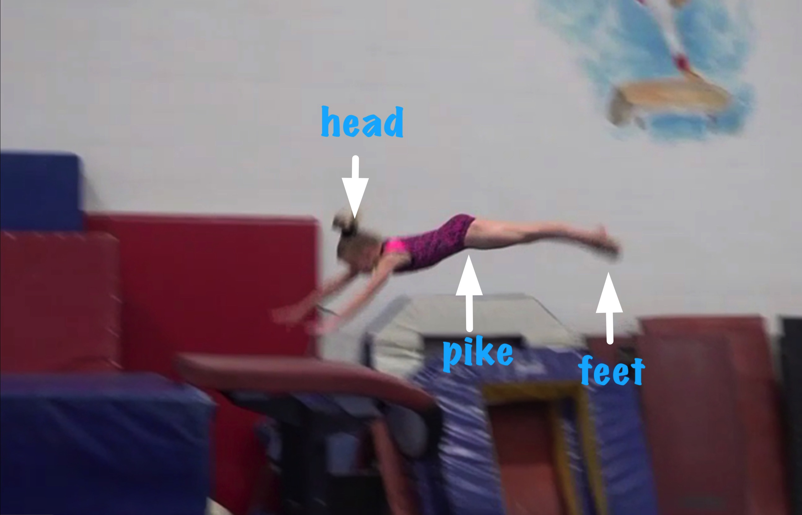
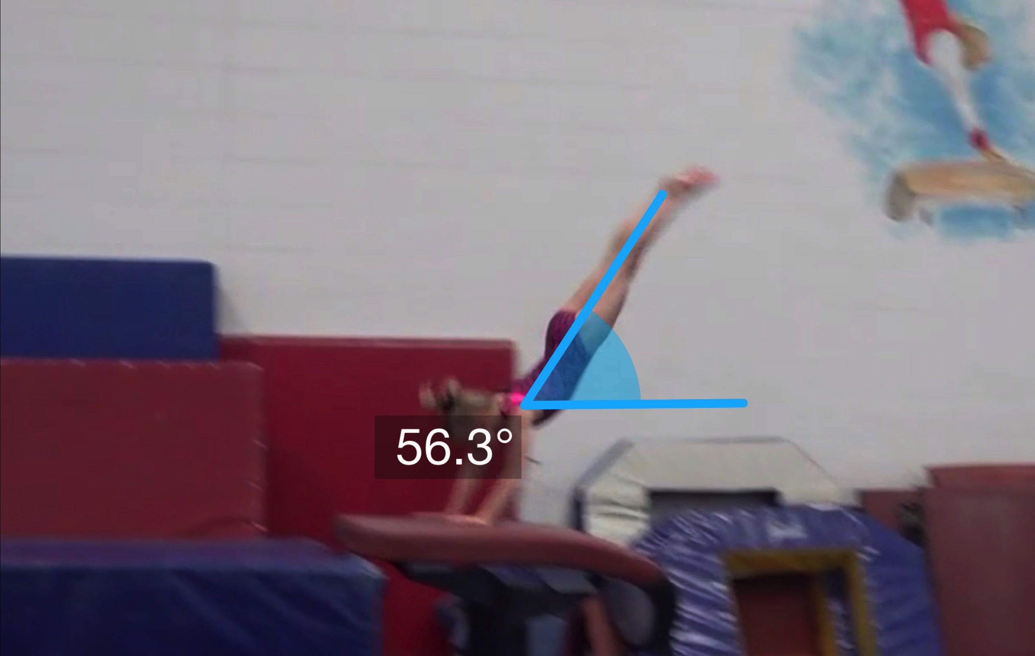
Handspring #12
Pre Flight Body Position
Angle of Arrival

Slide 28
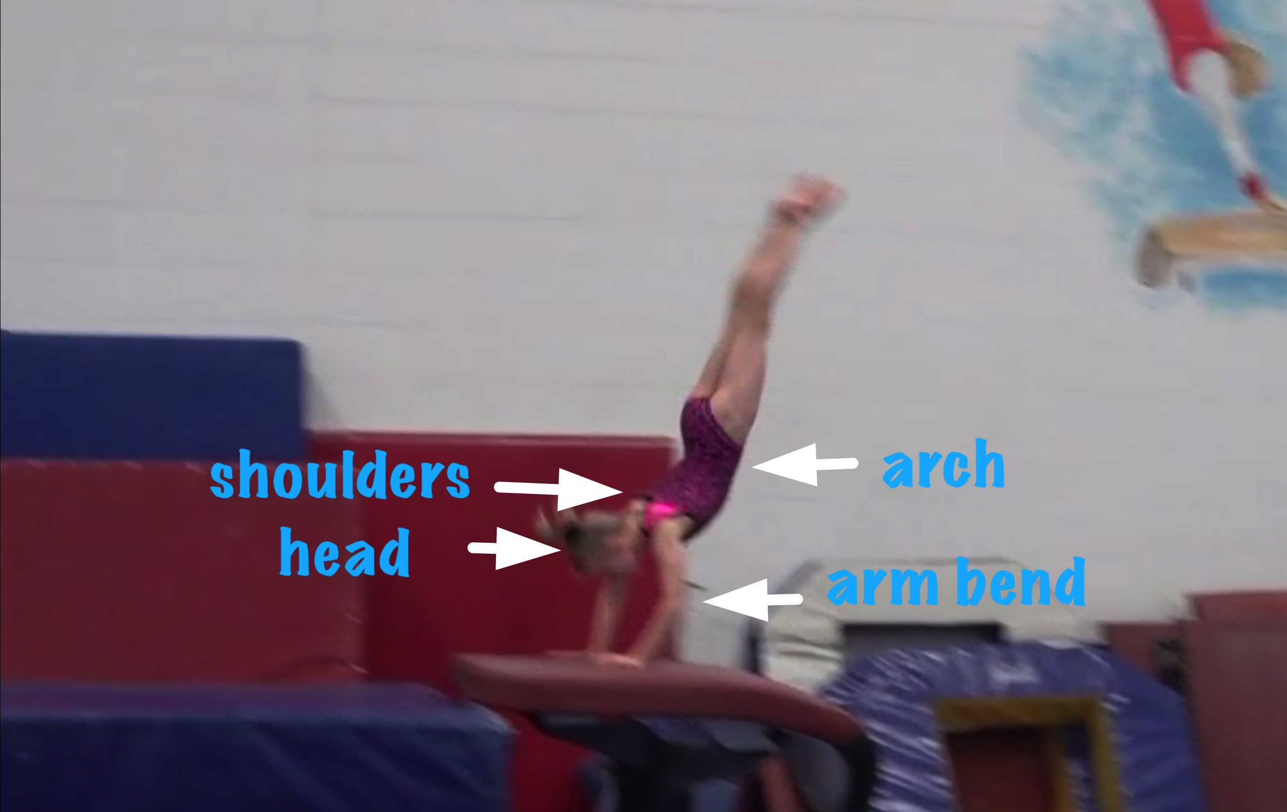
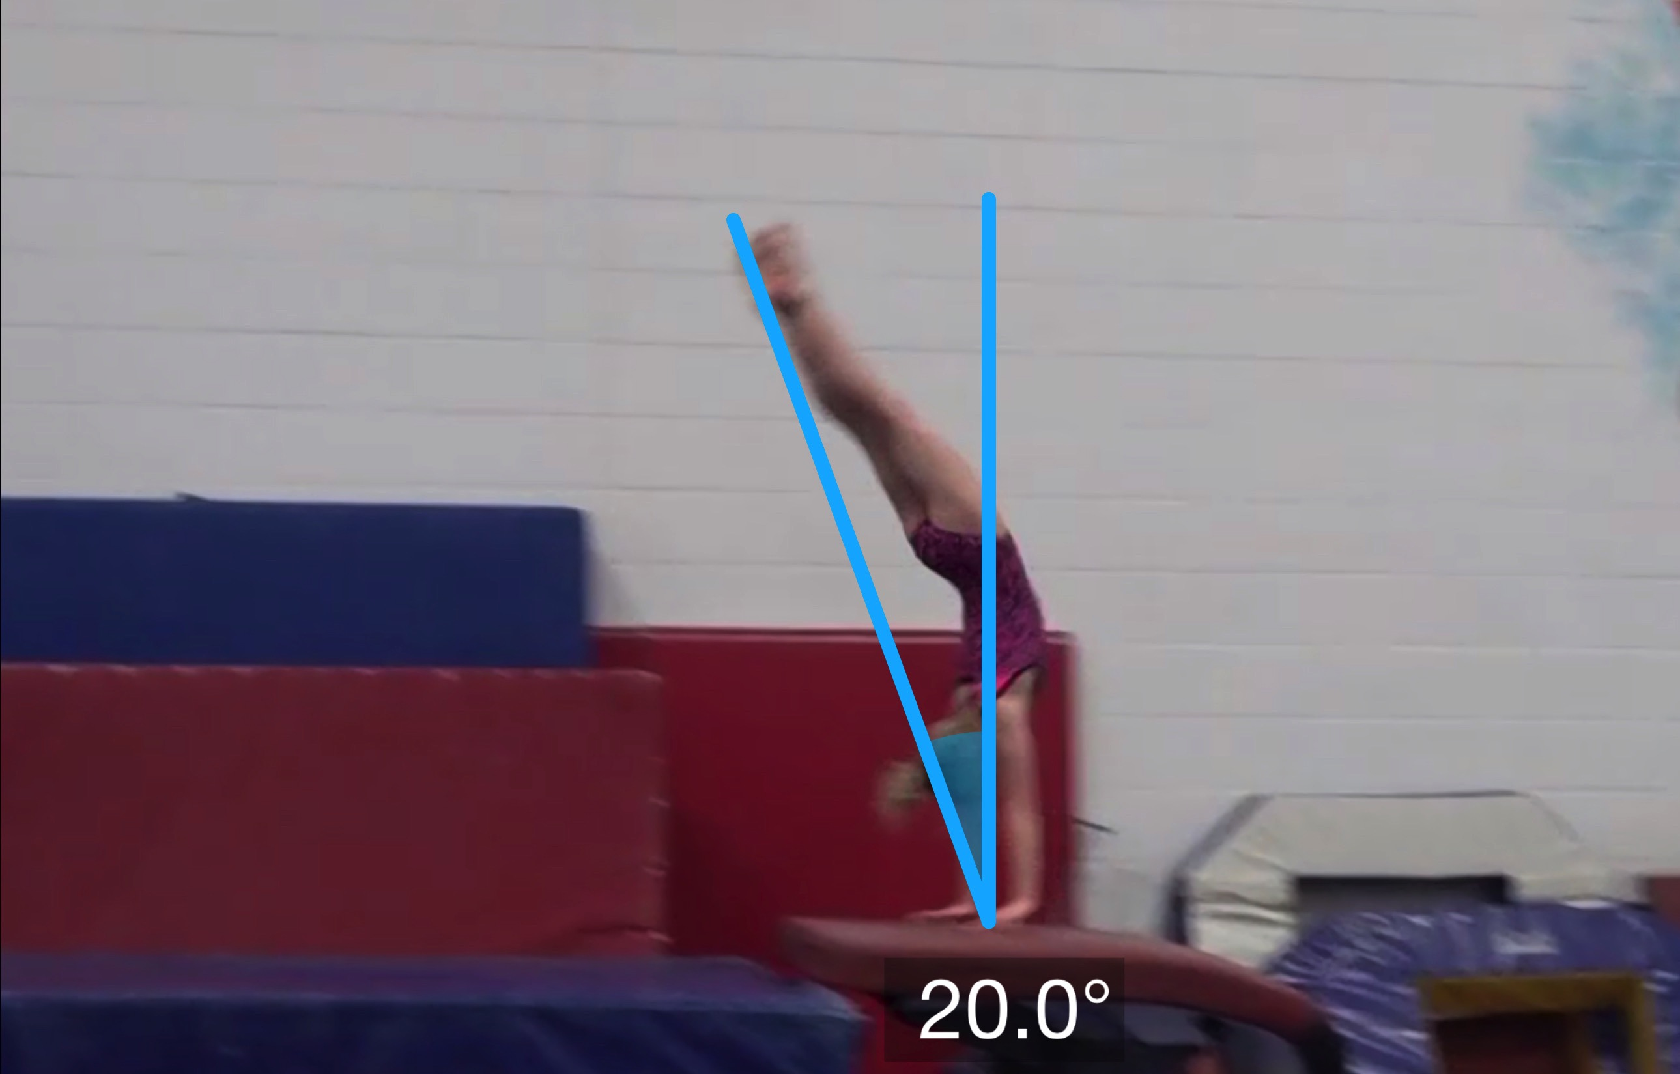
Handspring #12
Body Position in Support
Angle off the Table and corresponding Time in Support

Slide 29
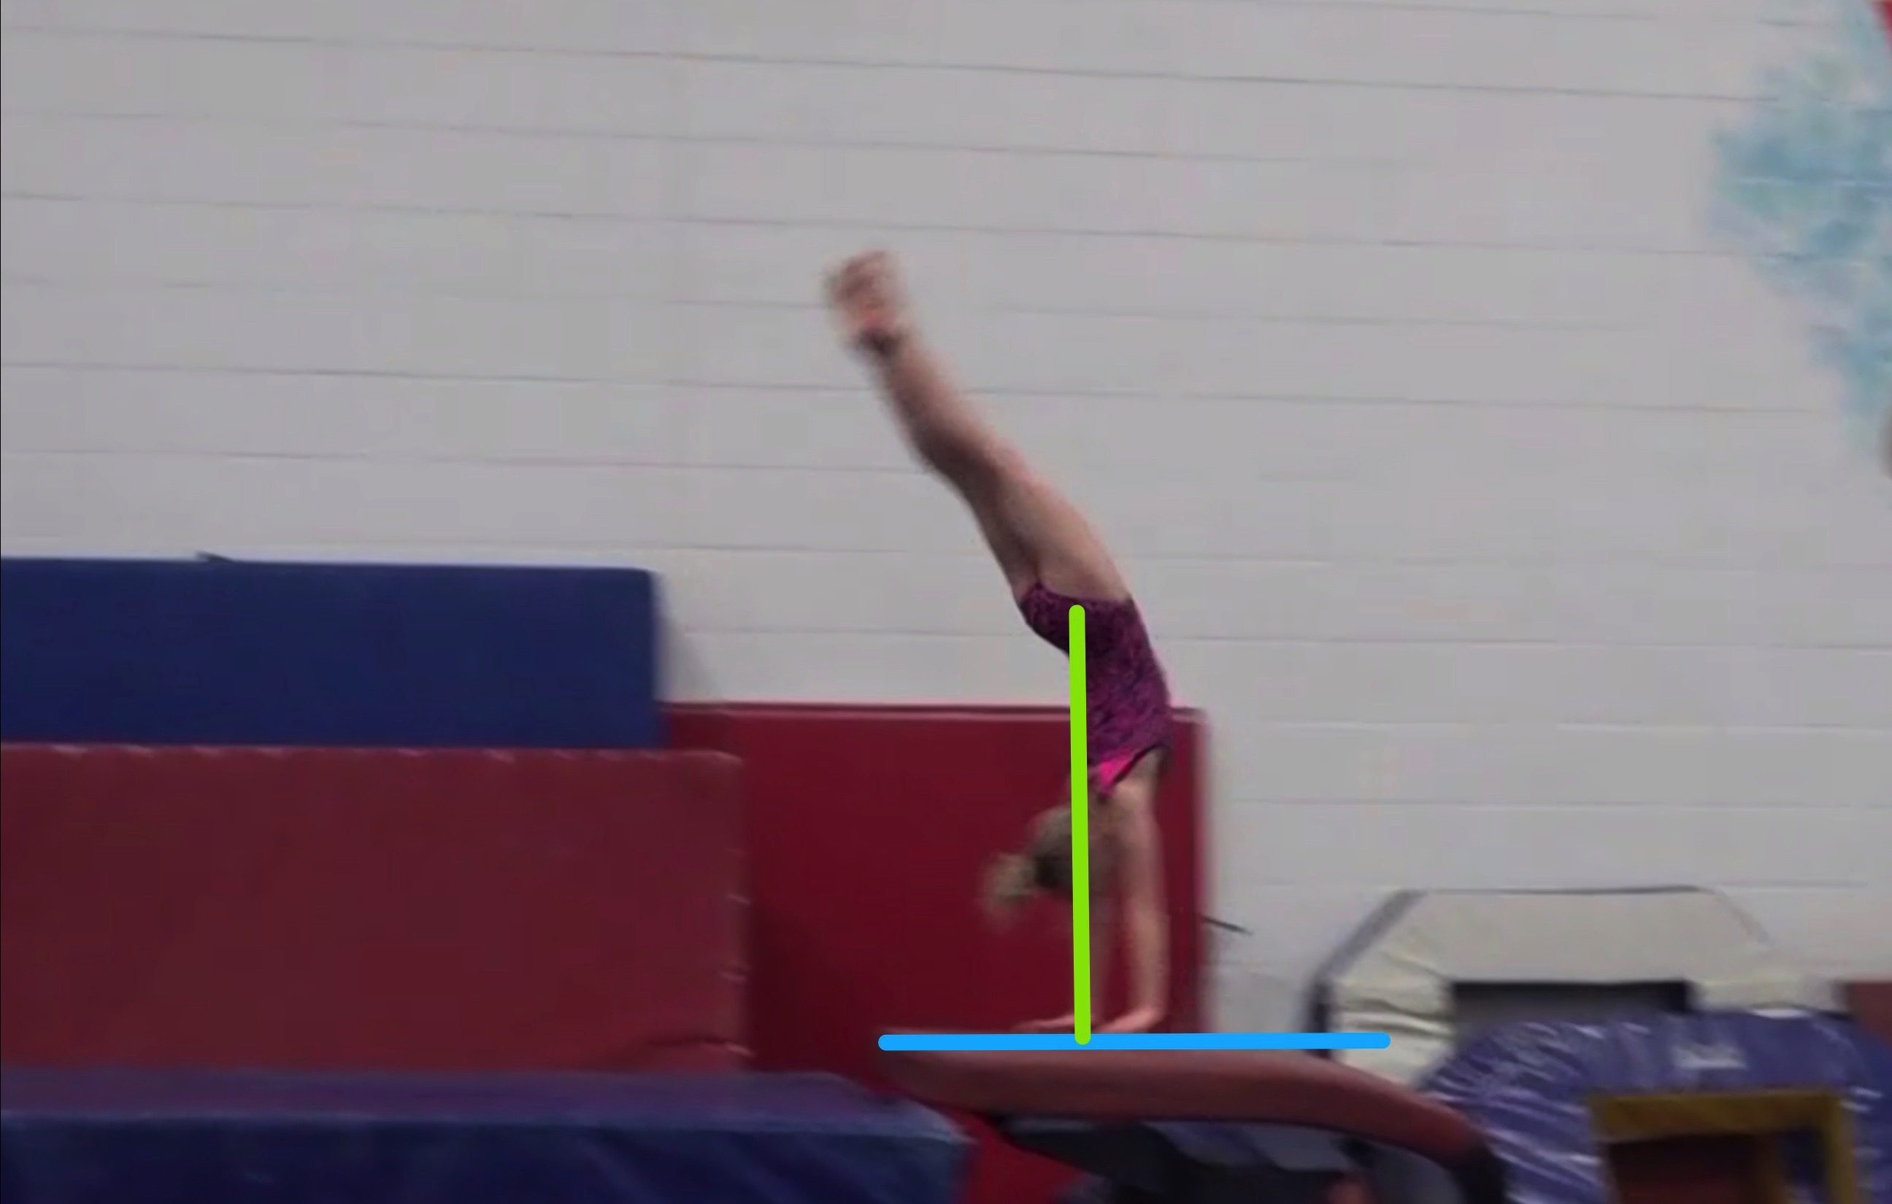
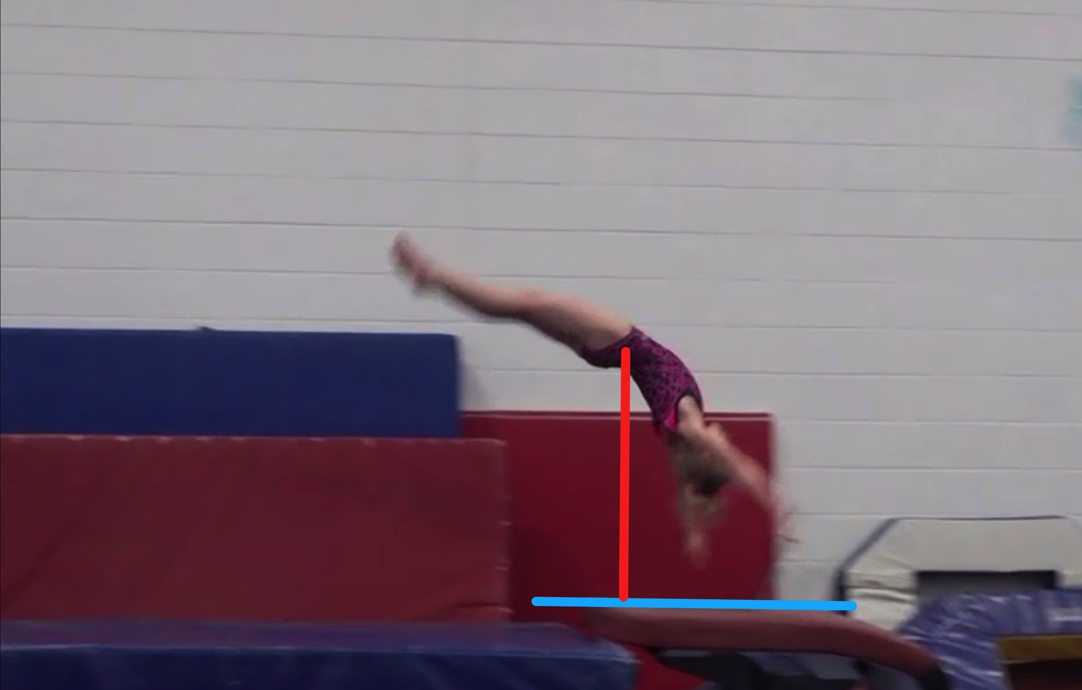
Handspring #12
Height Baseline (measured from table to center of gravity when inverted before repulsion)
Height Achieved (compare red line to green line after lining up blue table height line for accurate comparison.

Slide 30
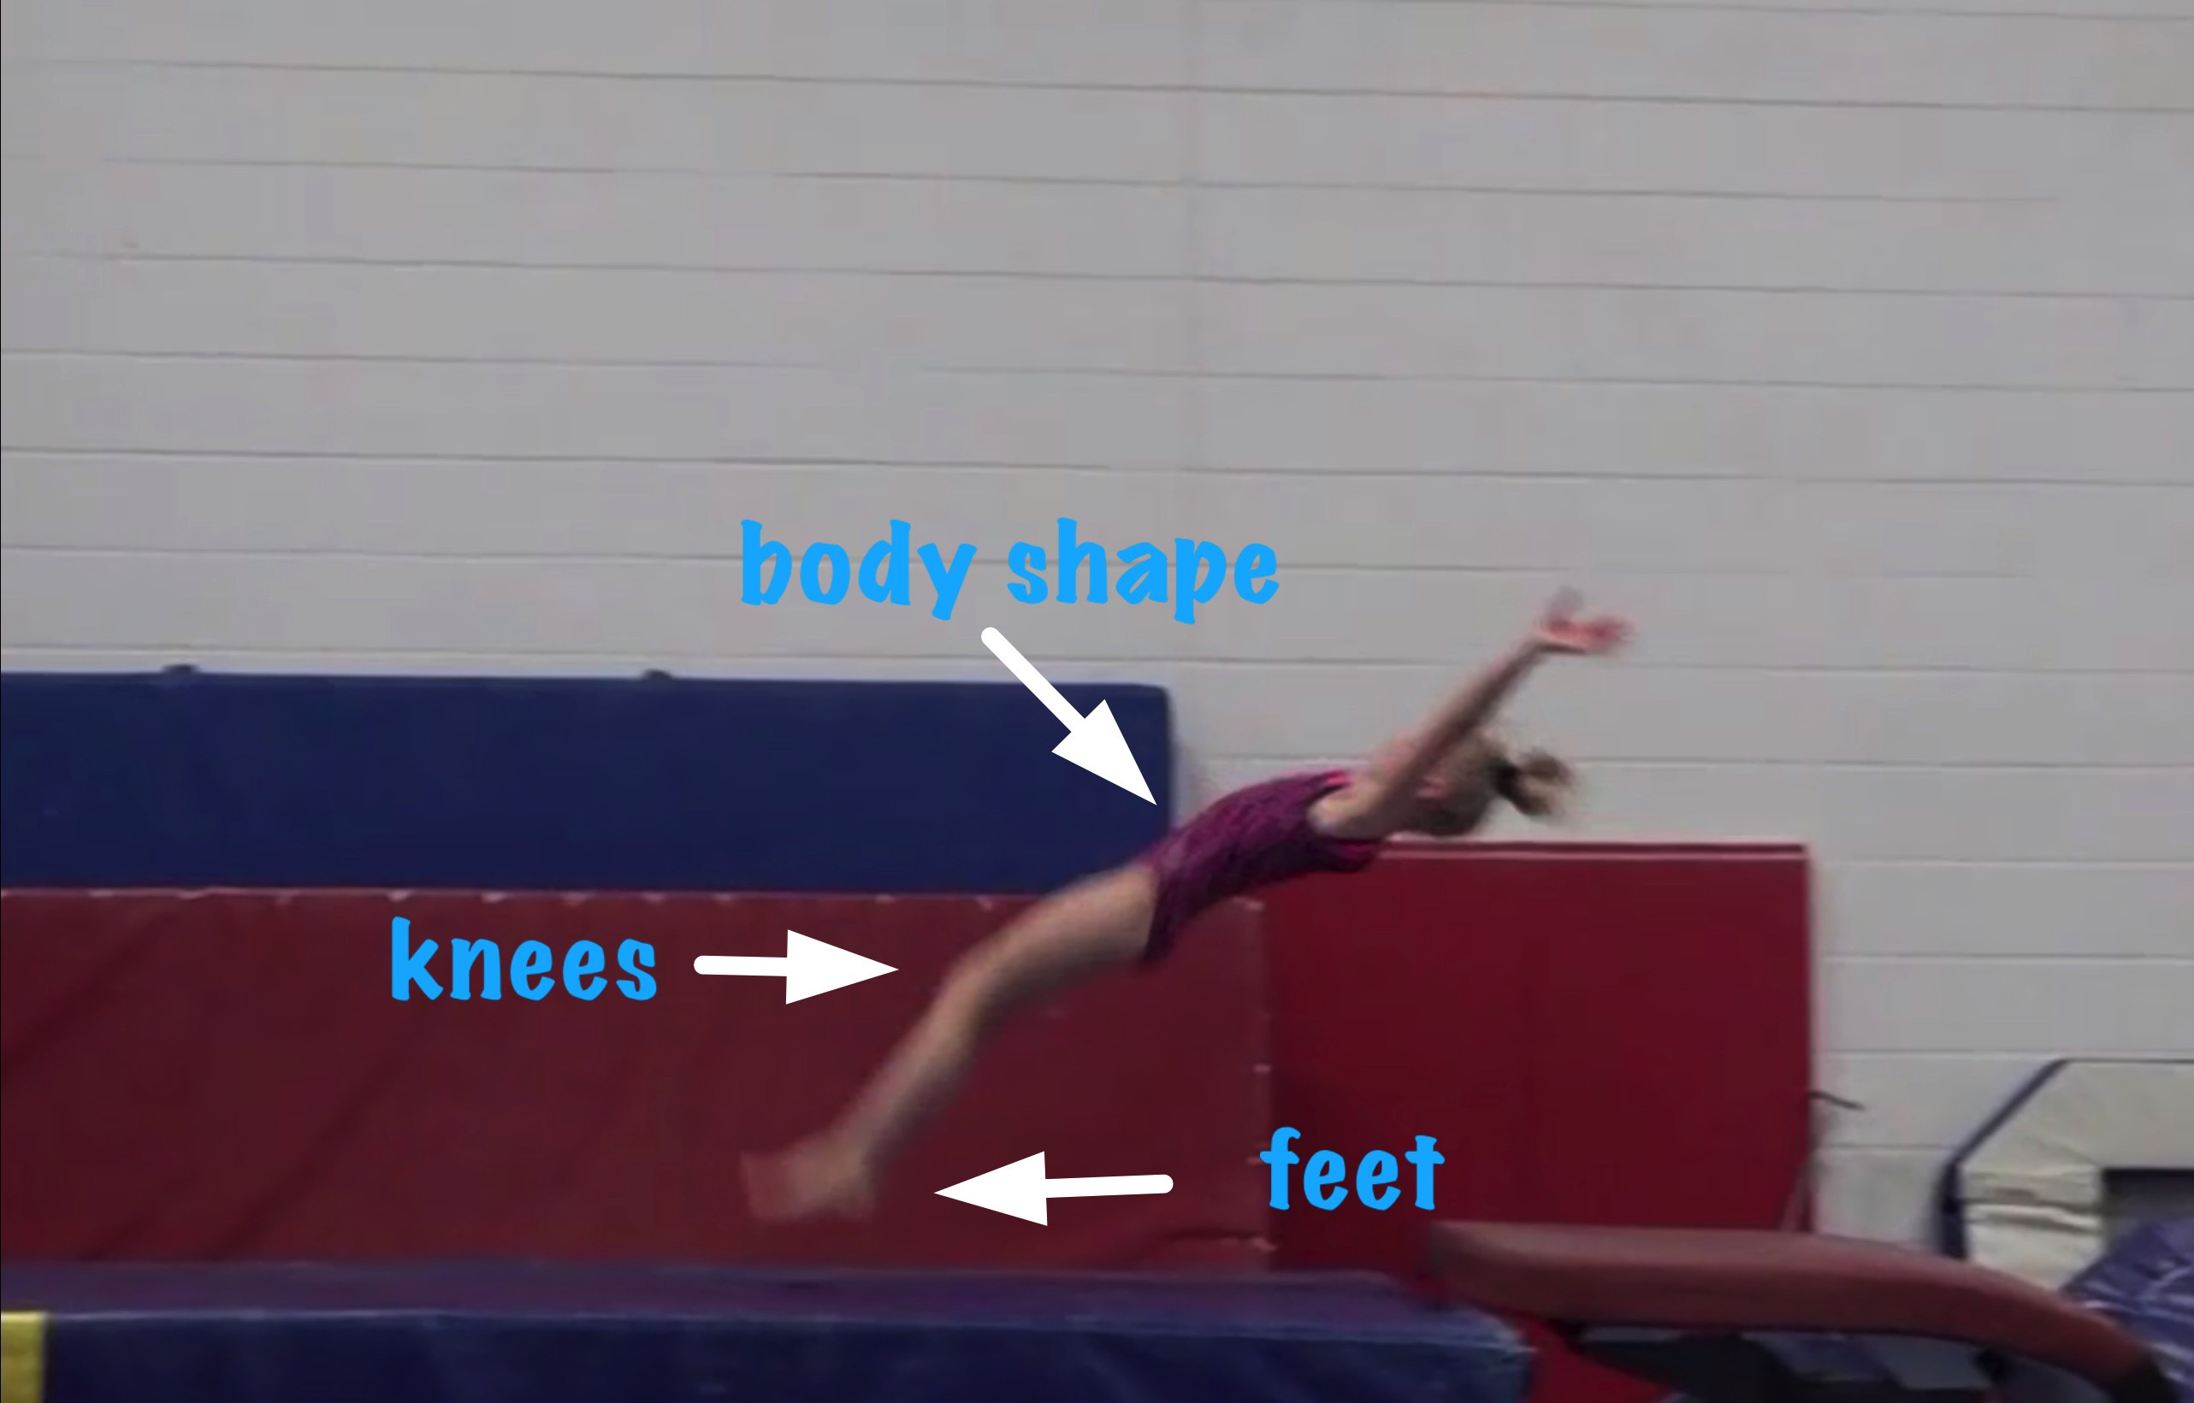
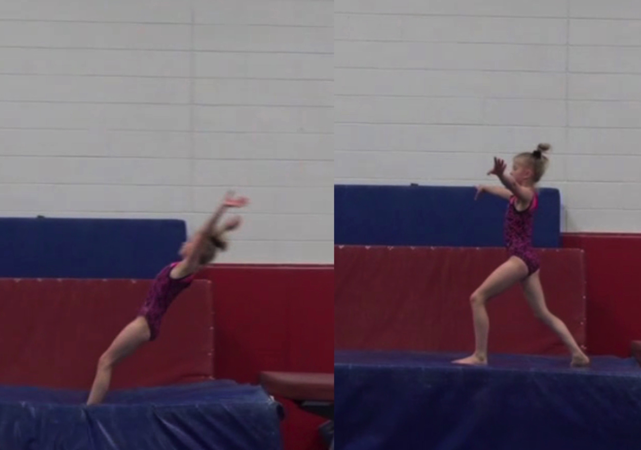
Handspring #12
Body Position in post flight
Posture on Contact & Distance

Slide 31
Handspring #12 UNOFFICIAL but Vetted Deductions Breakdown
Pre Flight Body Position: .2
Angle on: .2
In Support Body Position: .5
Angle off: .3
Time in Support: .3
Height: .4
Off Flight Body Position: .2
Posture on Landing: .1
Landing: .1
Distance: .2
Dynamics: .2
Score: 7.3
Look at the vault again and use the slider to view it in slow motion and study the corresponding deductions for each phase of the vault.

