Slide 1
Level 6/7 TSUKAHARA vault by Nawgj
Education committee August 2018
Films provided by nawgj libRARY
6/7 Tsukahara Parameters
•45 degree or less arrival angle
•Hollow BP in pre flight
•On Table hollow body position
•Off table at vertical
•Minimal time in support
•Maximum Height
•Hollow BP in post flight
•Good distance with good posture upon contact with mat.

Slide 2
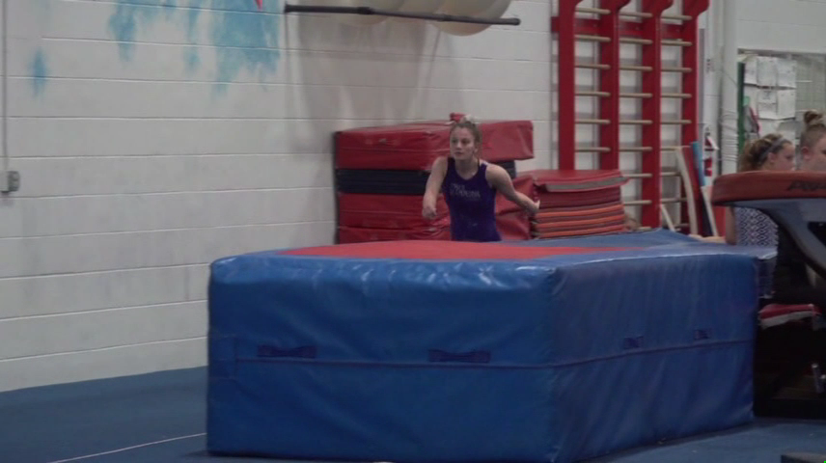
Current Tsukahara MODEL (NOT a 10.0!)

Slide 3
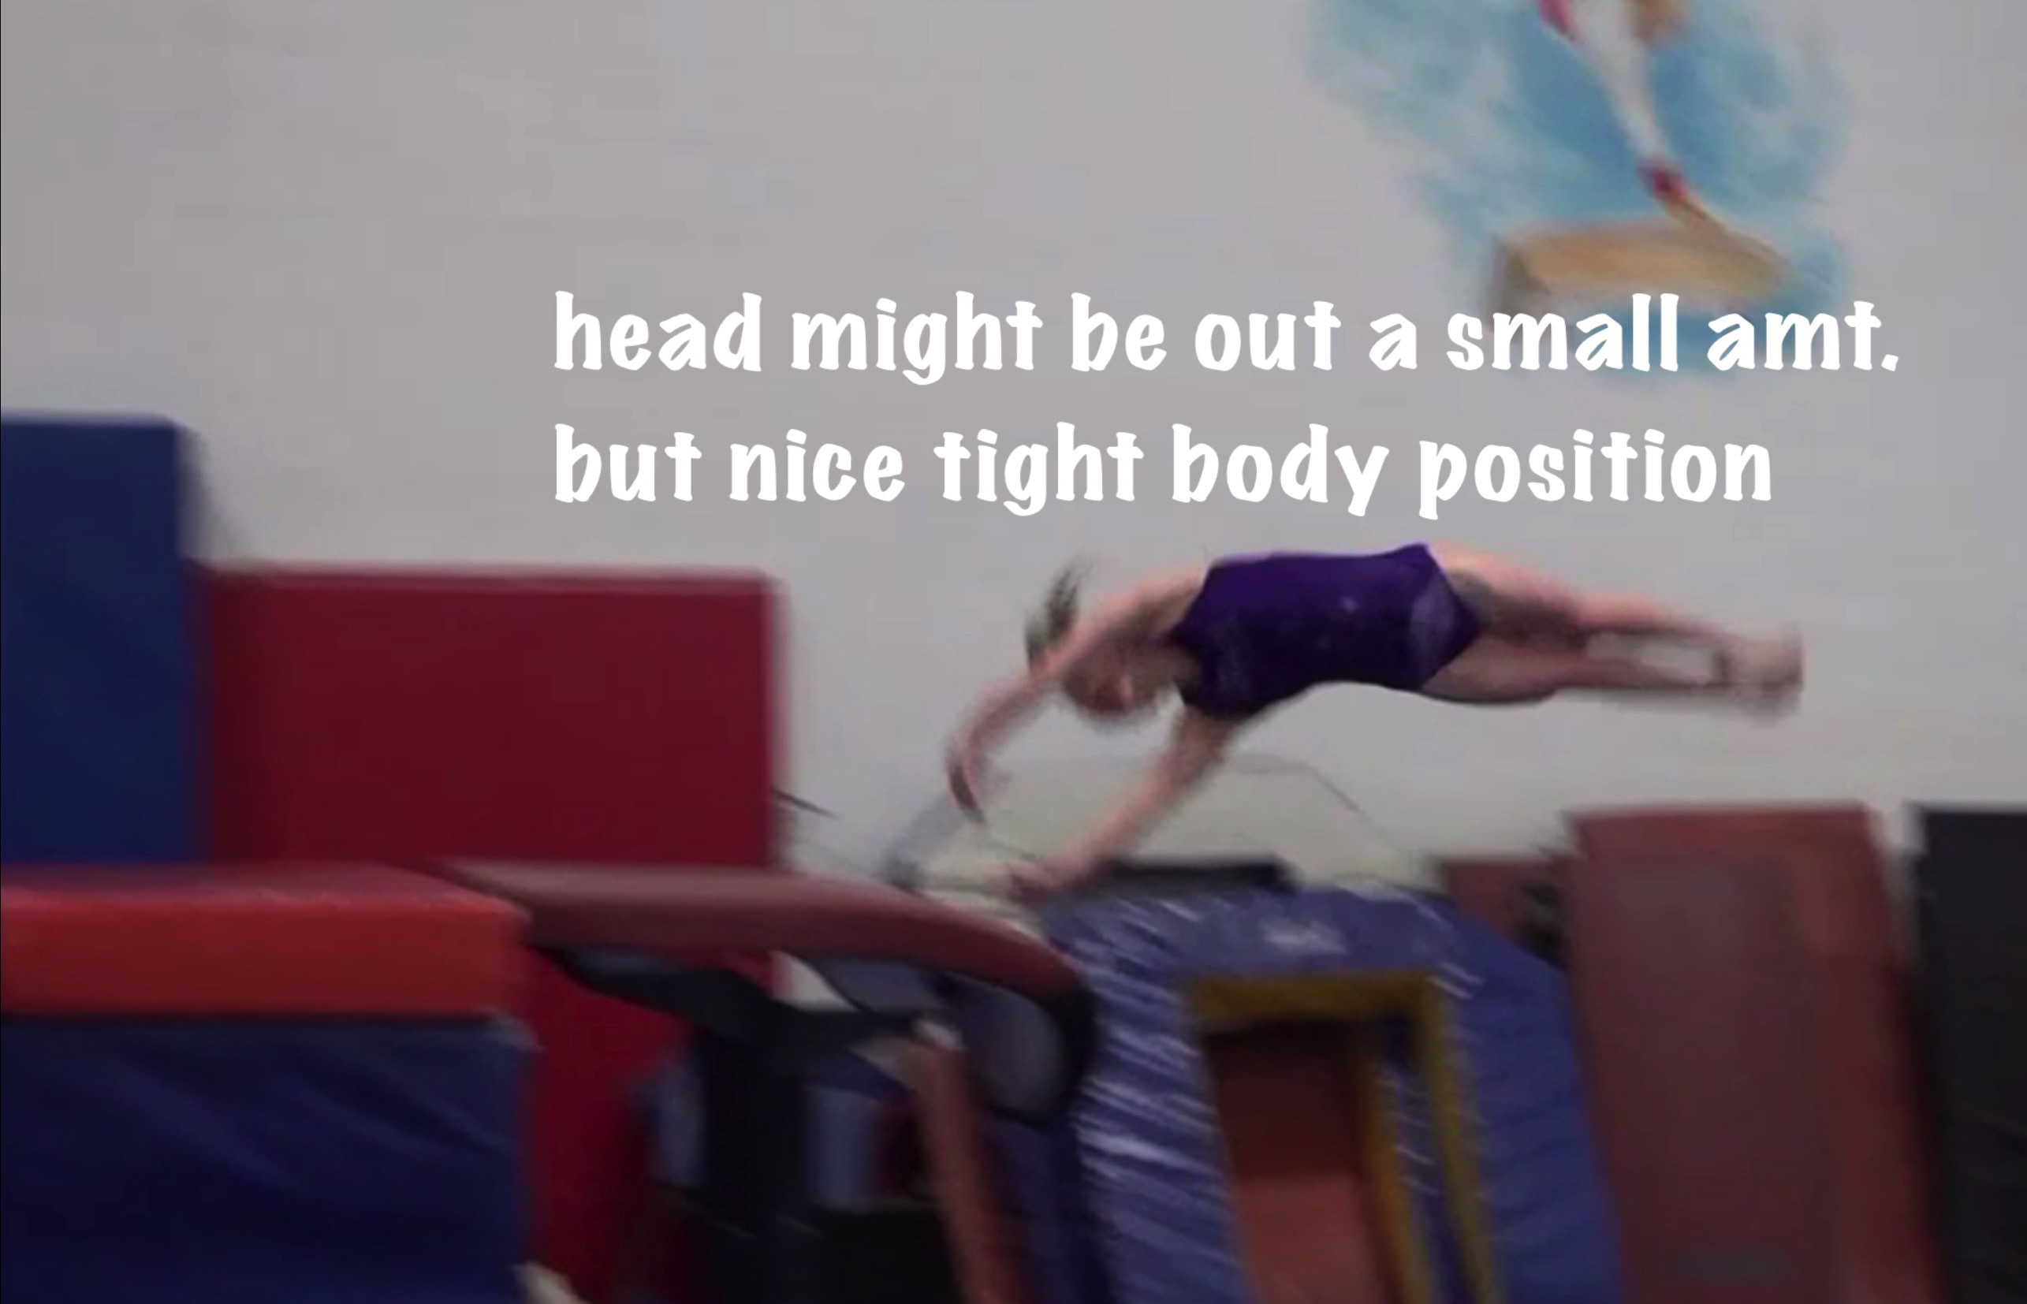
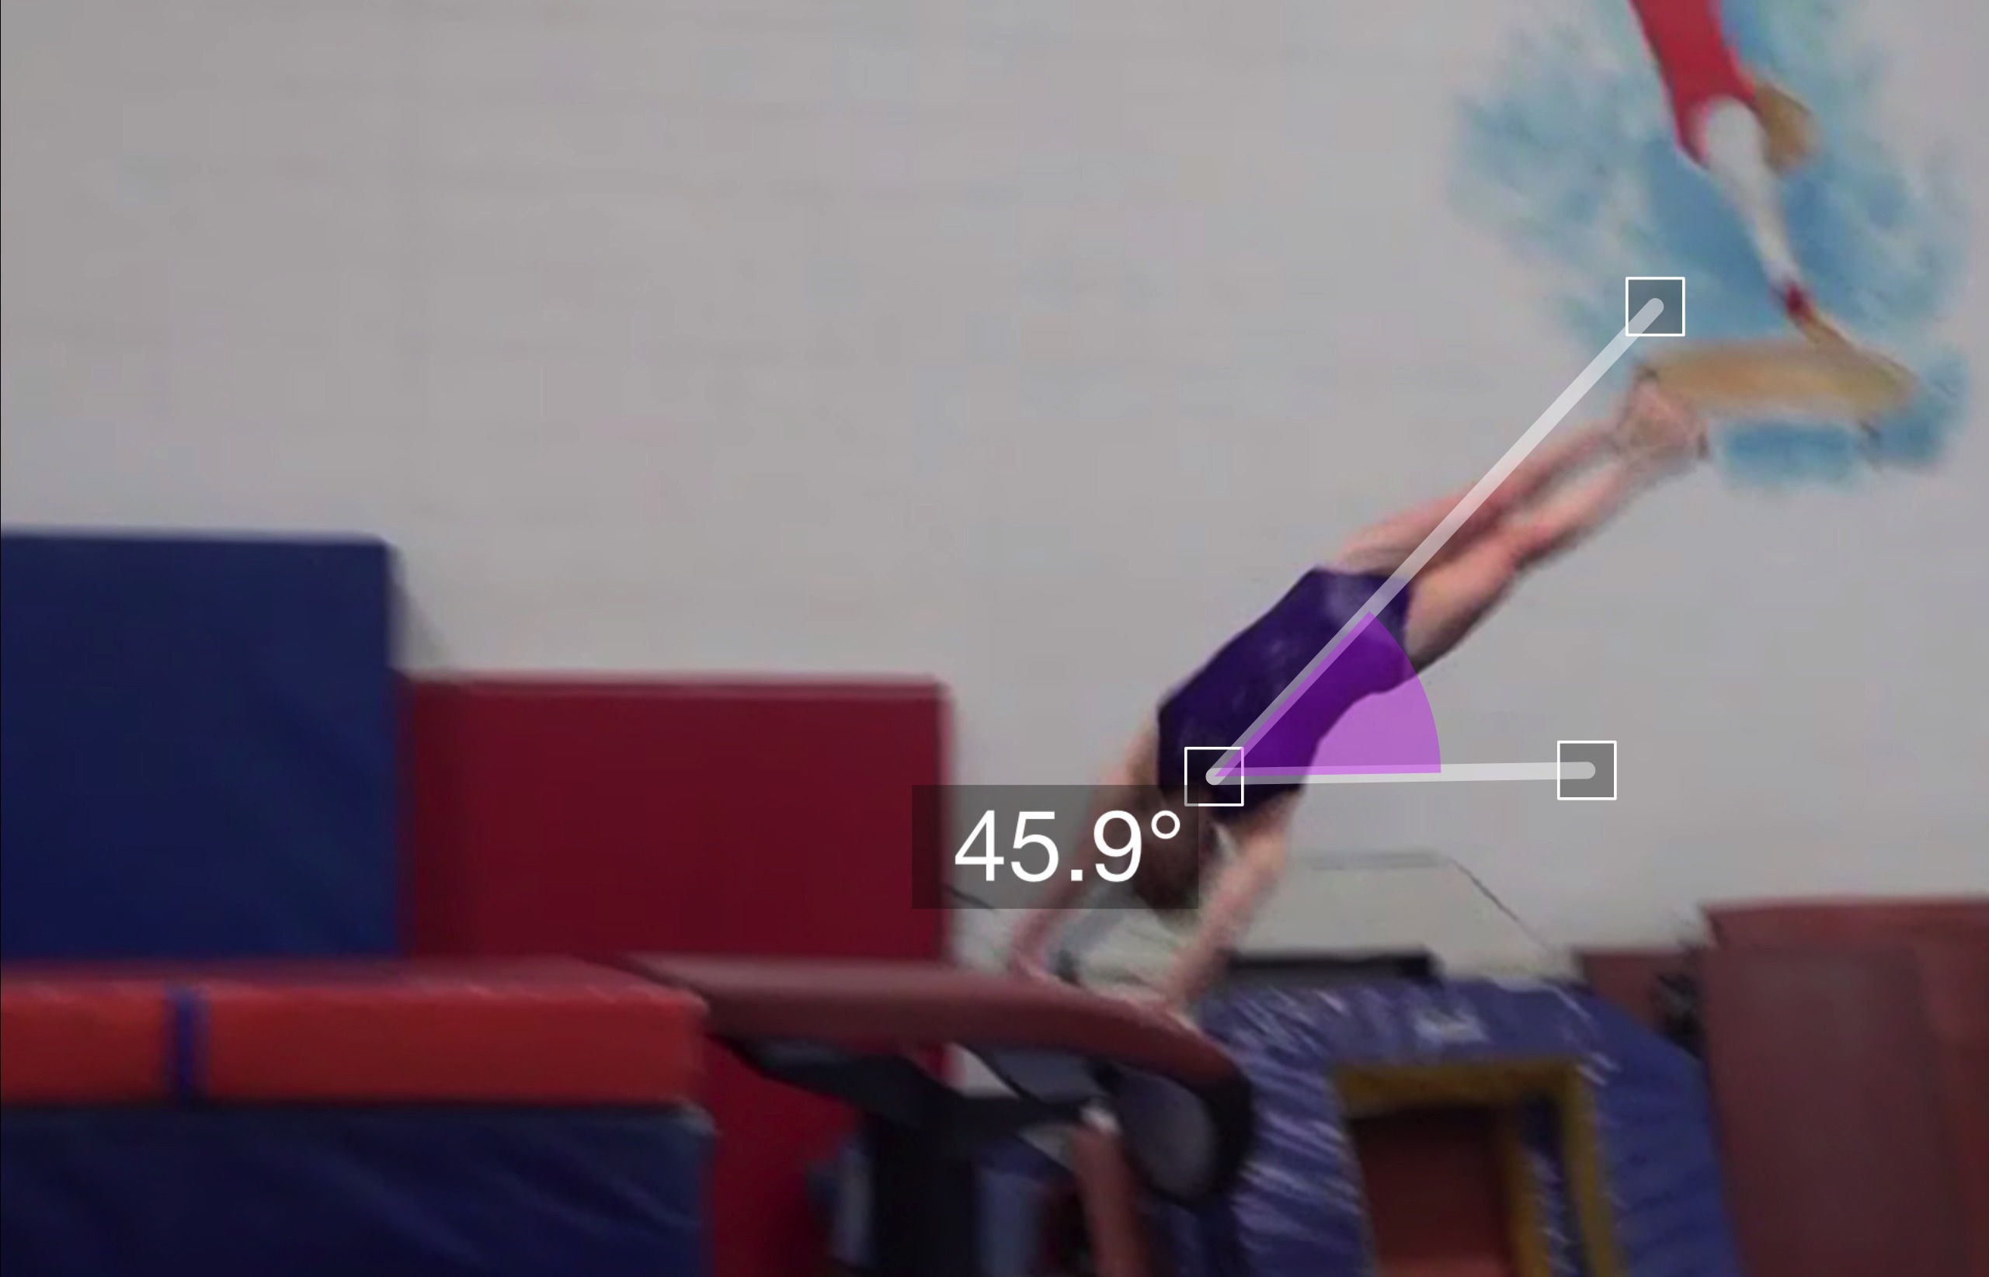
Tsukahara #11 model
(as is numbered on library dvd to correspond)
Pre Flight Body Position
Angle of Arrival
Notes:
The angle on is either measured from the shoulders through hips if a closed shoulder angle OR from hands through hips for an open shoulder angle. In this vault the shoulders are fairly open and so it could go hands through hips as well but the reality of our evaluation is what we take in as an angle in the space of a ”moment” with our protractor eye! Angle evaluation begins when the FIRST hand contacts the table. Some tsuk vaulters place their hands nearly simultaneously, like this vaulter. You can also see that she is on the very front portion of the table, making it possible to keep the angle low and get both hands on quickly.

Slide 4
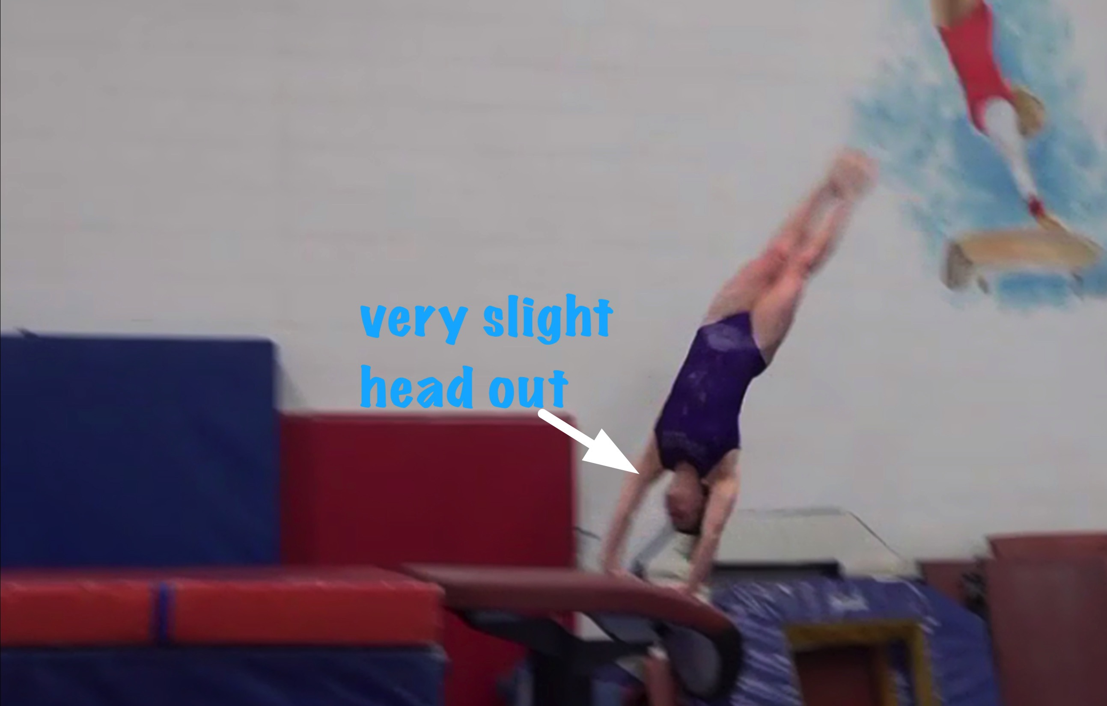
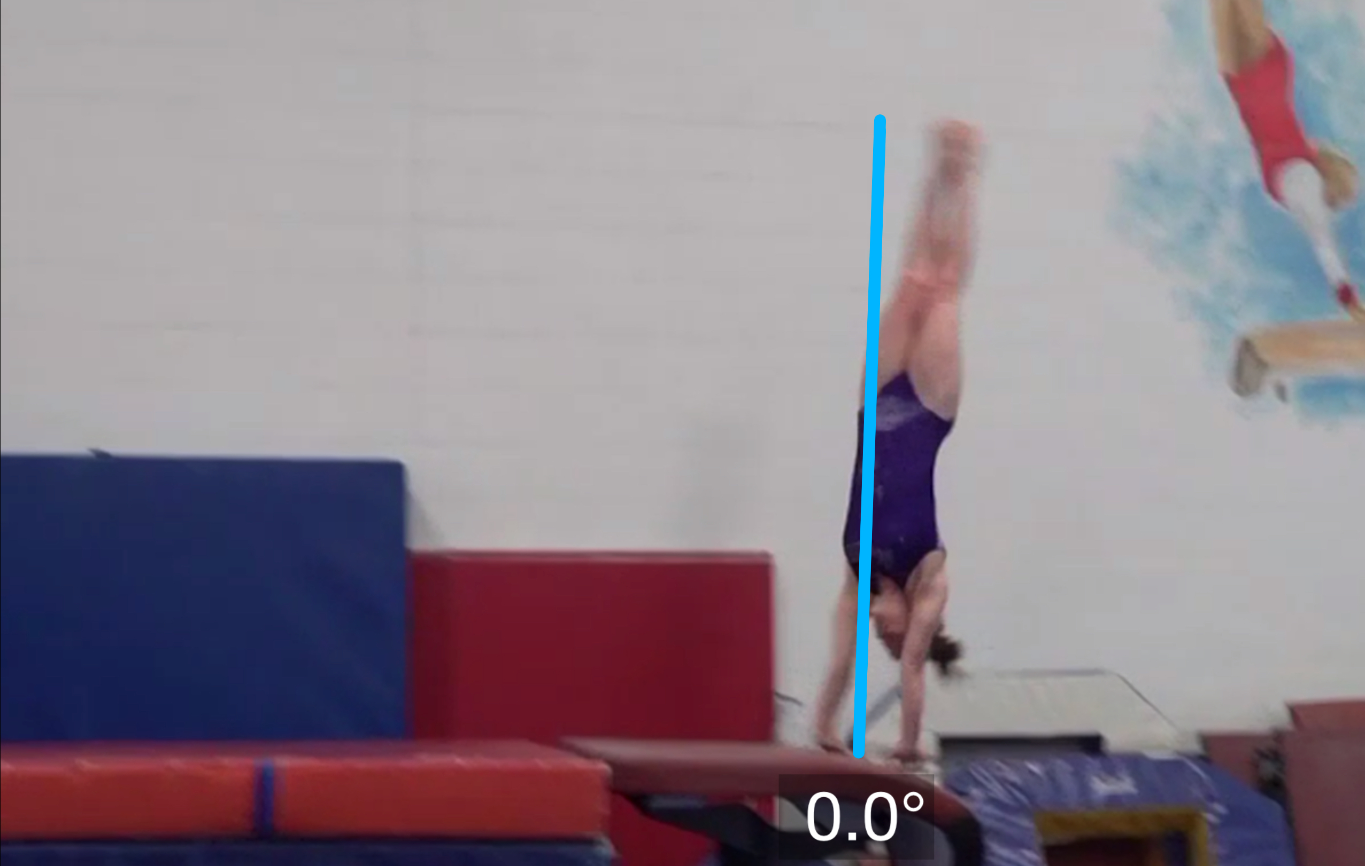
Tsukahara #11 model
Angle off the Table and corresponding Time in Support
Body Position in Support
Notes:
Result was no deduction for head out – in regular speed this looks fine and was very slight to begin with even in a still shot.

Slide 5
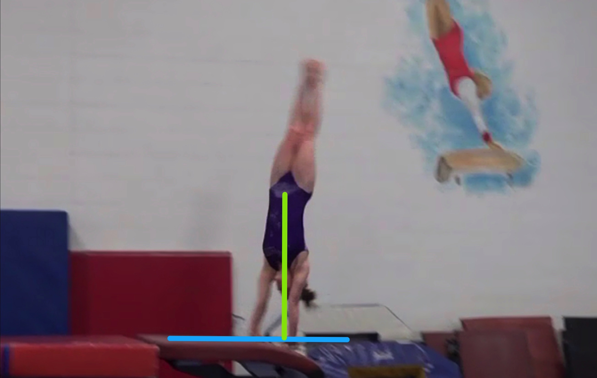
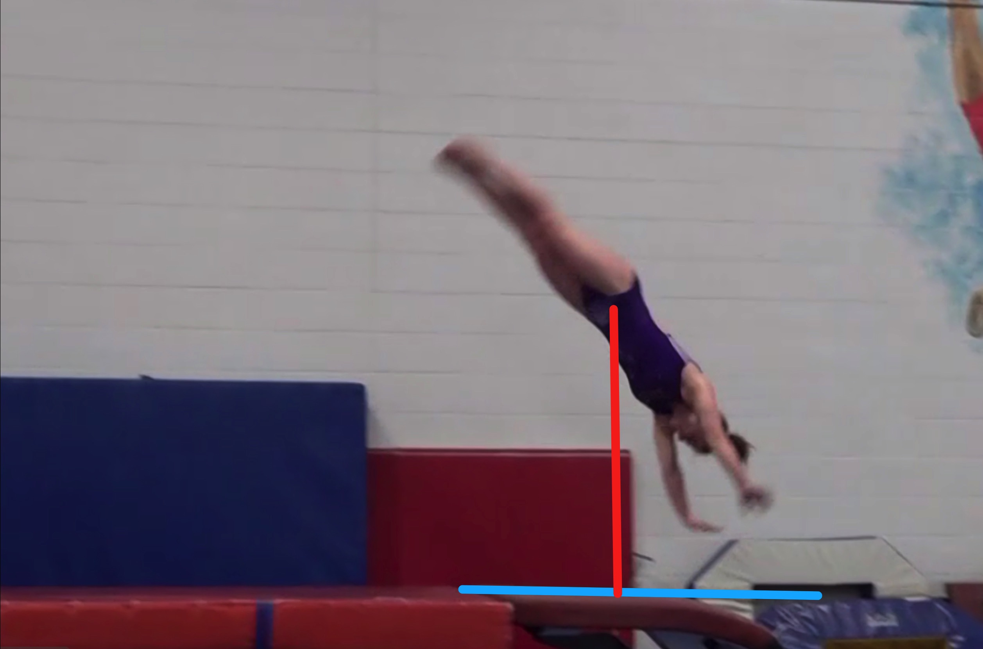
Tsukahara #11 model
Height Baseline (measured from table to center of gravity when inverted at moment of repulsion.
Height Achieved (compare red line to green line after lining up blue table height line for accurate comparison.

Slide 6
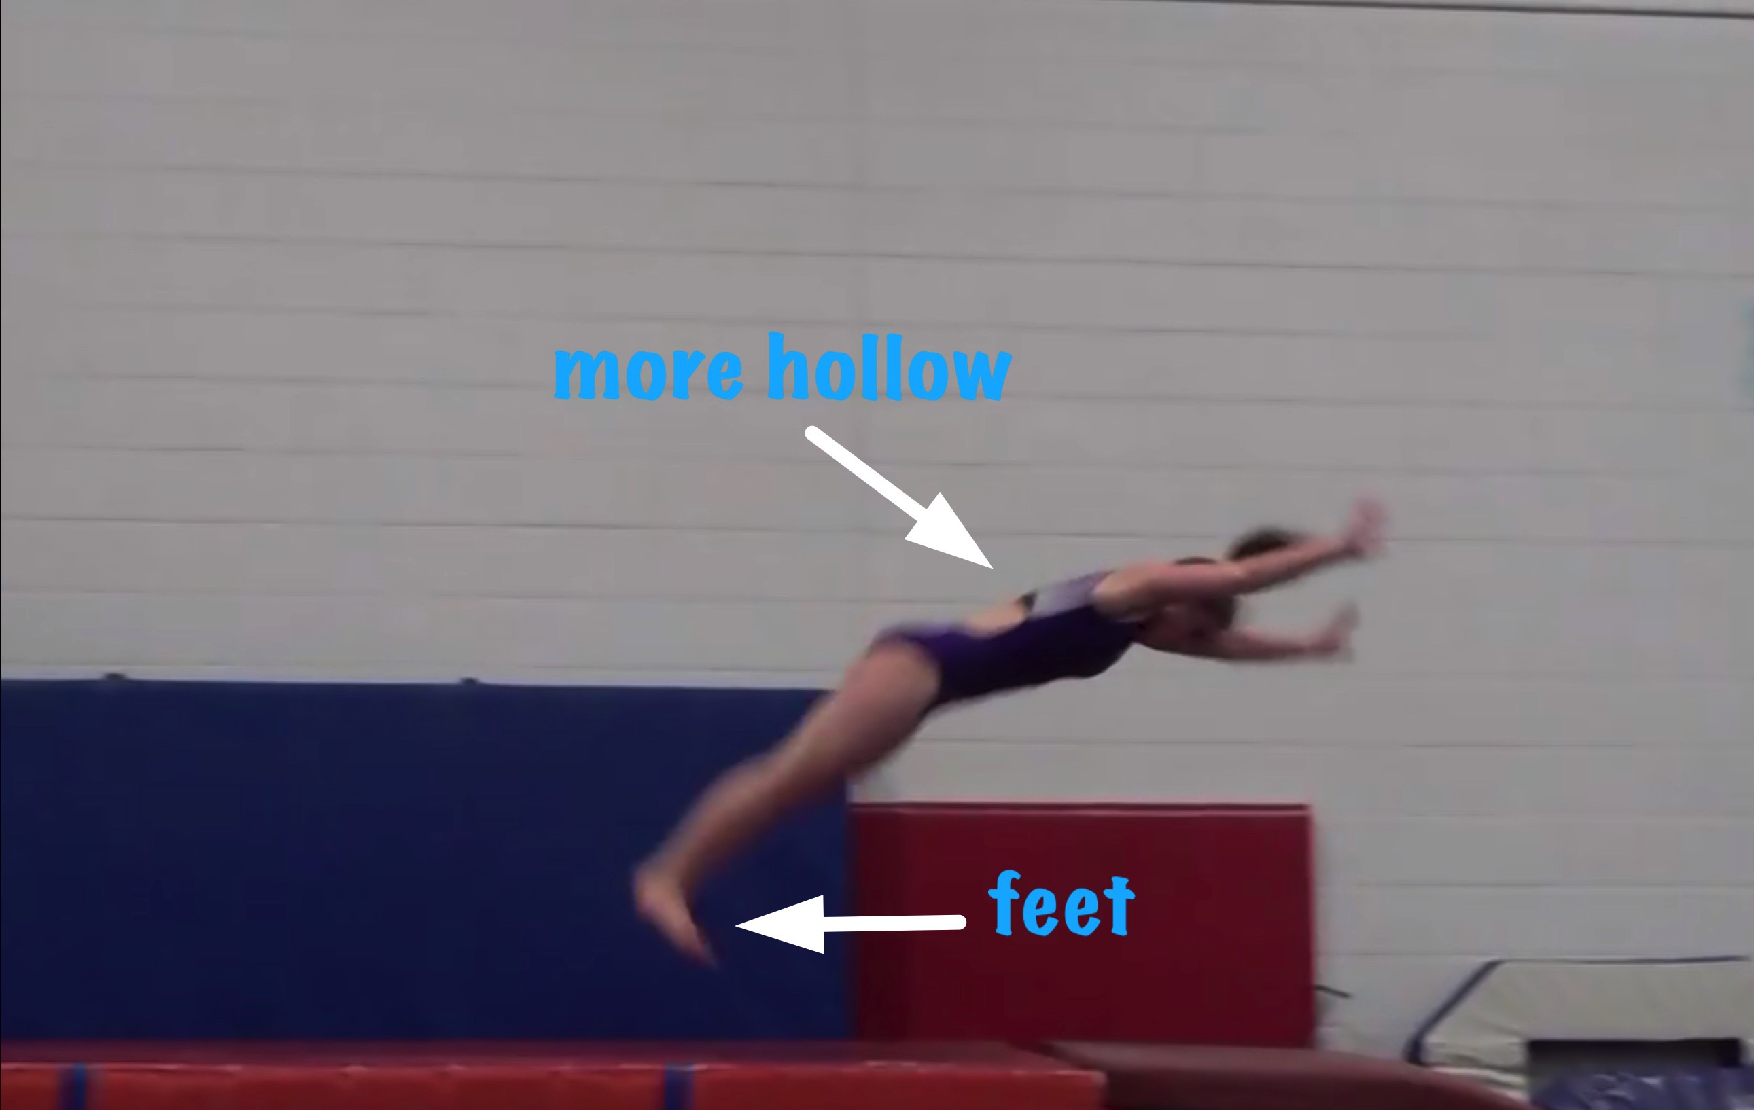
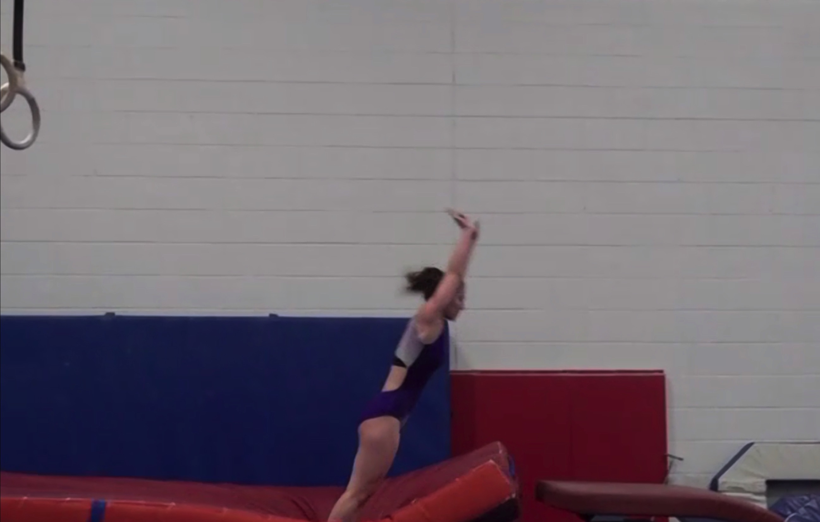
Tsukahara #11 model
Body Position in post flight
Posture on Contact & Distance

Slide 7
“Model” UNOFFICIAL Vetted Deductions Breakdown
Pre Flight Body Position: .05
Angle on: 0
In Support Body Position: 0
Angle off: 0
Time in Support: 0
Height: .2
Off Flight Body Position: .2
Posture on Landing: 0
Landing: 0
Distance: .05
Dynamics: 0
Score: 9.45
Look at the vault again and use the slider to view it in slow motion and study the corresponding deductions for each phase of the vault.

Slide 8
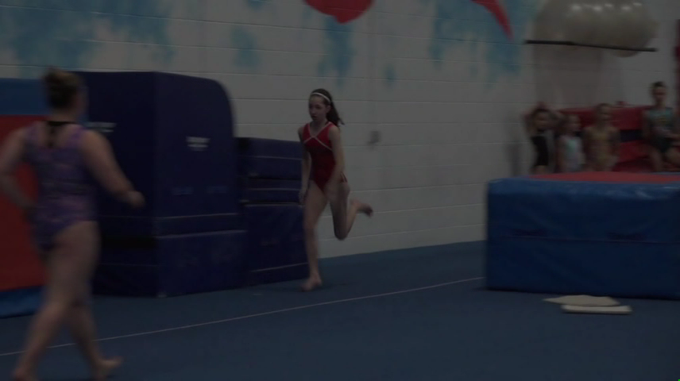
Tsukahara #8
Tsukahara #8 – compare to model at right.
Tsukahara #11 MODEL – compare to Tsuk #8 at left

Slide 9
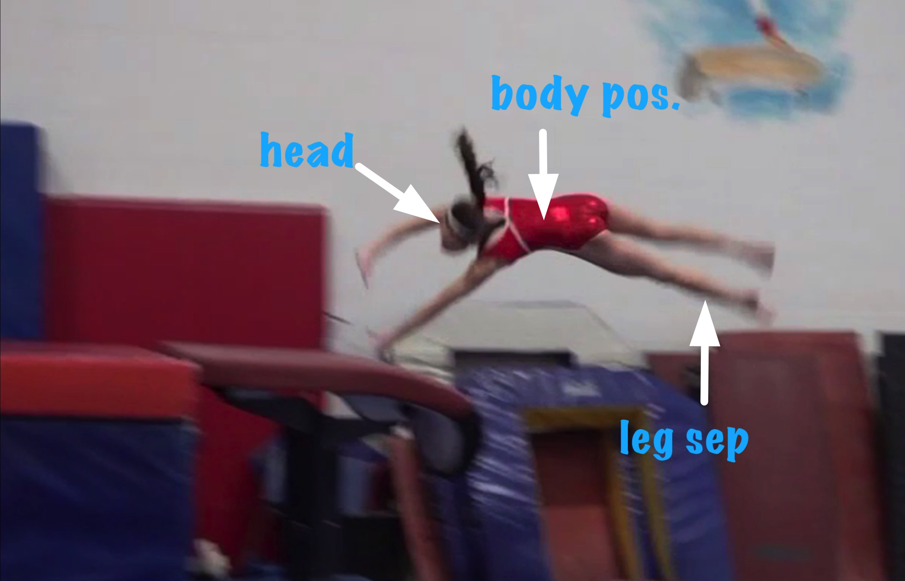
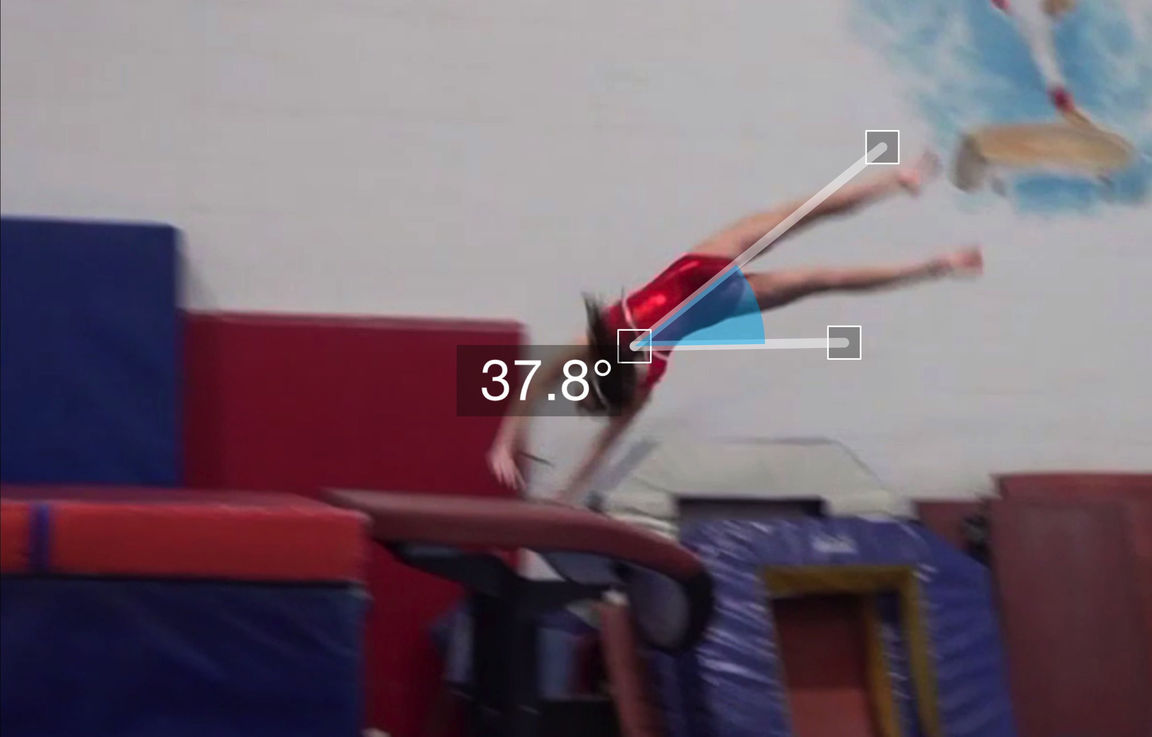
Tsukahara #8
(as is numbered on library dvd to correspond)
Pre Flight Body Position
Angle of Arrival

Slide 10
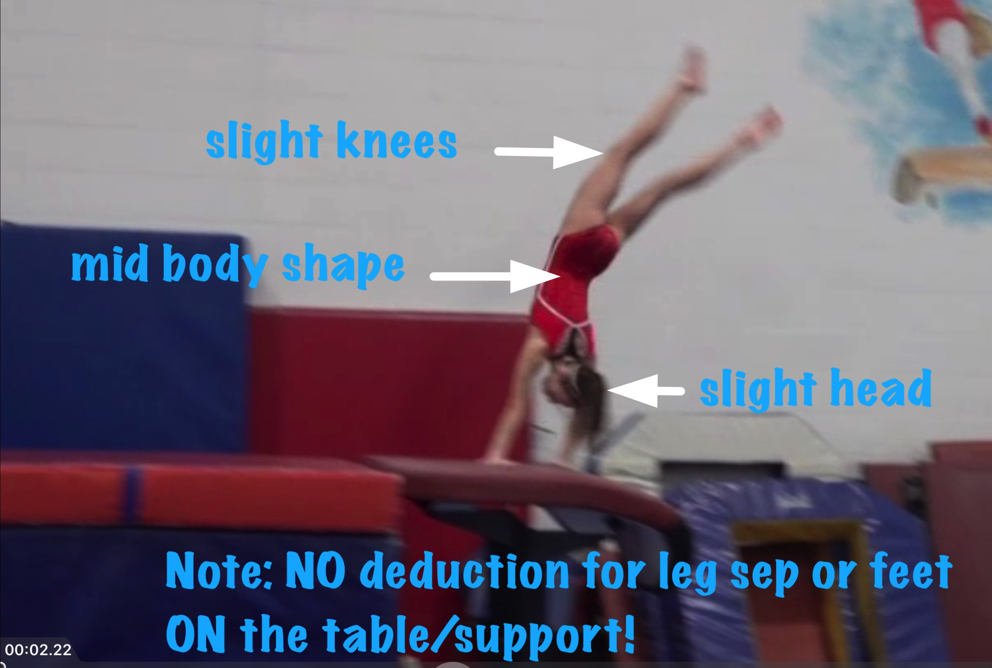
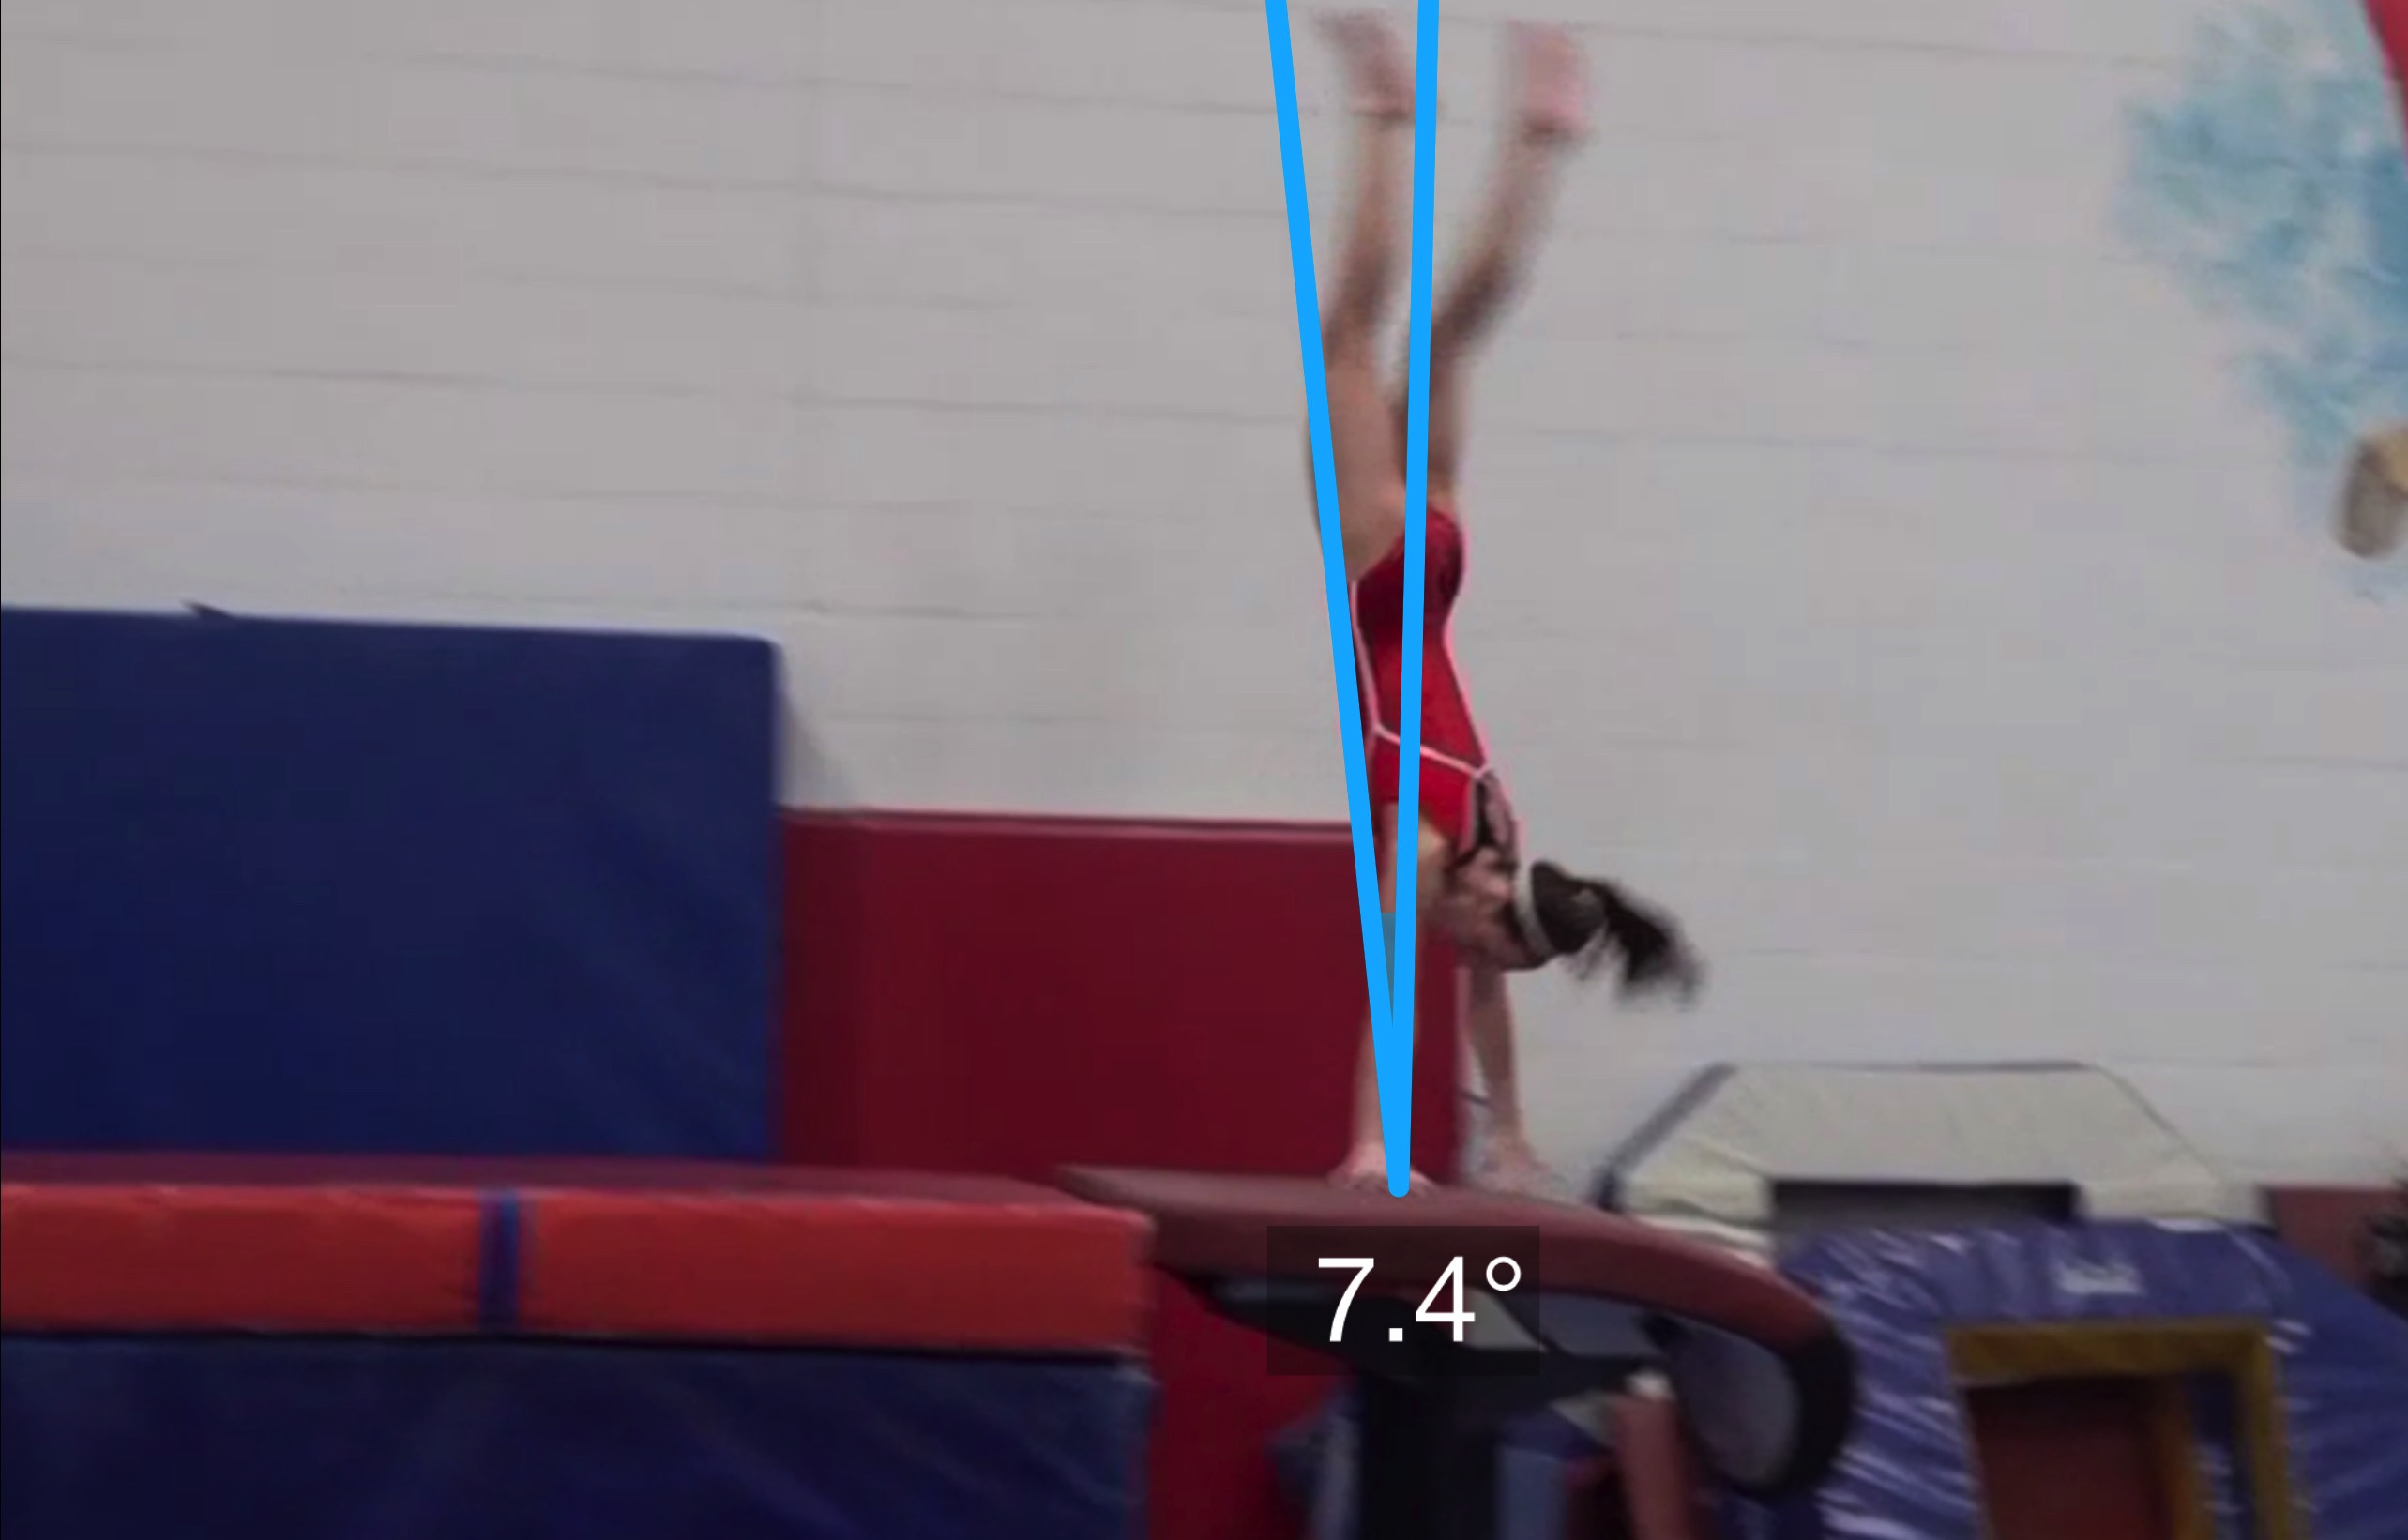
Tsukahara #8
Angle off the Table and corresponding Time in Support
Body Position in Support

Slide 11
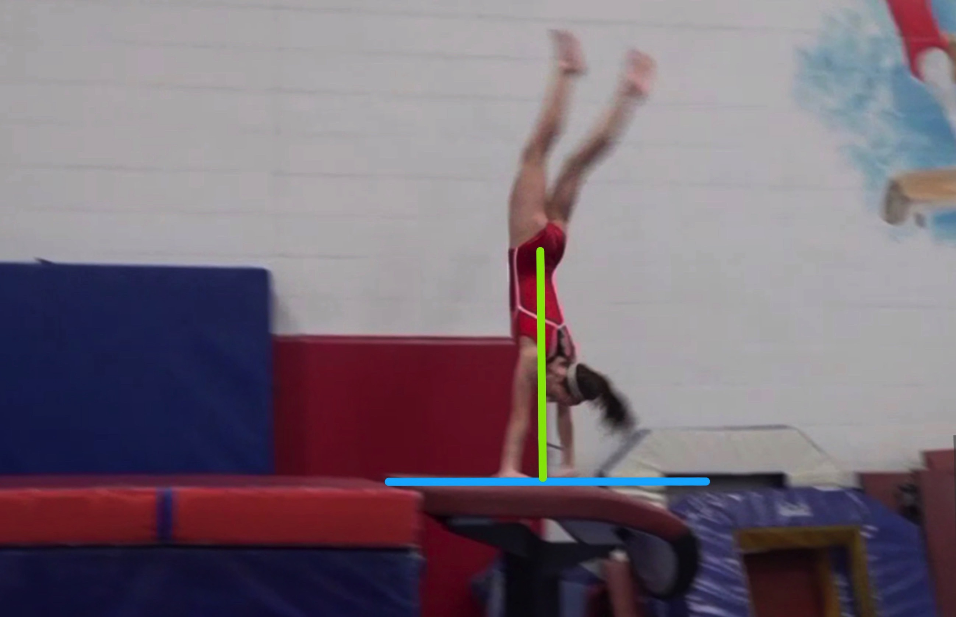
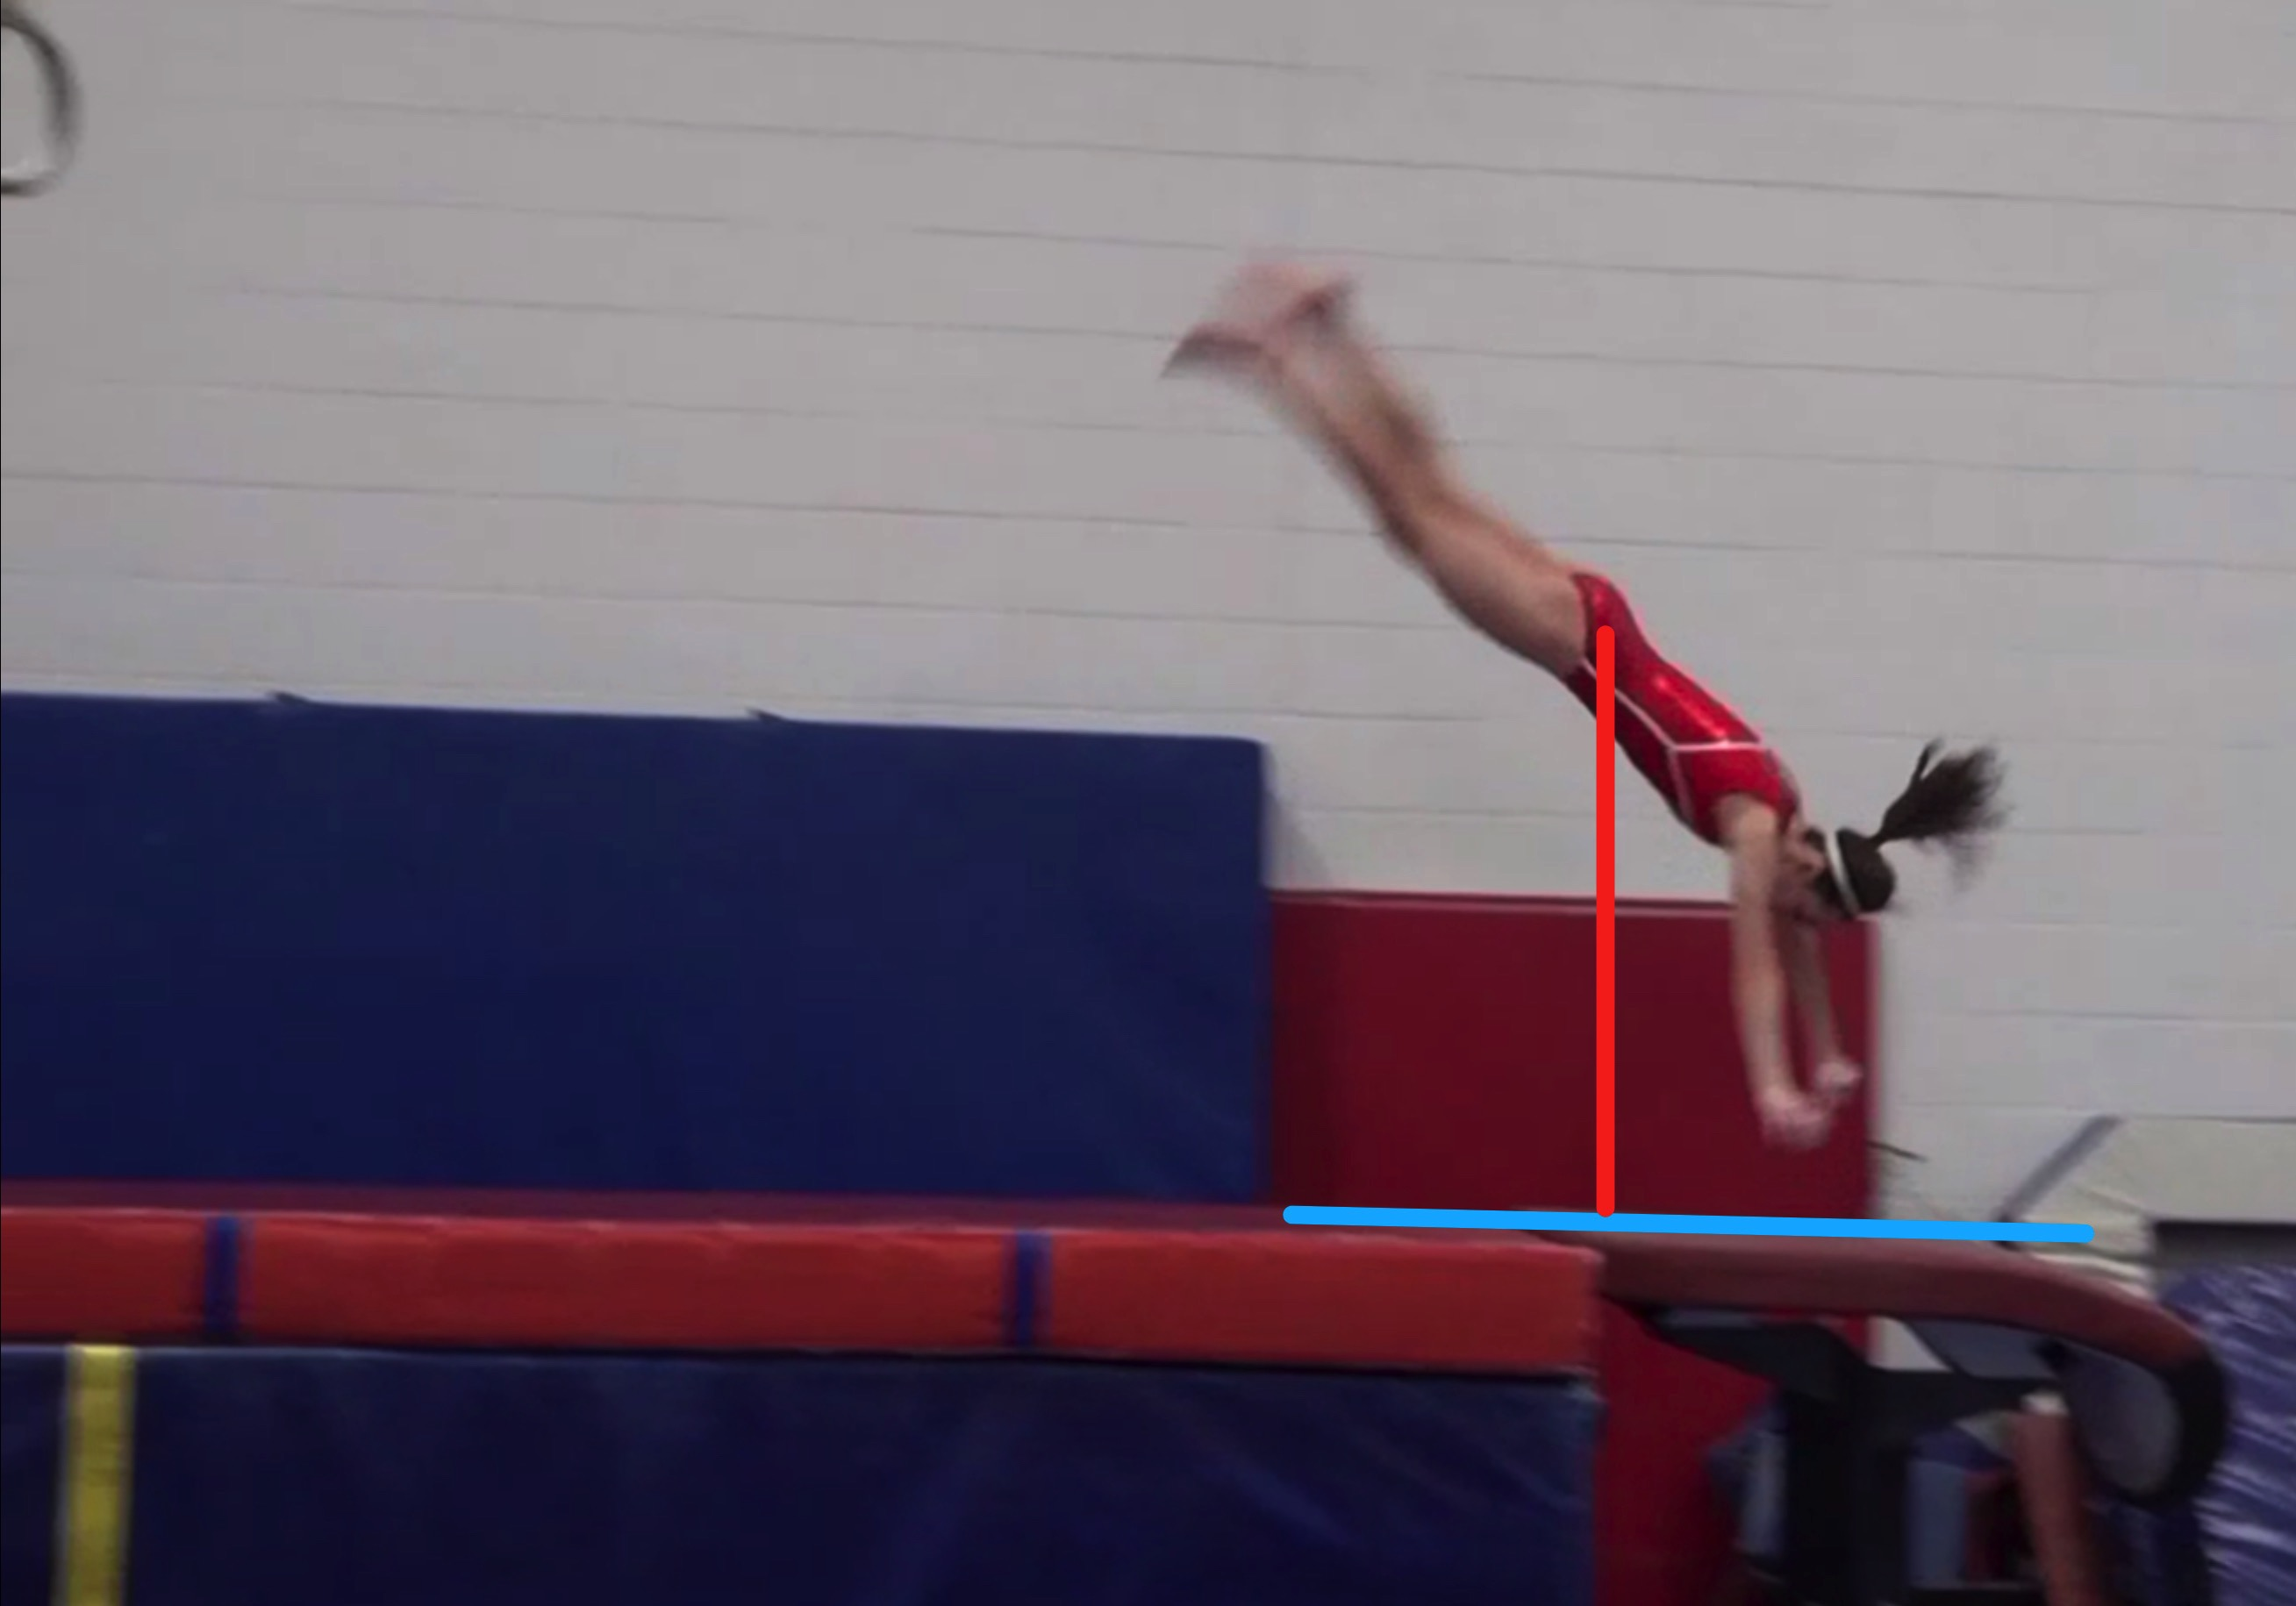
Tsukahara #8
Height Baseline (measured from table to center of gravity when inverted at moment of repulsion.
Height Achieved (compare red line to green line after lining up blue table height line for accurate comparison.

Slide 12
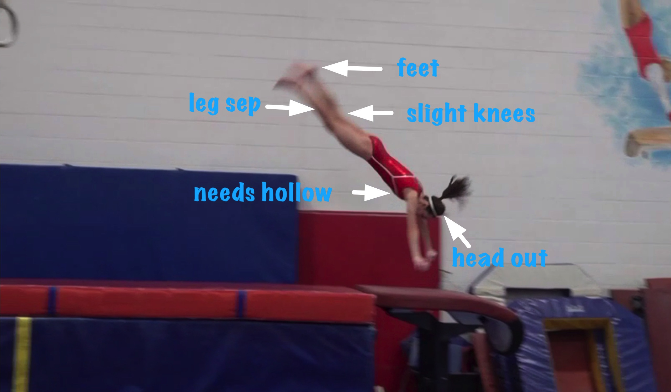
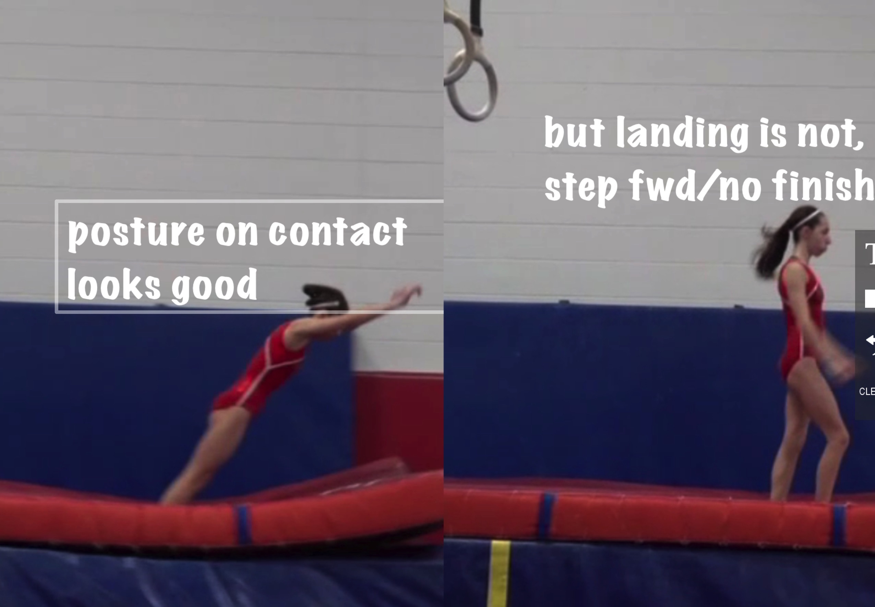
Tsukahara #8
Body Position in post flight
Posture on Contact & Distance

Slide 13
Tsuk #8 UNOFFICIAL Vetted Deductions Breakdown
Pre Flight Body Position: .3
Angle on: 0
In Support Body Position: .25
Angle off: .2
Time in Support: .1
Height: .4
Off Flight Body Position: .3
Posture on Landing: .1
Landing: 0
Distance: .05
Dynamics: .2
Score: 8.1
Look at the vault again and use the slider to view it in slow motion and study the corresponding deductions for each phase of the vault.

Slide 14
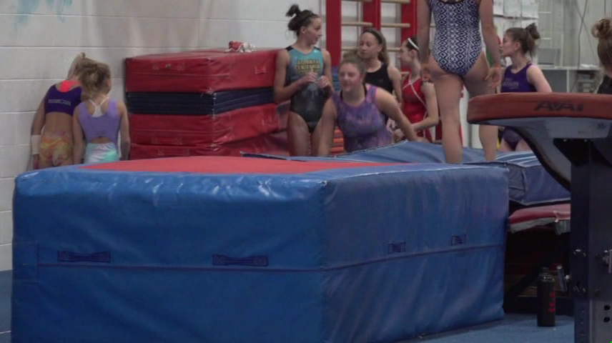
Tsukahara #5
Tsukahara #5 – compare to model at right.
Tsukahara #11 MODEL – compare to Tsuk #8 at left

Slide 15
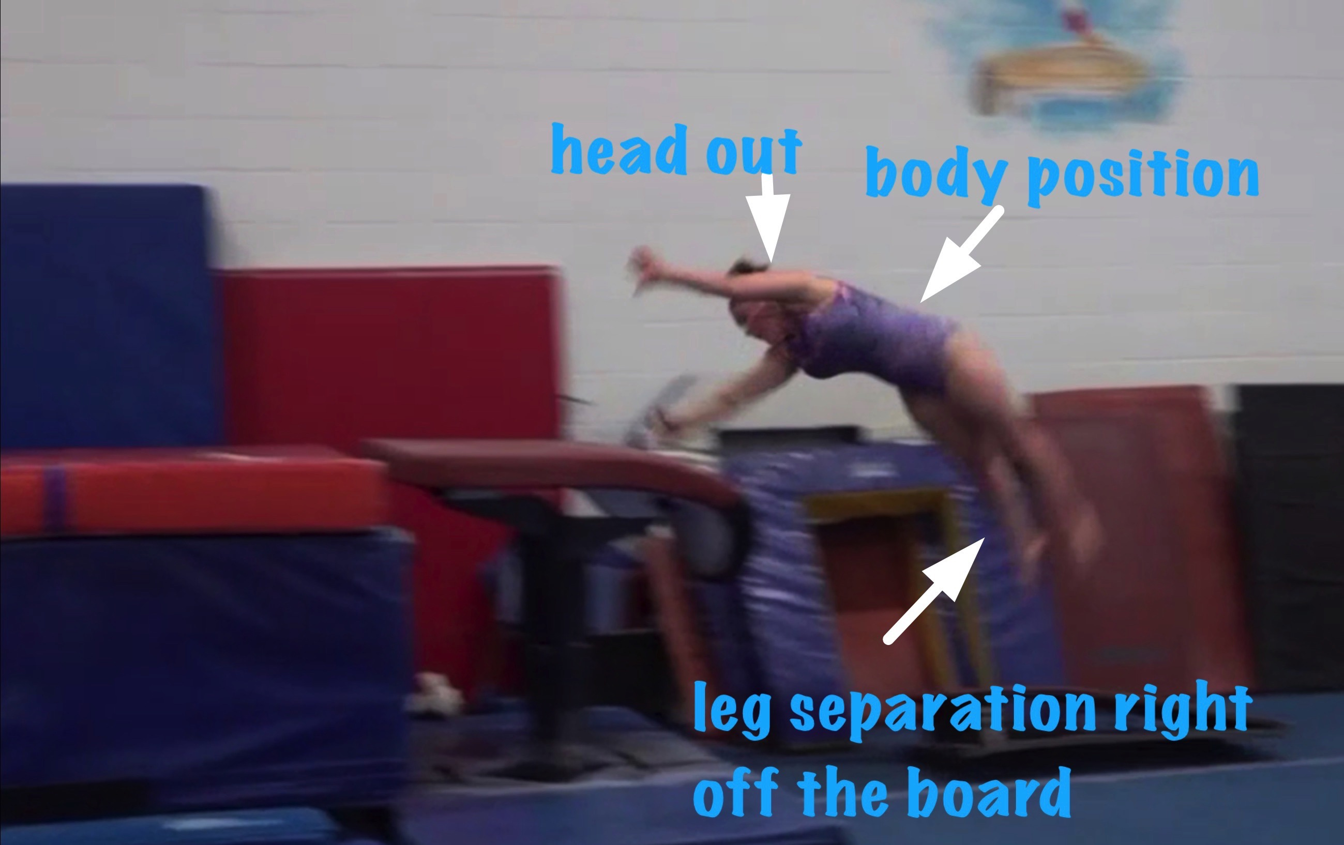
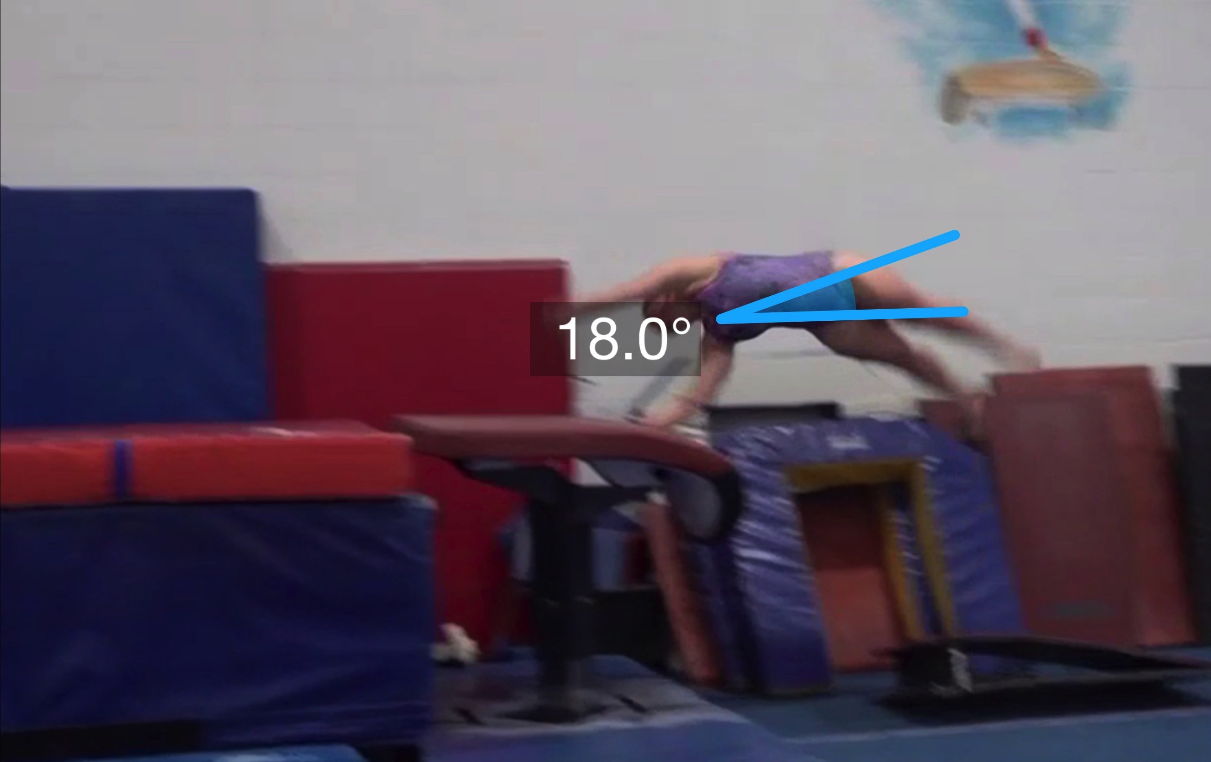
Tsukahara #5
(as is numbered on library dvd to correspond)
Pre Flight Body Position
Angle of Arrival

Slide 16
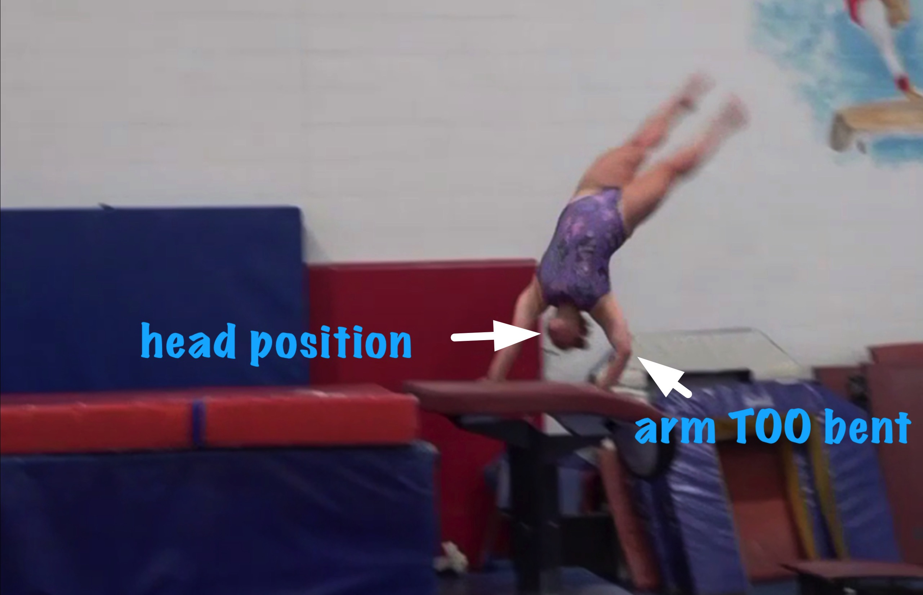
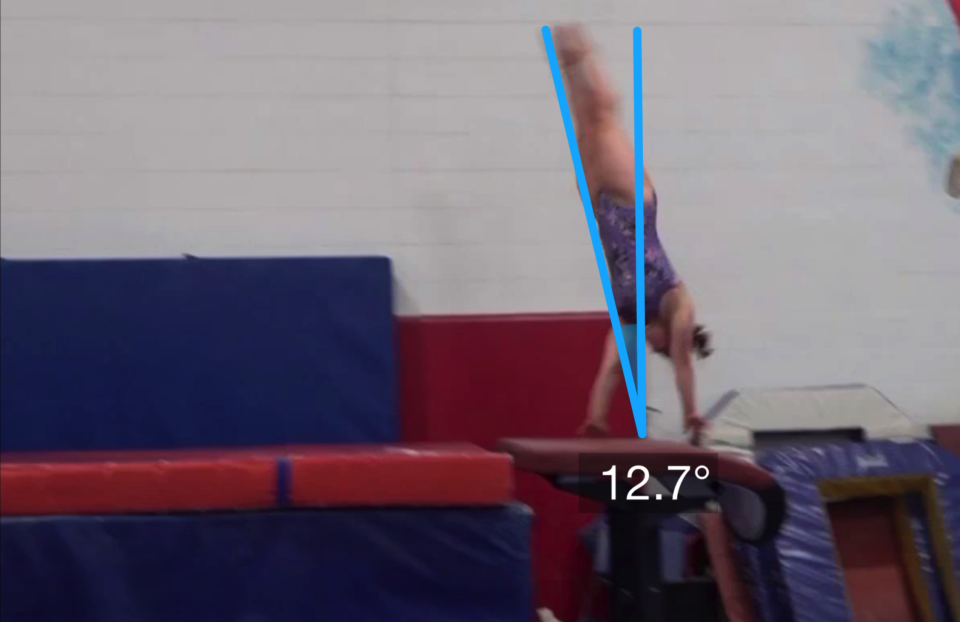
Tsukahara #5
Angle off the Table and corresponding Time in Support
Body Position in Support

Slide 17
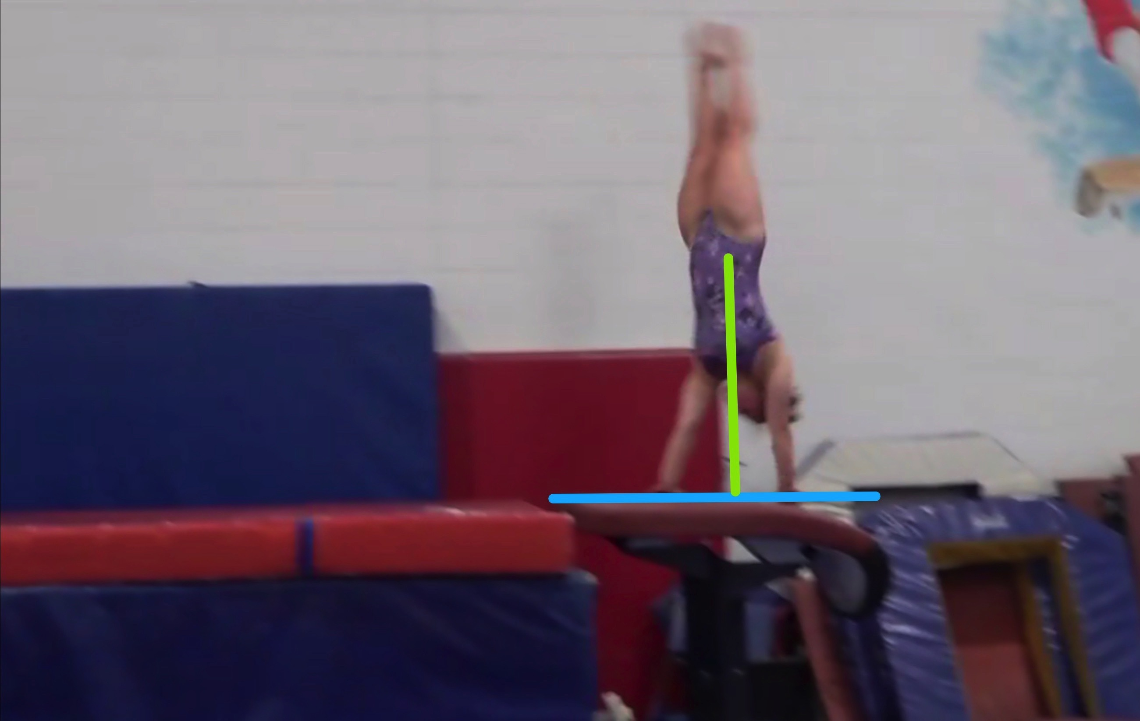
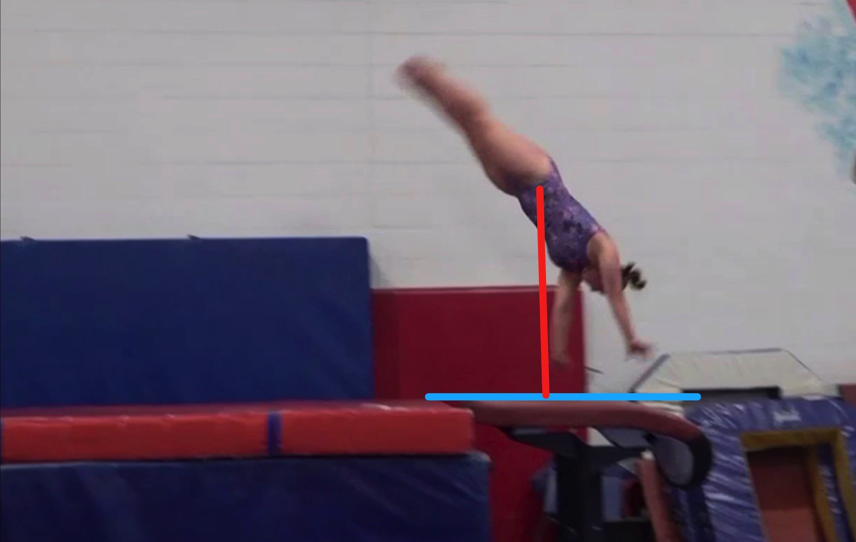
Tsukahara #5
Height Baseline (measured from table to center of gravity when inverted at moment of repulsion.
Height Achieved (compare red line to green line after lining up blue table height line for accurate comparison.

Slide 18
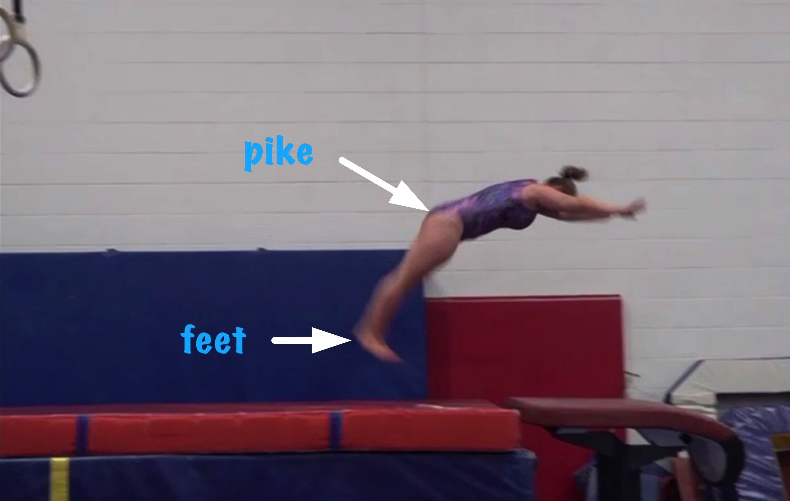
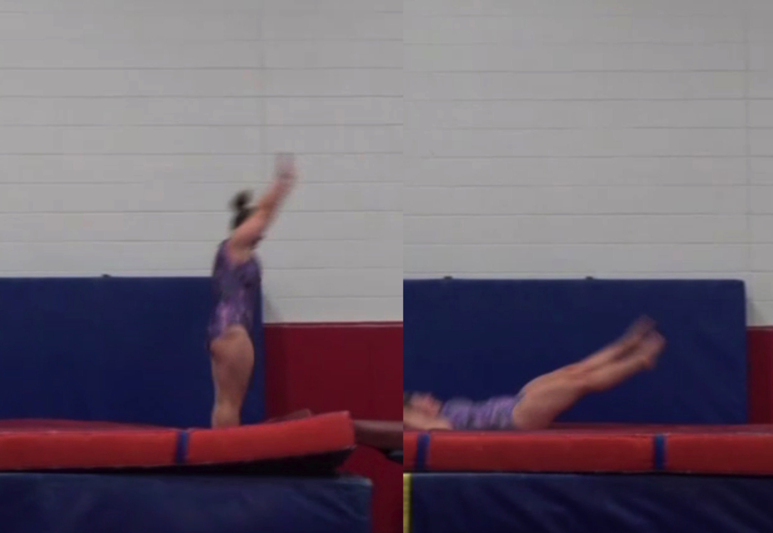
Tsukahara #5
Body Position in post flight
Posture on Contact & Distance
Notes:
Slide for posture on contact went too far into the touch down – if caught just a bit earlier one would see a very slight shaping/stretch error.

Slide 19
Tsuk #5 UNOFFICIAL Vetted Deductions Breakdown
Pre Flight Body Position: .3
Angle on: 0
In Support Body Position: .2
Angle off: .1
Time in Support: .1
Height: .25
Off Flight Body Position: .3
Posture on Landing: .05
Landing: 0
Distance: .15
Dynamics: .2
Score: 8.35
Look at the vault again and use the slider to view it in slow motion and study the corresponding deductions for each phase of the vault.

Slide 20
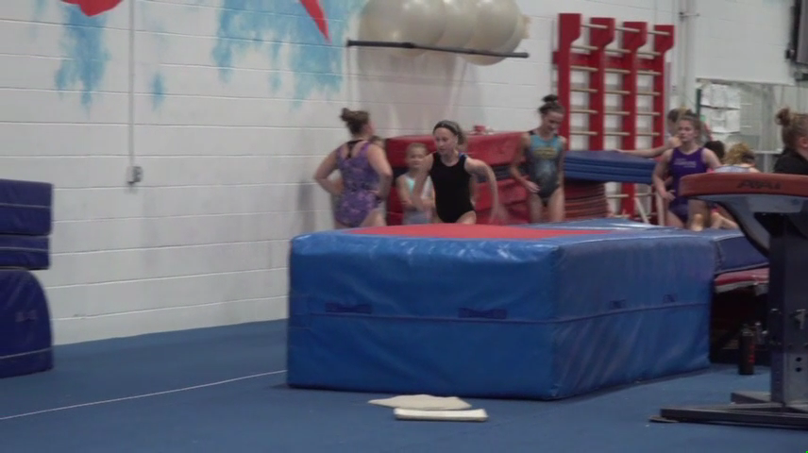
Tsukahara #4
Tsukahara #4 – compare to model at right.
Tsukahara #11 MODEL – compare to Tsuk #8 at left

Slide 21
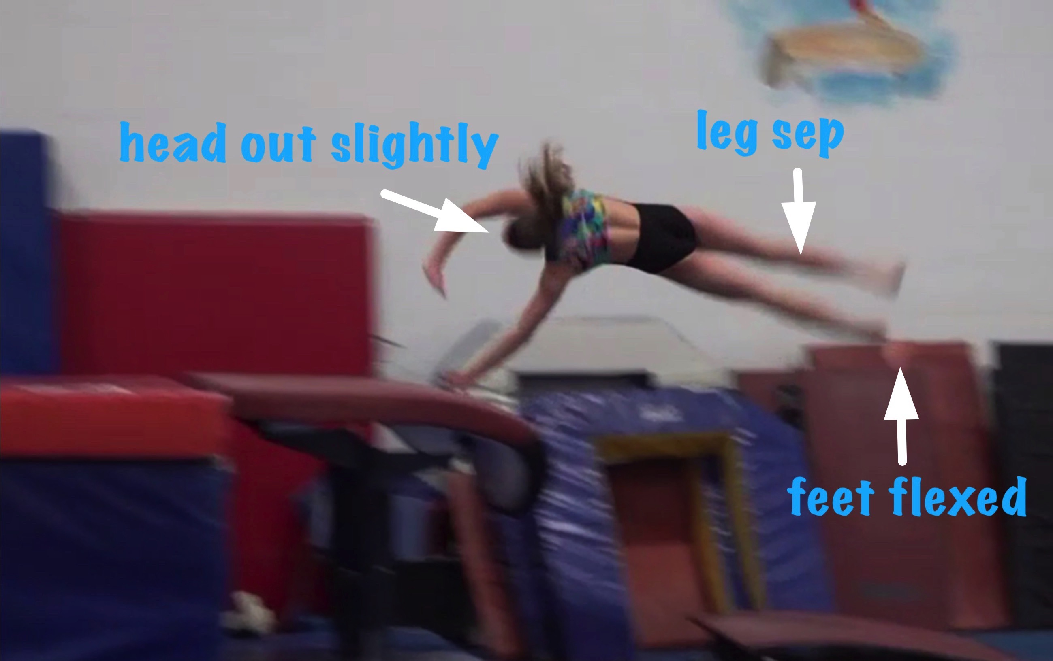
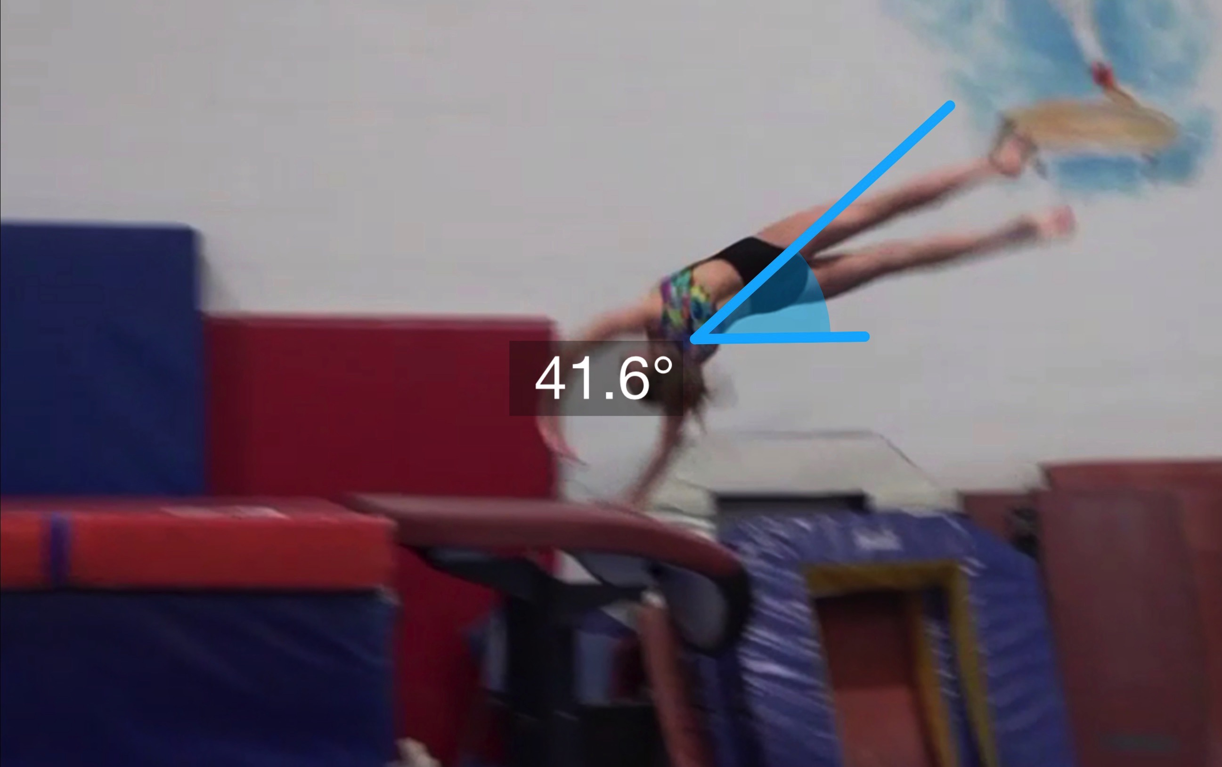
Tsukahara #4
(as is numbered on library dvd to correspond)
Pre Flight Body Position
Angle of Arrival

Slide 22
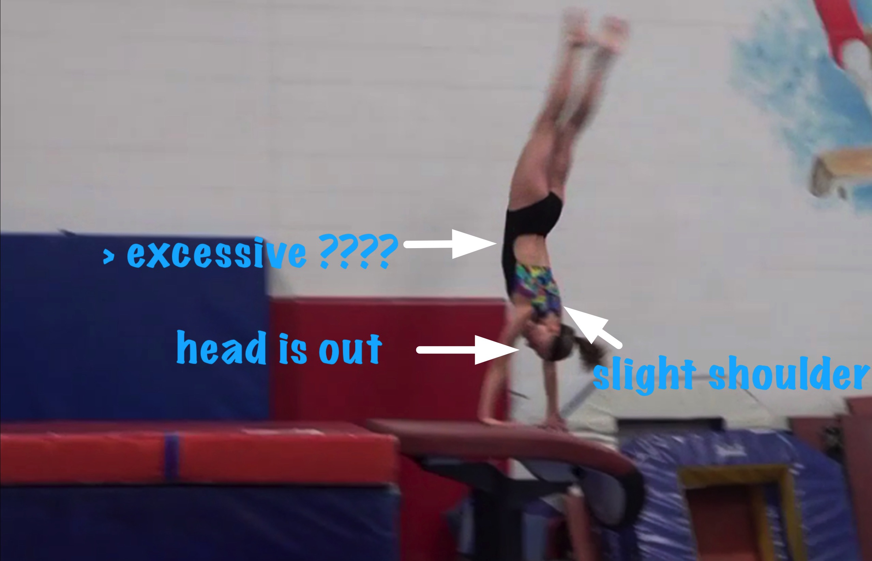
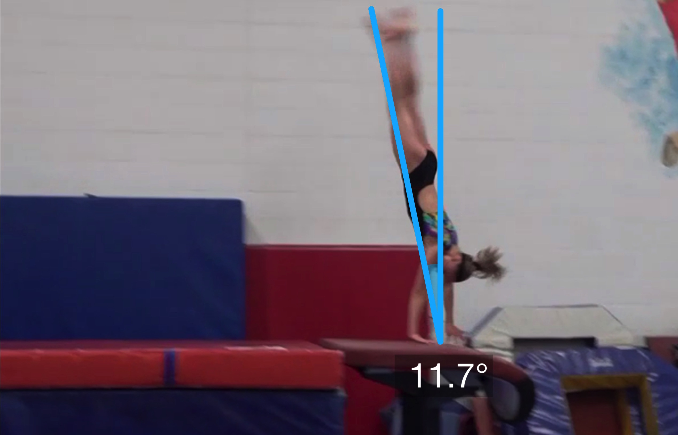
Tsukahara #4
Angle off the Table and corresponding Time in Support
Body Position in Support

Slide 23
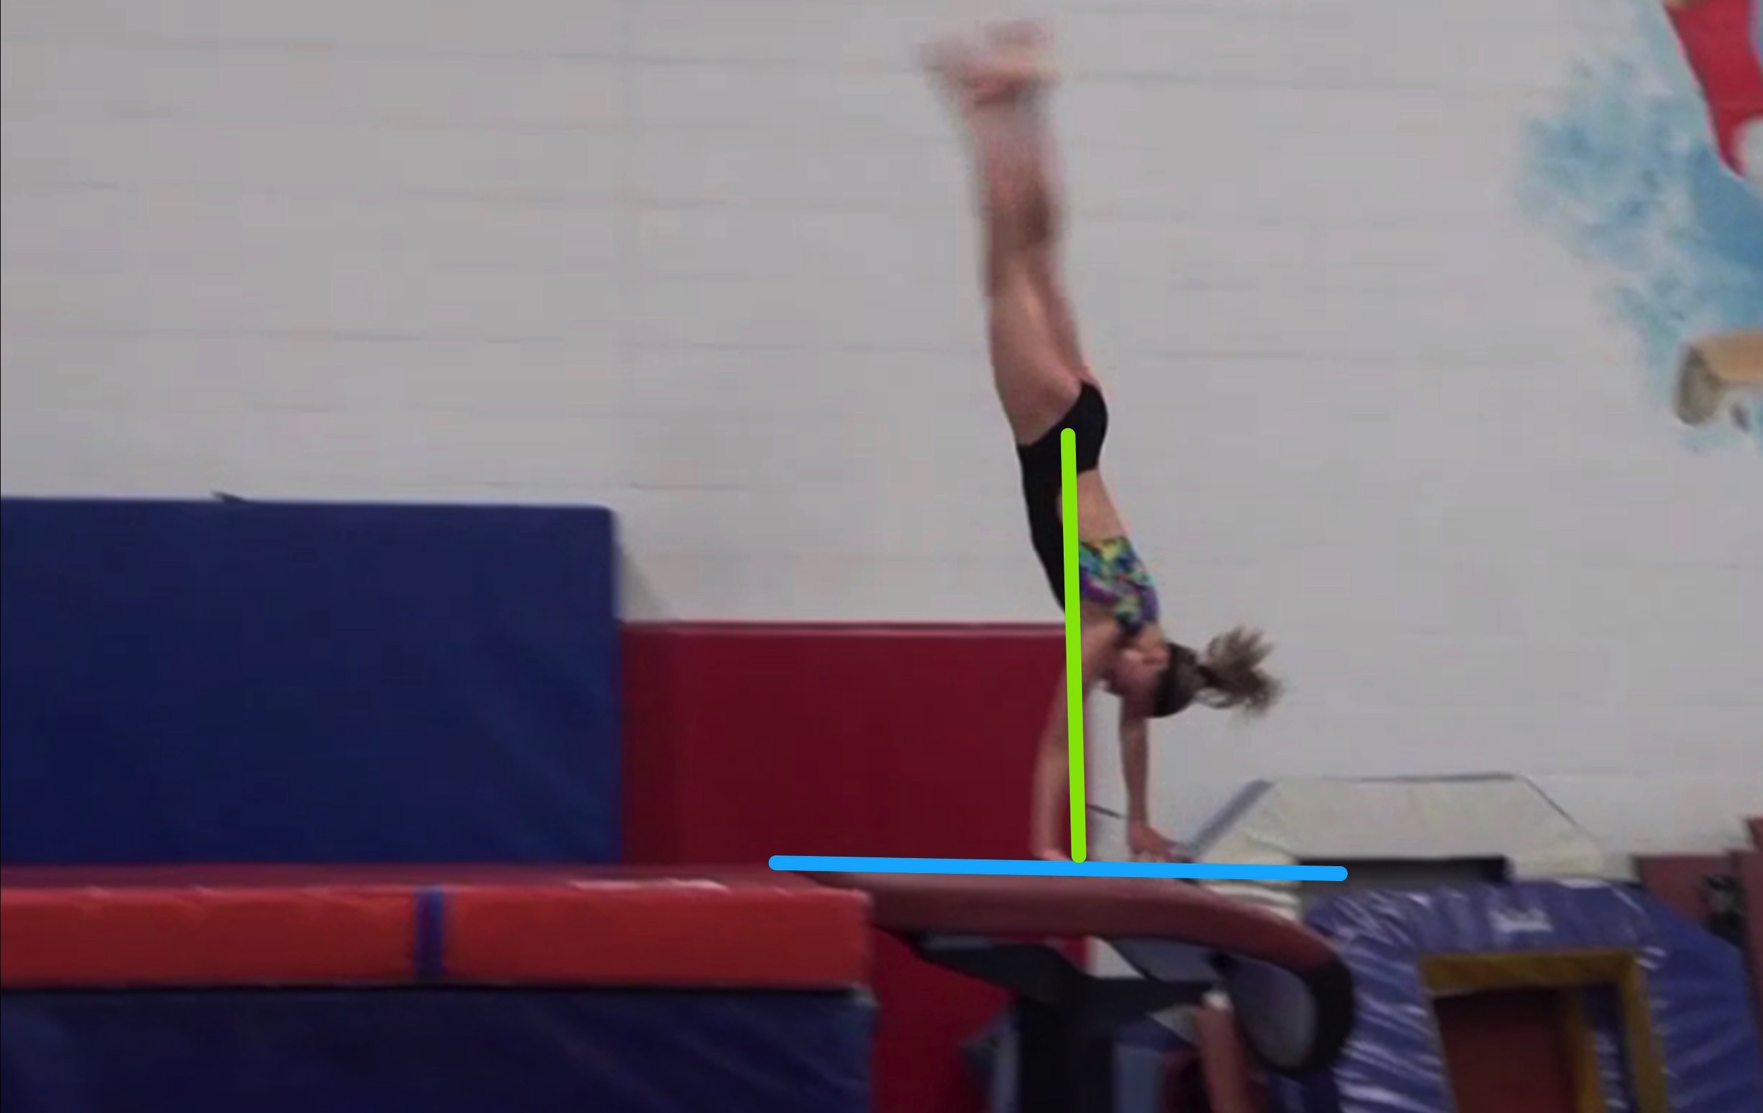
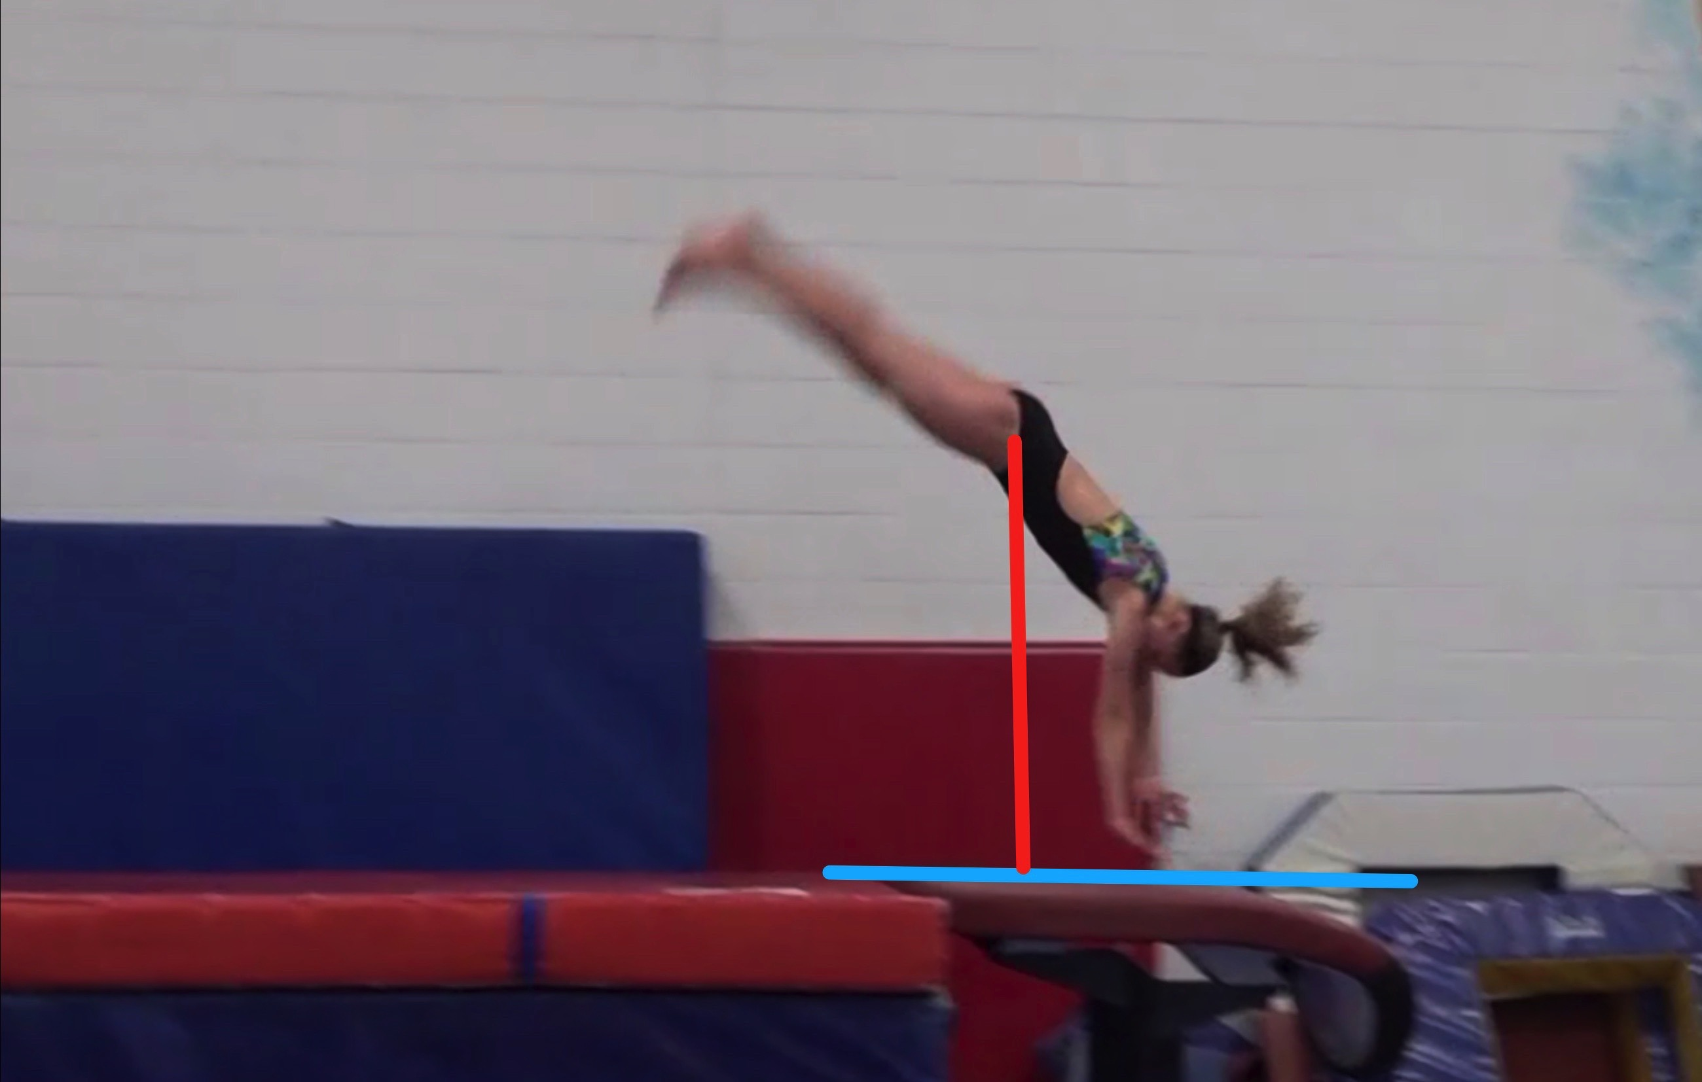
Tsukahara #4
Height Baseline (measured from table to center of gravity when inverted at moment of repulsion.
Height Achieved (compare red line to green line after lining up blue table height line for accurate comparison.

Slide 24
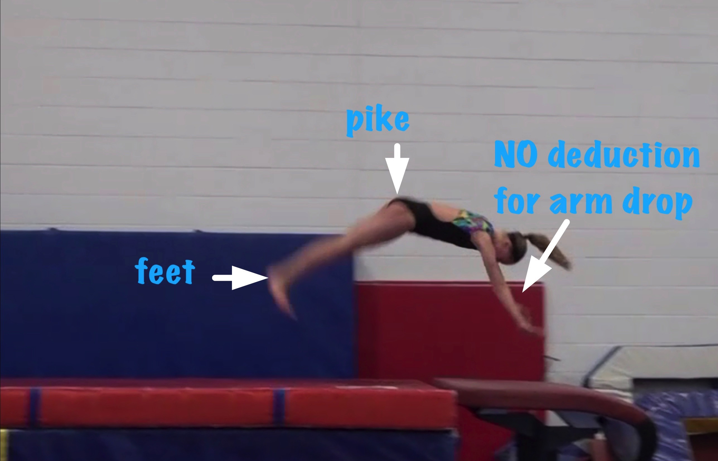
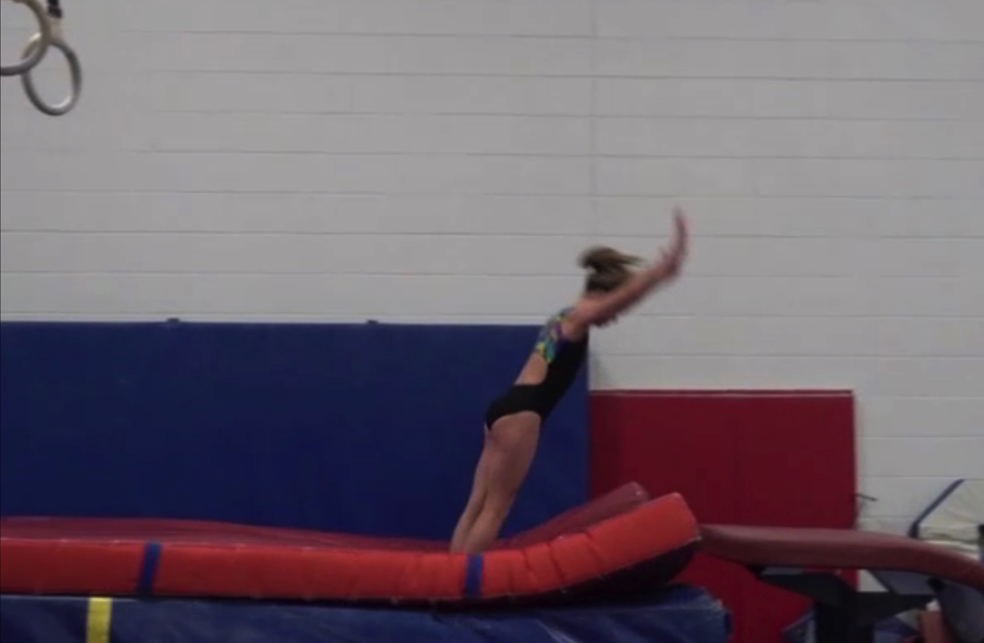
Tsukahara #4
Body Position in post flight
Posture on Contact & Distance

Slide 25
Tsuk #4 UNOFFICIAL Vetted Deductions Breakdown
Pre Flight Body Position: .3
Angle on: 0
In Support Body Position: .1
Angle off: .2
Time in Support: .25
Height: .4
Off Flight Body Position: .3
Posture on Landing: 0
Landing: 0
Distance: .2
Dynamics: .2
Score: 8.05
Look at the vault again and use the slider to view it in slow motion and study the corresponding deductions for each phase of the vault.

Slide 26
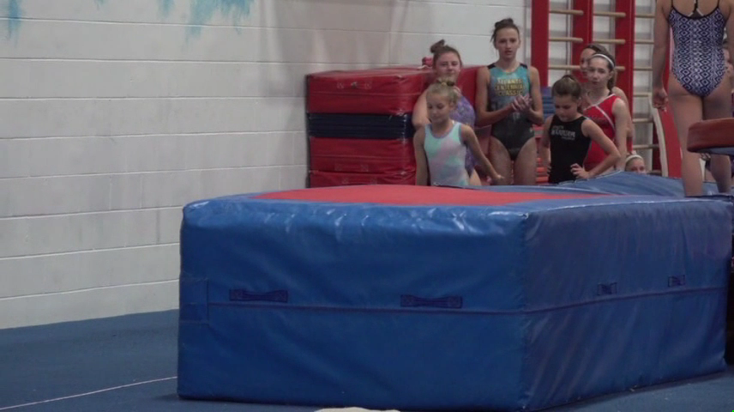
Tsukahara #3
Tsukahara #3– compare to model at right.
Tsukahara #11 MODEL – compare to Tsuk #8 at left

Slide 27
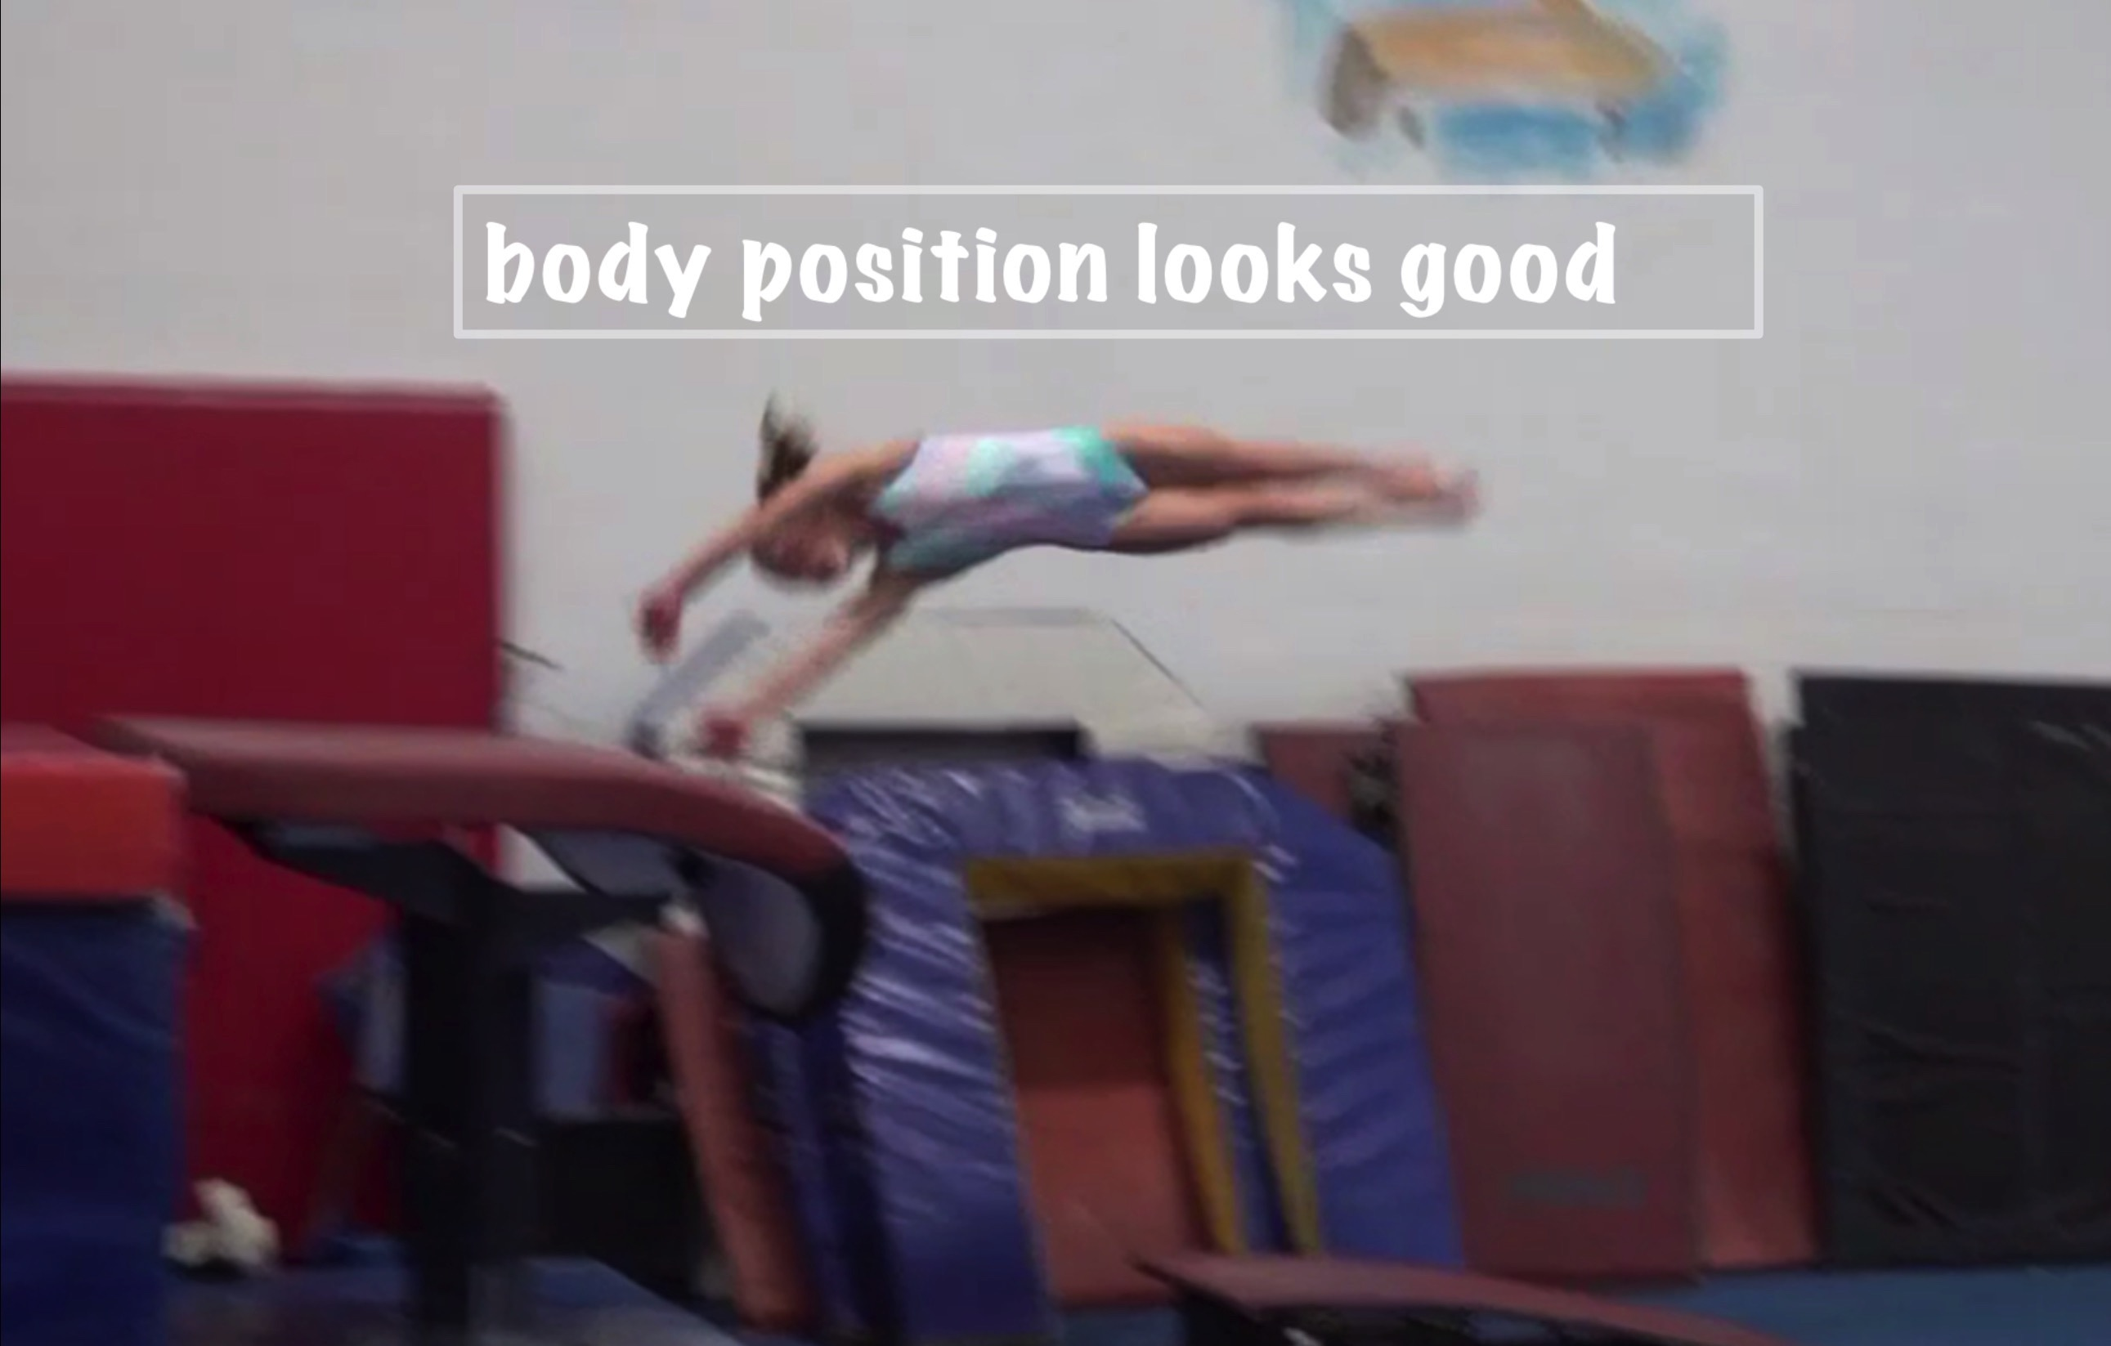
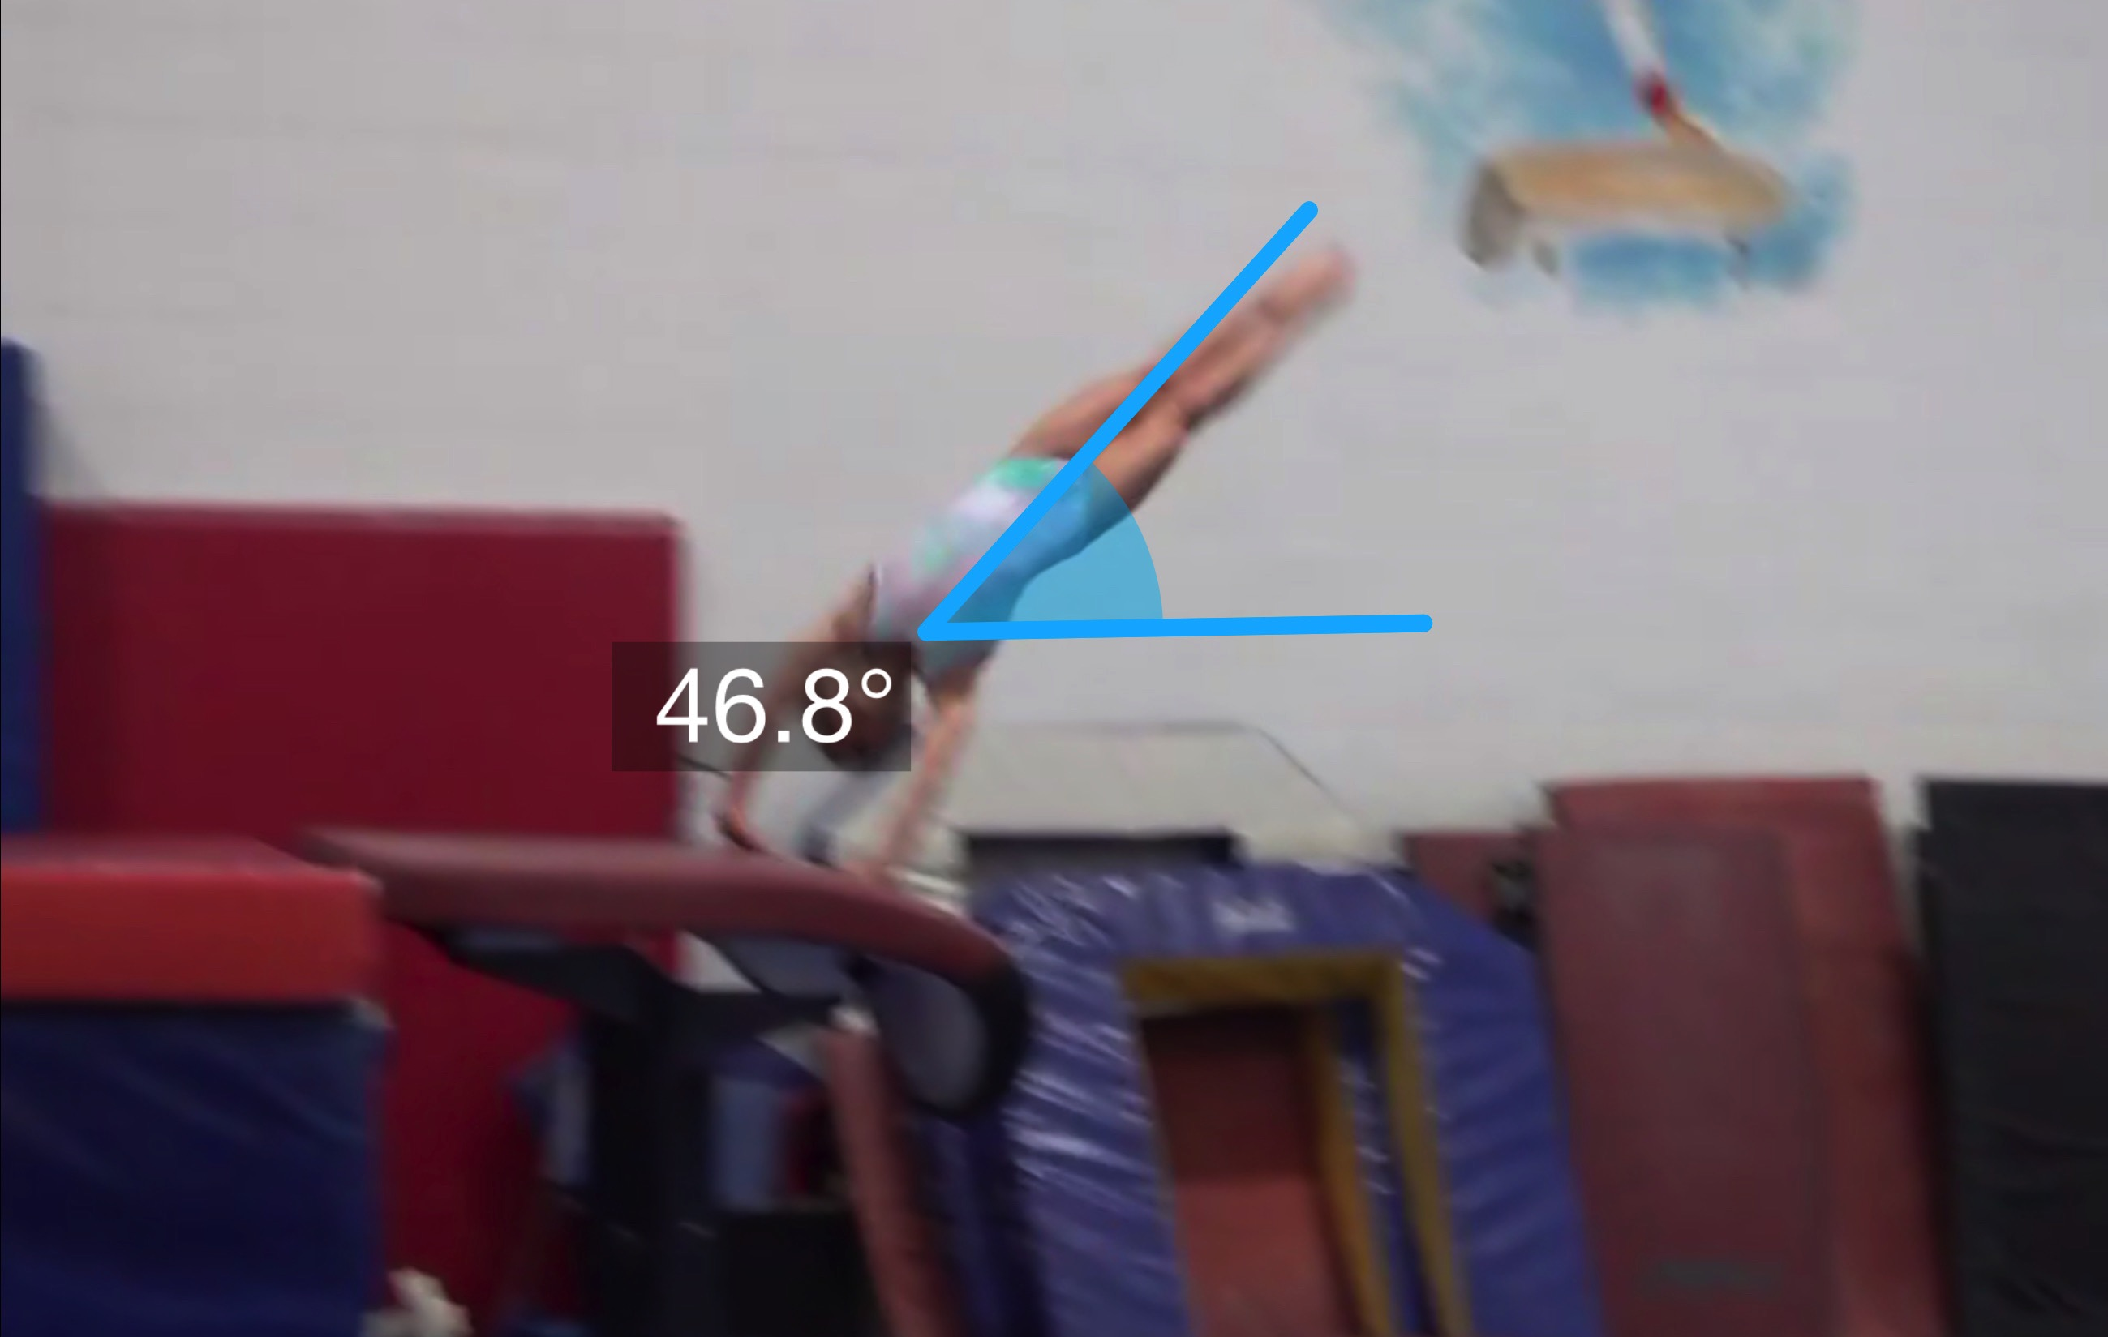
Tsukahara #3
(as is numbered on library dvd to correspond)
Pre Flight Body Position
Angle of Arrival

Slide 28
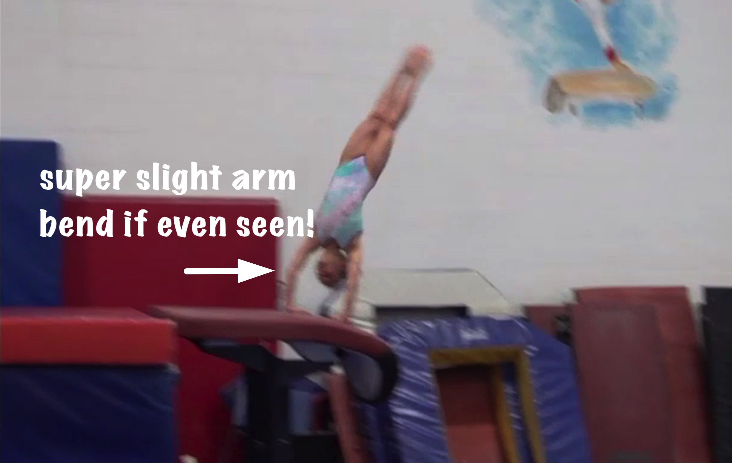
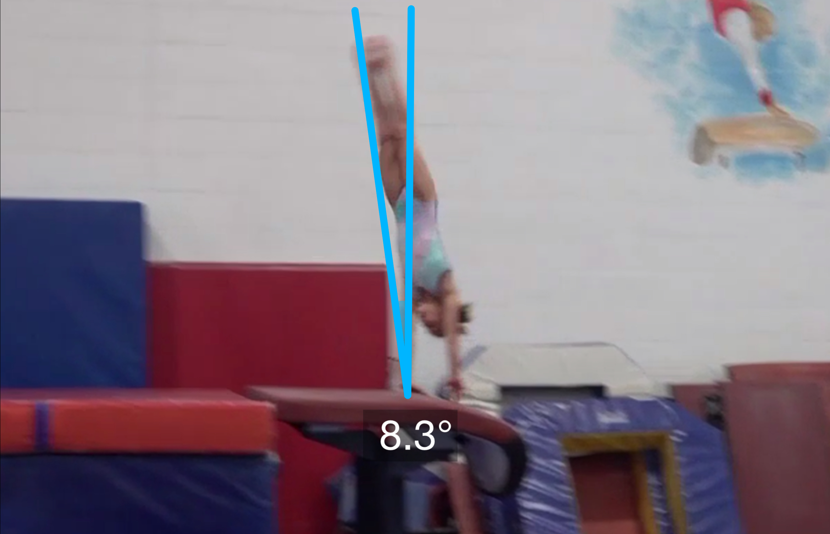
Tsukahara #3
Angle off the Table and corresponding Time in Support
Body Position in Support

Slide 29
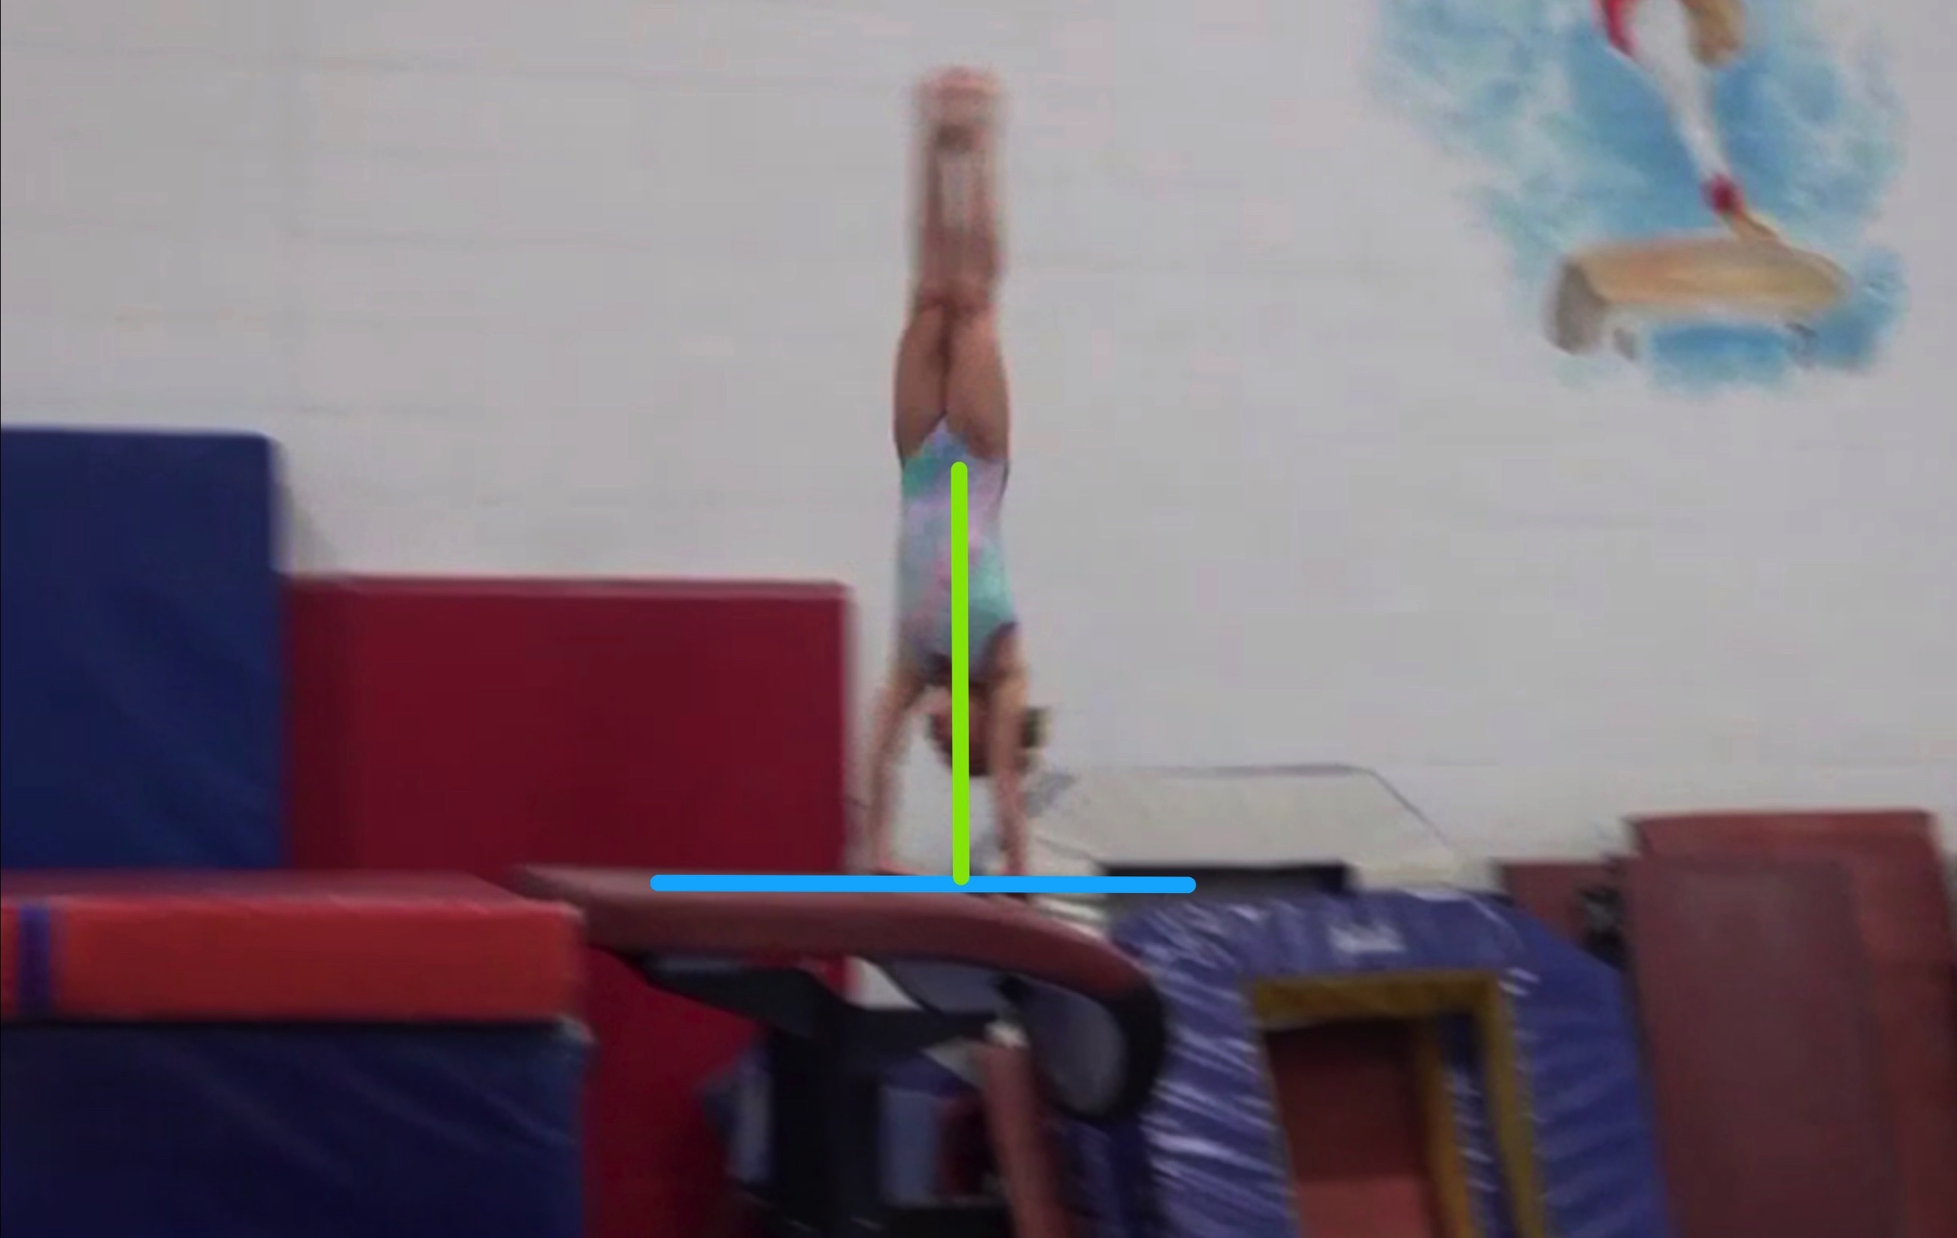
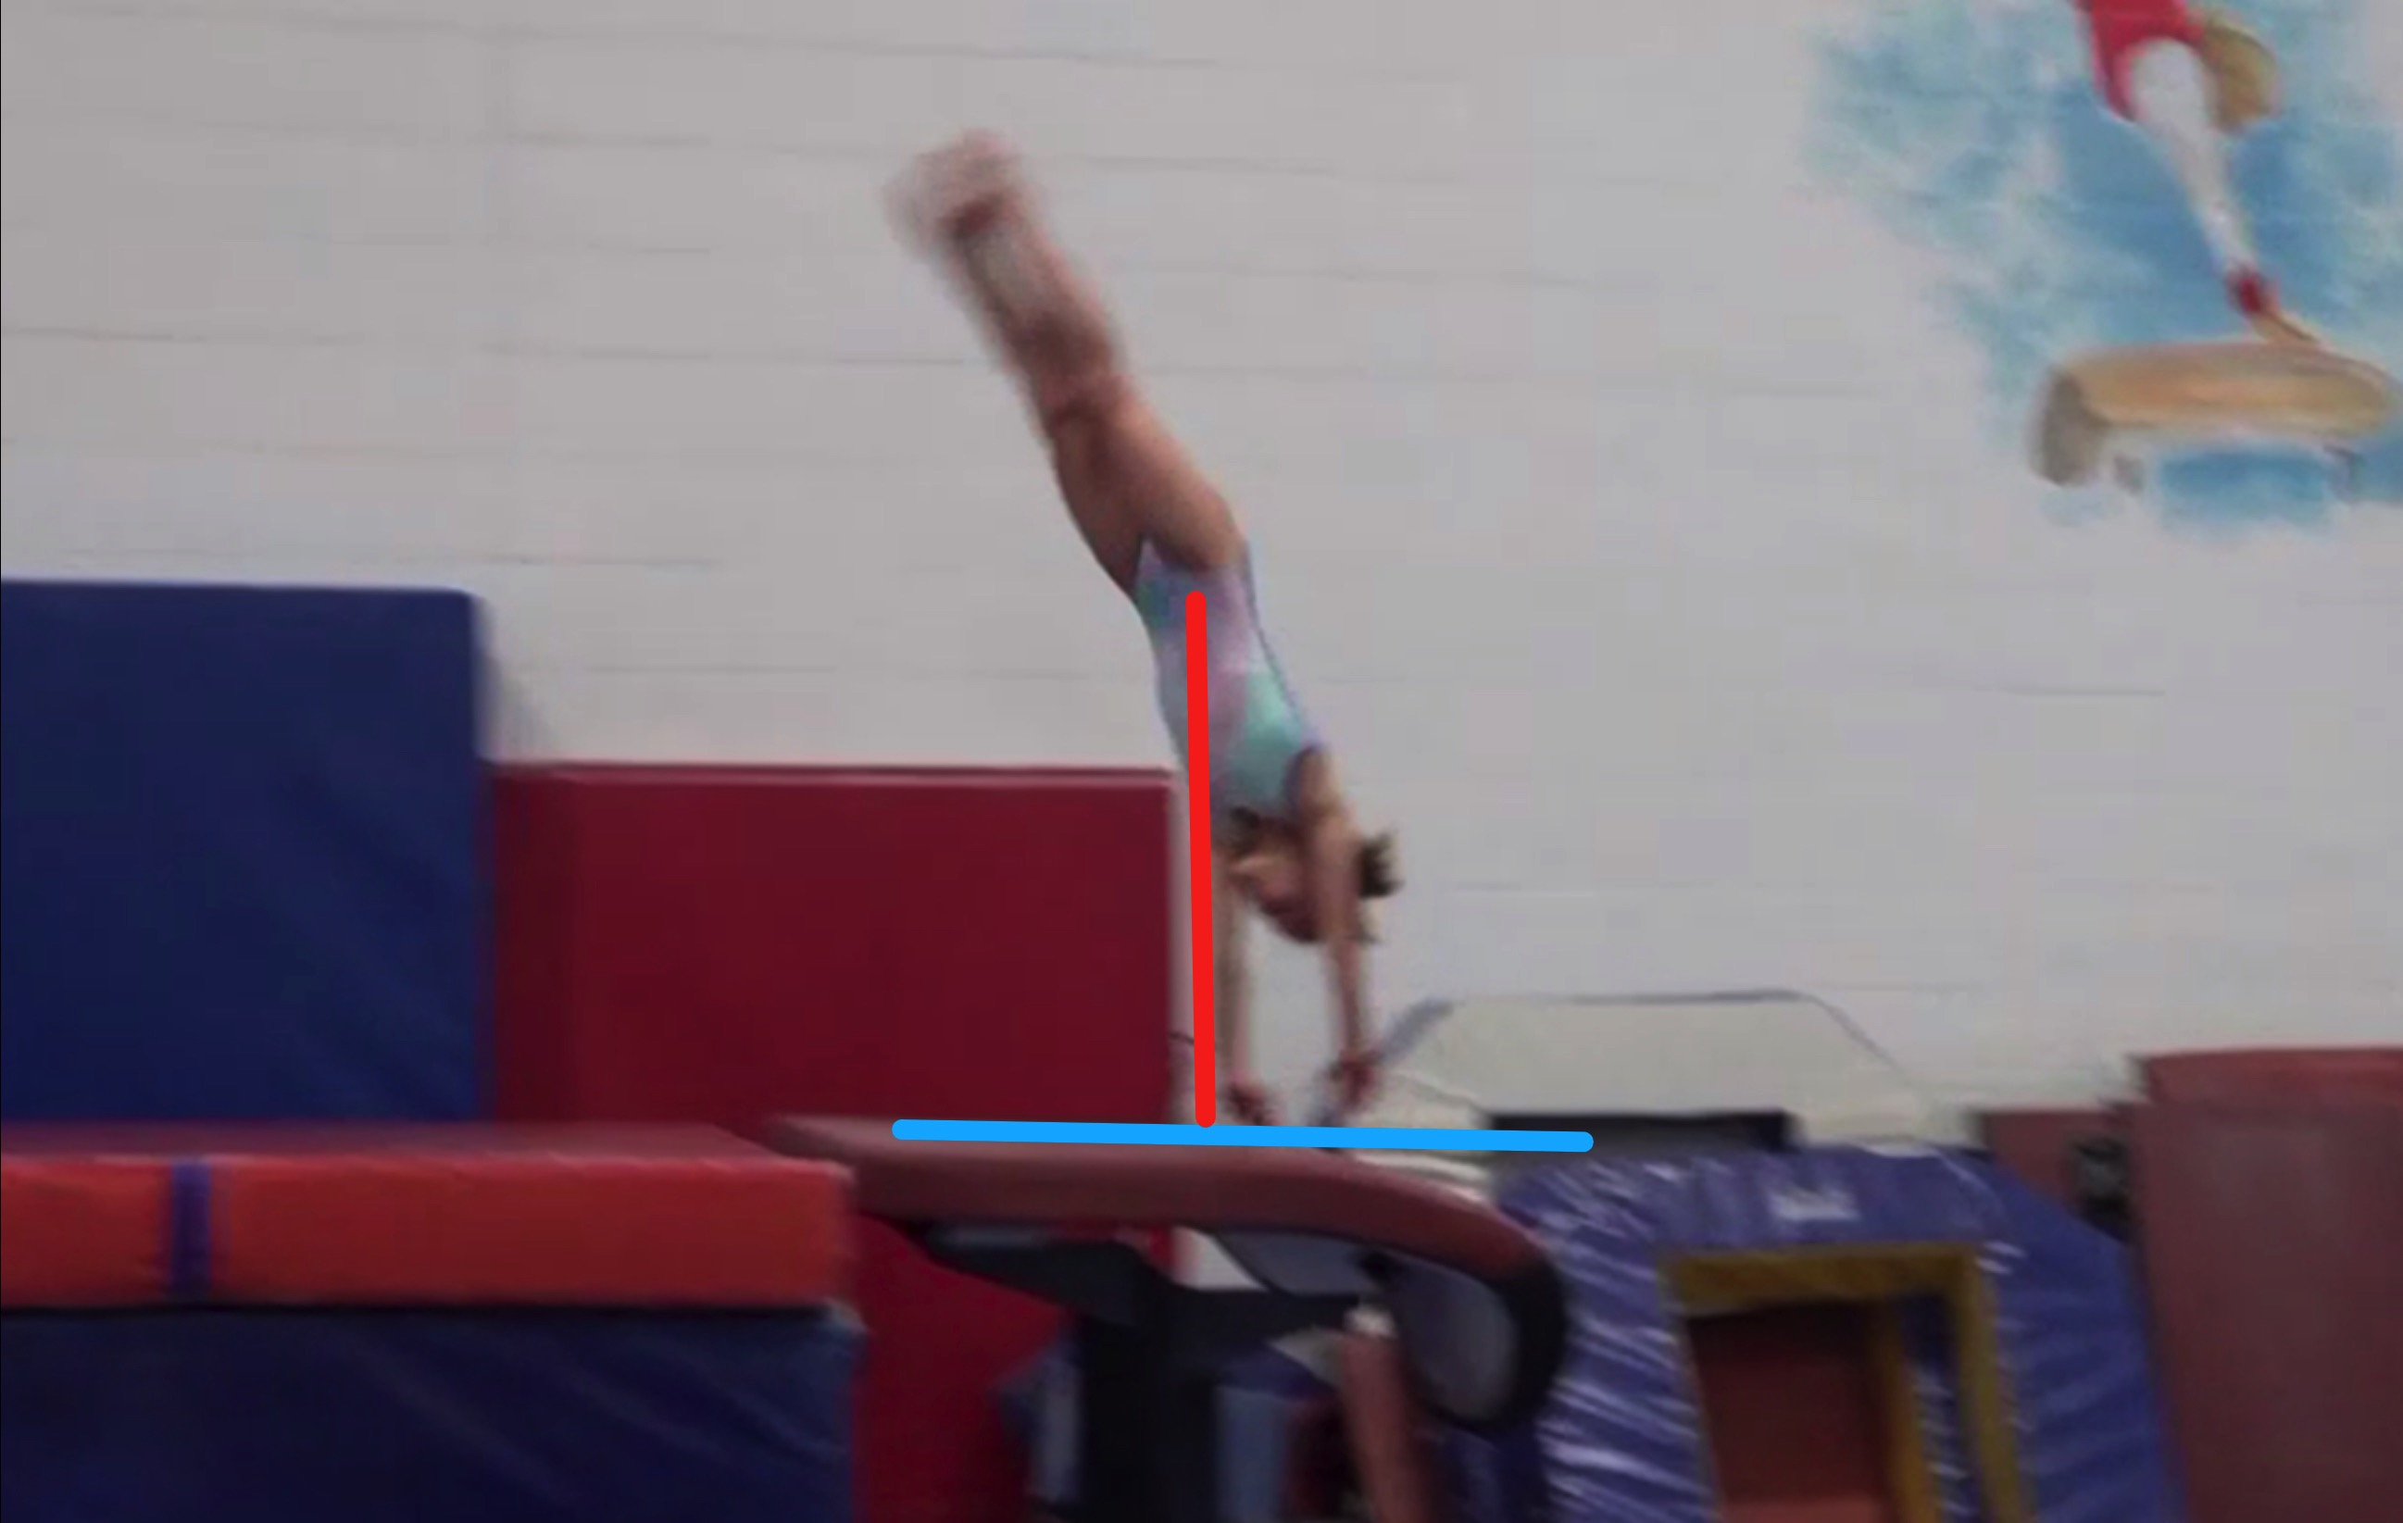
Tsukahara #3
Height Baseline (measured from table to center of gravity when inverted at moment of repulsion.
Height Achieved (compare red line to green line after lining up blue table height line for accurate comparison.

Slide 30
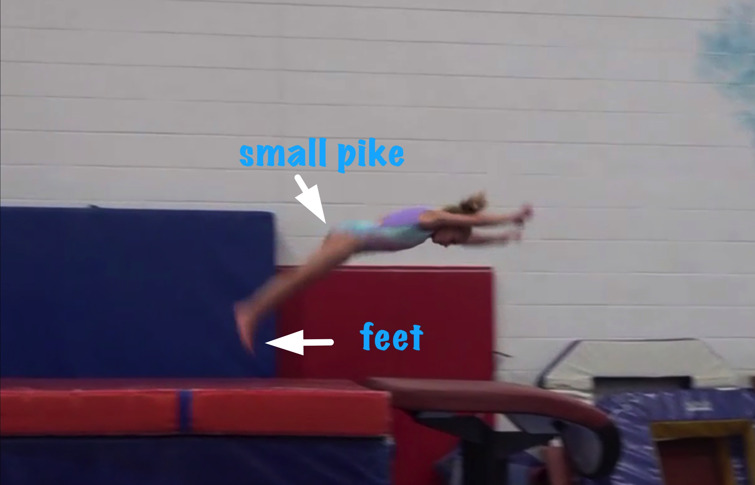
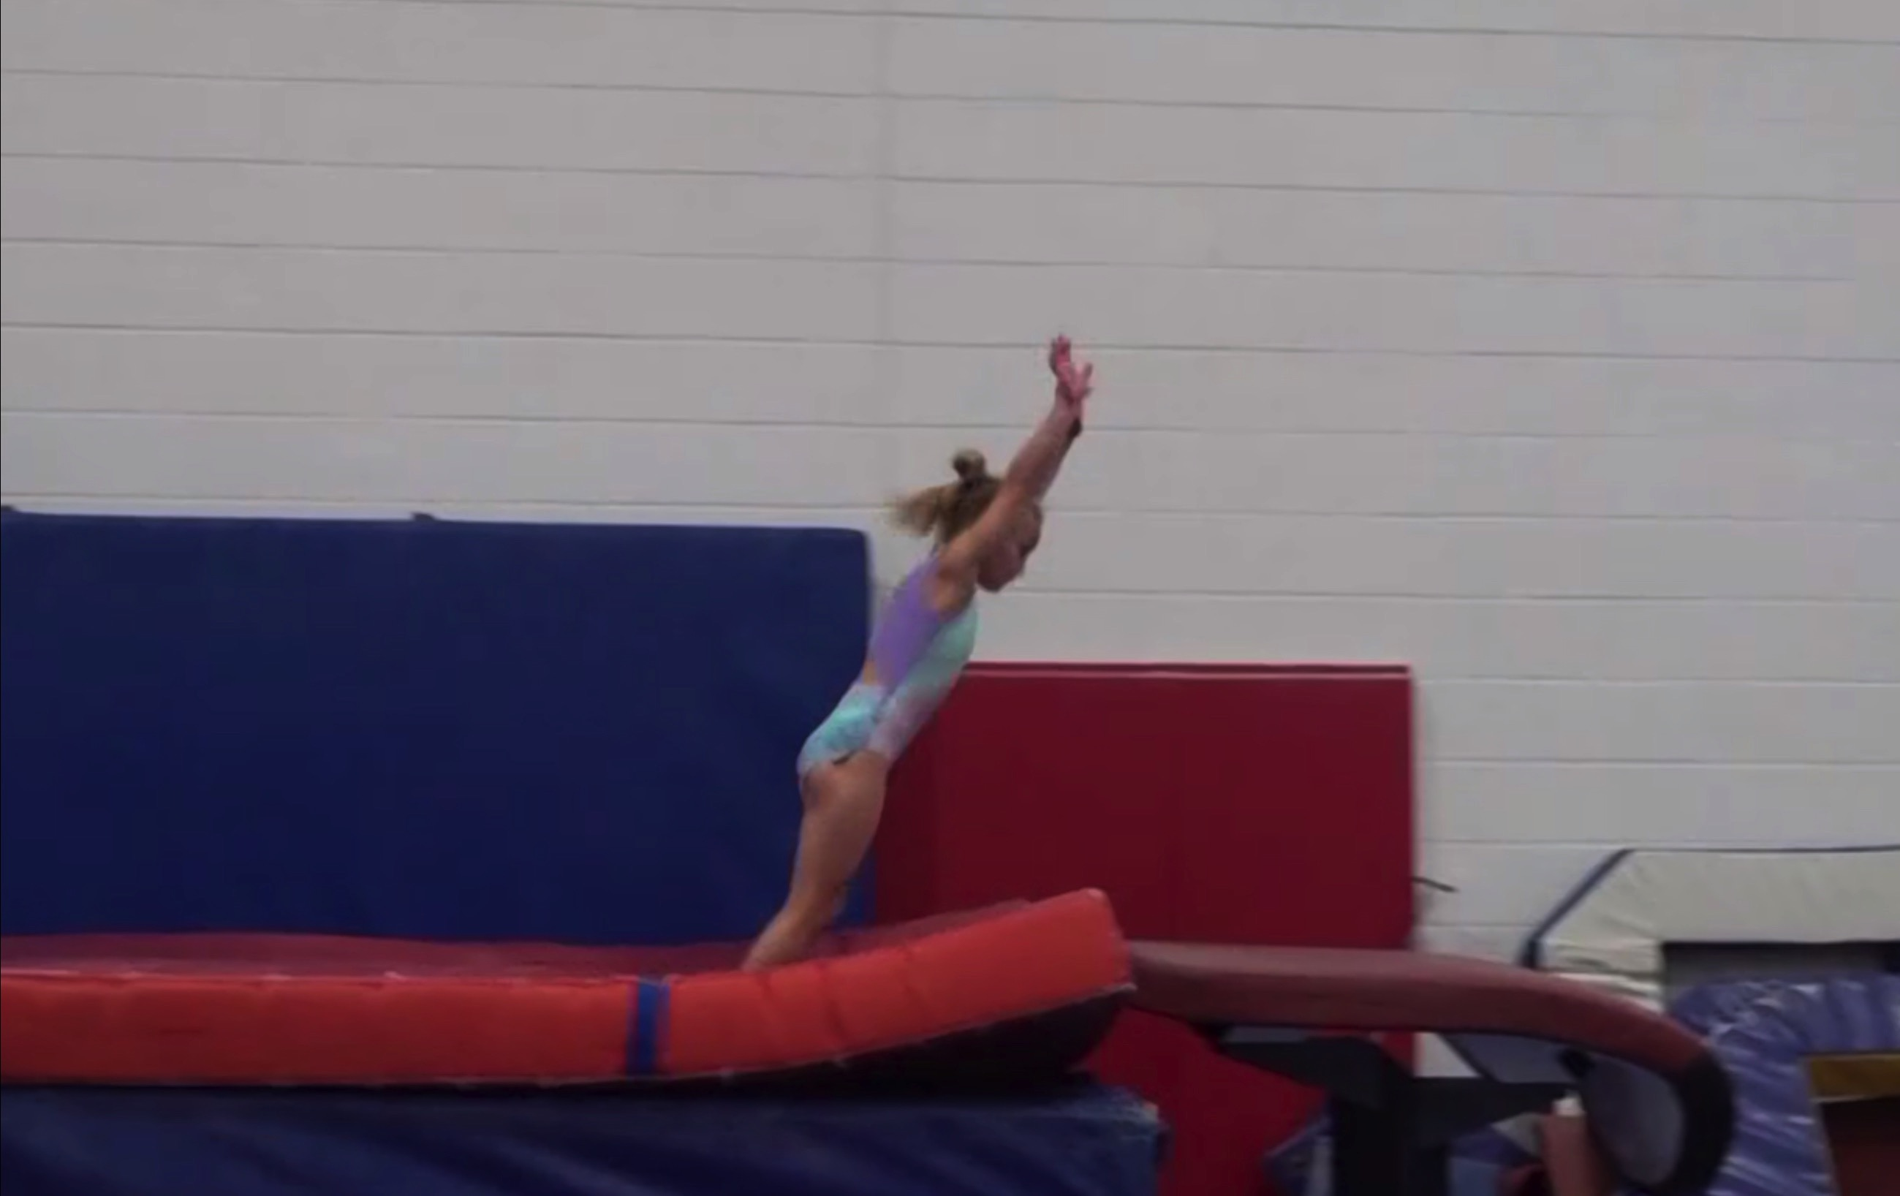
Tsukahara #3
Body Position in post flight
Posture on Contact & Distance

Slide 31
Tsuk #3 UNOFFICIAL Vetted Deductions Breakdown
Pre Flight Body Position: 0
Angle on: .05
In Support Body Position: 0
Angle off: .1
Time in Support: 0
Height: .3
Off Flight Body Position: .05
Posture on Landing: .05
Landing: 0
Distance:.05
Dynamics: .05
Score: 9.35
Look at the vault again and use the slider to view it in slow motion and study the corresponding deductions for each phase of the vault.
Notes:
This vault was pretty good except that she lacked a powerful block which would have helped her height in a big way so dynamics deduction was slight but still a factor.

