Slide 1
Level 6/7 YURCHENKO vault by Nawgj
Education committee August 2018
Films provided by nawgj libRARY
6/7 Yurchenko Parameters
•45 degree or less arrival angle
•Tight, open, stretched pre flight
•On Table open/slight, tight arch position
•Off table at vertical
•Minimal time in support
•Maximum Height
•Hollow BP in post flight
•Good distance with good posture upon contact with mat.

Slide 2
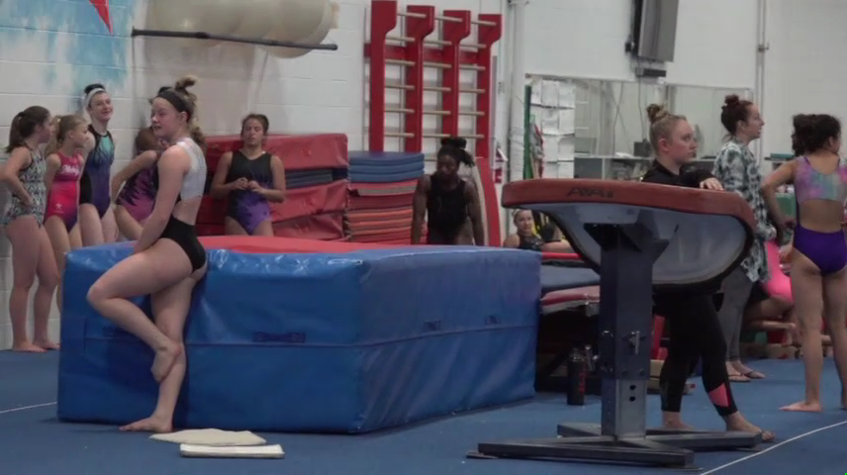
Current Yurchenko MODEL (NOT a 10.0!)

Slide 3
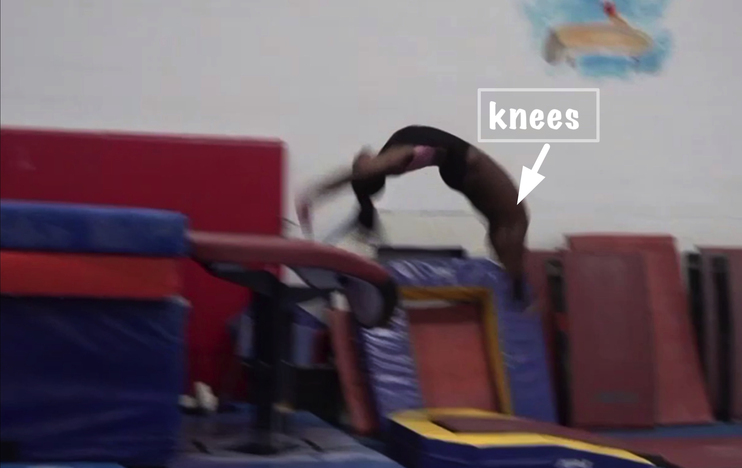
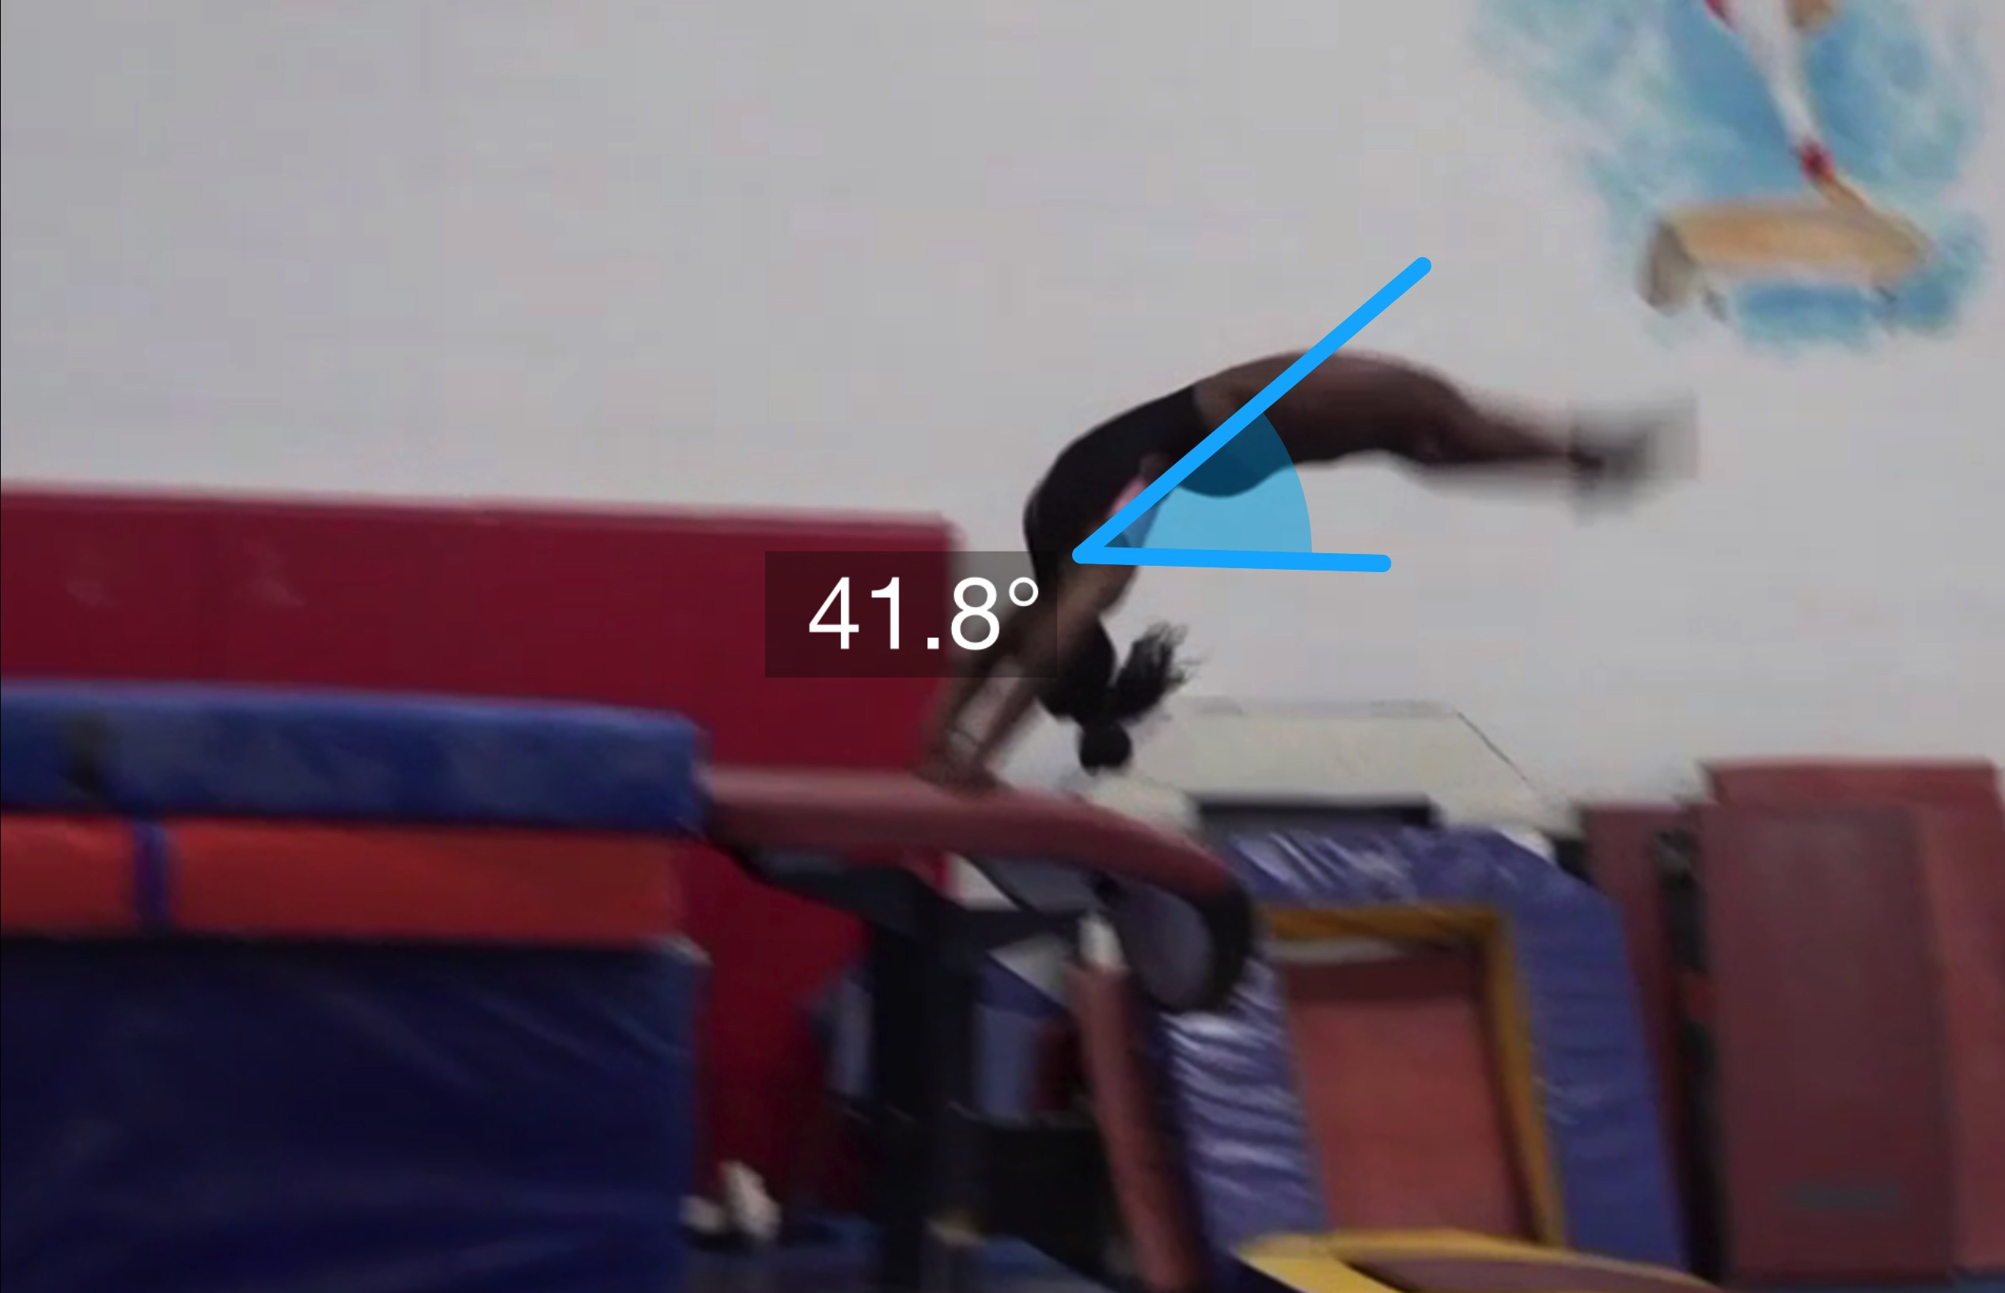
Yurchenko #9 model
(as is numbered on library dvd to correspond)
Pre Flight Body Position
Angle of Arrival

Slide 4
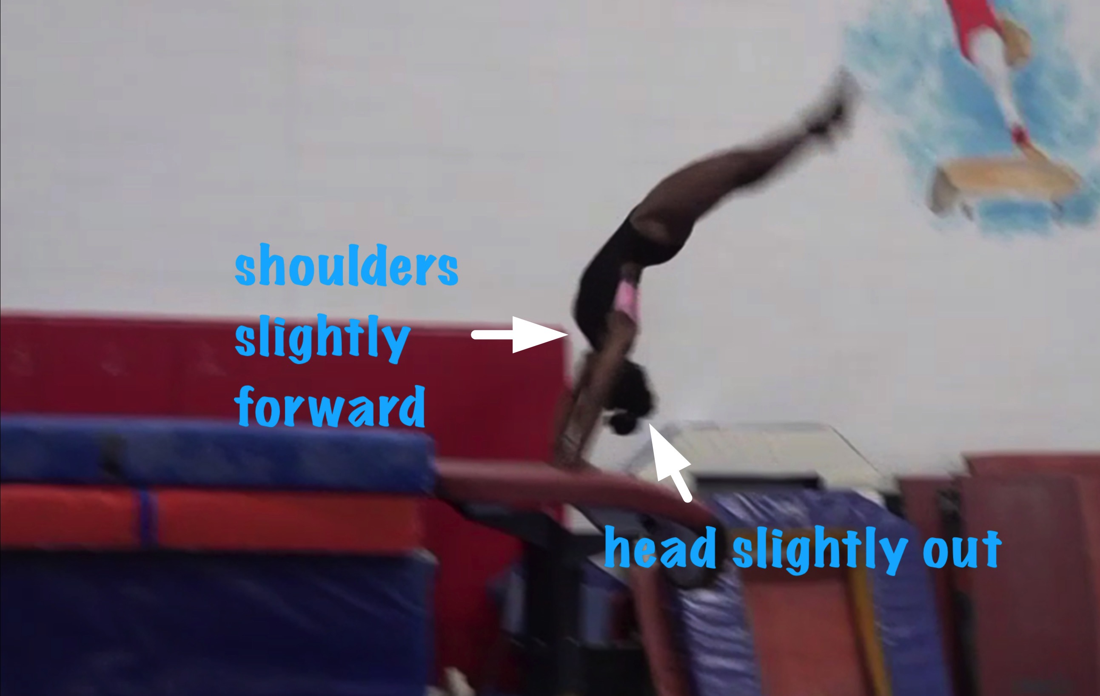
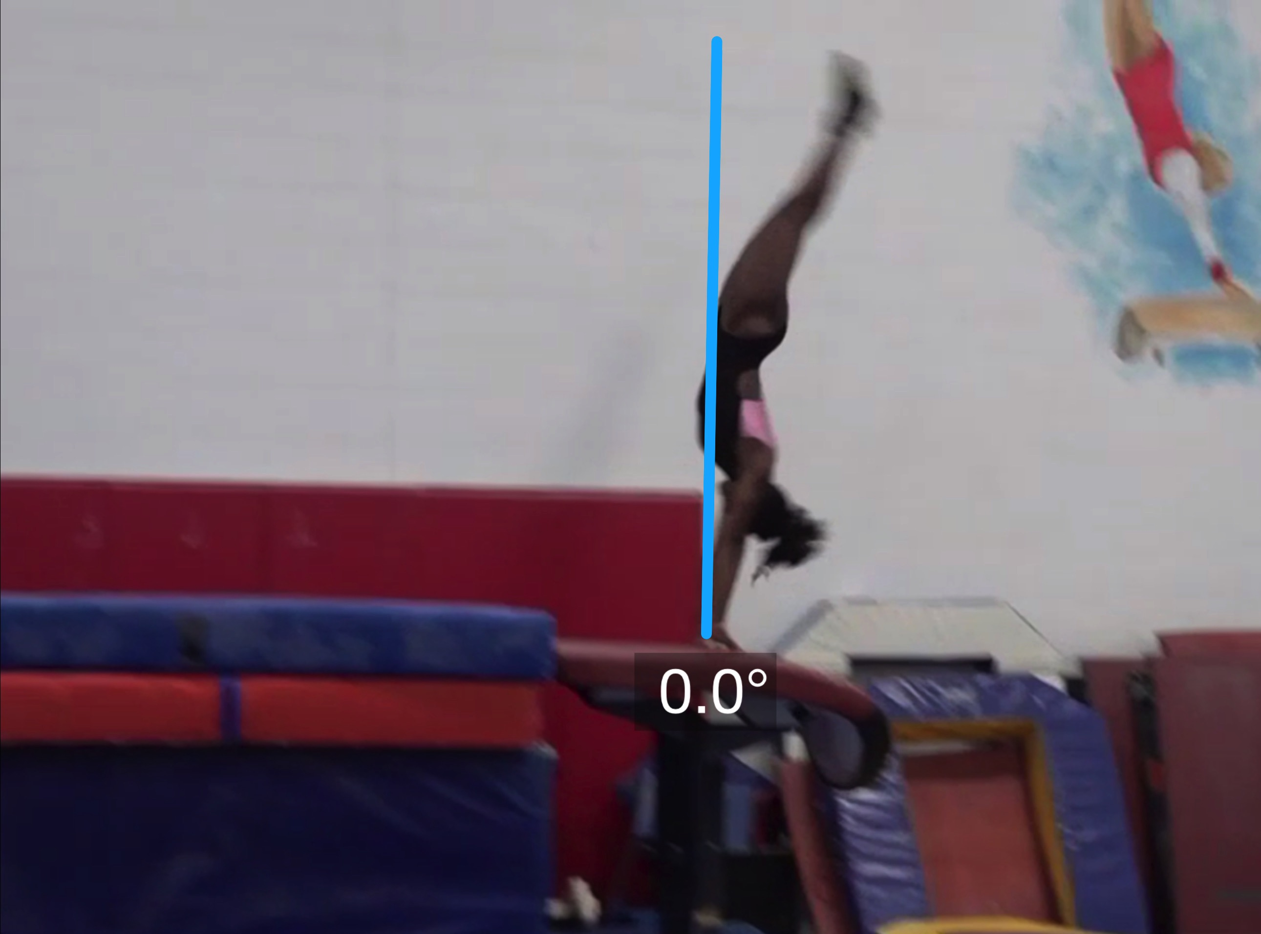
Yurchenko #9 model
Angle off the Table and corresponding Time in Support
Body Position in Support

Slide 5
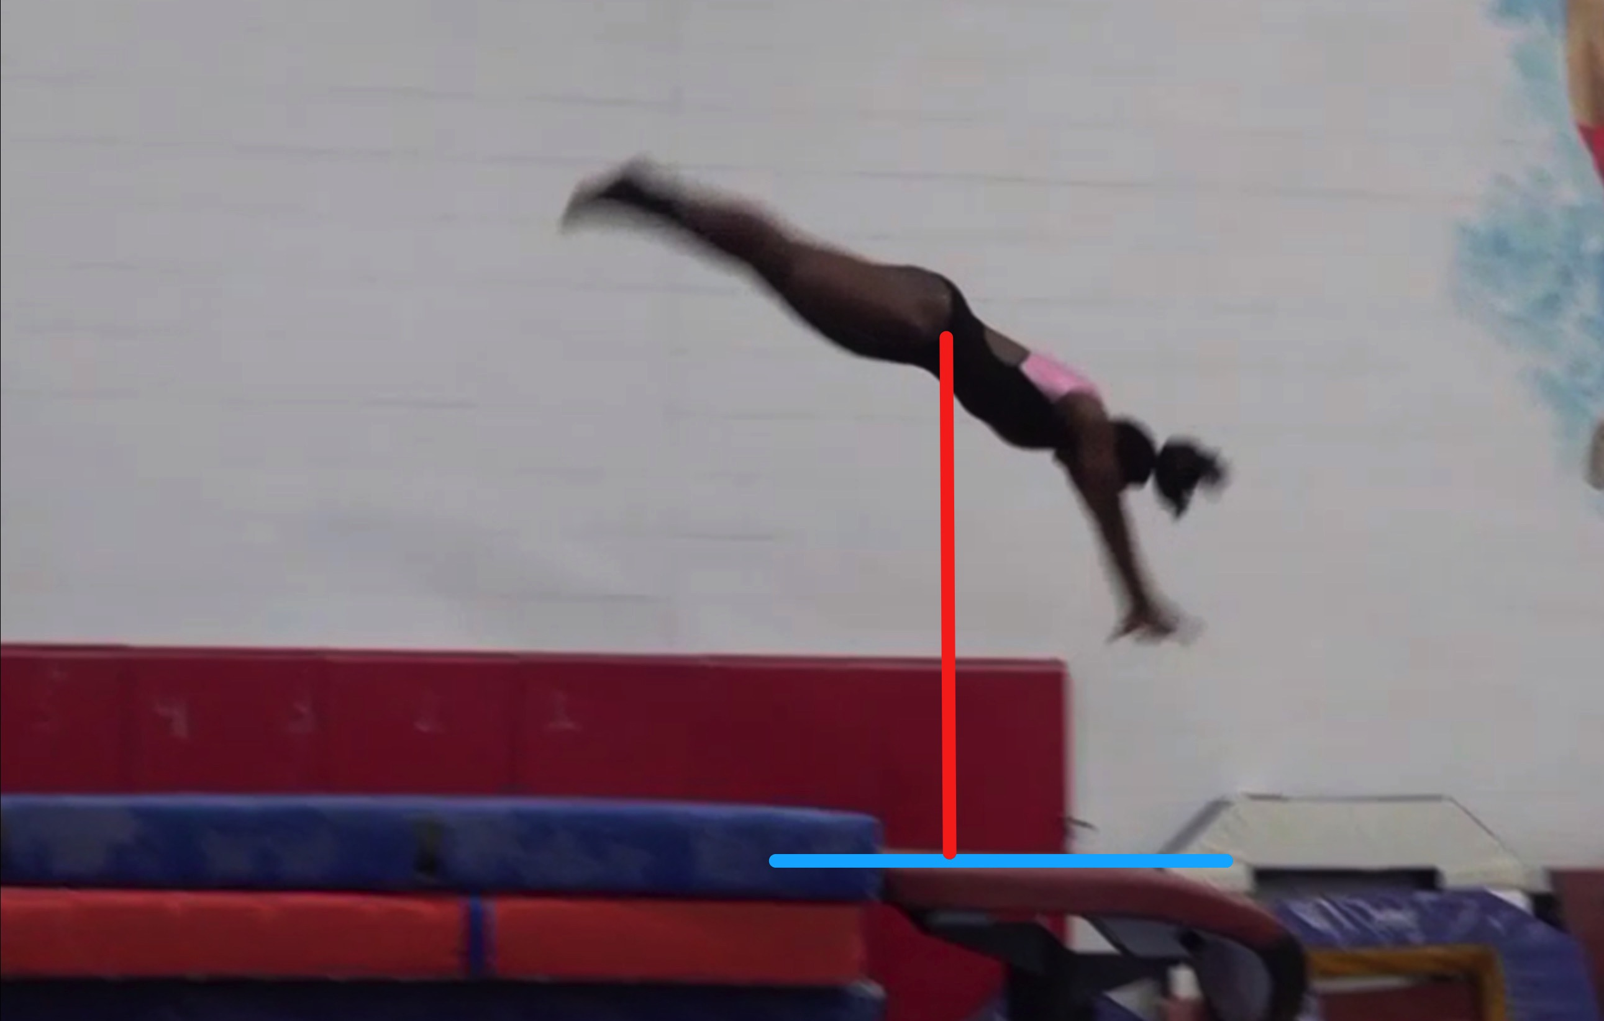
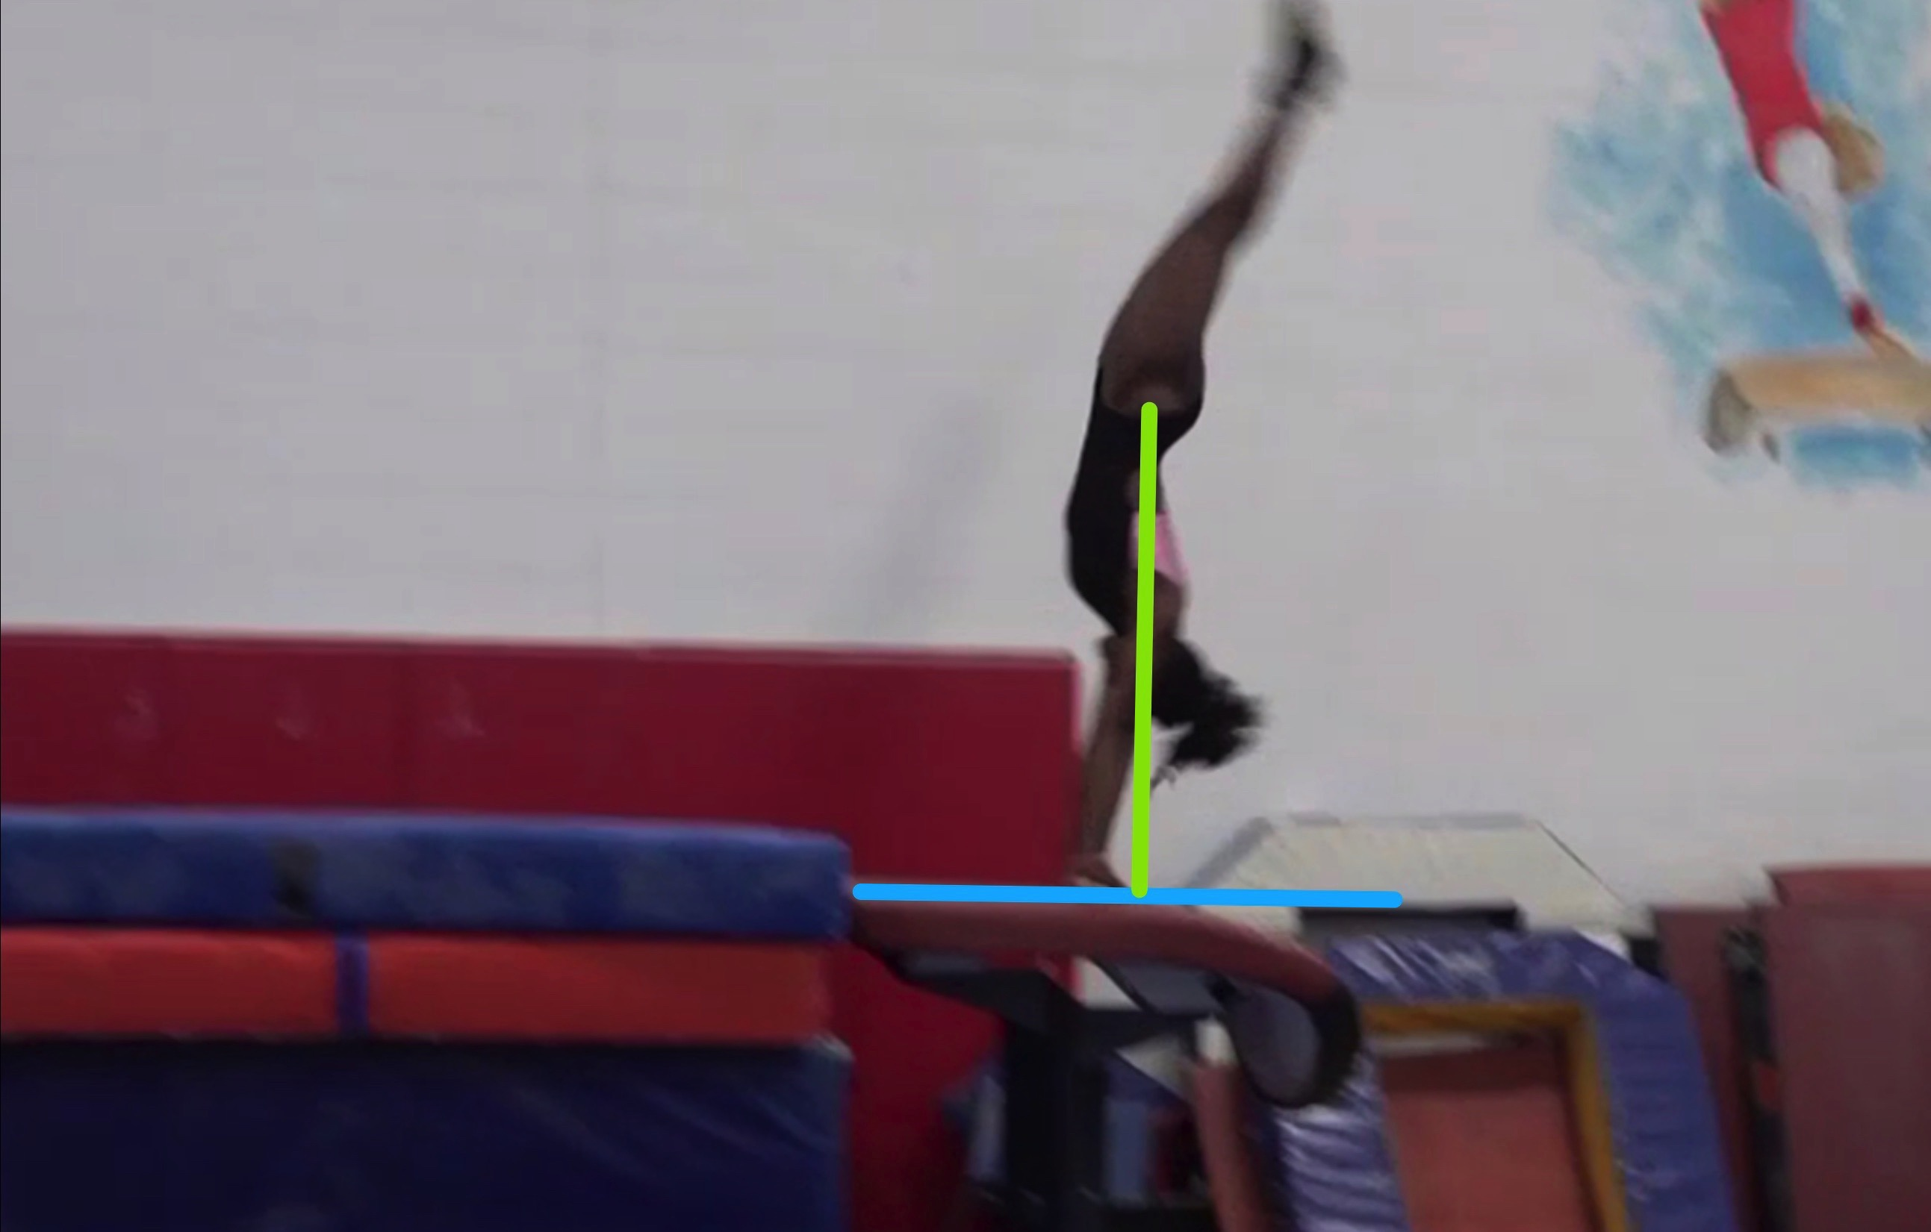
Yurchenko #9 model
Height Baseline (measured from table to center of gravity when inverted at moment of repulsion.
Height Achieved (compare red line to green line after lining up blue table height line for accurate comparison.

Slide 6
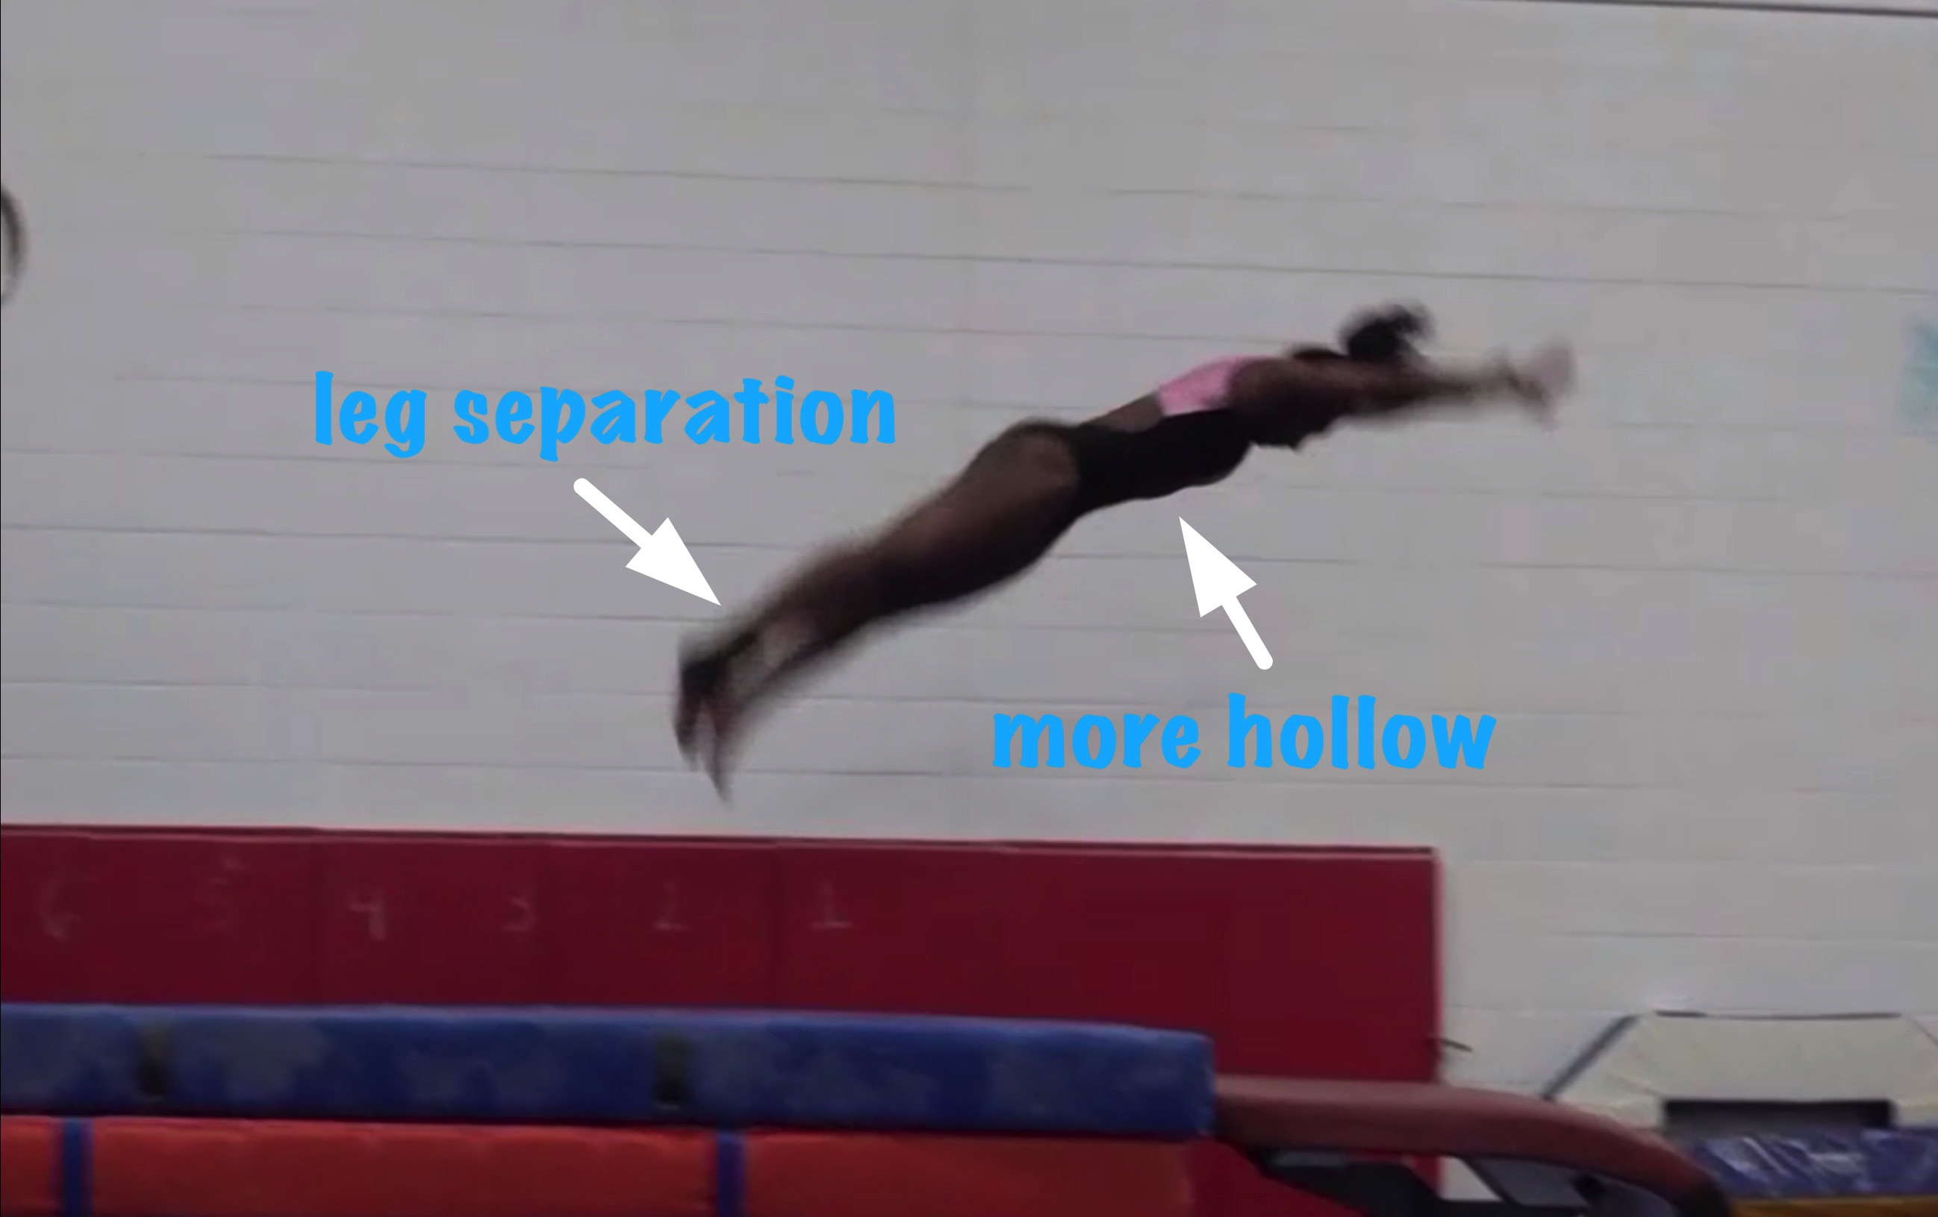
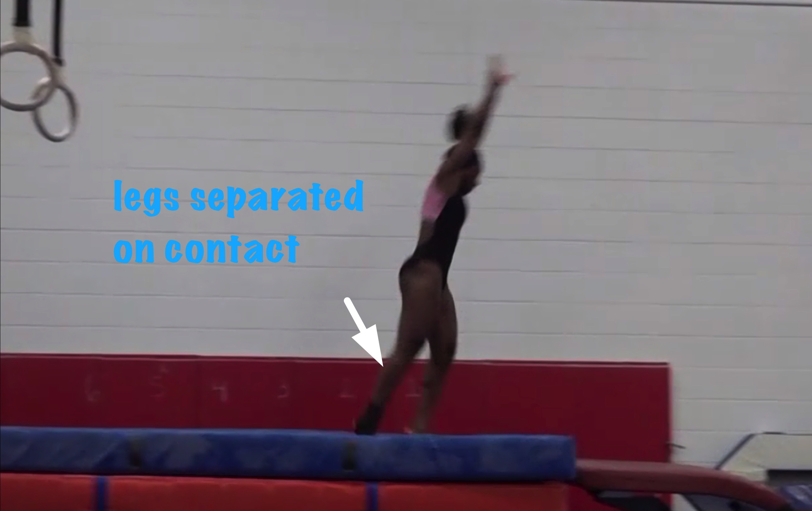
Yurchenko #9 model
Body Position in post flight
Posture on Contact & Distance
Notes:
In Body Position in post flight slide the feet not fully pointed should be noted within the deductions consideration. The leg separation on contact was evaluated as a landing step toward the table. In any case it is a deduction.

Slide 7
Yurchenko #9 model UNOFFICIAL Vetted Deductions Breakdown
Pre Flight Body Position: .1
Angle on: 0
In Support Body Position: .1
Angle off: 0
Time in Support: .05
Height: .1
Off Flight Body Position: .2
Posture on Landing: 0
Landing: .1
Distance: .05
Dynamics: .05
Score: 9.25
Look at the vault again and use the slider to view it in slow motion and study the corresponding deductions for each phase of the vault.
Notes:
Gymnast landed with legs apart which was assessed as a LANDING step forward as opposed to posture upon landing contact. In either case it is a deduction. The result after the landing reinforces the need for the additional landing mat below the landing surface.

Slide 8
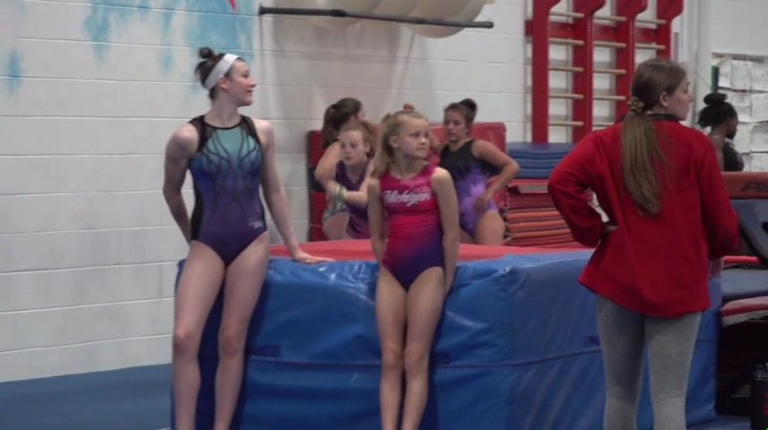
Level 6/7 vault by Nawgj
Education committee August 2018
Films provided by judy dobransky, nawgj library
Yurchenko #4 (watch and compare to model on the right)
Current Yurchenko MODEL (#9)

Slide 9
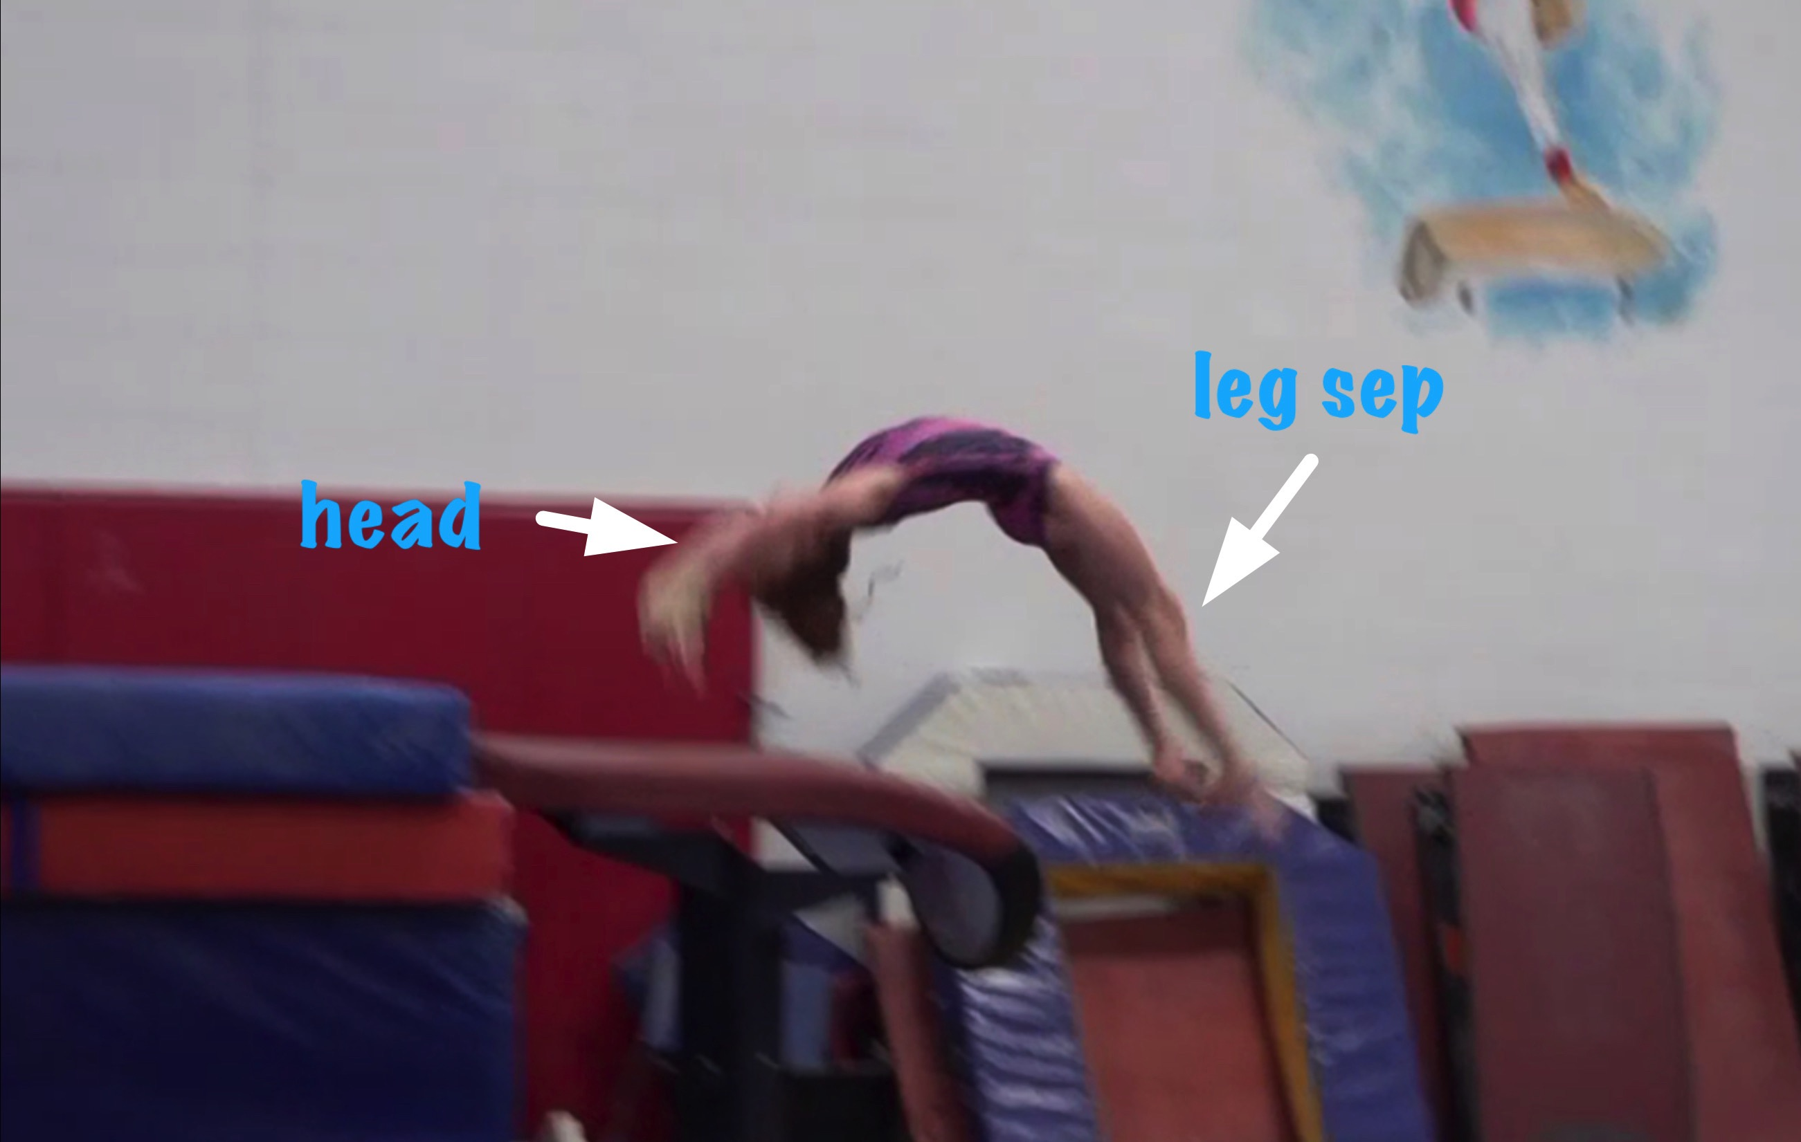
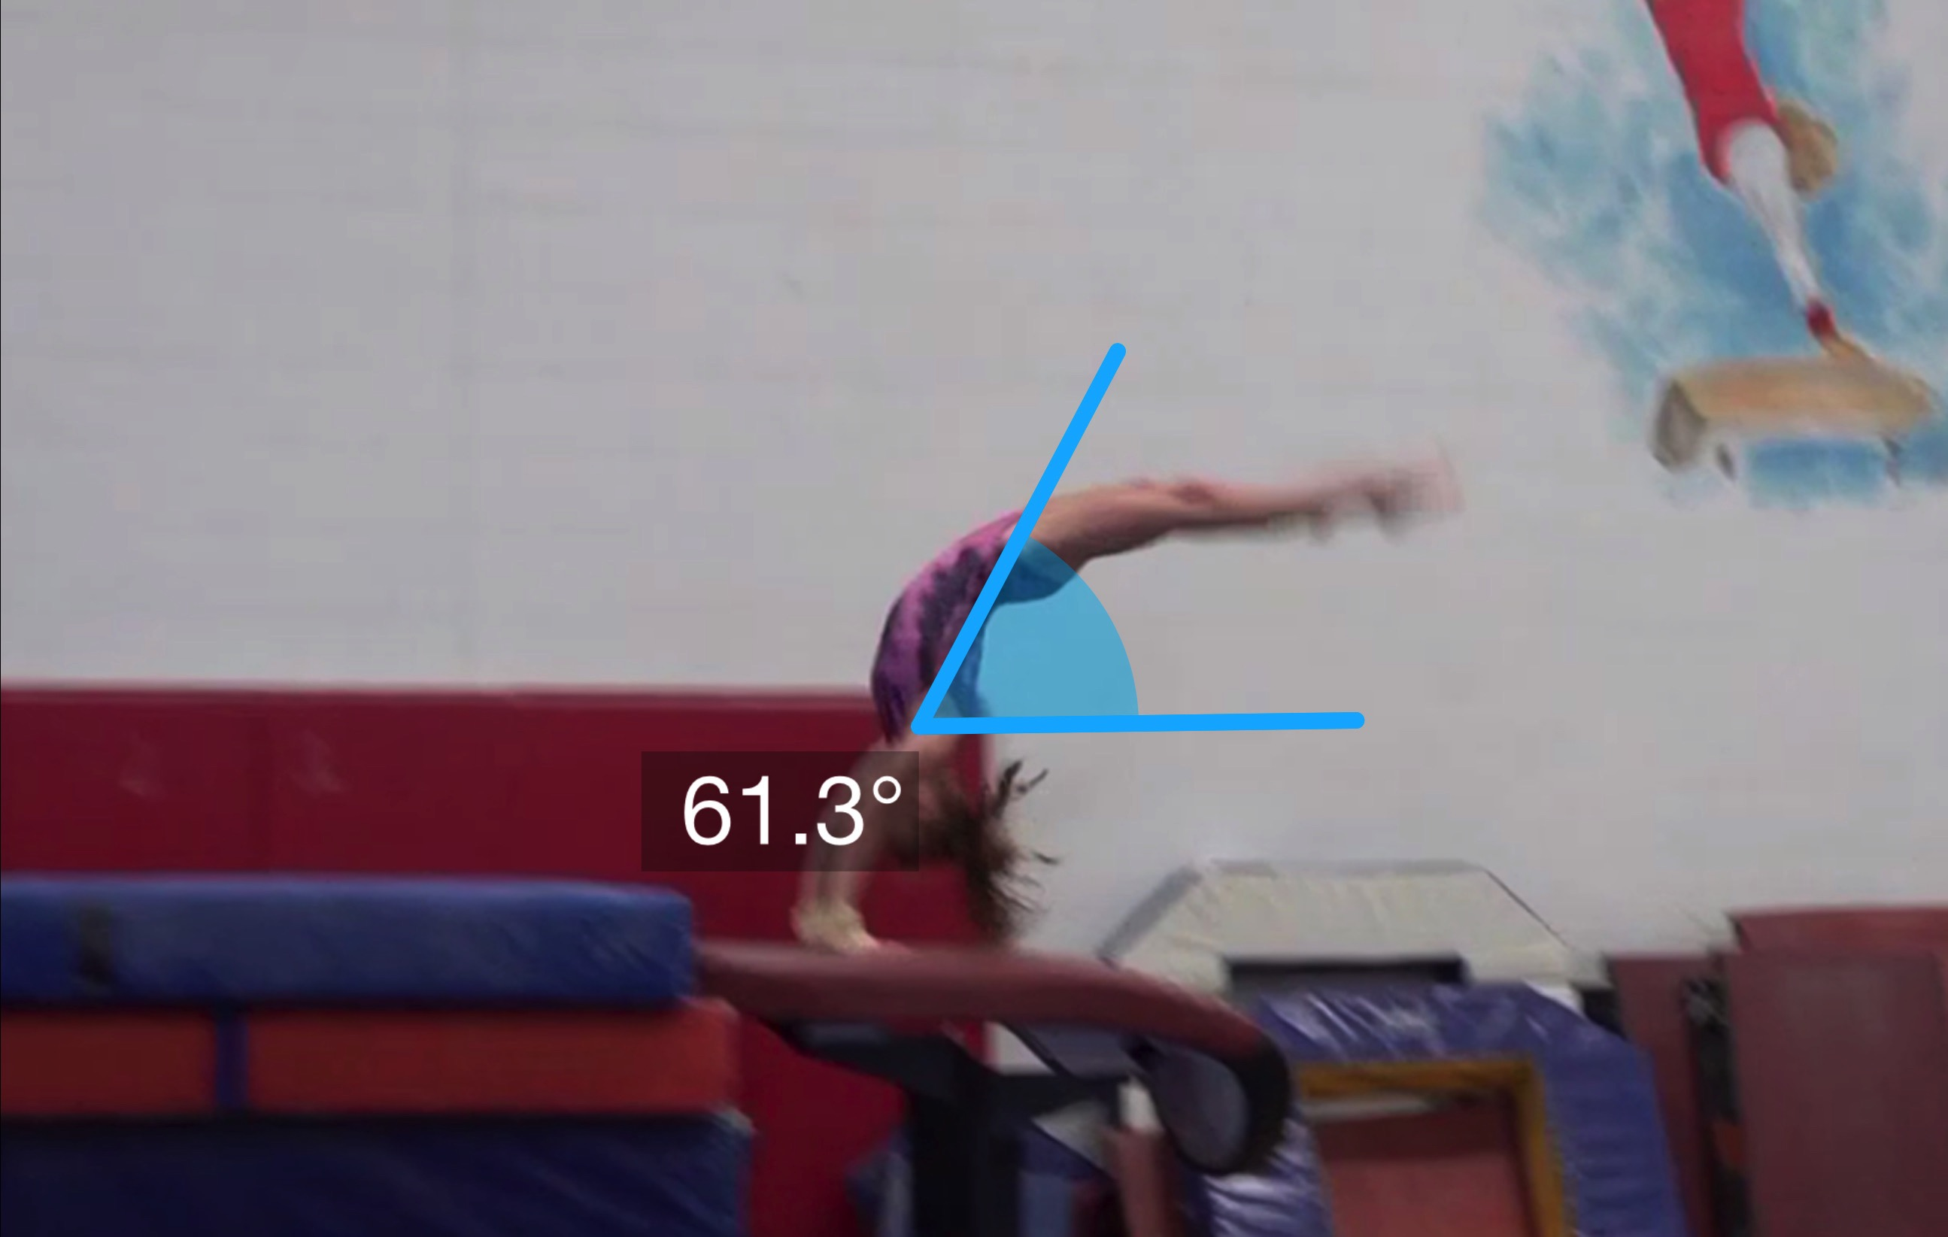
Yurchenko #4
(as is numbered on library dvd to correspond)
Pre Flight Body Position
Angle of Arrival

Slide 10
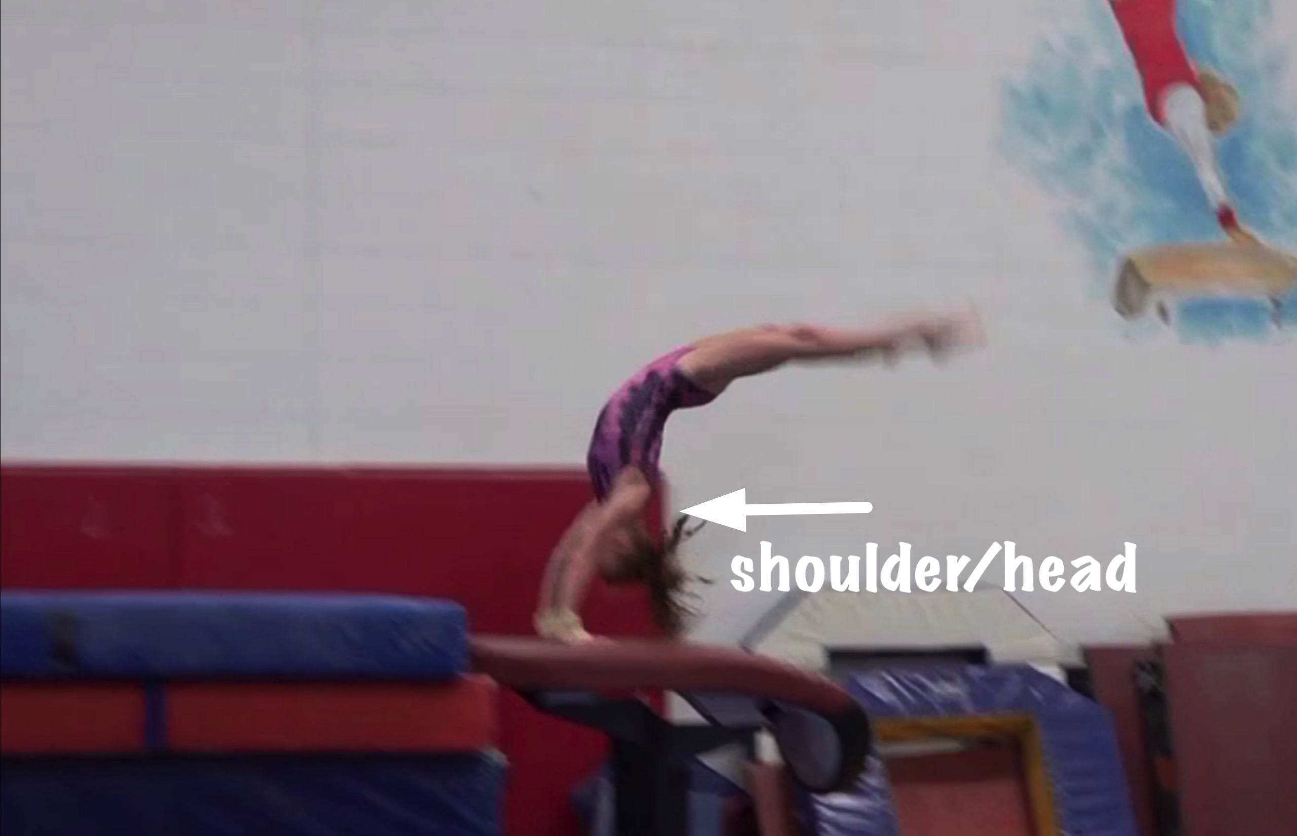
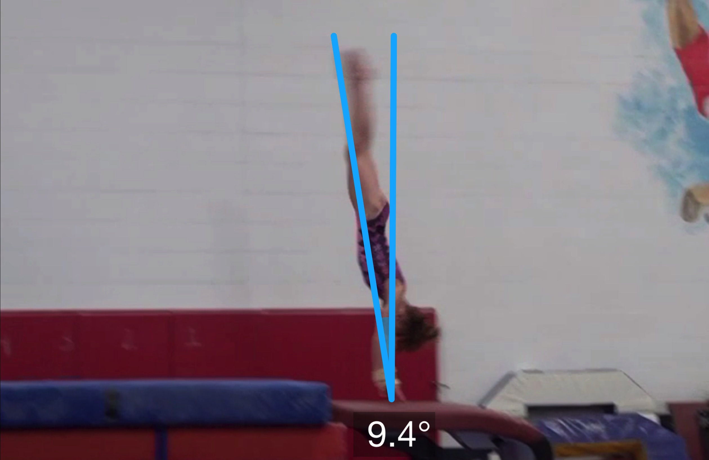
Yurchenko #4
Angle off the Table and corresponding Time in Support
Body Position in Support

Slide 11
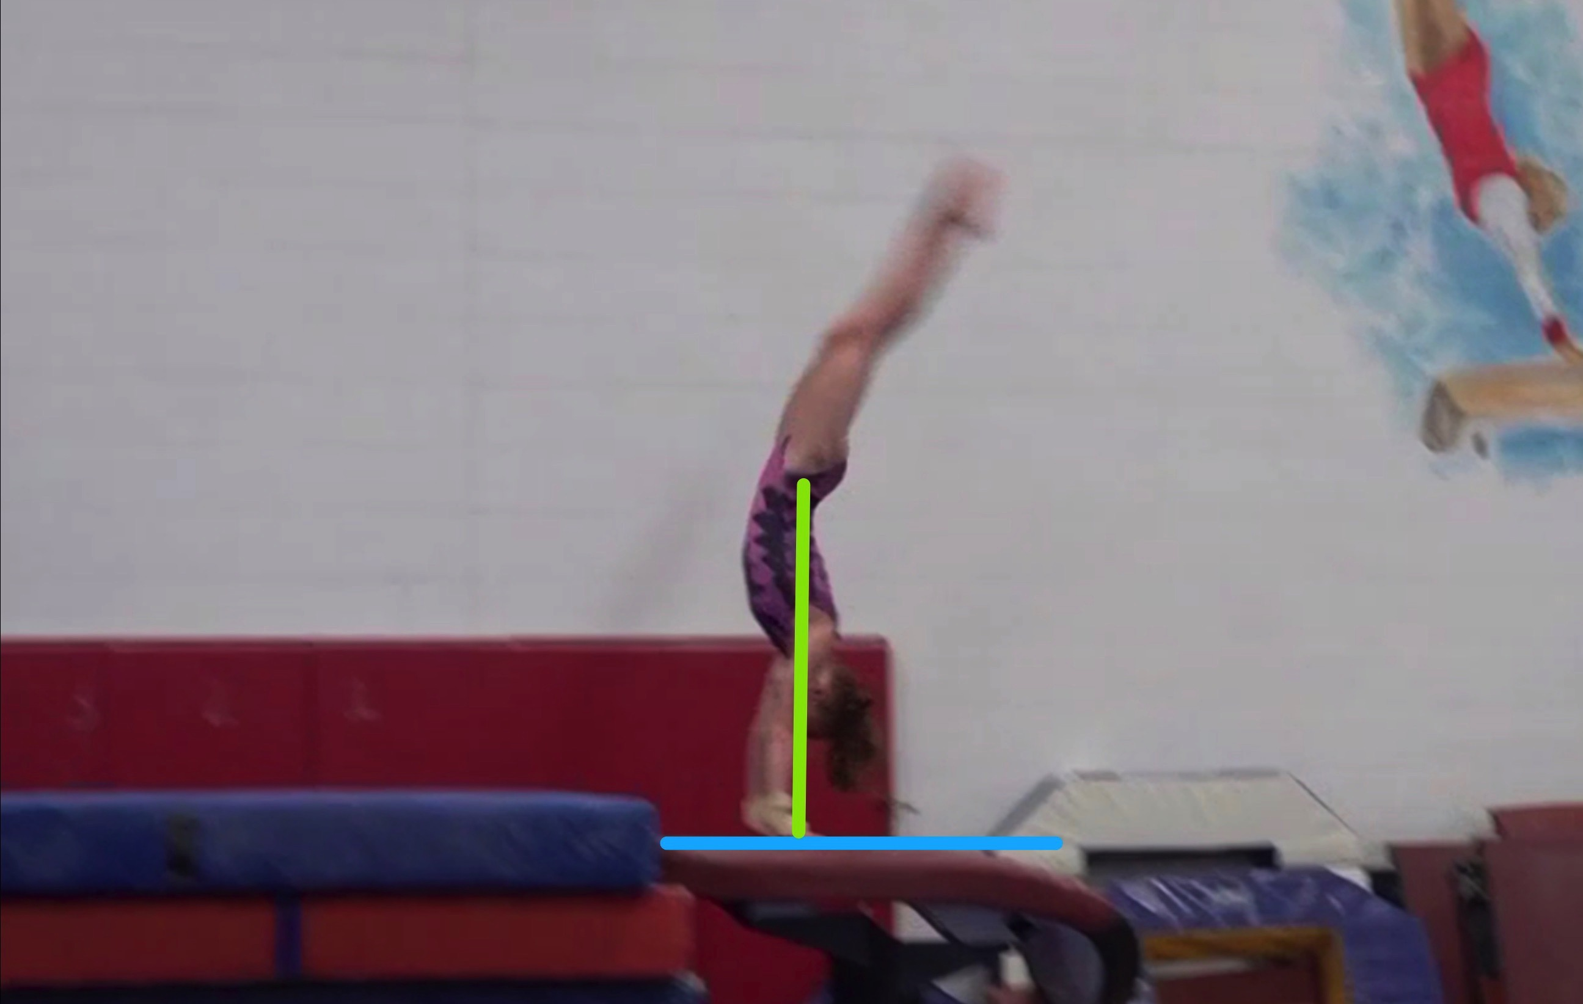
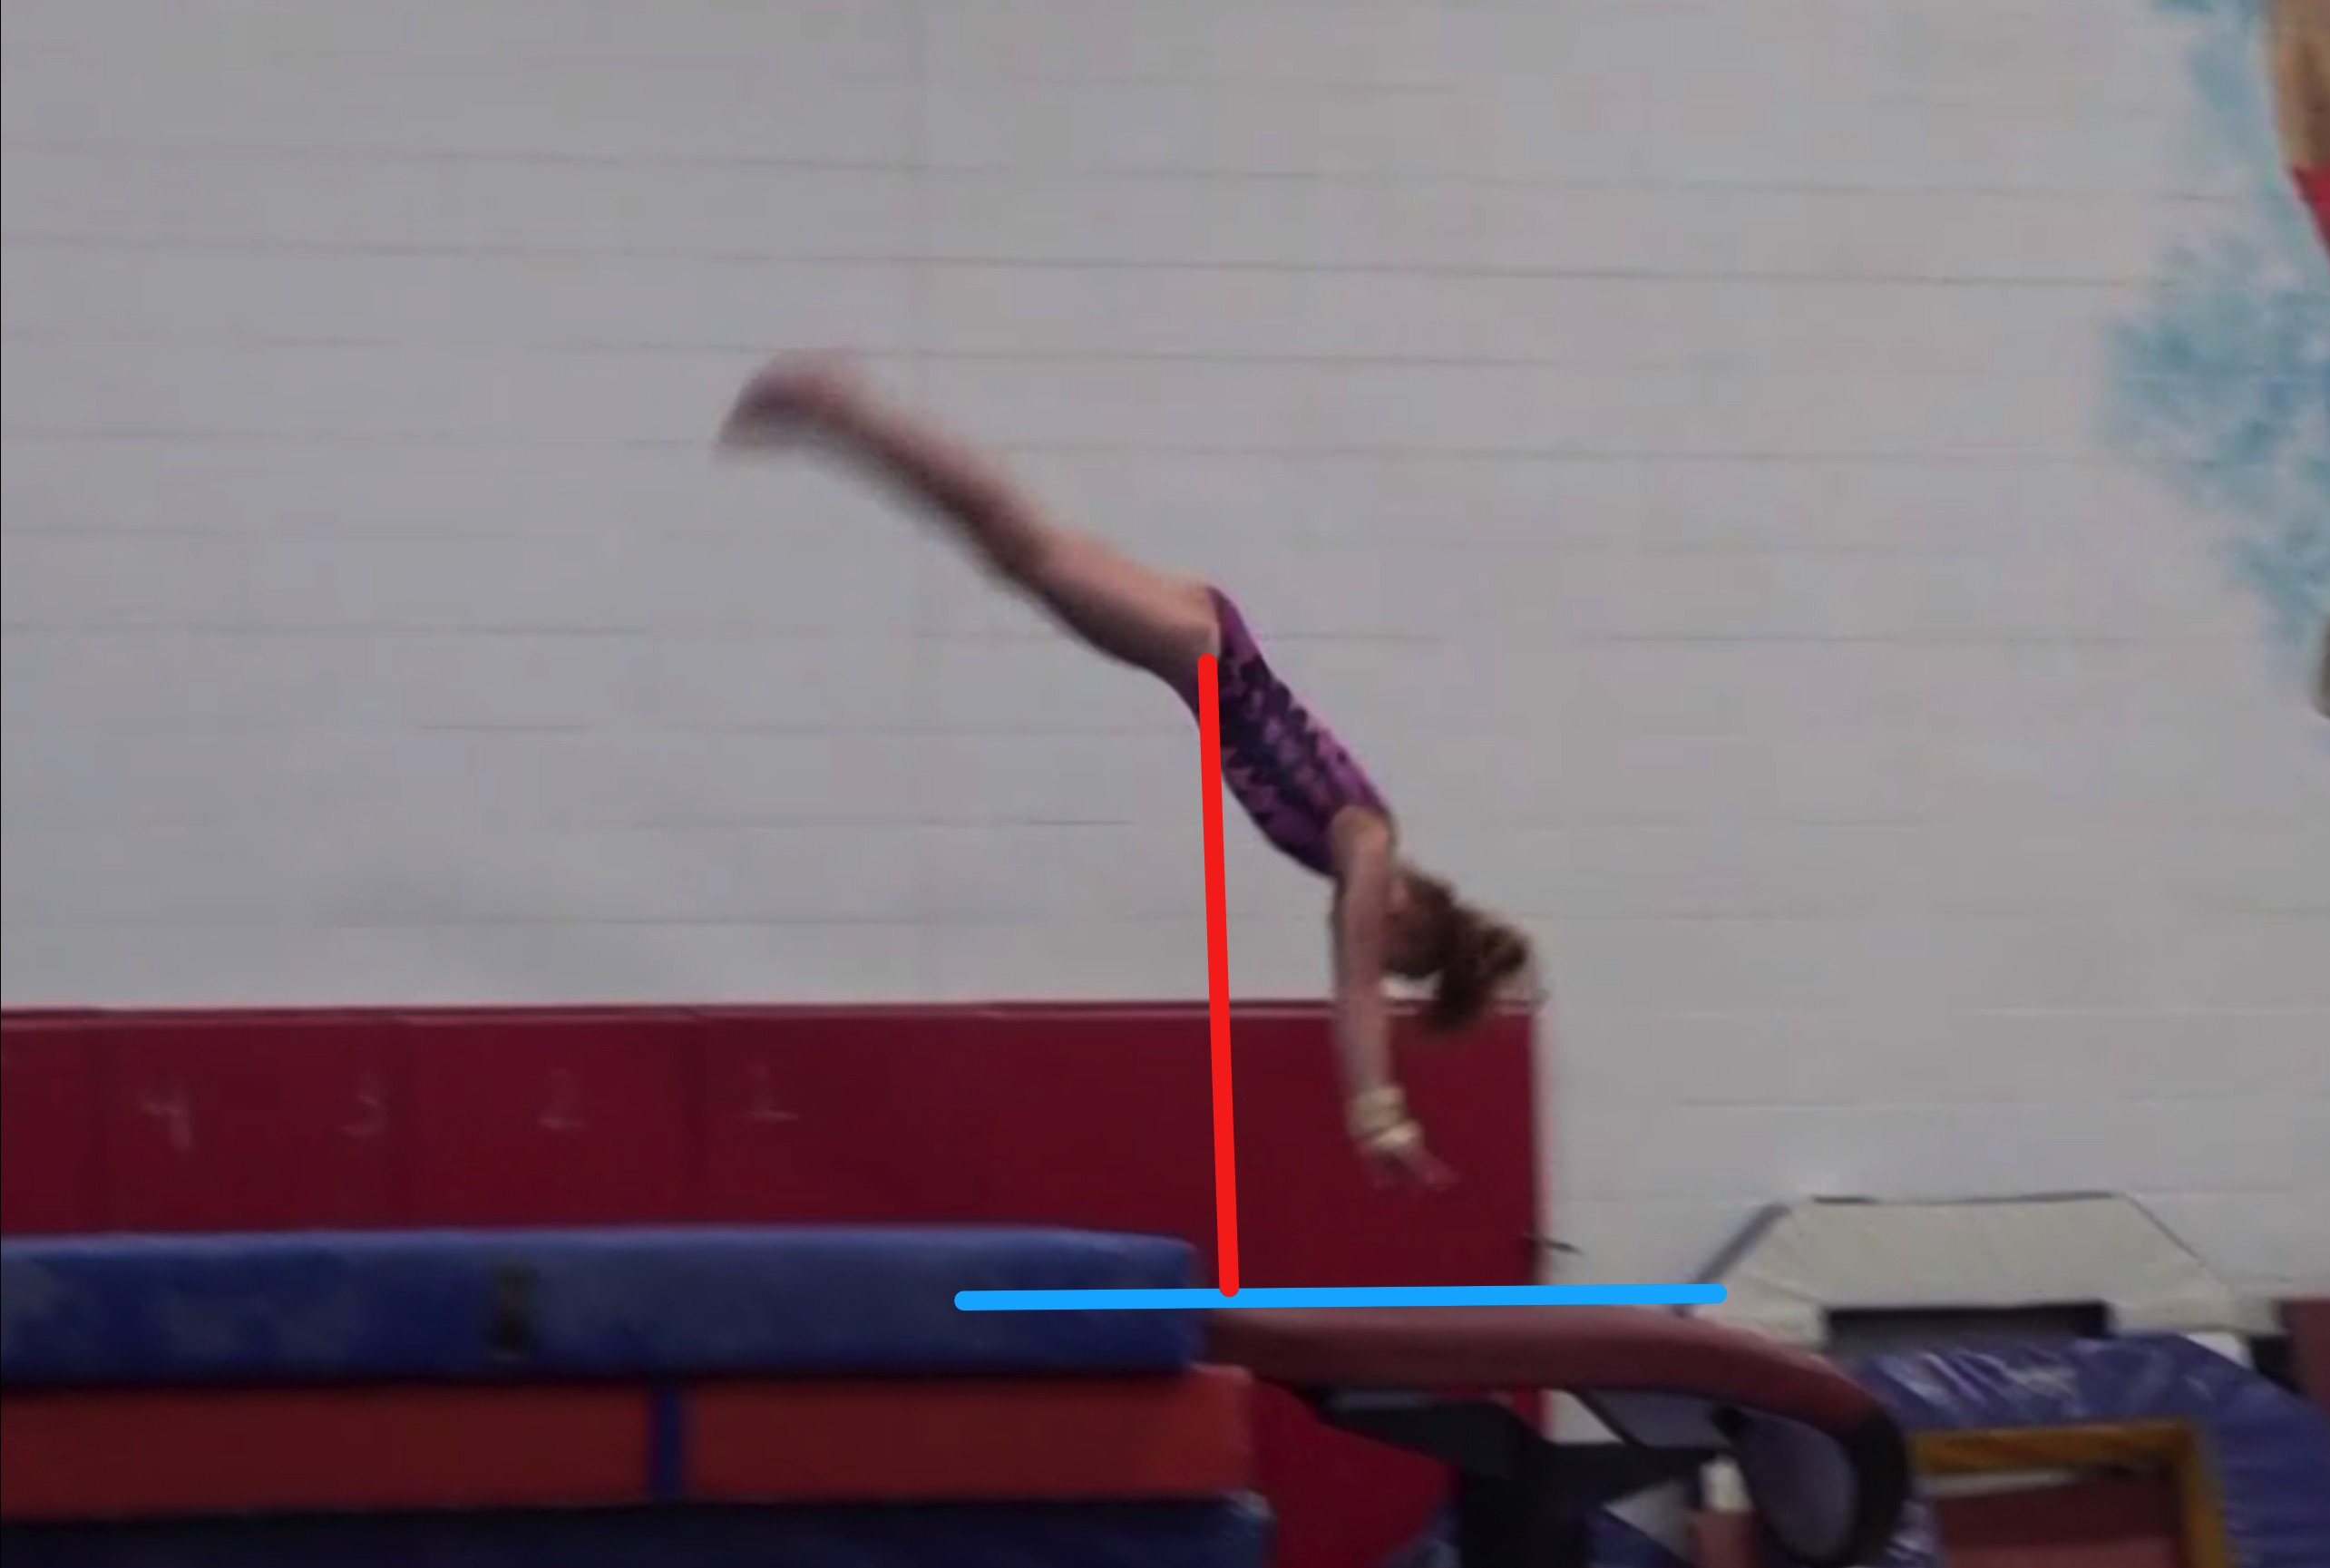
Yurchenko #4
Height Baseline (measured from table to center of gravity when inverted at moment of repulsion.
Height Achieved (compare red line to green line after lining up blue table height line for accurate comparison.

Slide 12
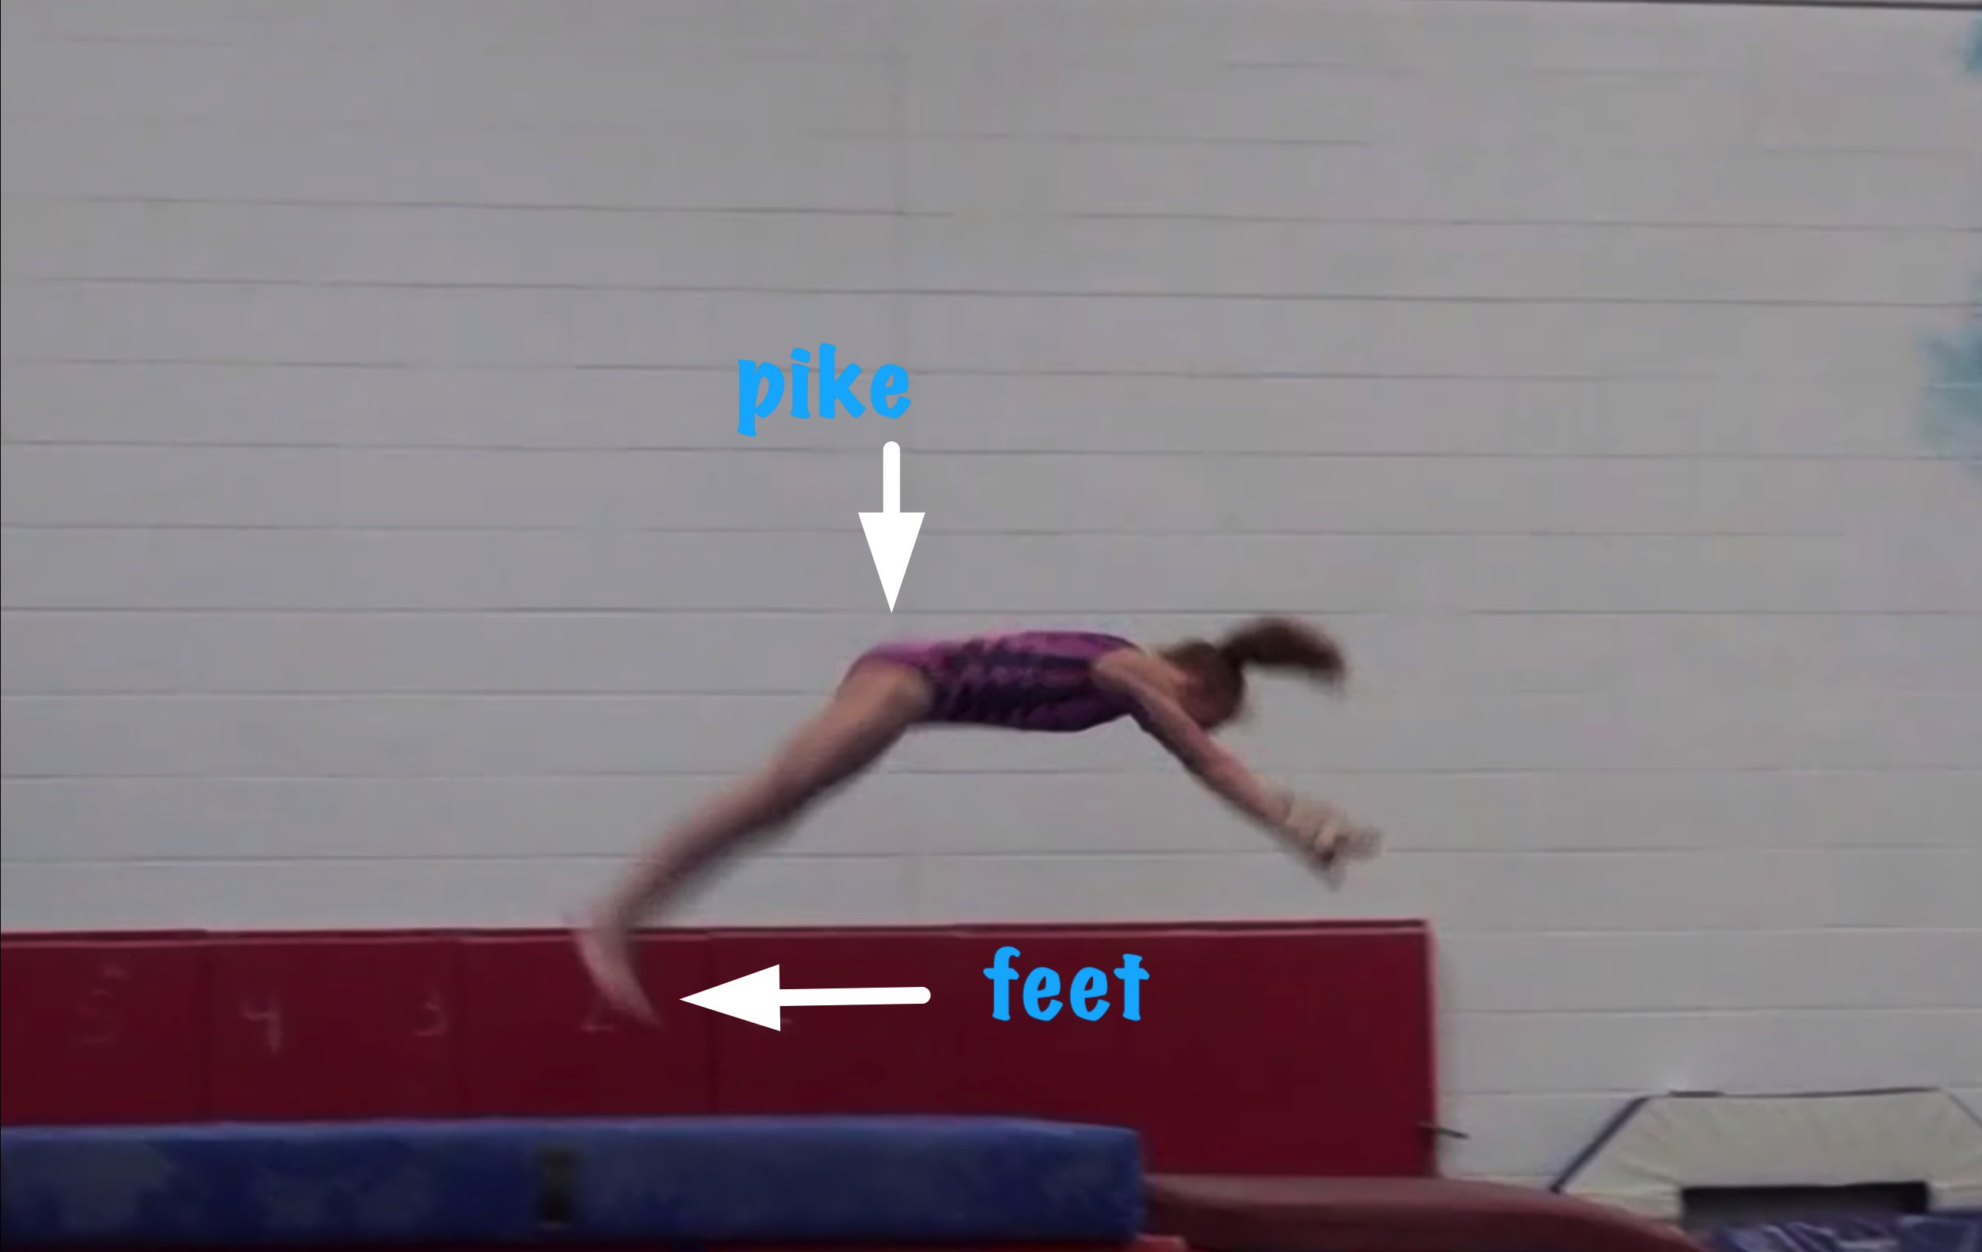
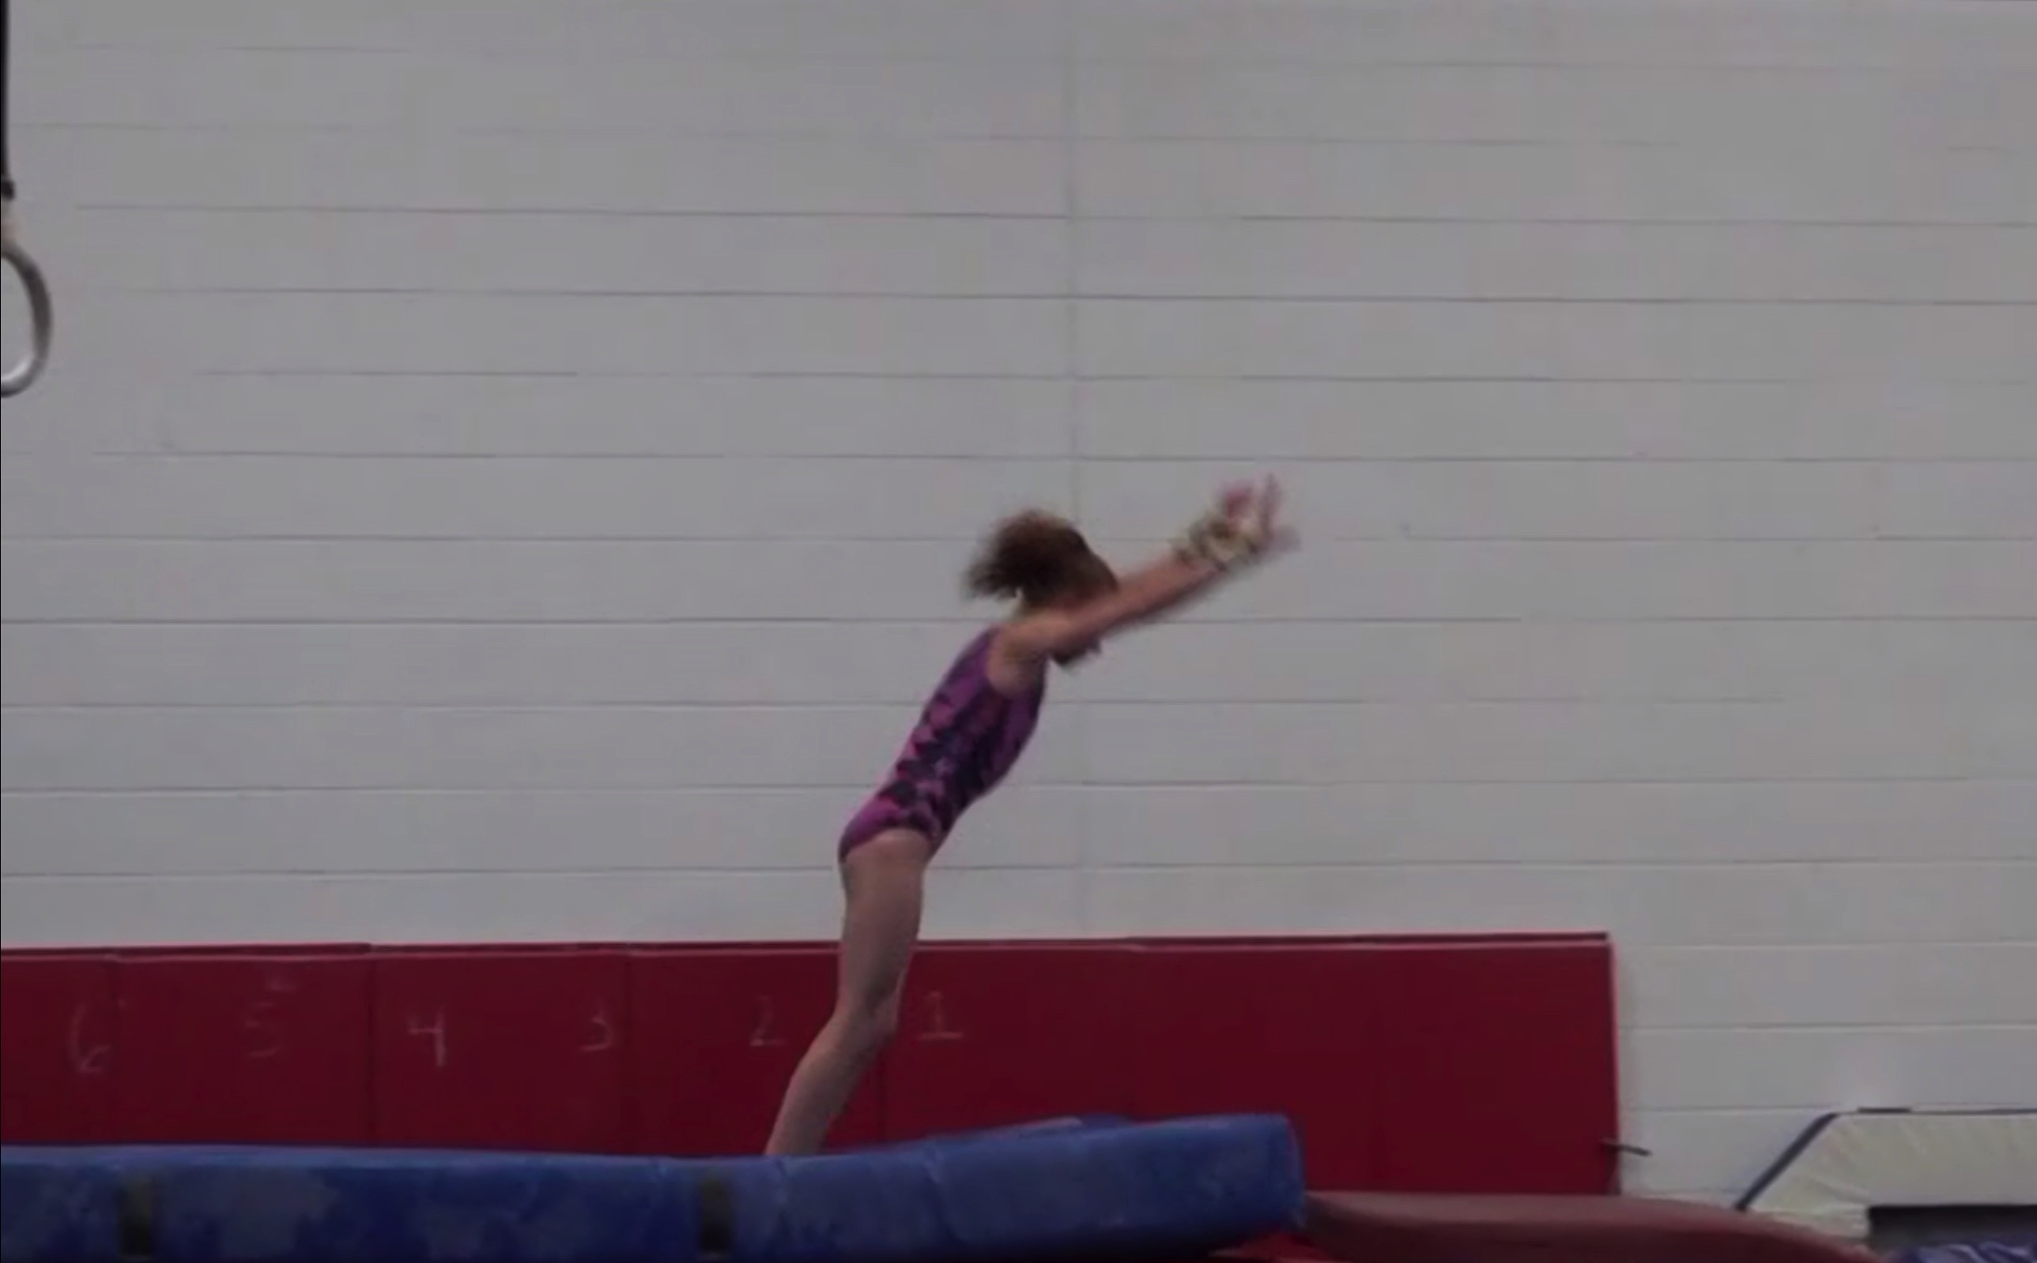
Yurchenko #4
Body Position in post flight
Posture on Contact & Distance

Slide 13
Yurchenko #4 UNOFFICIAL Vetted Deductions Breakdown
Pre Flight Body Position: .2
Angle on: .2
In Support Body Position: .3
Angle off: .1
Time in Support: .1
Height: .3
Off Flight Body Position: .3
Posture on Landing: 0
Landing: 0
Distance: .1
Dynamics: .2
Score: 8.2
Look at the vault again and use the slider to view it in slow motion and study the corresponding deductions for each phase of the vault.

Slide 14
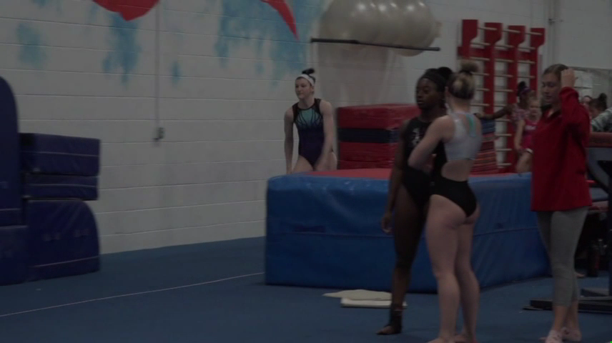
Level 6/7 vault by Nawgj
Education committee August 2018
Films provided by judy dobransky, nawgj library
Yurchenko #2 (watch and compare to model on the right)
Current Yurchenko MODEL (#9)

Slide 15
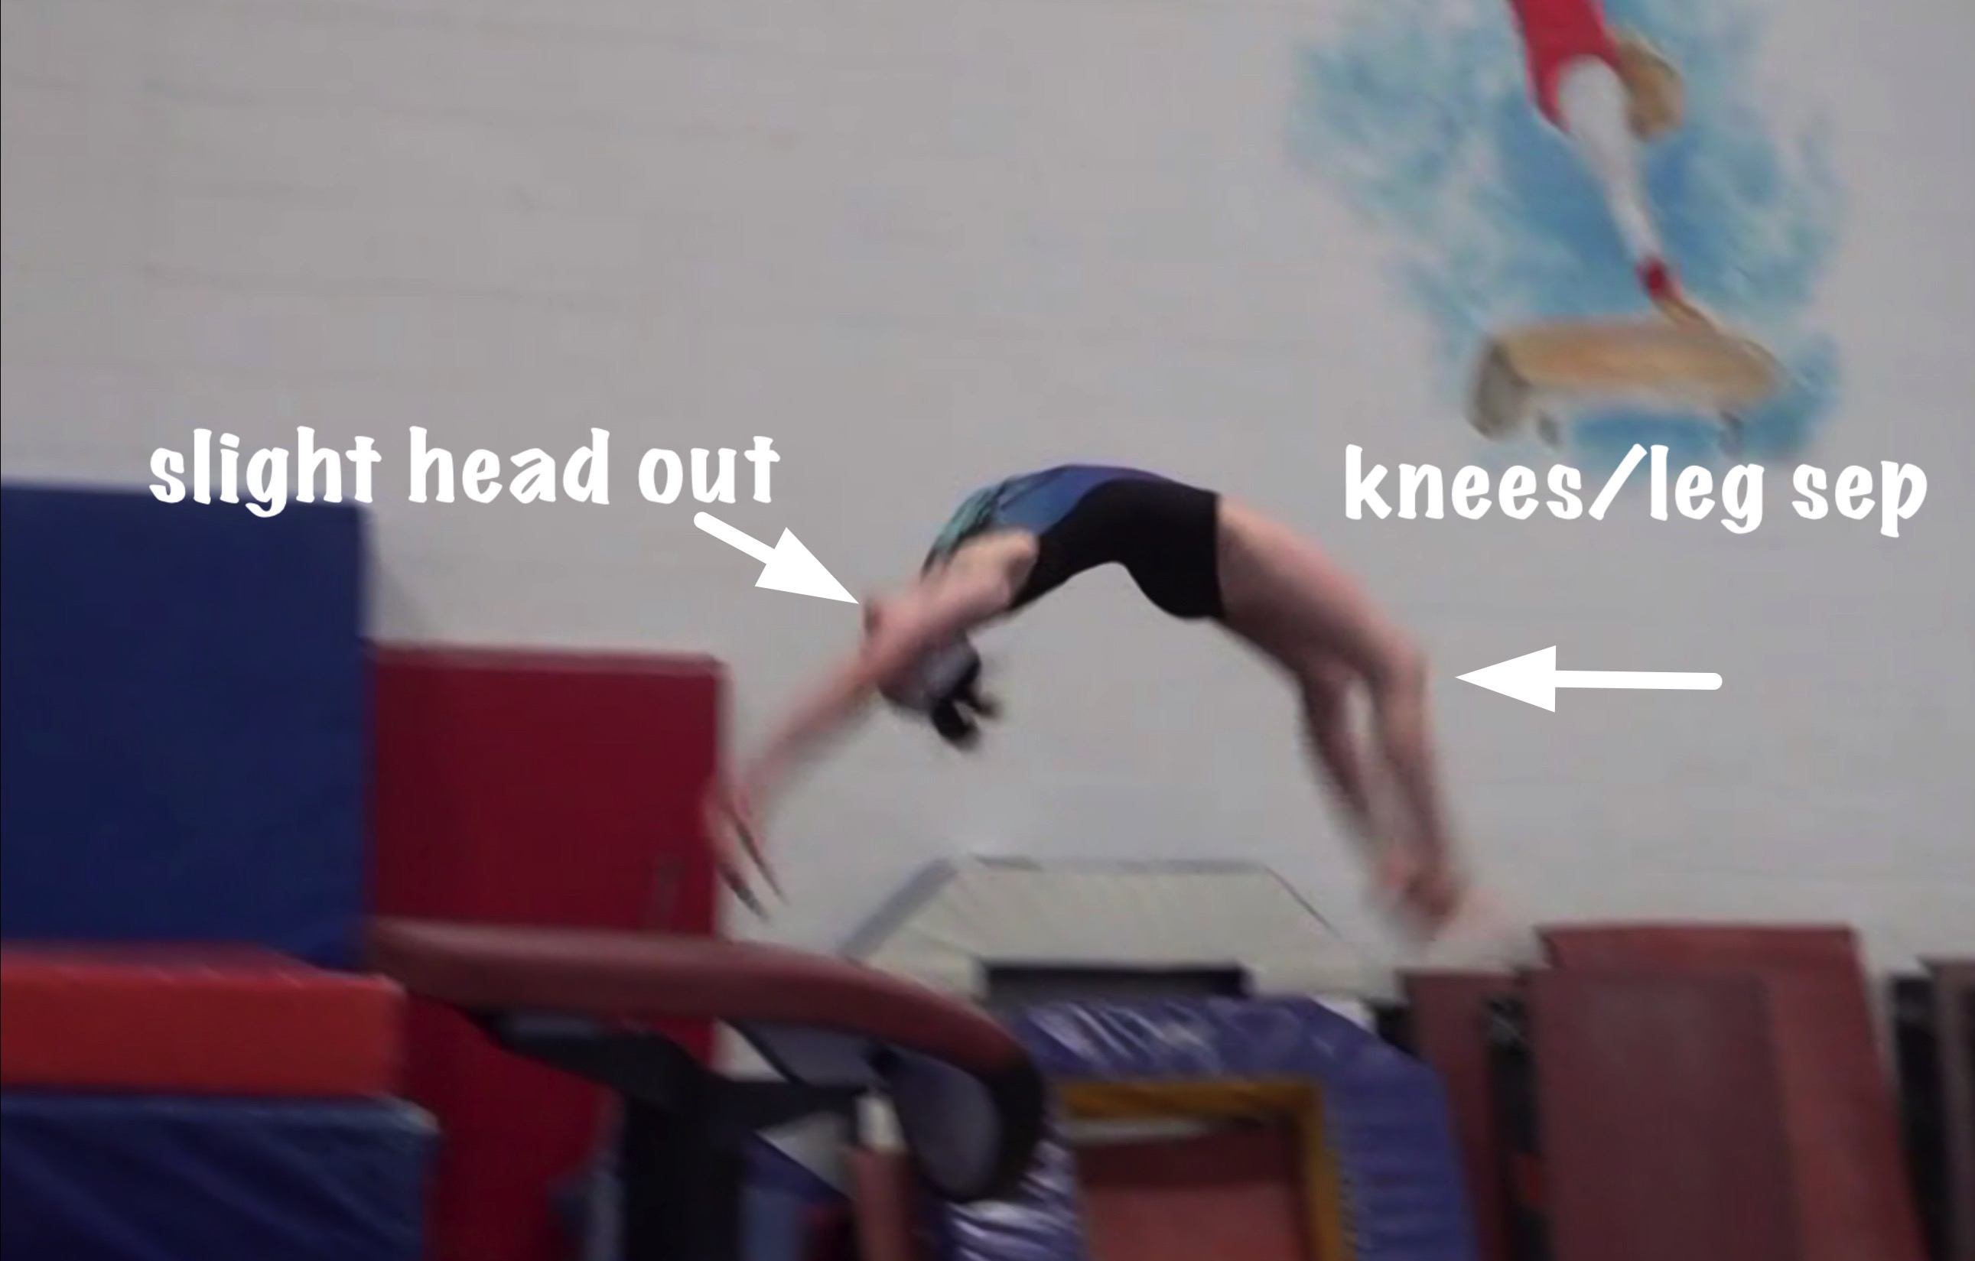
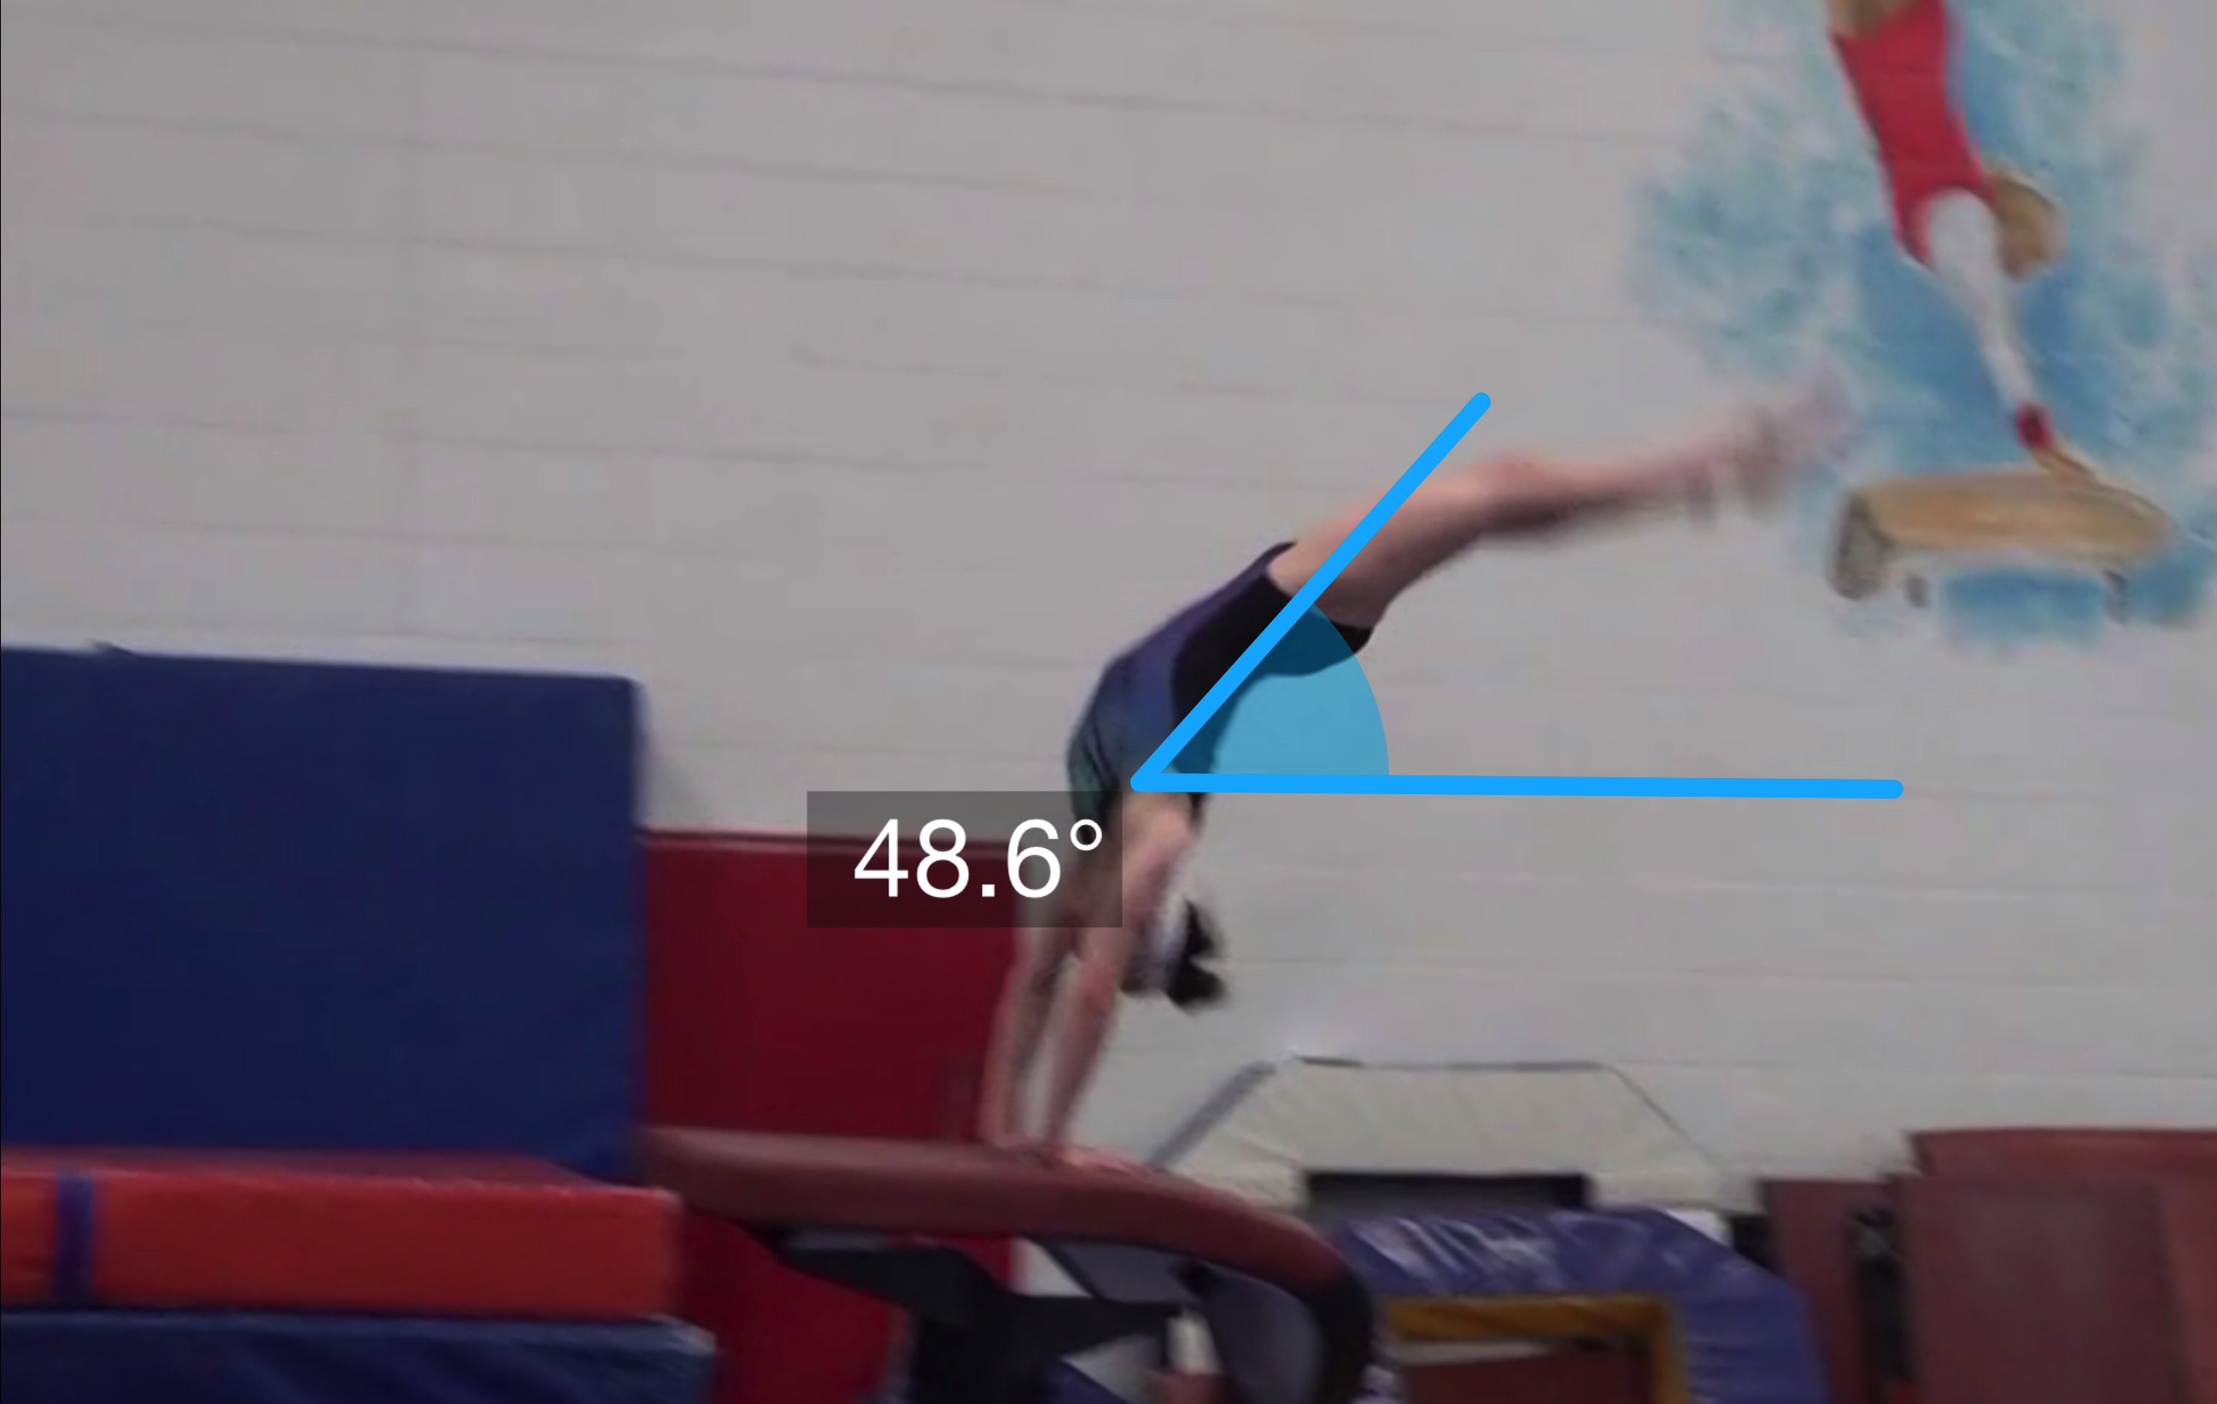
Yurchenko #2
(as is numbered on library dvd to correspond)
Pre Flight Body Position
Angle of Arrival
Notes:
On the angle of arrival slide the shoulders may arguable be considered OPEN so with tech committee clarifications you may draw the angle on from the hands through hips. The reality is that in full speed it appears to be slightly high on and therefore perhaps a .1 deduction.

Slide 16
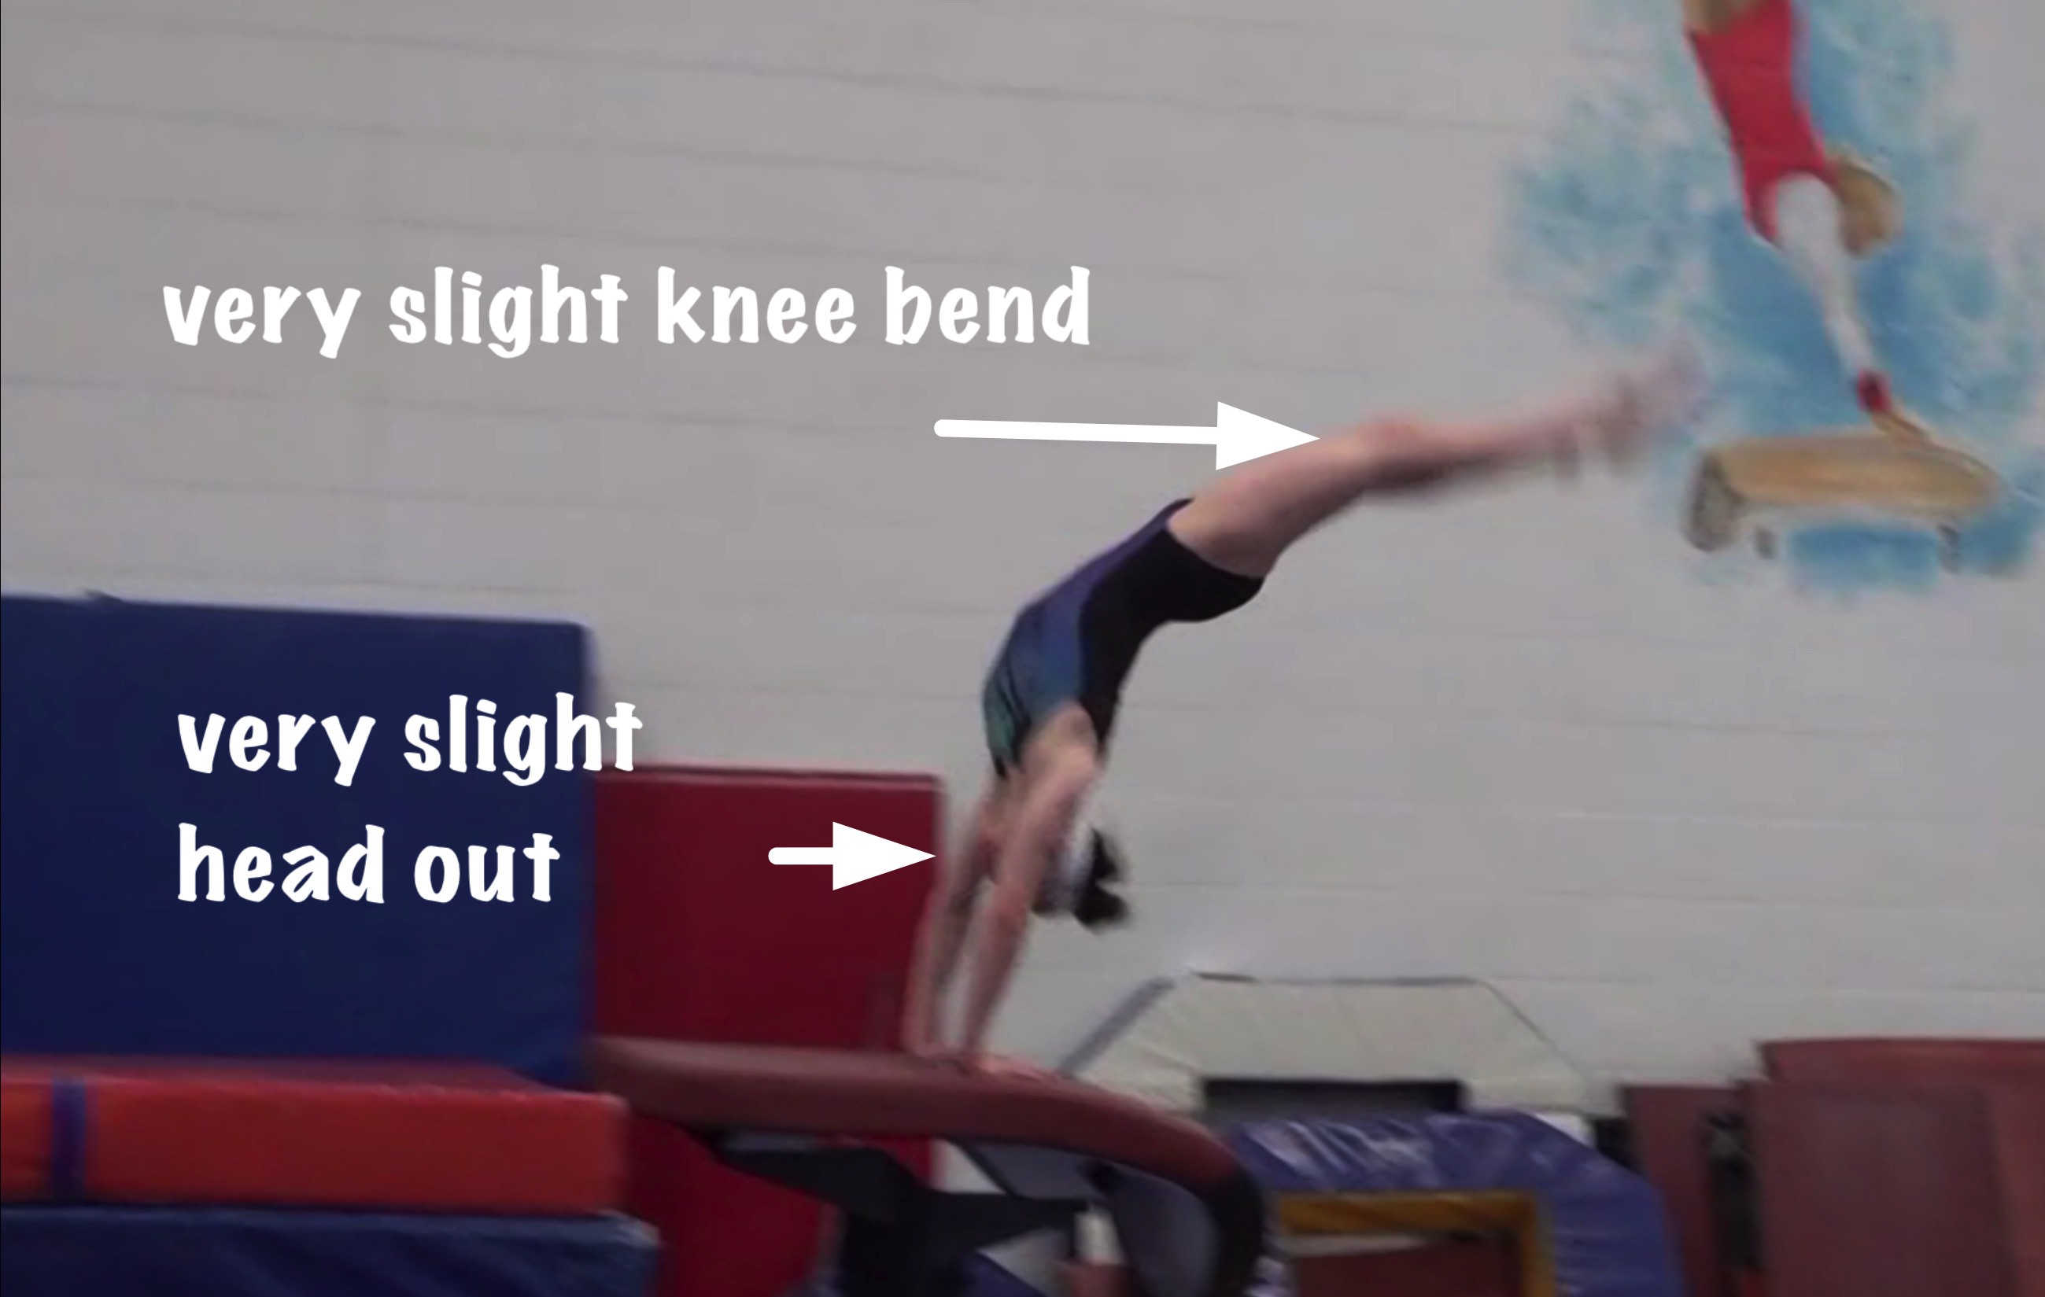
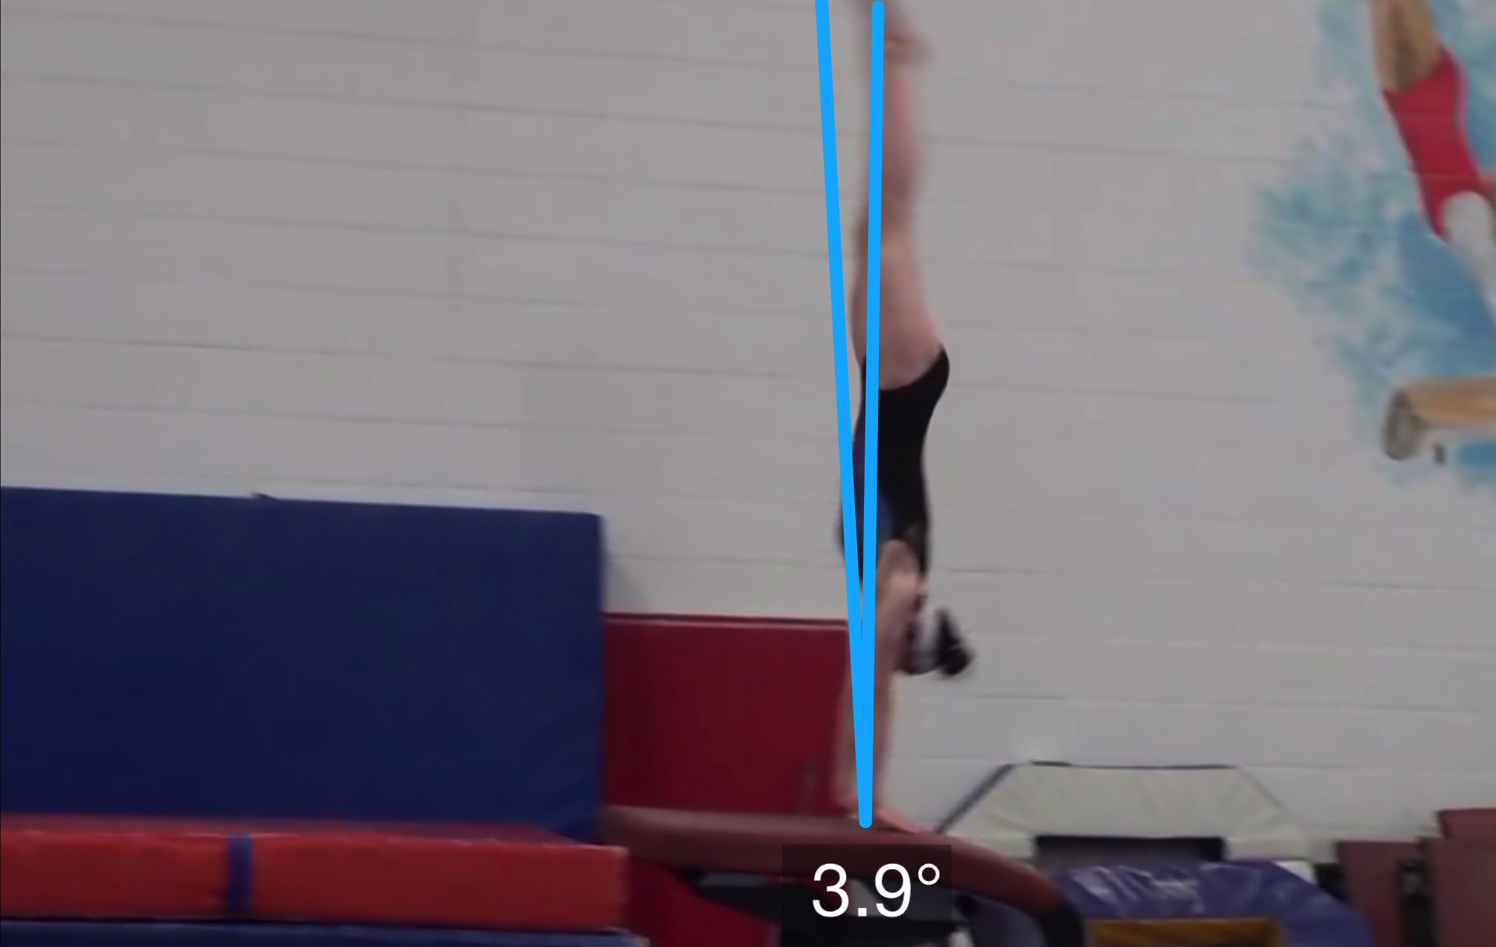
Yurchenko #2
Angle off the Table and corresponding Time in Support
Body Position in Support

Slide 17
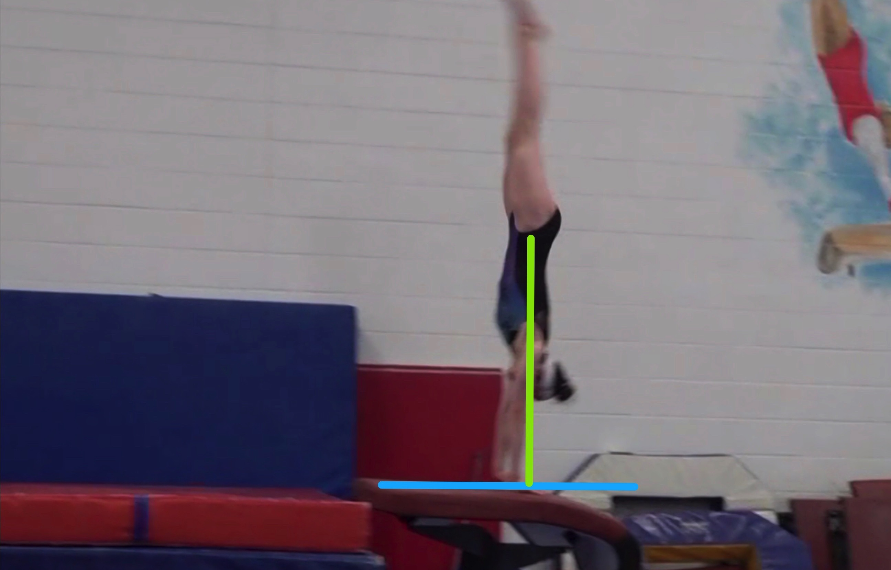
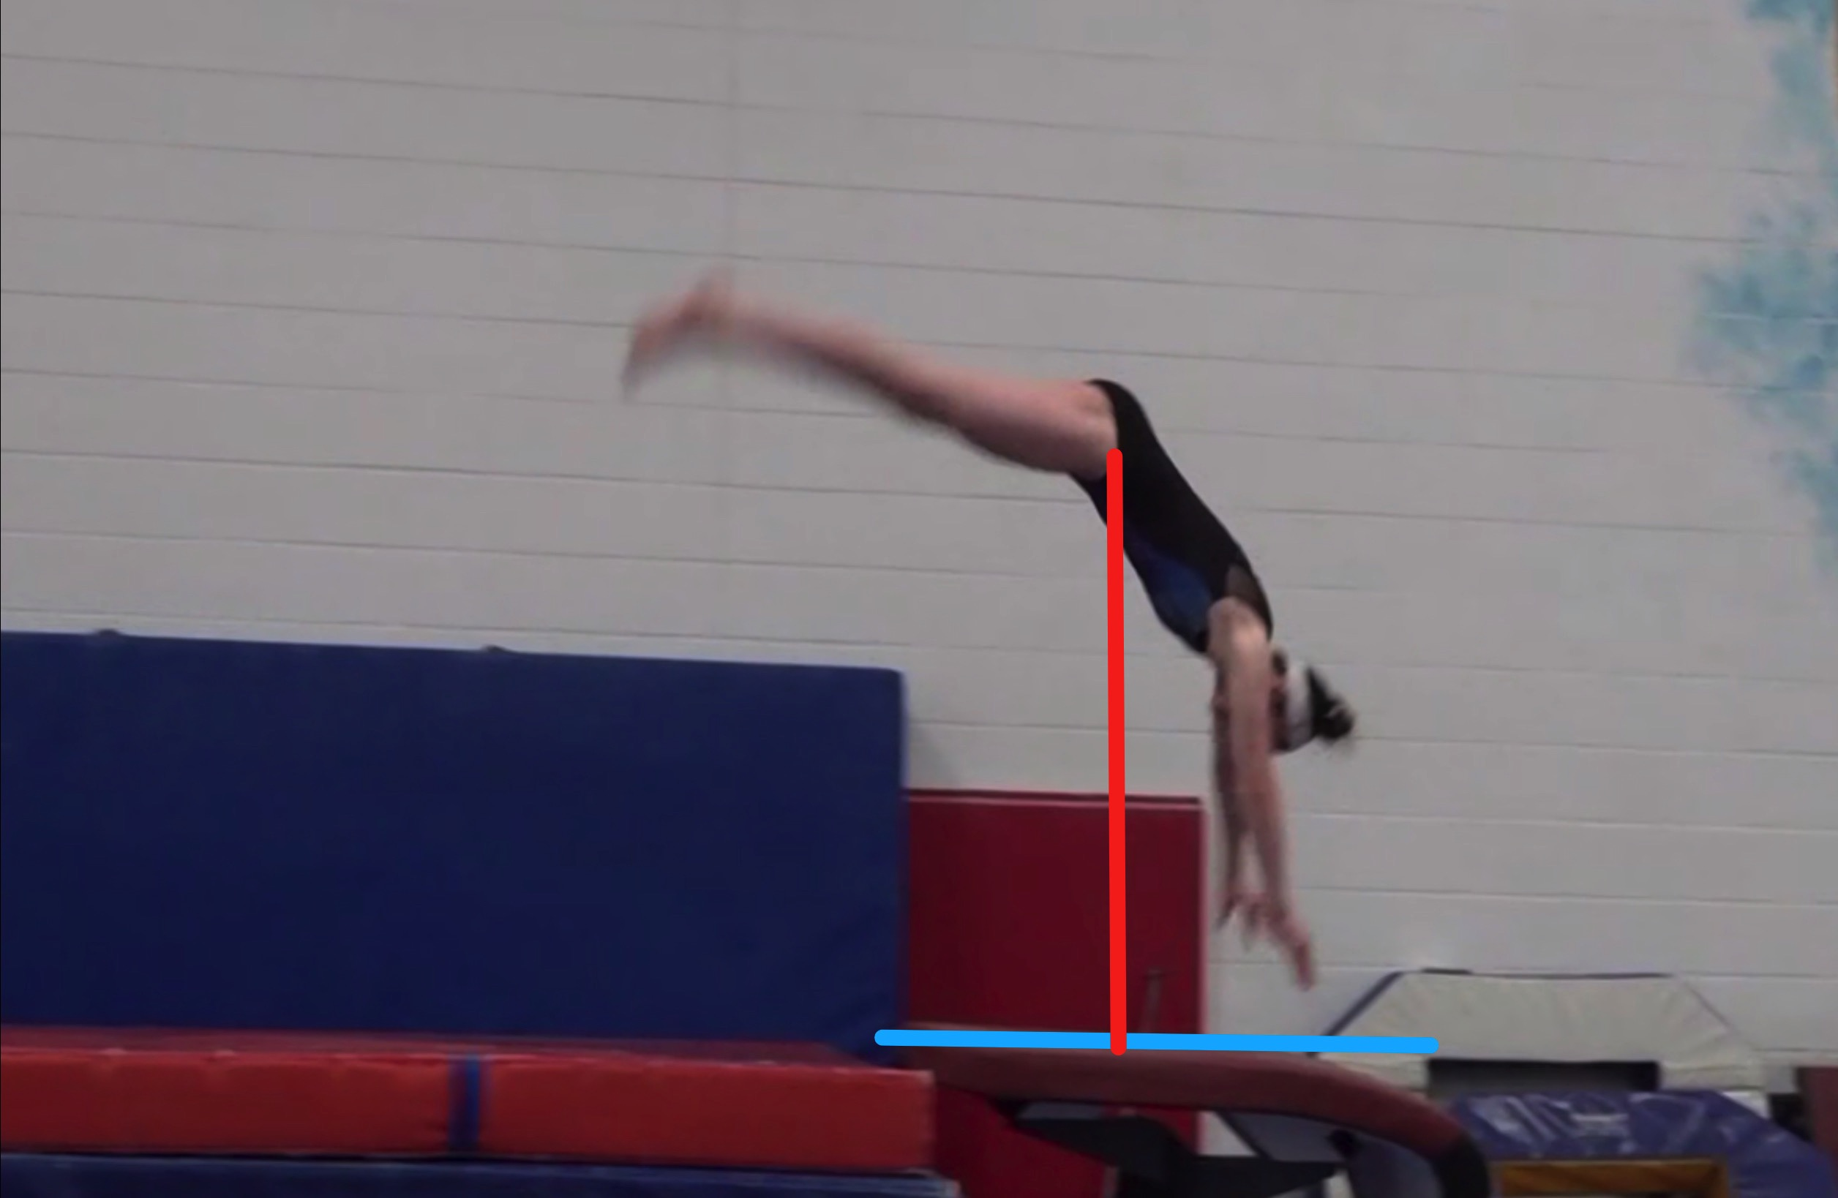
Yurchenko #2
Height Baseline (measured from table to center of gravity when inverted at moment of repulsion.
Height Achieved (compare red line to green line after lining up blue table height line for accurate comparison.

Slide 18
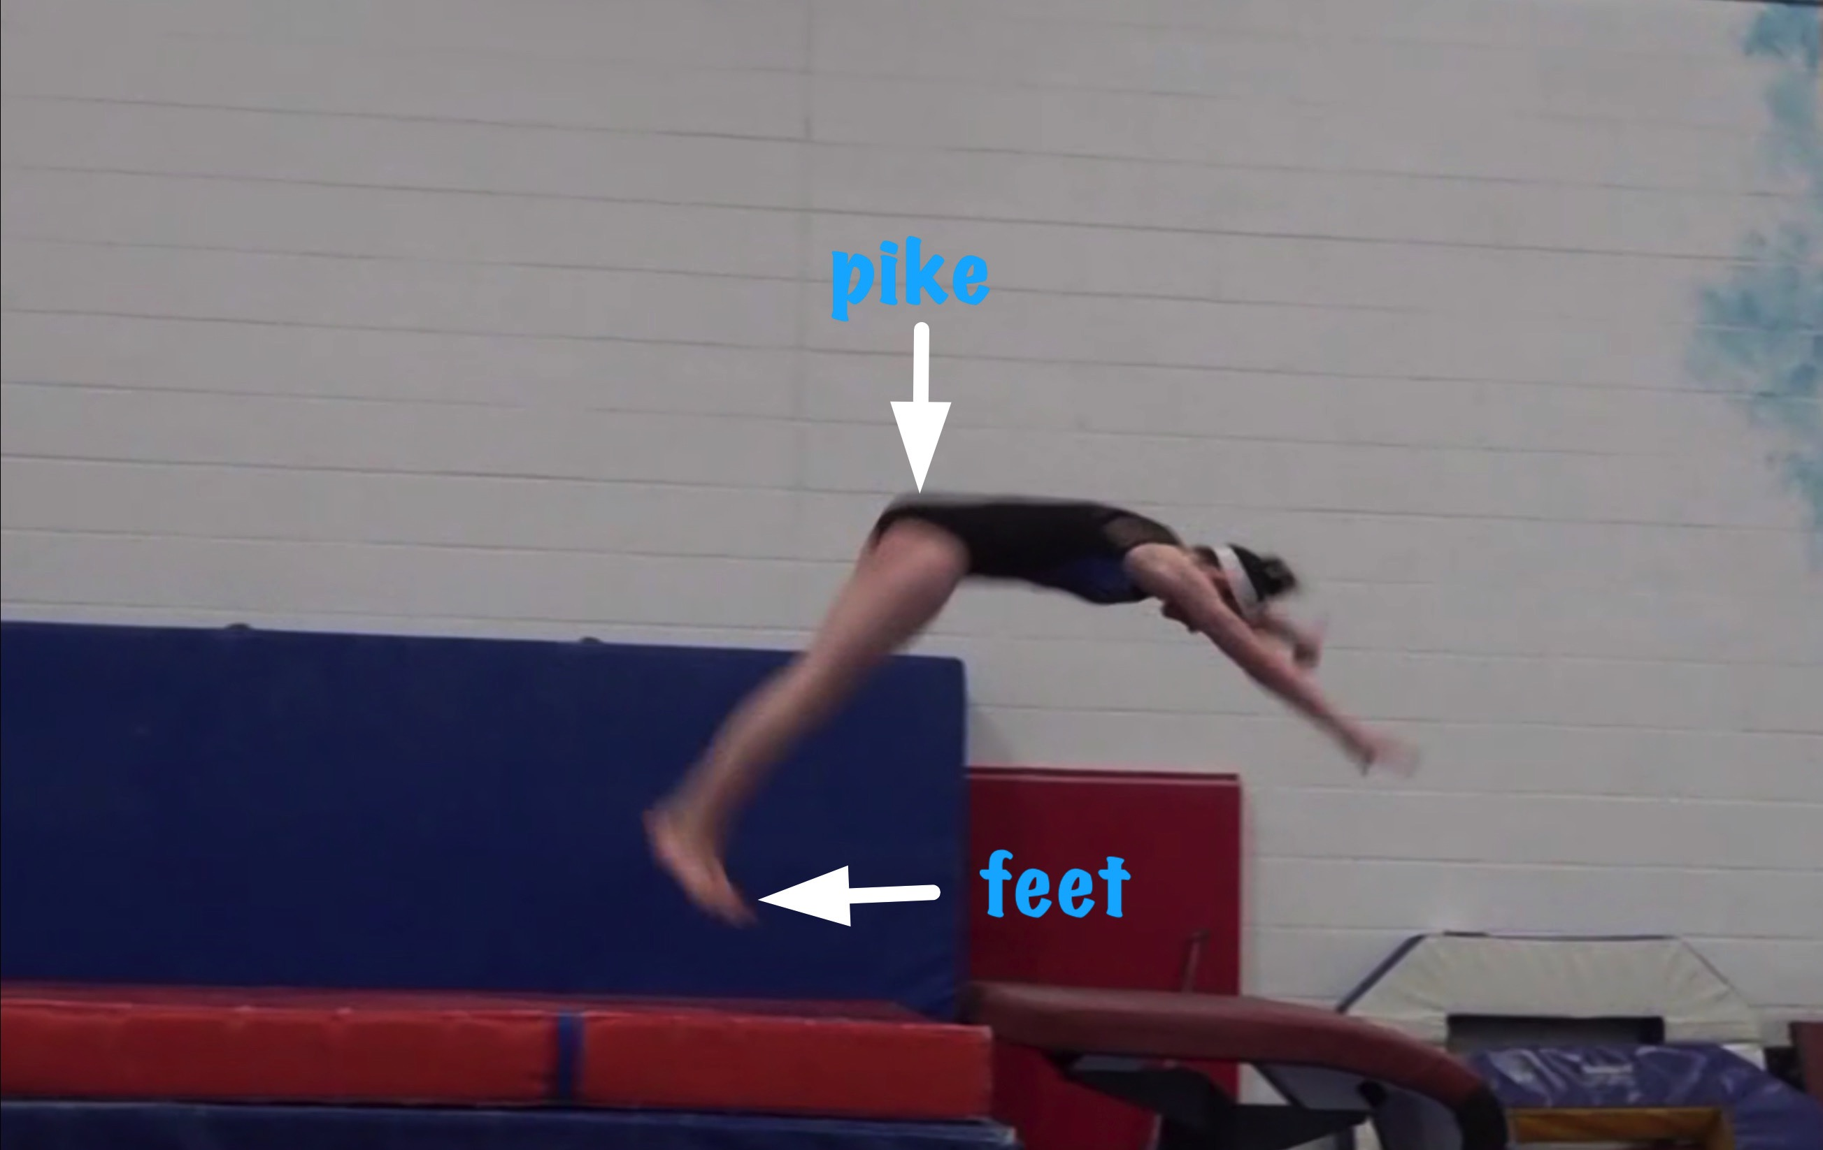
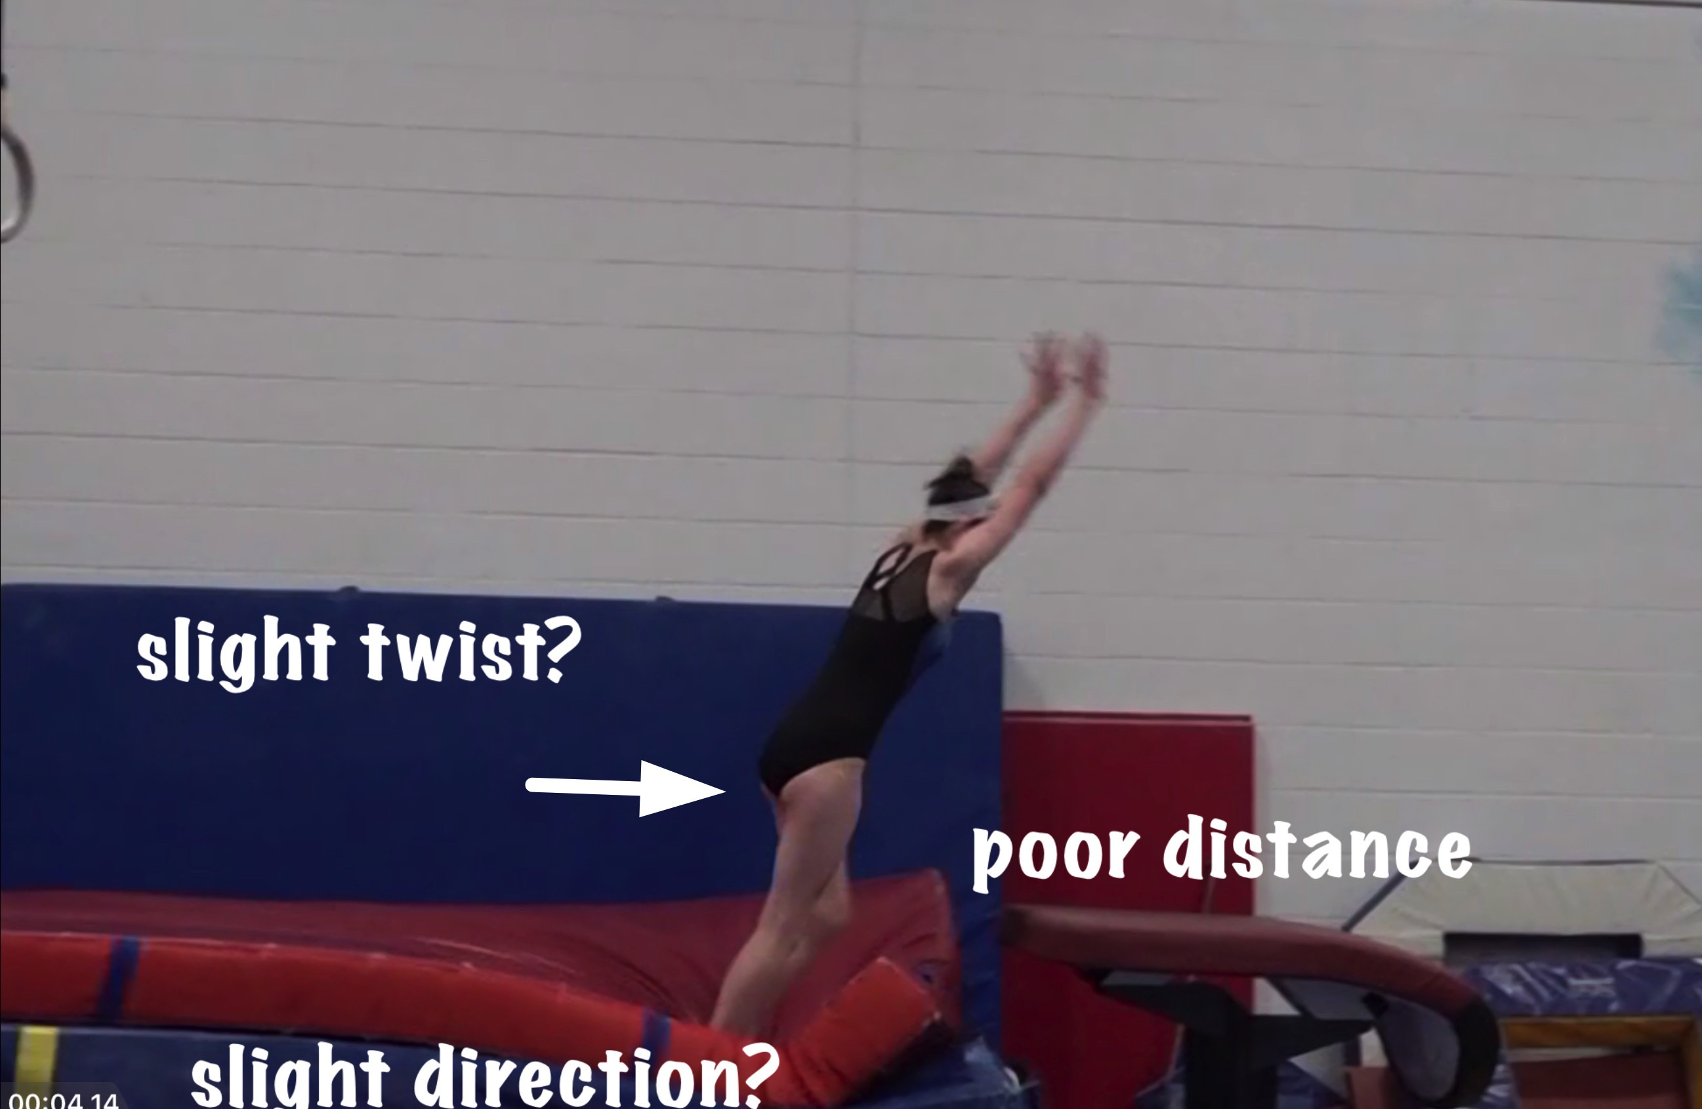
Yurchenko #2
Body Position in post flight
Posture on Contact & Distance

Slide 19
Yurchenko #2 l UNOFFICIAL Vetted Deductions Breakdown
Pre Flight Body Position: .25
Angle on: .1
In Support Body Position: .1
Angle off: .05
Time in Support: .15
Height: .35
Off Flight Body Position: .3
Posture on Landing: .1
Landing: 0
Distance: .2
Dynamics: .15
Score Range: 8.25
Look at the vault again and use the slider to view it in slow motion and study the corresponding deductions for each phase of the vault.

Slide 20
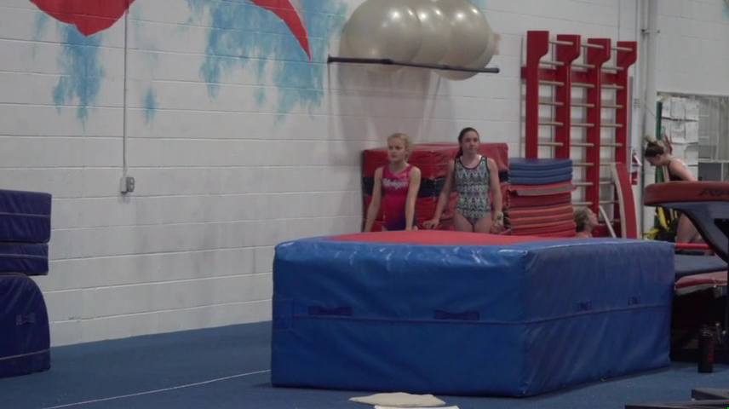
Level 6/7 vault by Nawgj
Education committee August 2018
Films provided by judy dobransky, nawgj library
Yurchenko #5 (watch and compare to model on the right)
Current Yurchenko MODEL (#9)

Slide 21
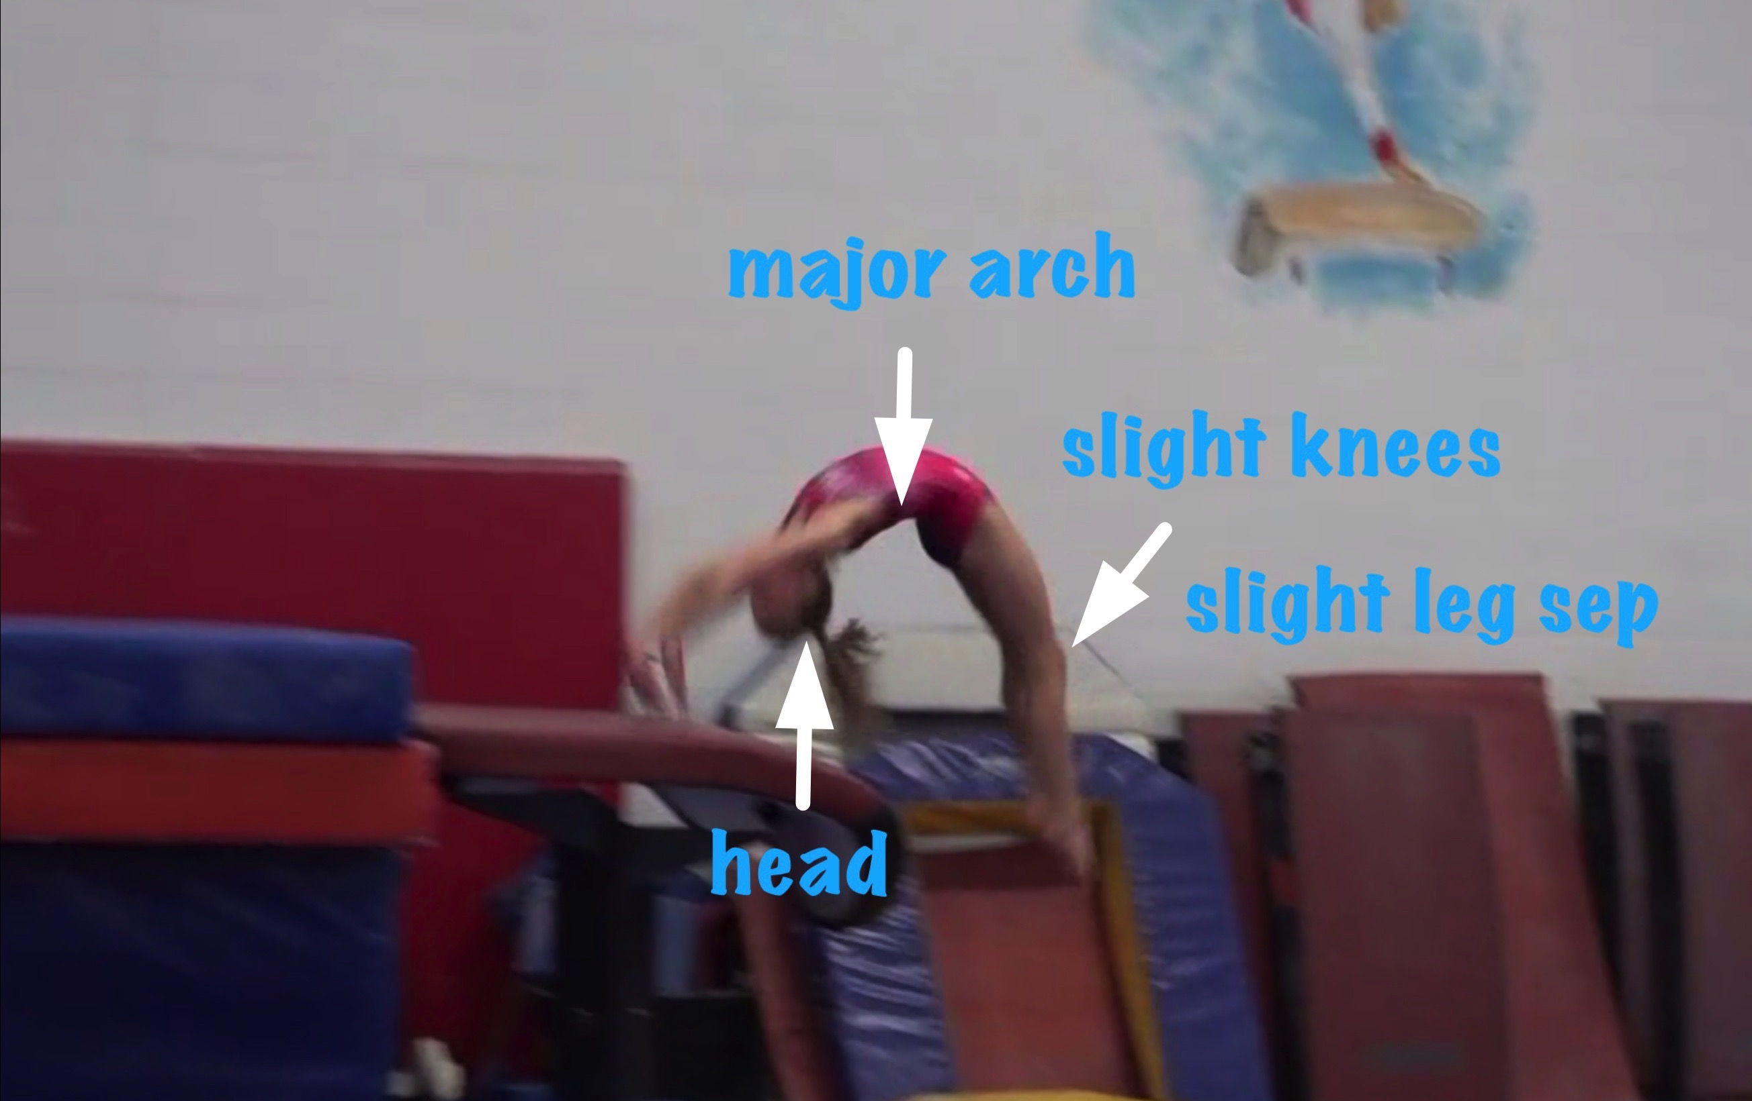
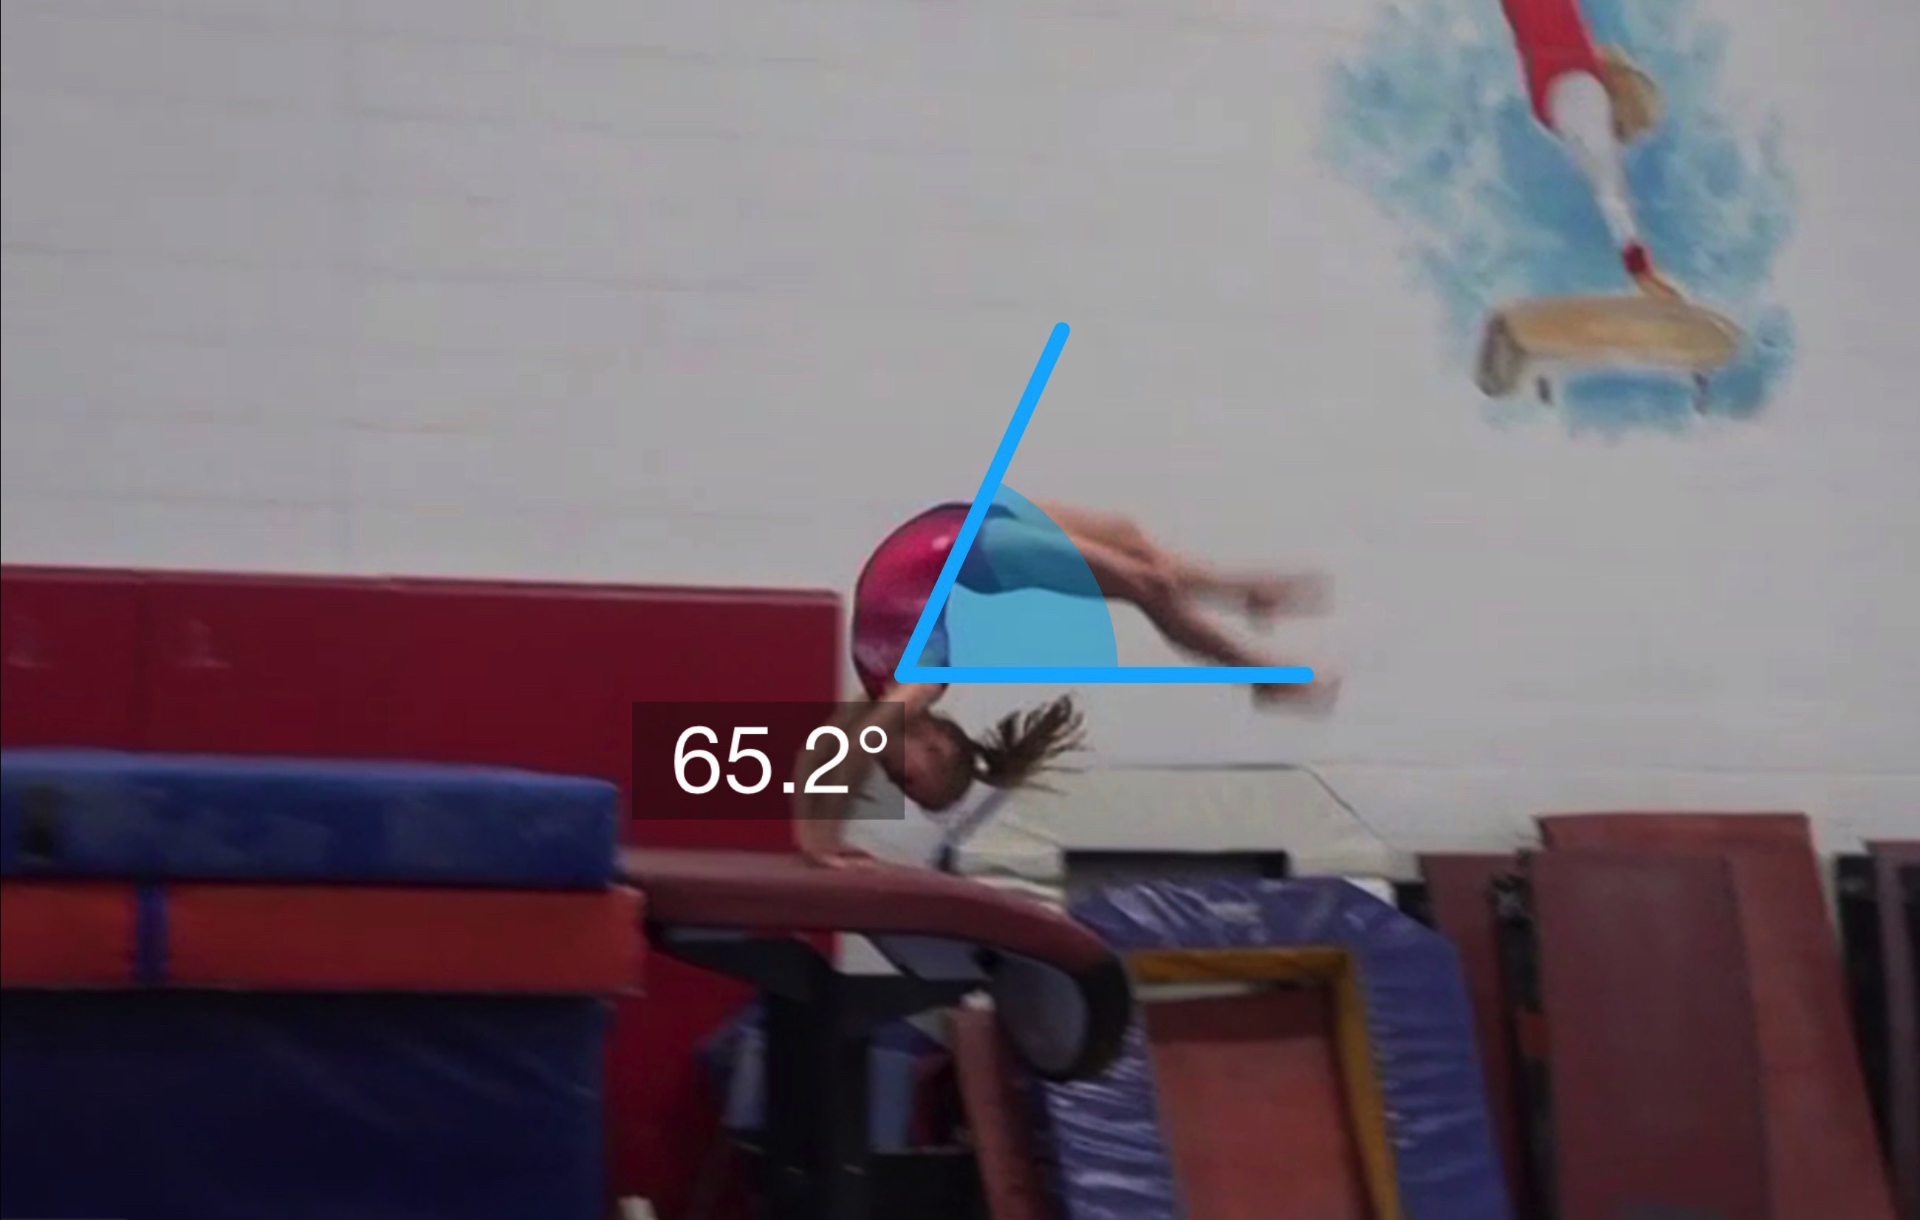
Yurchenko #5
(as is numbered on library dvd to correspond)
Pre Flight Body Position
Angle of Arrival

Slide 22
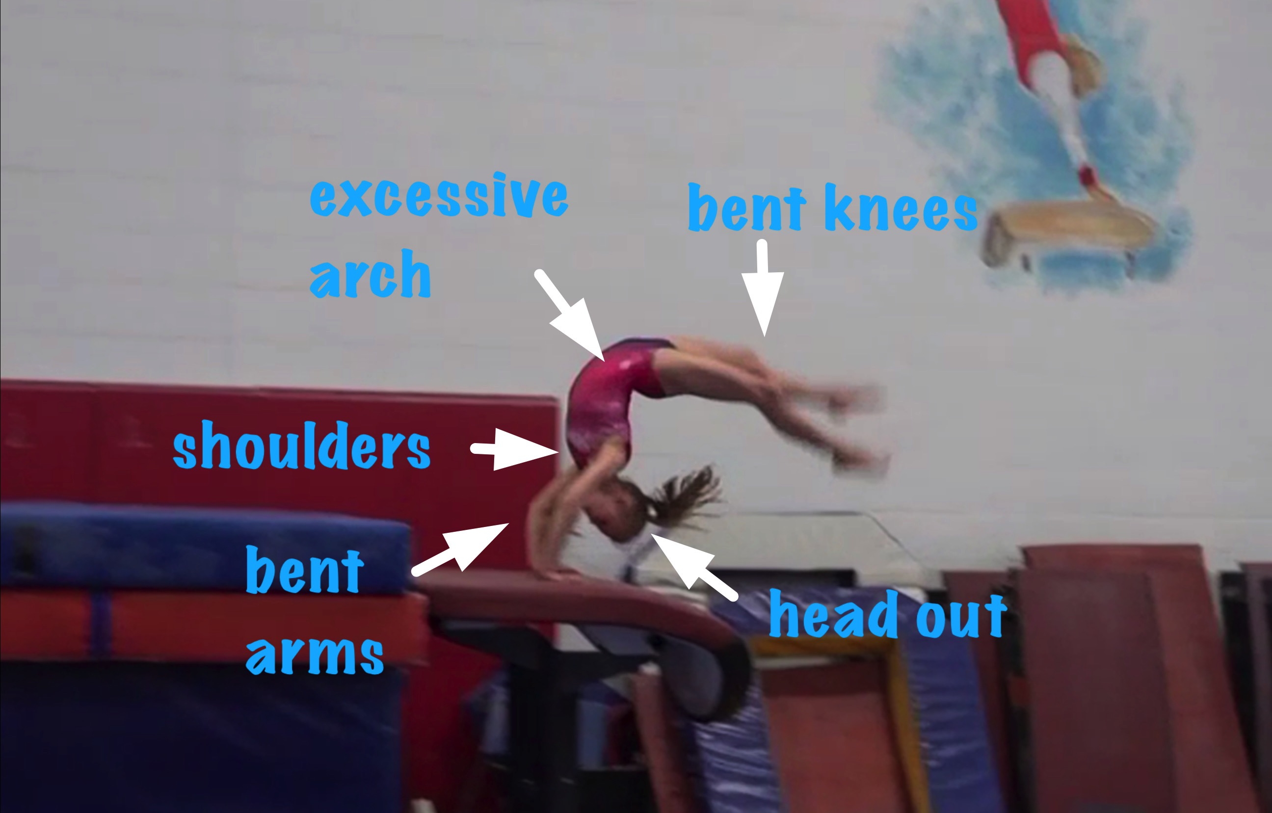
Yurchenko #5
Angle off the Table and corresponding Time in Support
Body Position in Support

Slide 23
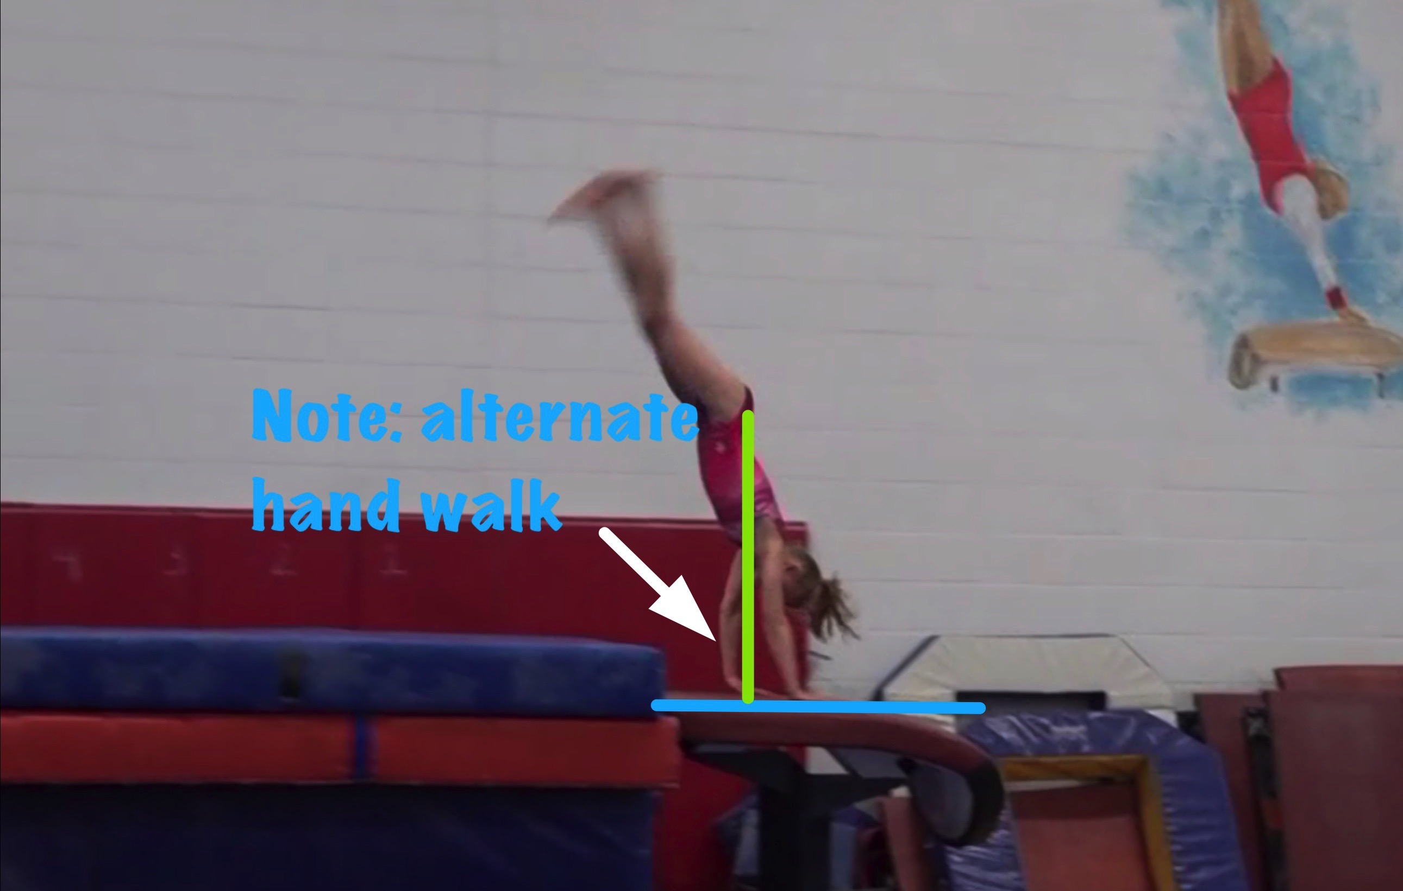
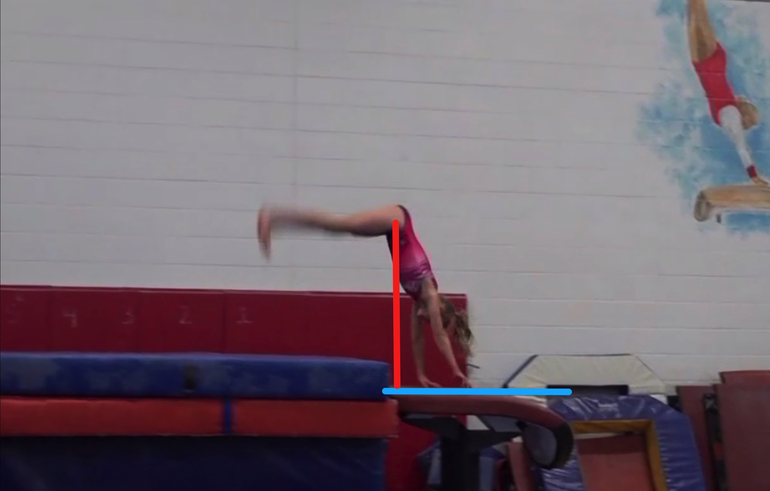
Yurchenko #5
Height Baseline (measured from table to center of gravity when inverted at moment of repulsion.
Height Achieved (compare red line to green line after lining up blue table height line for accurate comparison.

Slide 24
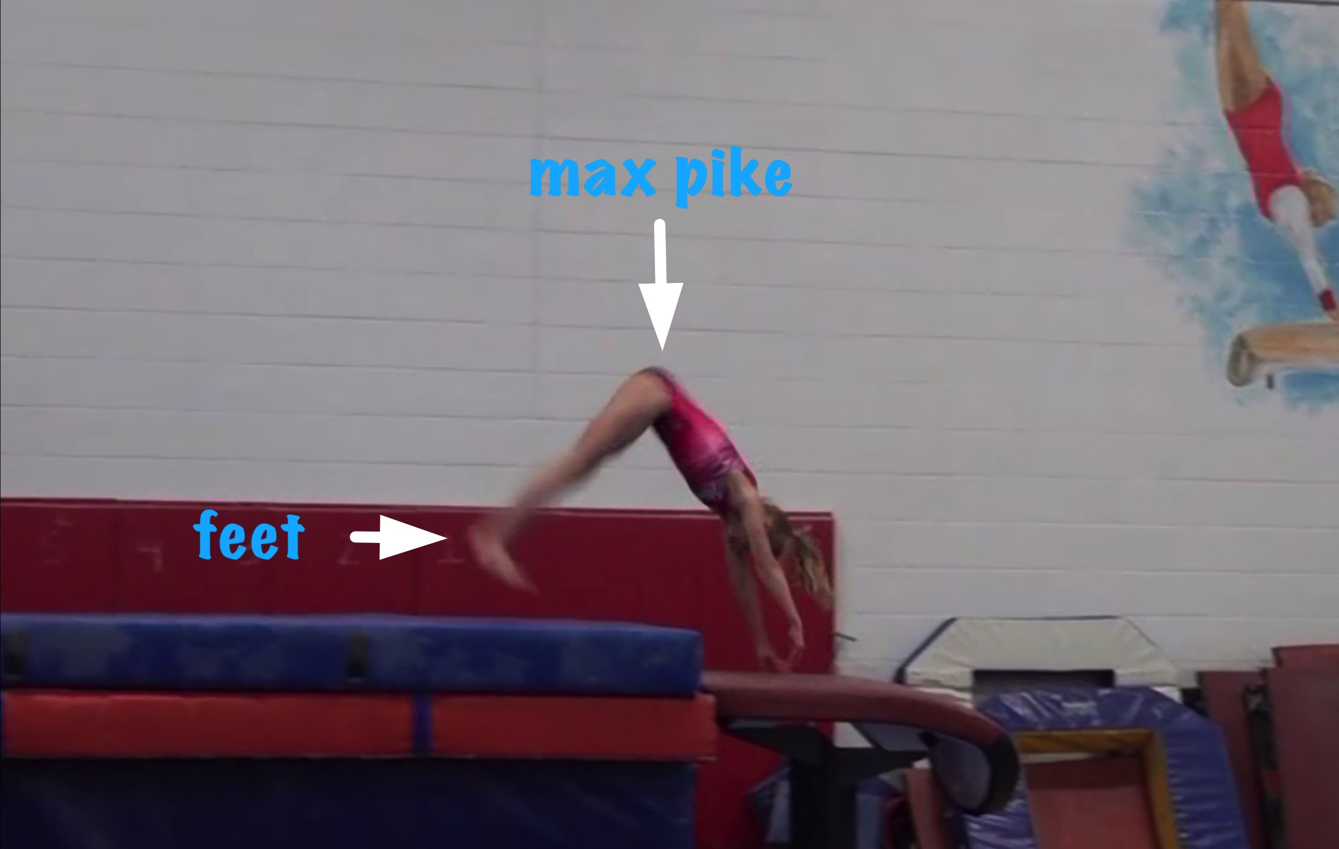
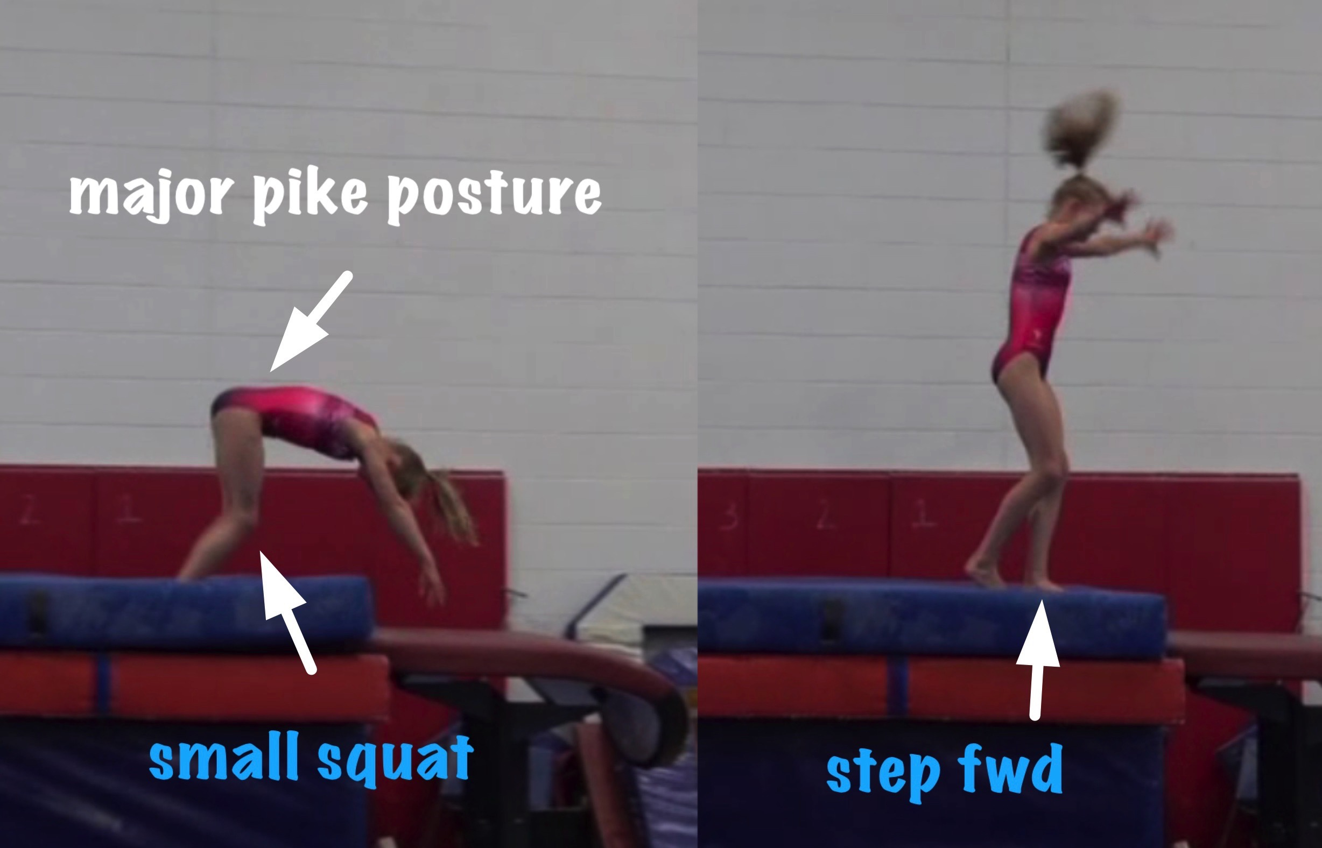
Yurchenko #5
Body Position in post flight
Posture on Contact & Distance

Slide 25
Yurchenko #5 l UNOFFICIAL Vetted Deductions Breakdown
Pre Flight Body Position: .4
Angle on: .2
In Support Body Position: .7
Angle off: .6
Time in Support: .5
Height: .5
Off Flight Body Position: .4
Posture on Landing: .5
Landing: .1
Distance: .3
Dynamics: .3
Score: 5.5
Look at the vault again and use the slider to view it in slow motion and study the corresponding deductions for each phase of the vault.

Slide 26
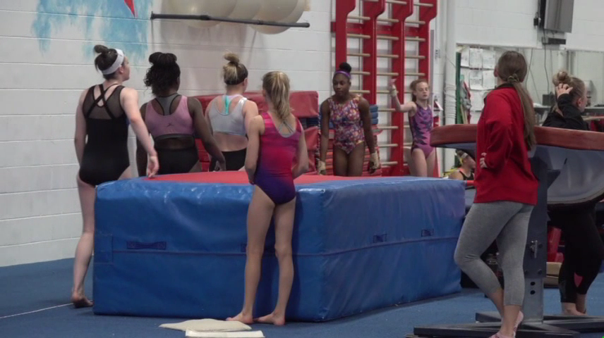
Level 6/7 vault by Nawgj
Education committee August 2018
Films provided by judy dobransky, nawgj library
Yurchenko #3 (watch and compare to model on the right)
Current Yurchenko MODEL (#9)

Slide 27
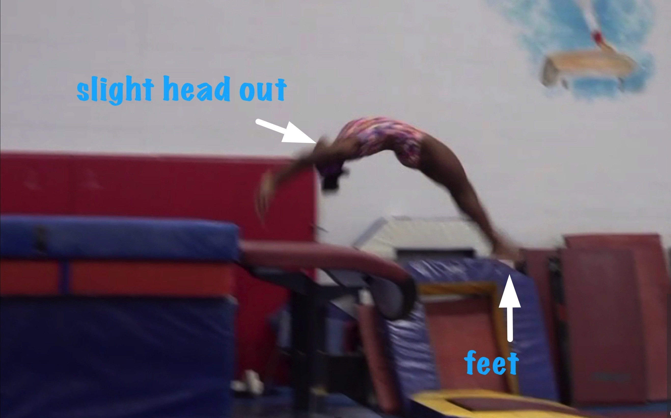
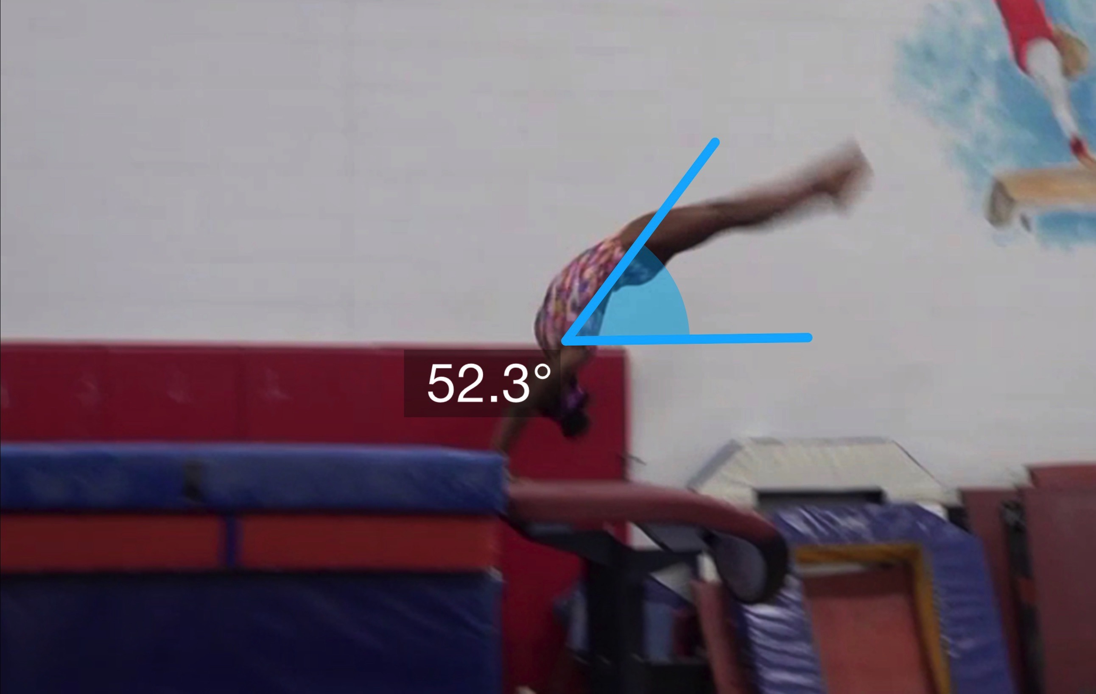
Yurchenko #3
(as is numbered on library dvd to correspond)
Pre Flight Body Position
Angle of Arrival

Slide 28
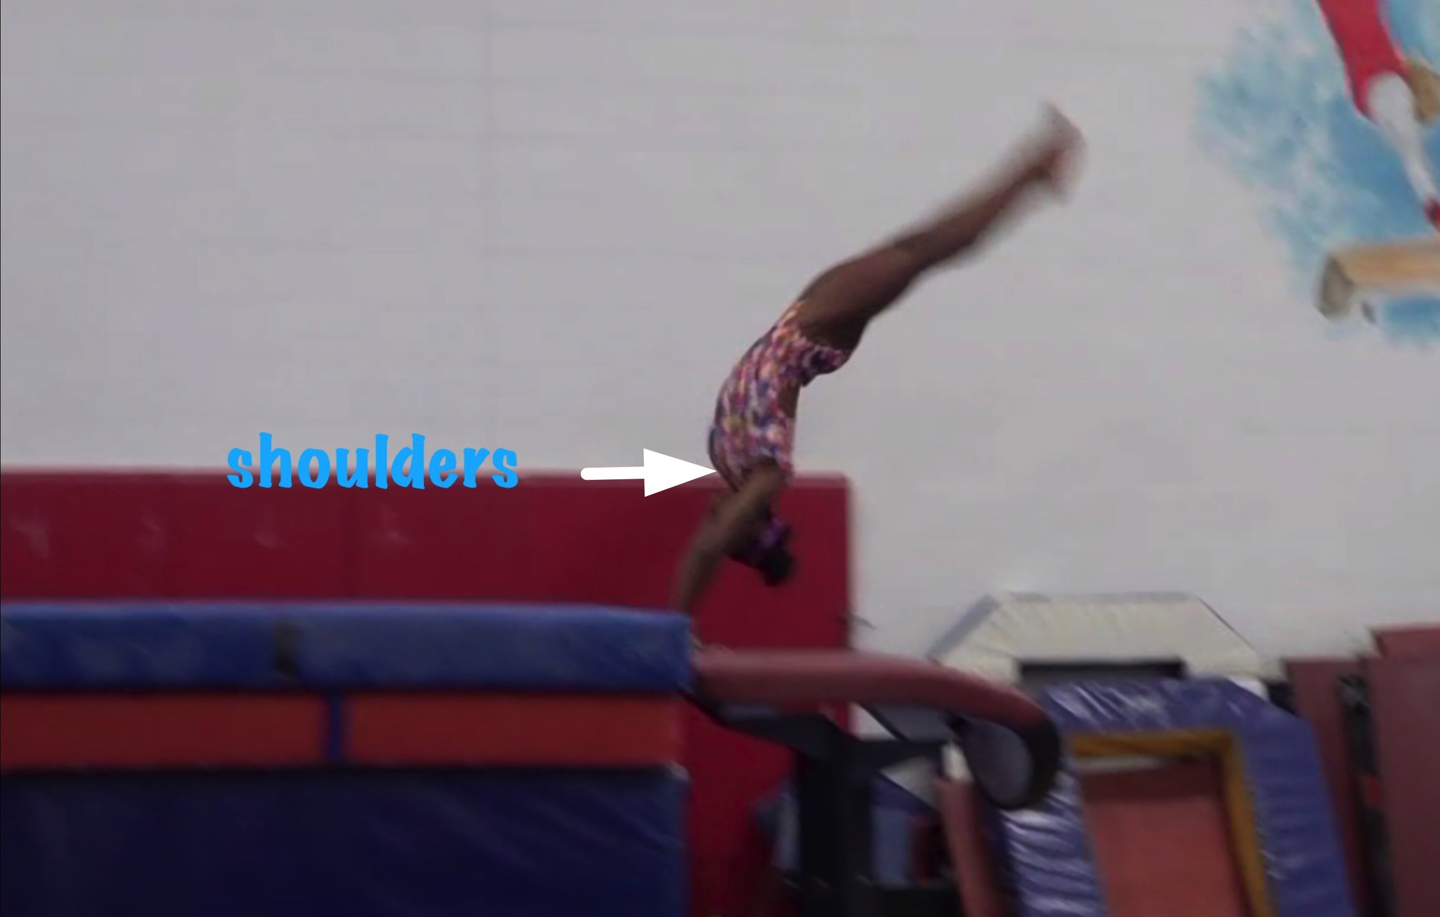
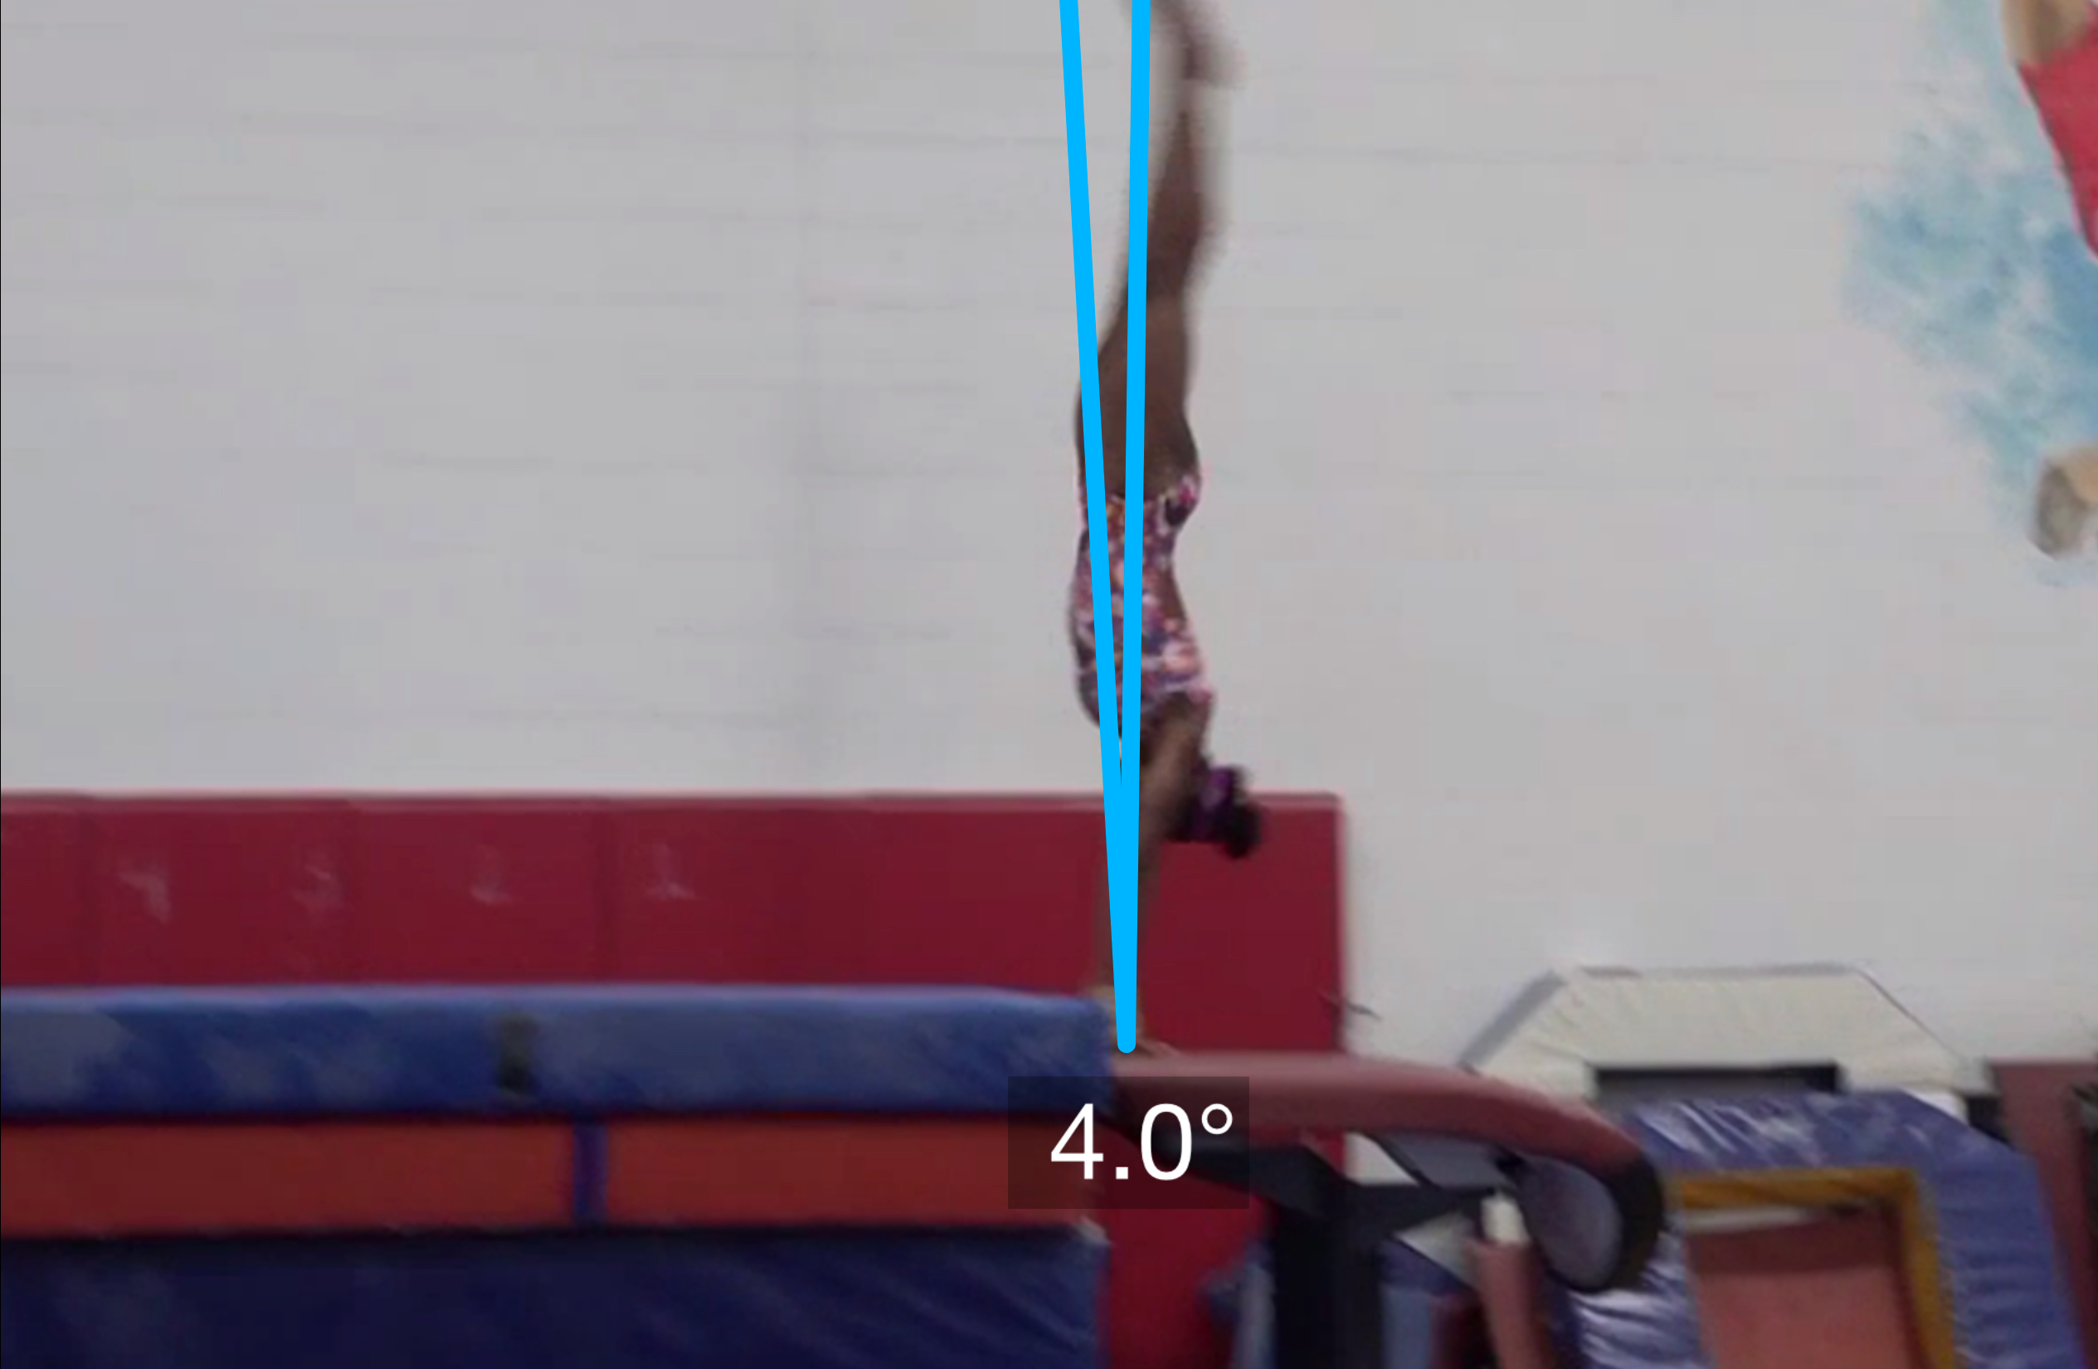
Yurchenko #3
Angle off the Table and corresponding Time in Support
Body Position in Support

Slide 29
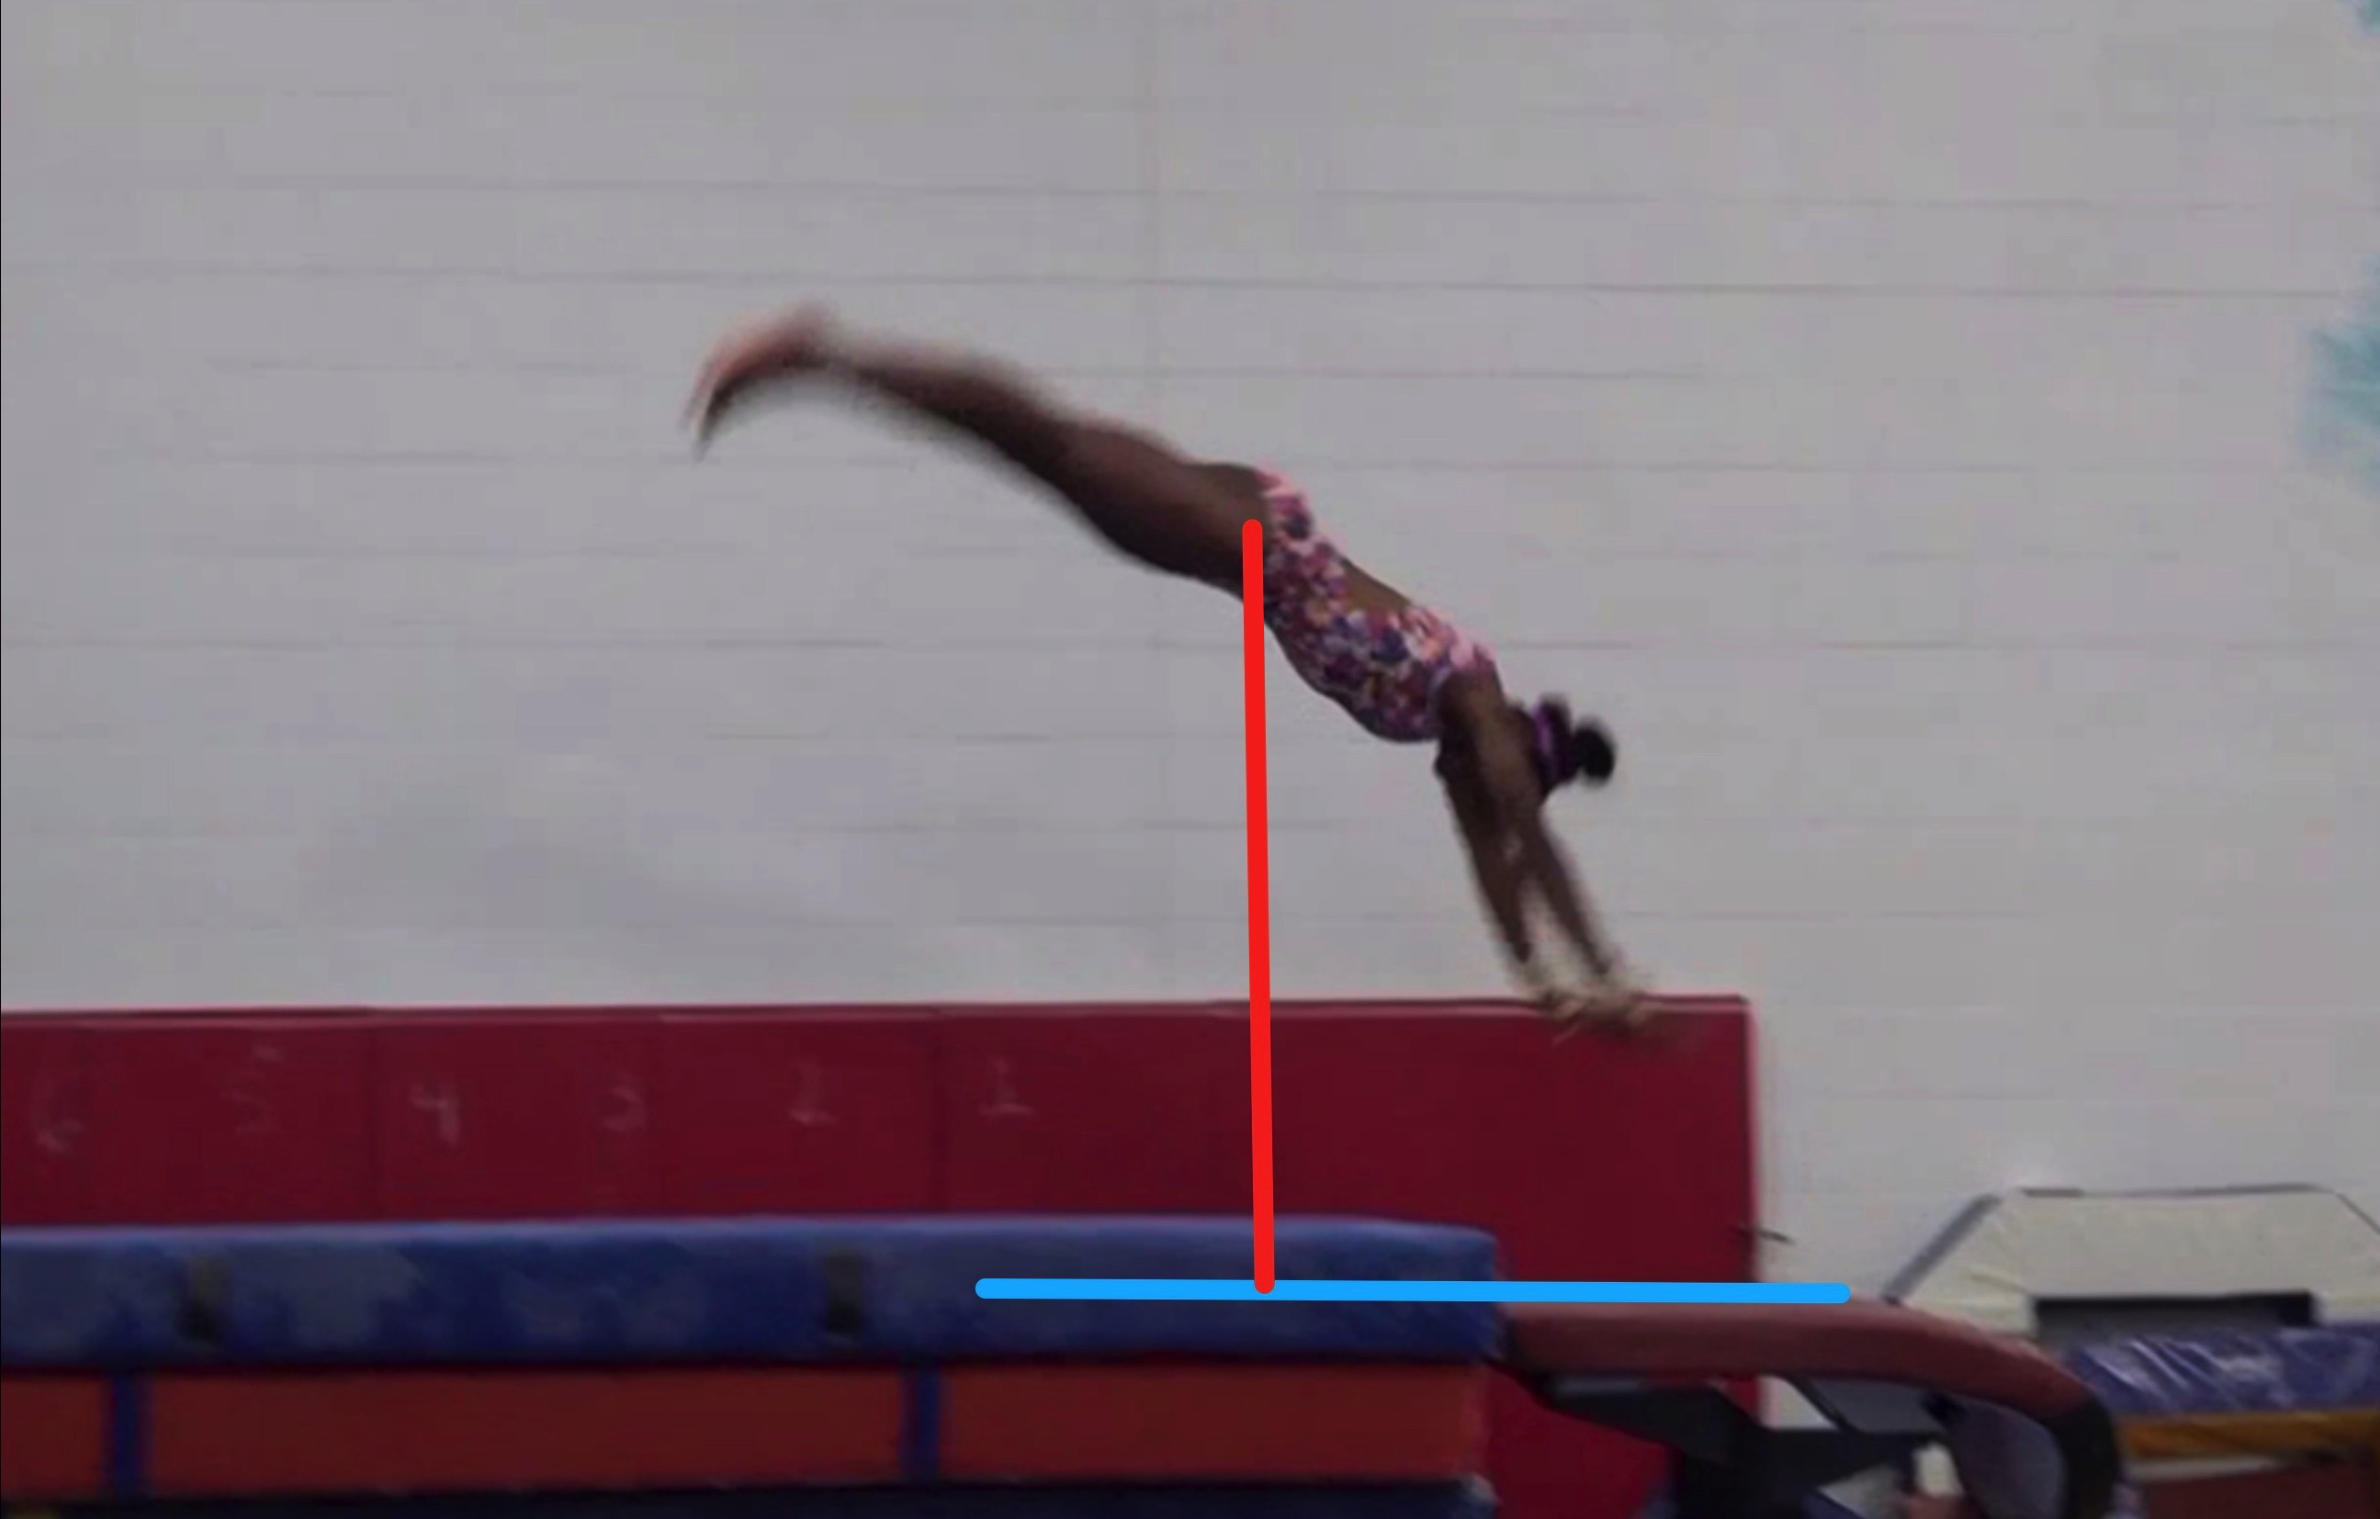
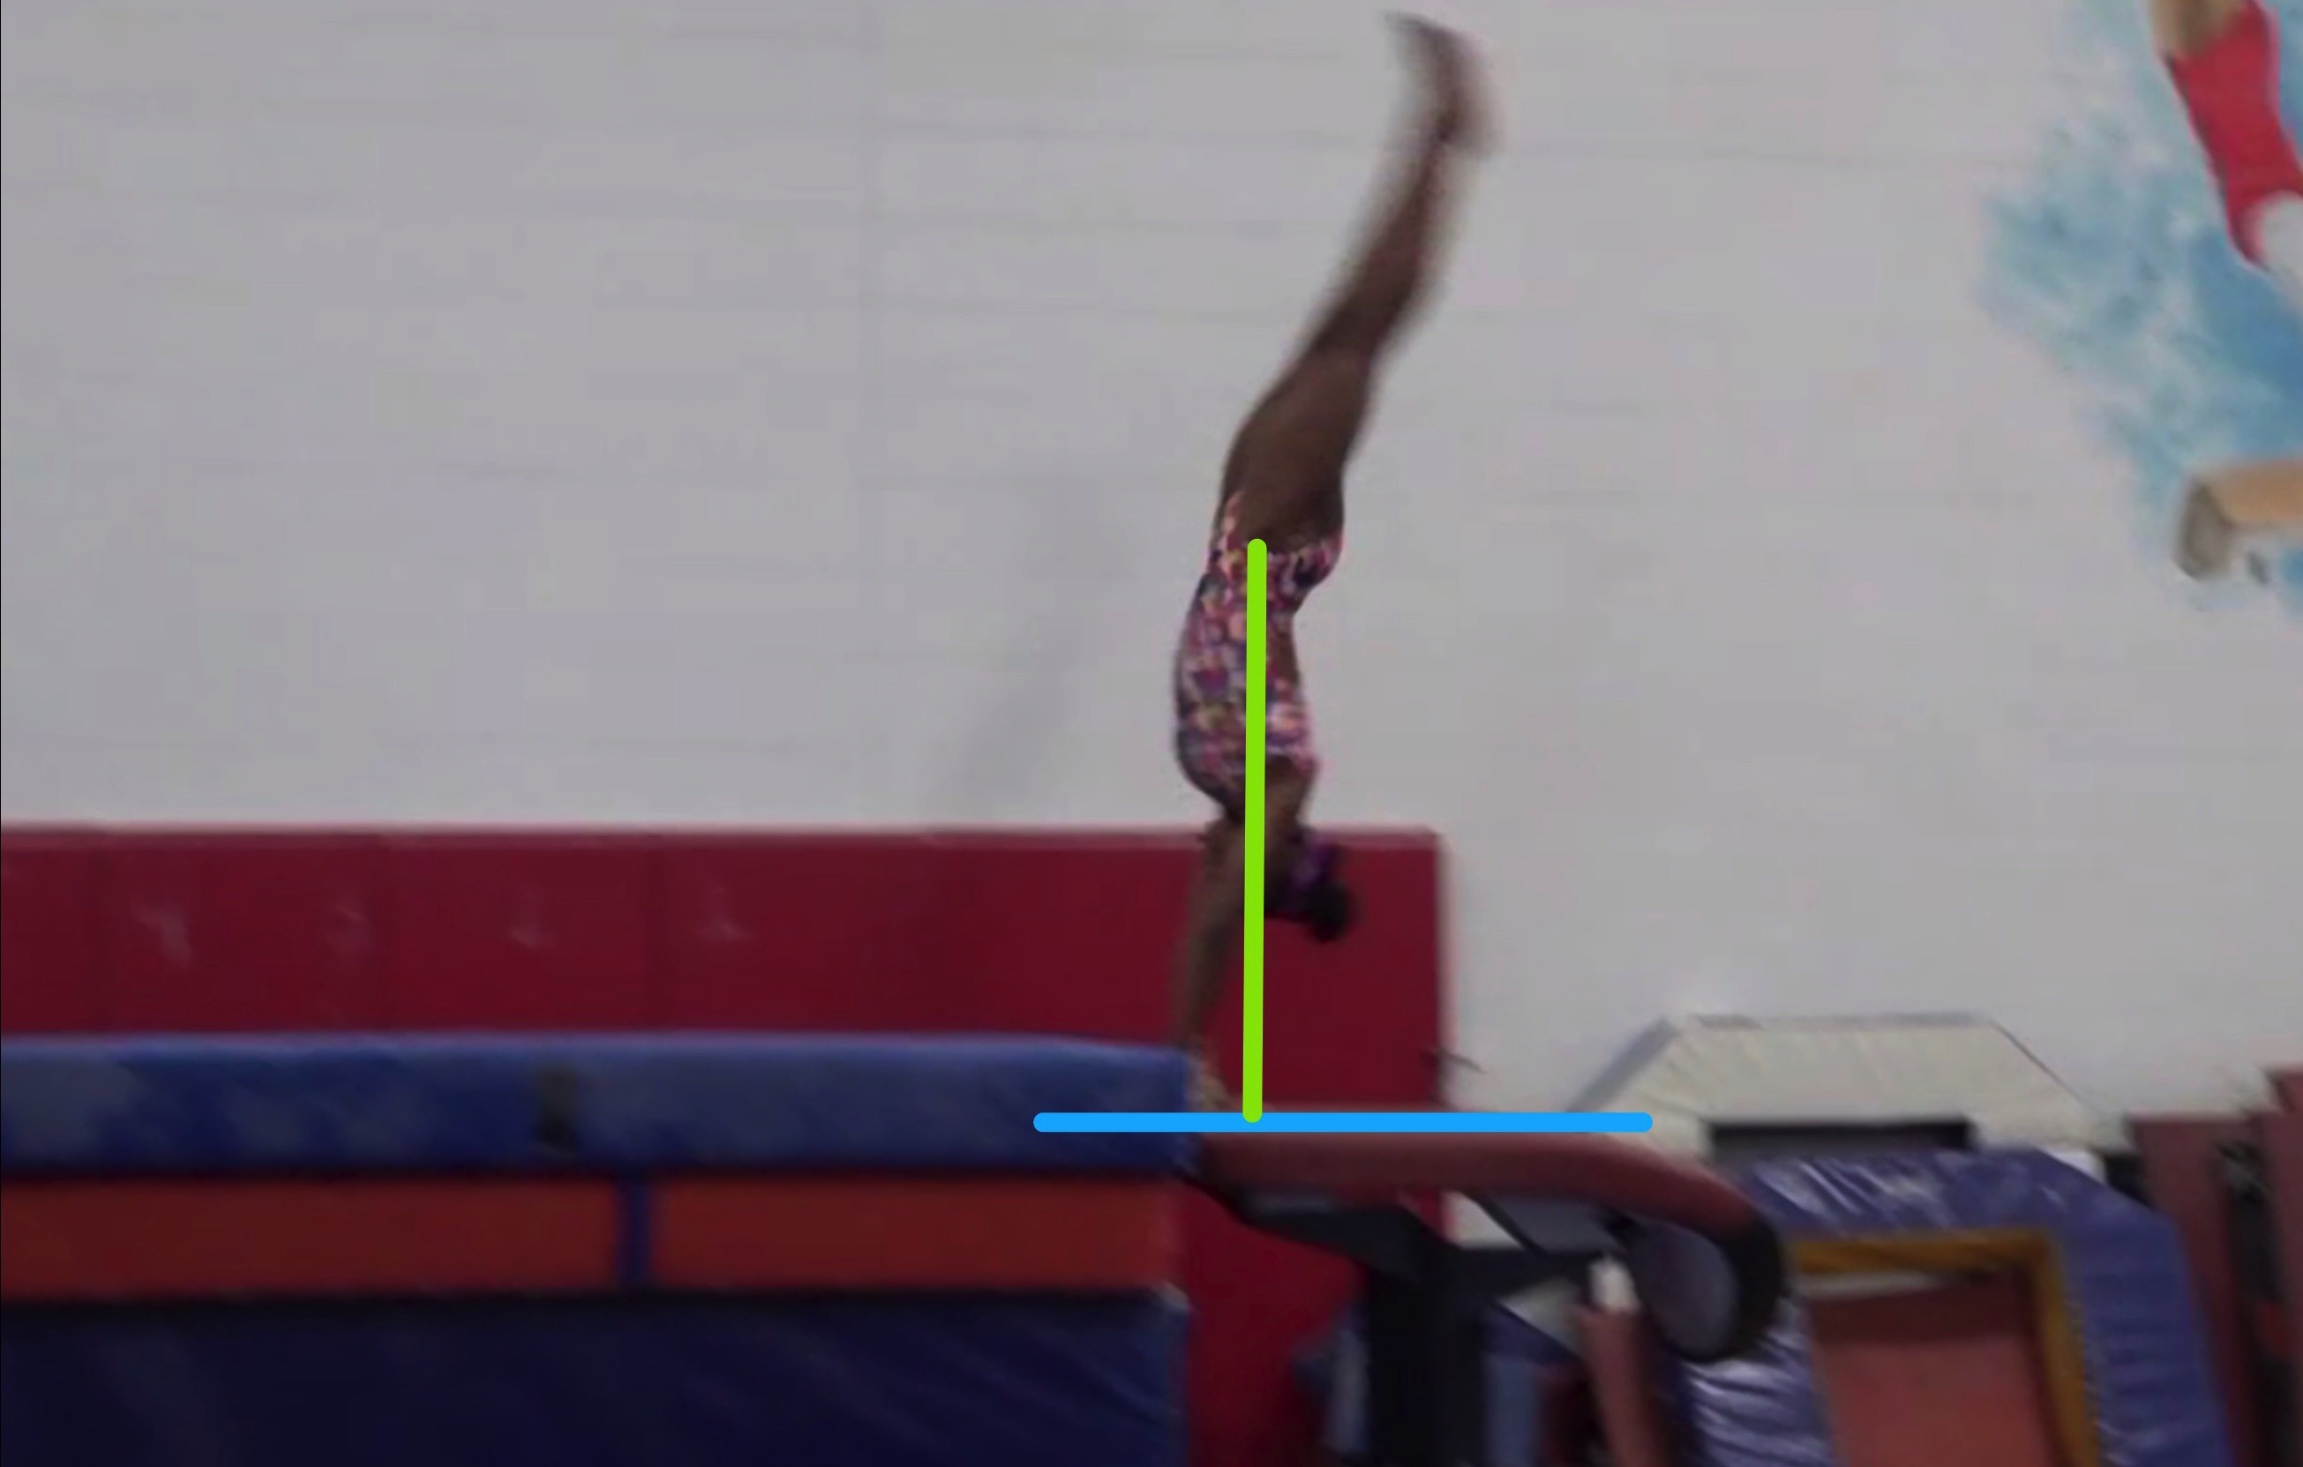
Yurchenko #3
Height Baseline (measured from table to center of gravity when inverted at moment of repulsion.
Height Achieved (compare red line to green line after lining up blue table height line for accurate comparison.

Slide 30
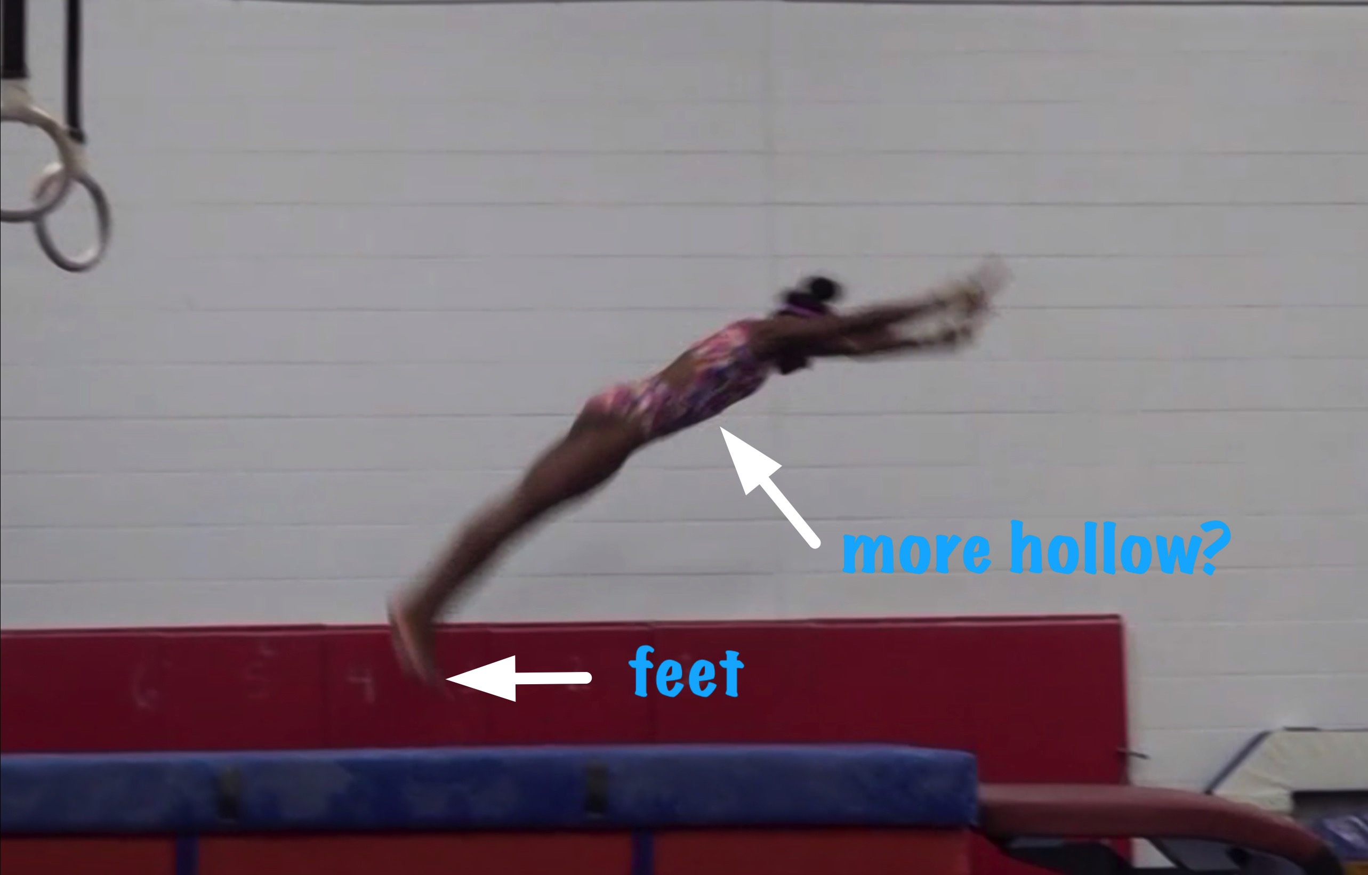
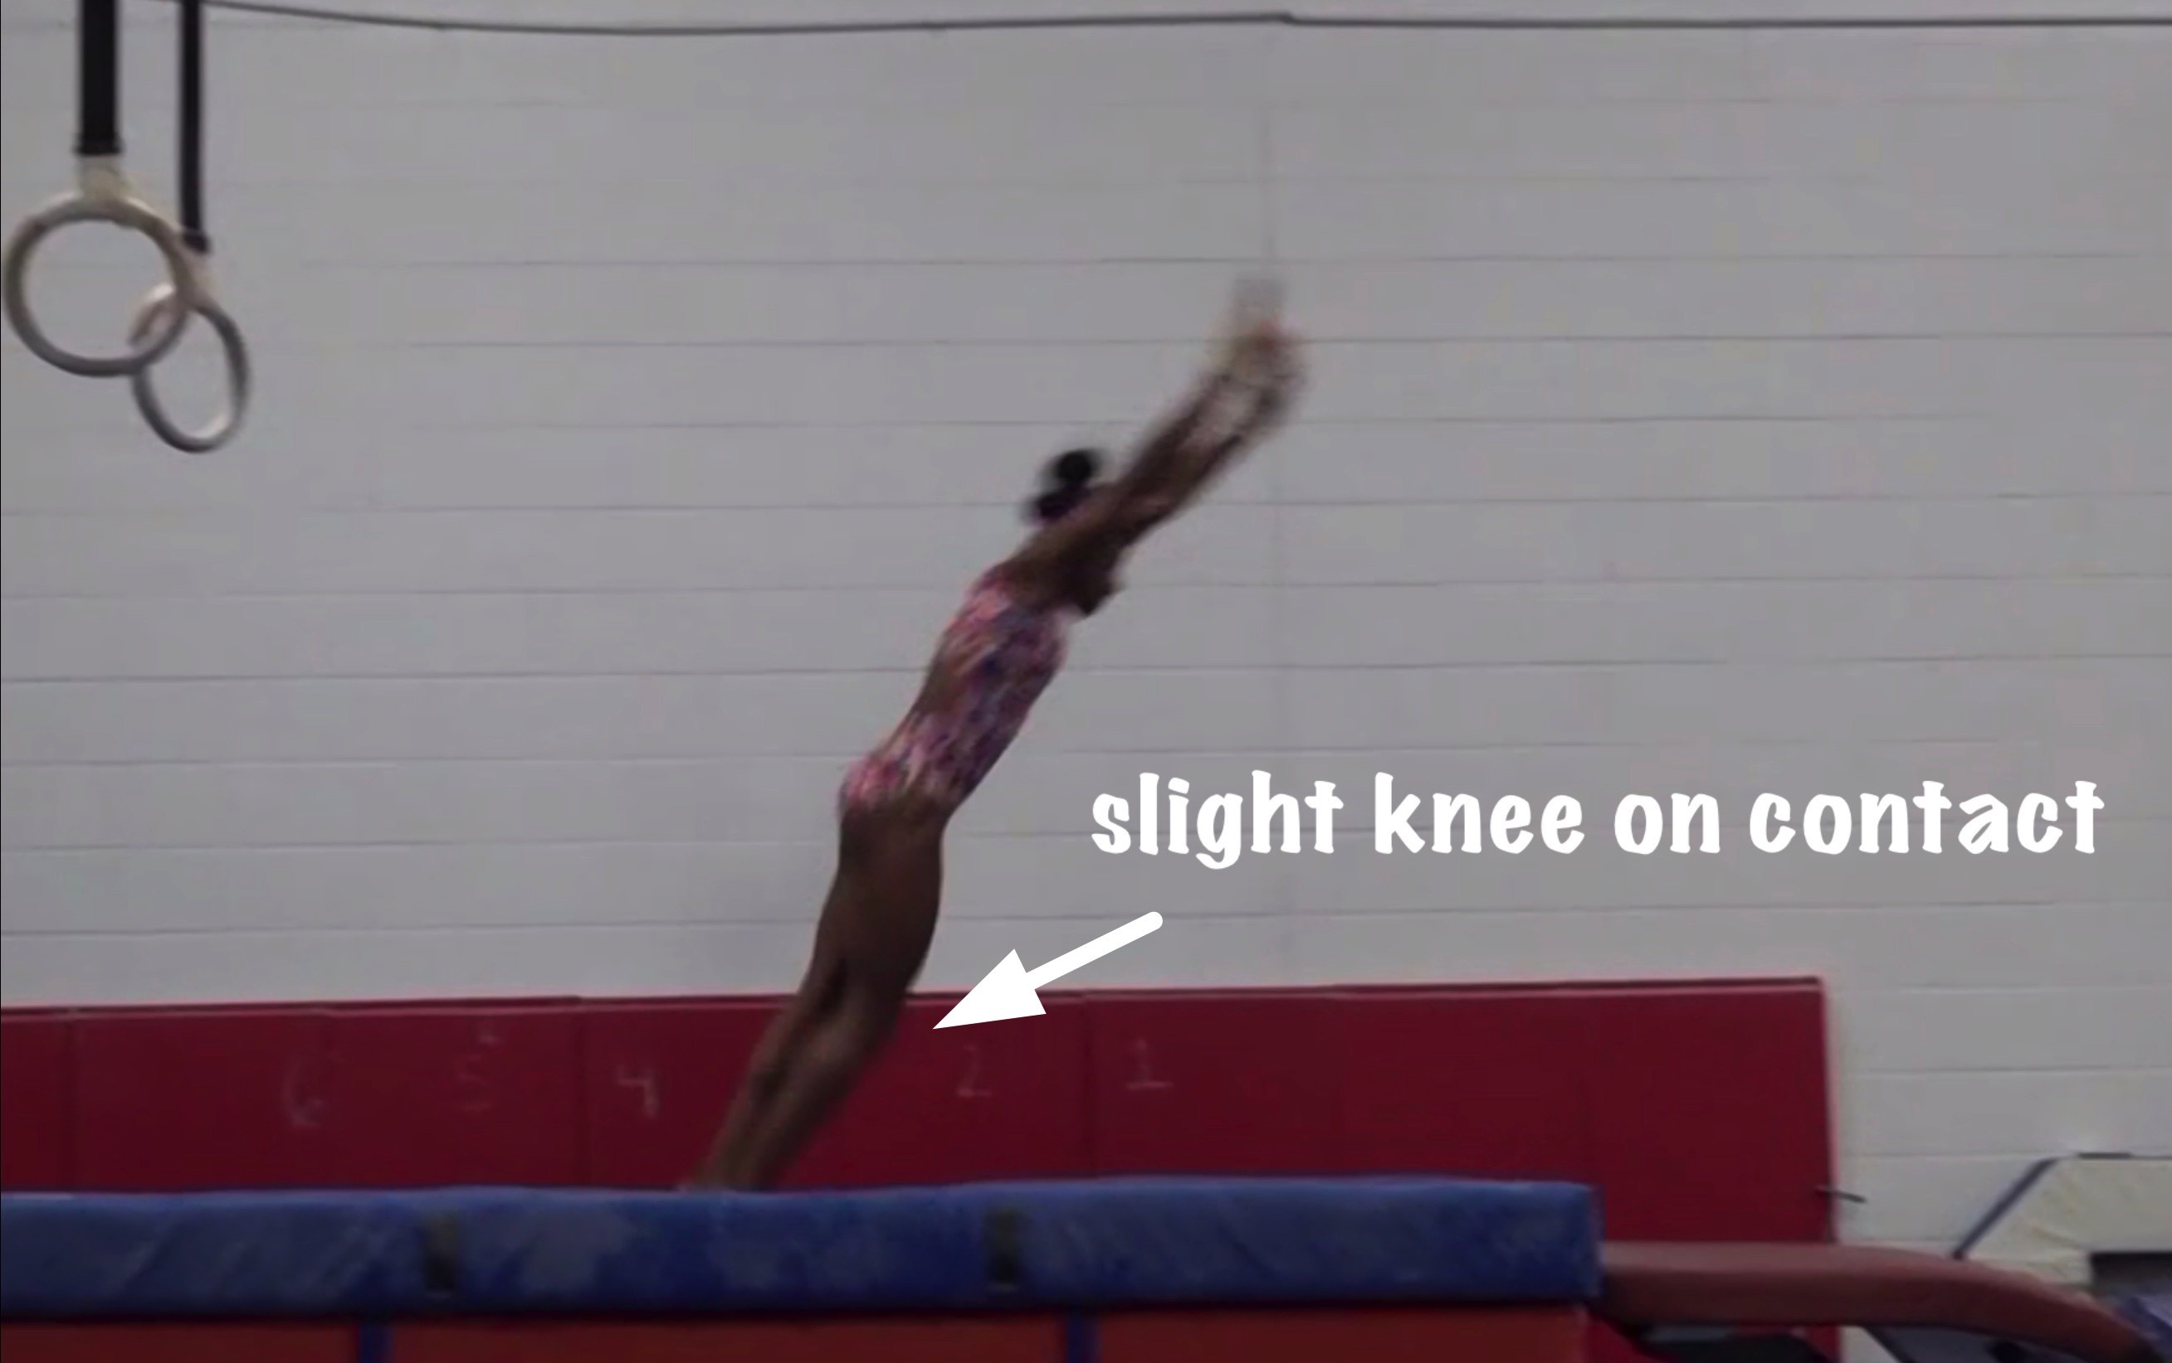
Yurchenko #3
Body Position in post flight
Posture on Contact & Distance
Notes:
For distance – note in the video that the hands contacted at the far end of the table so in that case the distance was a deduction.

Slide 31
Yurchenko #3 UNOFFICIAL Vetted Deductions Breakdown
Pre Flight Body Position: .1
Angle on: .1
In Support Body Position: .3
Angle off: .05
Time in Support: .1
Height: .2
Off Flight Body Position: .1
Posture on Landing: .1
Landing: 0
Distance: .1
Dynamics: .05
Score: 8.8
Look at the vault again and use the slider to view it in slow motion and study the corresponding deductions for each phase of the vault.

